Slide 1
Distributed Ledger Technology (Blockchain) to Transform Healthcare
Is The Promise Real?
J Kabyemela, MD, MSc, FRCOG
EAH&S Conference, Dar es Salaam, Tanzania, March 2019

Slide 2
Distributed Ledger Technology (DLT)
A process of transacting and storing information on a decentralized, distributed ledger; information that is
reliable,
unchangeable, and
readily available to relevant individuals and entities anywhere in the world
In other words…
A blockchain is a shared, immutable record of peer-to-peer transactions built from linked transaction blocks and stored in a digital ledger
The data is in a network of hundreds or thousands of computers (nodes) distributed around the world and, crucially, there is no central entity (server)

Slide 3
Deploying Blockchain in Healthcare
Main areas
Health Records
Supply Chain
Research

Slide 4
Supply chain in Healthcare
Pharmaceutical
Ensuring product’s authenticity and integrity is paramount
Counterfeit and sub-standard products cause serious harm and thousands of deaths throughout the world
The cost is estimated to be approx. $200 billion annually

Slide 5
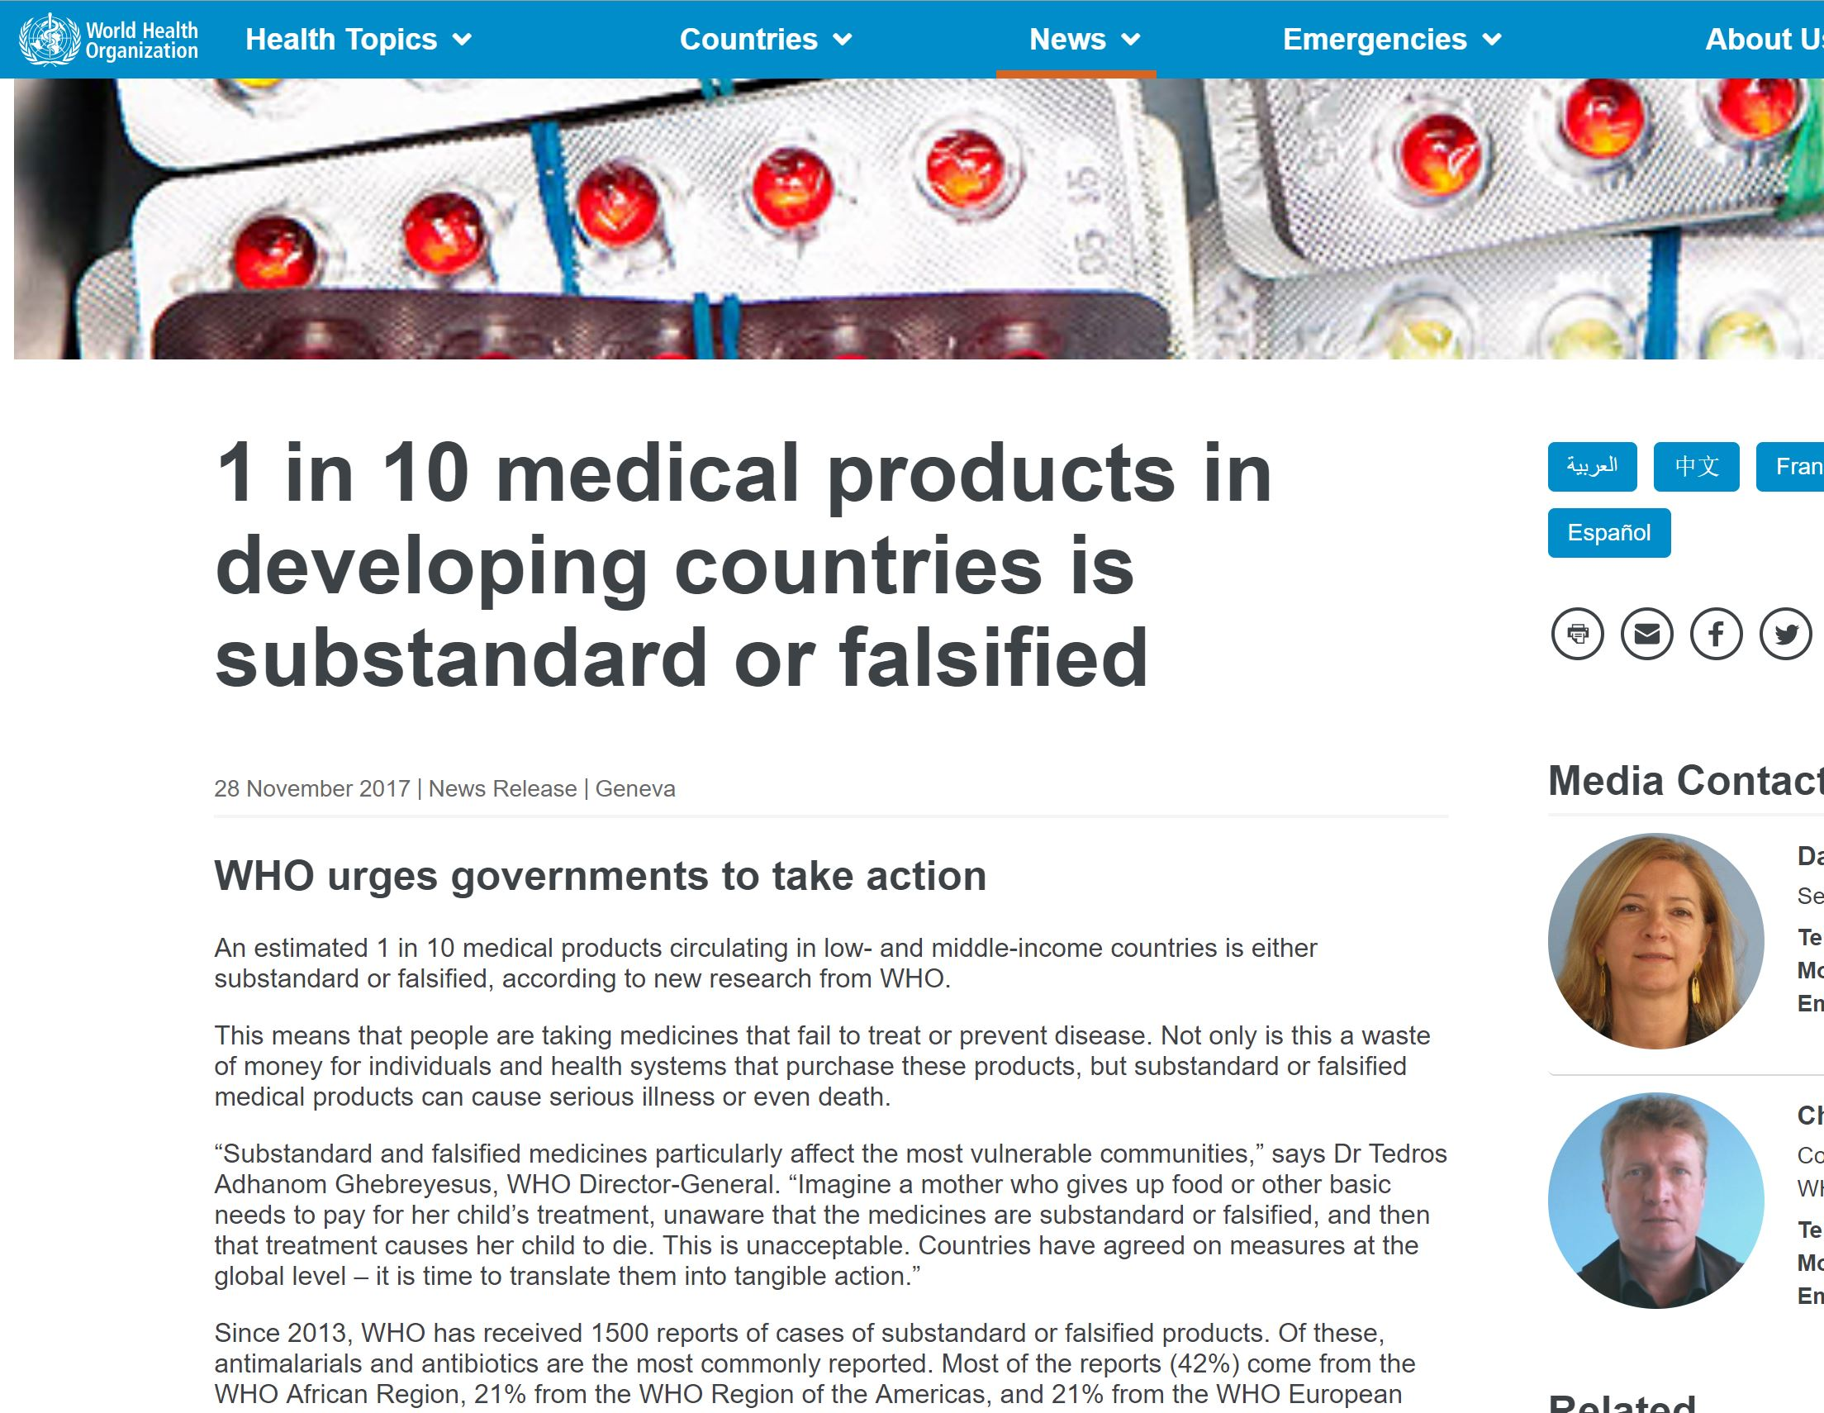

Slide 6
Video clip

Slide 7
Supply chain
End-to-end traceability by all stakeholders
Ensuring an unalterable auditable records ledger
Mediledger Project currently piloted by Sanofi, Genentech and Pfizer
Blockchain tech combined with embedded sensors to track environmental conditions esp for temperature-sensitive pharmaceuticals during shipment
Data is immutable and permanently available

Slide 8
Health/Medical Records
Fragmentation of medical records is a world-wide problem
Wide adoption of electronic medical records especially over the last 3 decades
1,200 EMR systems in North America and Europe. Most of these cannot communicate with each other
One individual = multiple records held by different healthcare providers
In the developing world EMR initiatives have accelerated but records still largely paper-based.
For many esp in rural setting, no records at all

Slide 9
Health/Medical Records
Paper-based records in disparate locations are difficult to access, transfer or share
Even where EMRs are in operation, inter-operability is poor or non-existent
Duplication of tests = increased costs
Where tests unavailable, risk to the wellbeing of the patient
Distant consultations are difficult and often impractical due to inaccessibility of appropriate records

Slide 10
The EMR problem
Inter-operability
x

Slide 11
The EMR problem

Slide 12
The EMR problem
EMR systems are dependent on centralised computer systems.
Patient information is private and has to be kept so at all times,
Healthcare providers have to invest in expensive IT systems
Maintenance and security costs are recurrent and the expertise is not cheap
The hardware requires replacement every so often
Personnel = the weakest link

Slide 13
EMR and security
All modern EMR systems depend on these centralised computer systems
Vulnerable to hackers and increasingly targeted
Security breaches particularly devastating for individuals affected
Breaches cripplingly expensive for healthcare providers and/or insurers

Slide 14
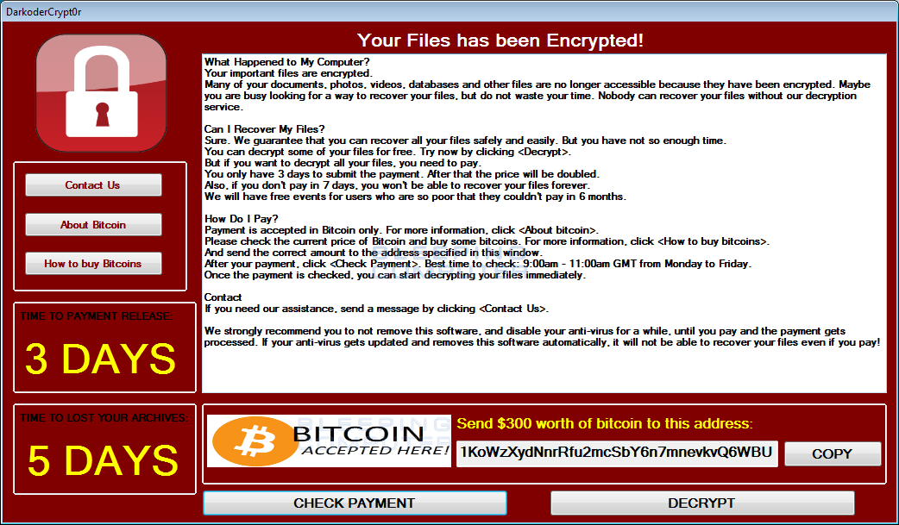
EMR and security

Slide 15
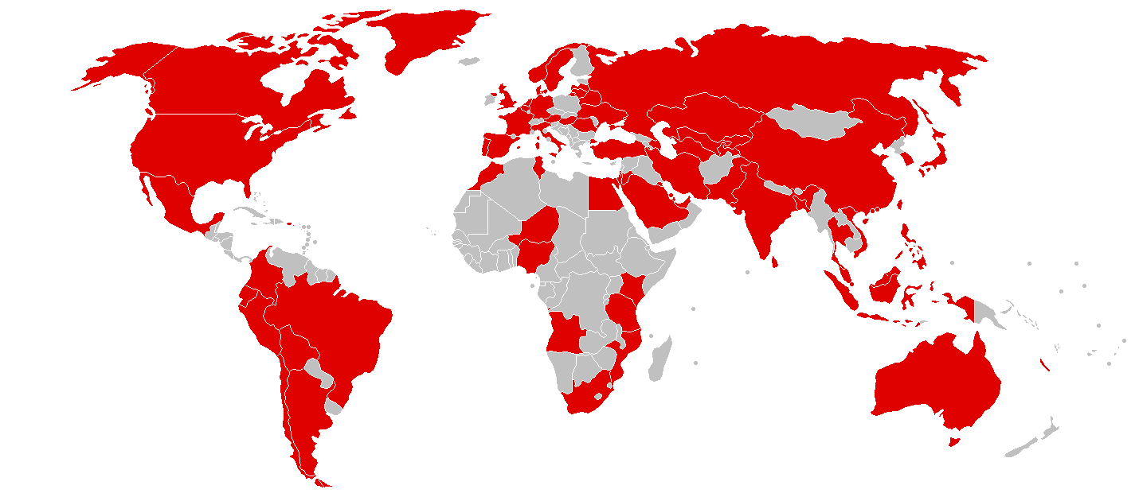
EMR and security
Countries most affected by the Wannacry ransomware in 2017

Slide 16
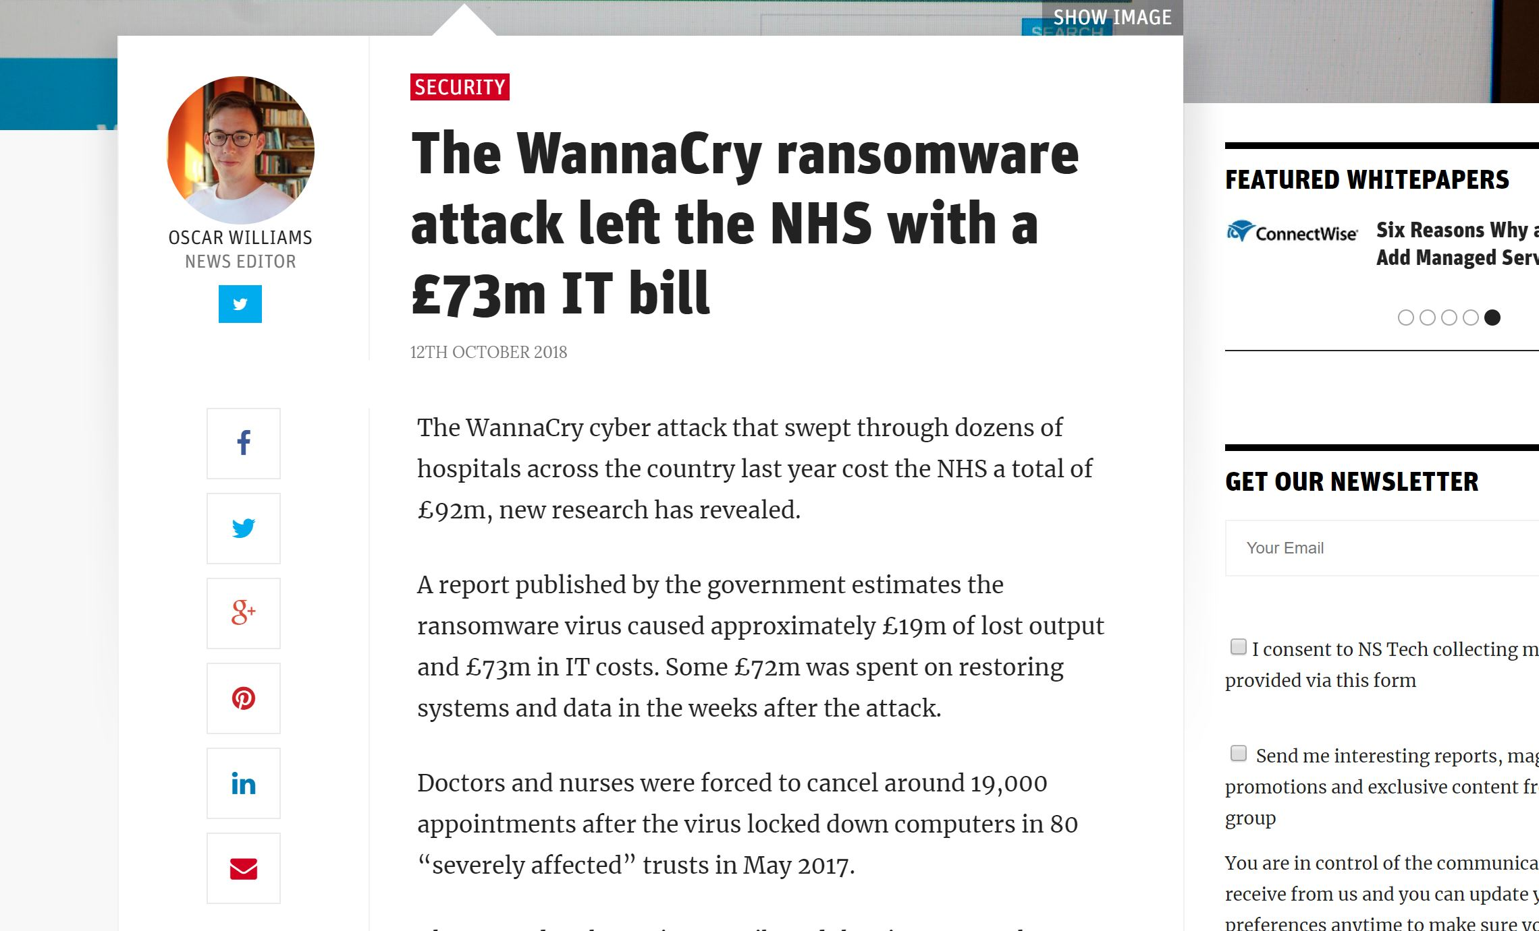
The cost…

Slide 17
EMR and security
Anthem®; 2nd largest health insurer in the United States
In 2015, a security breach affected records of 80 million clients
115 million breaches across the US that year alone
Damages paid: $6 billion

Slide 18
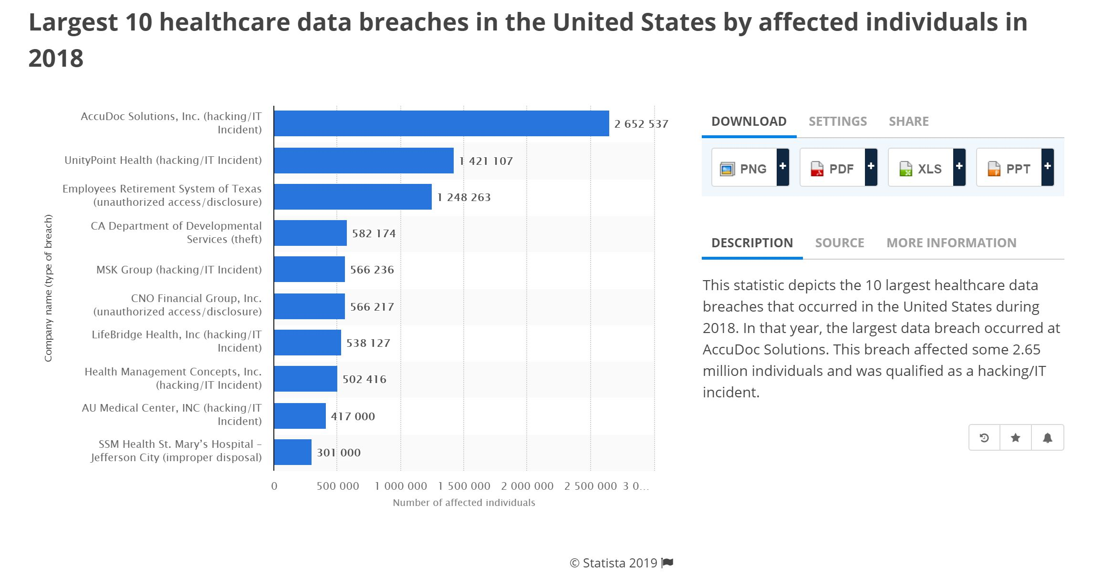
EMR and security

Slide 19
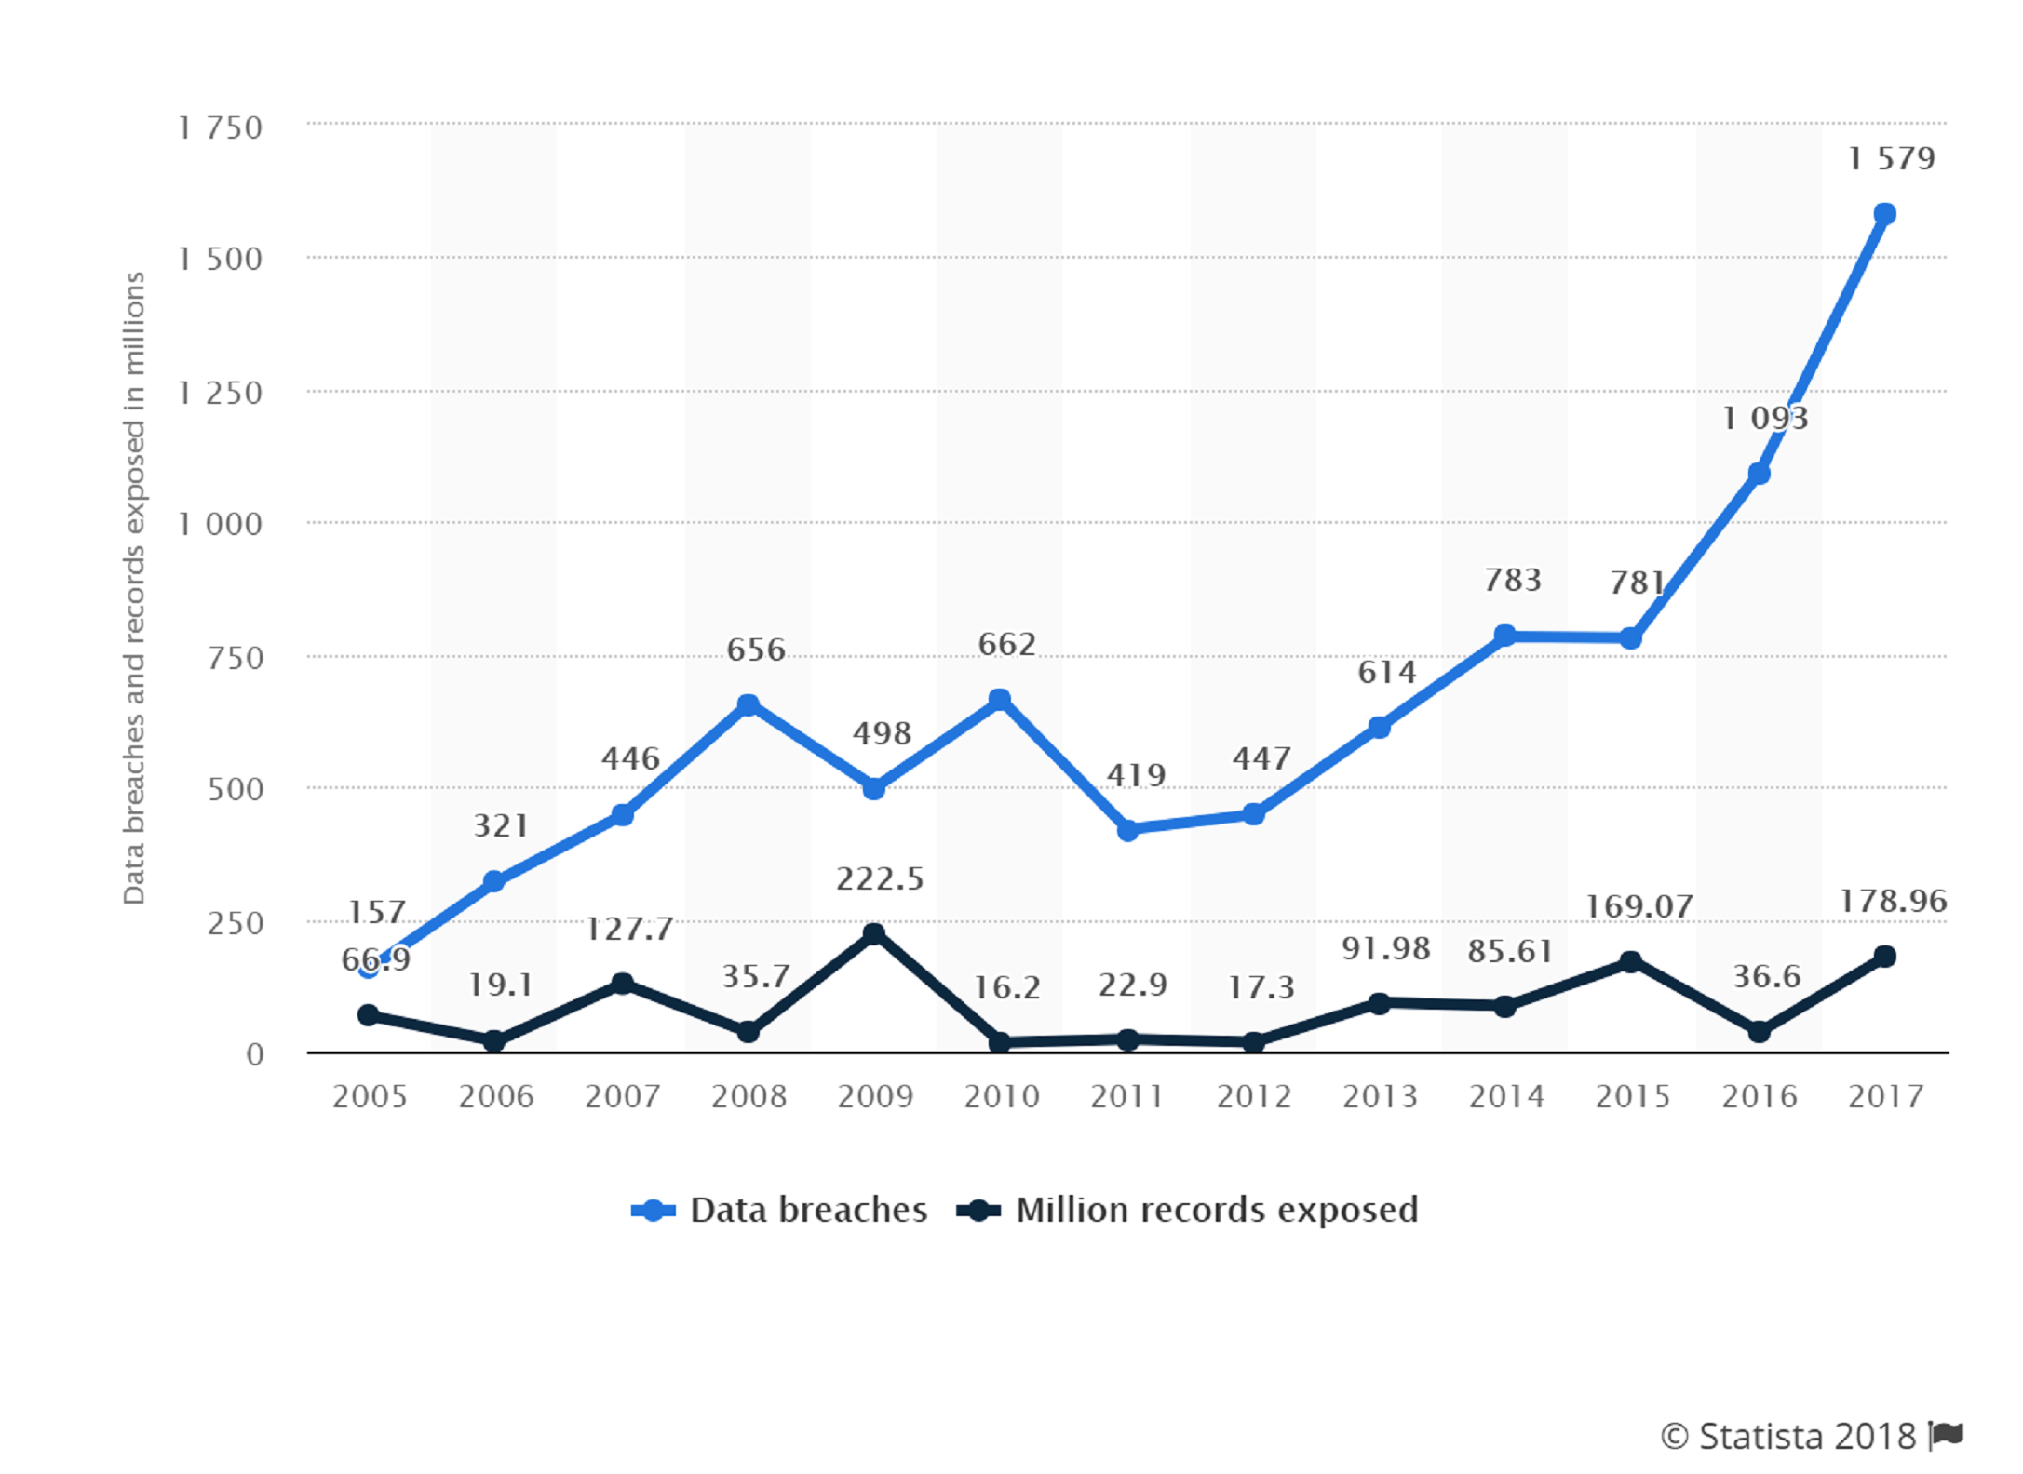
EMR and security
Annual number of data breaches and exposed records in the United States from 2005 to 2017 (in millions)

Slide 20
EMR and fraud
Falsification of medical information is a major problem and costs billions annually
Global problem
In the USA, this fraud responsible for up to 20% of all medical expenses
US health insurance fraud $68 billion annually; 3% of total annual healthcare expenditure (2010)
Globally, $260 billion or 6% of total annual health expenditure

Slide 21
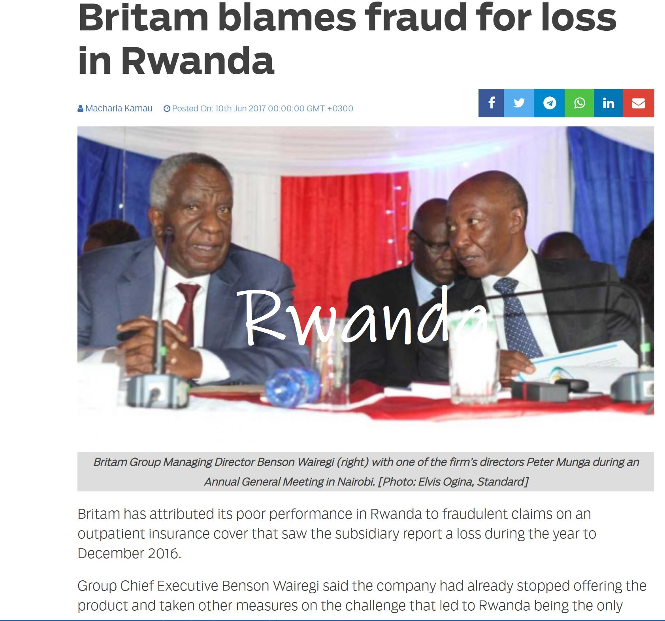
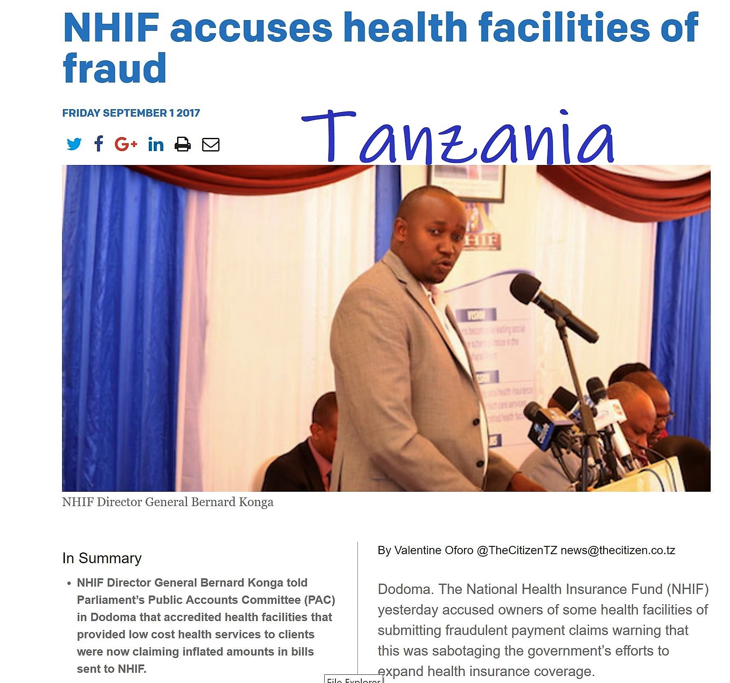
EMR and fraud

Slide 22
Healthcare Equity, Telemedicine and Blockchain
EAC countries remain poor but aspire to middle income status in less than a decade
Health Per Capita Expenditure 2015
Kenya | $70
Uganda | $46
Rwanda | $57
Tanzania | $32
Burundi | $24
South Sudan | $28
Brazil | $780

Slide 23
Healthcare Equity, Telemedicine and Blockchain
Pregnancy remains a high risk experience for women in developing countries
Maternal Mortality Ratio 2015 (per 100,000 live births)
Kenya | 510
Uganda | 343
Rwanda | 290
Tanzania | 398
Burundi | 712
South Sudan | 789
Brazil | 44
UK | 9

Slide 24
Equity Through Telemedicine
Healthcare facilities use = distance and cost
In Tanzania, up to 36% of births take place at home, many not out of choice
In Kenya, home births made up 20.4% of all births in 2012; dropped to 7.7% in 2016
Inequitable distribution of resources. Only large referral hospitals have specialist services.
Challenging healthcare facilities and transport infrastructure throughout the region

Slide 25
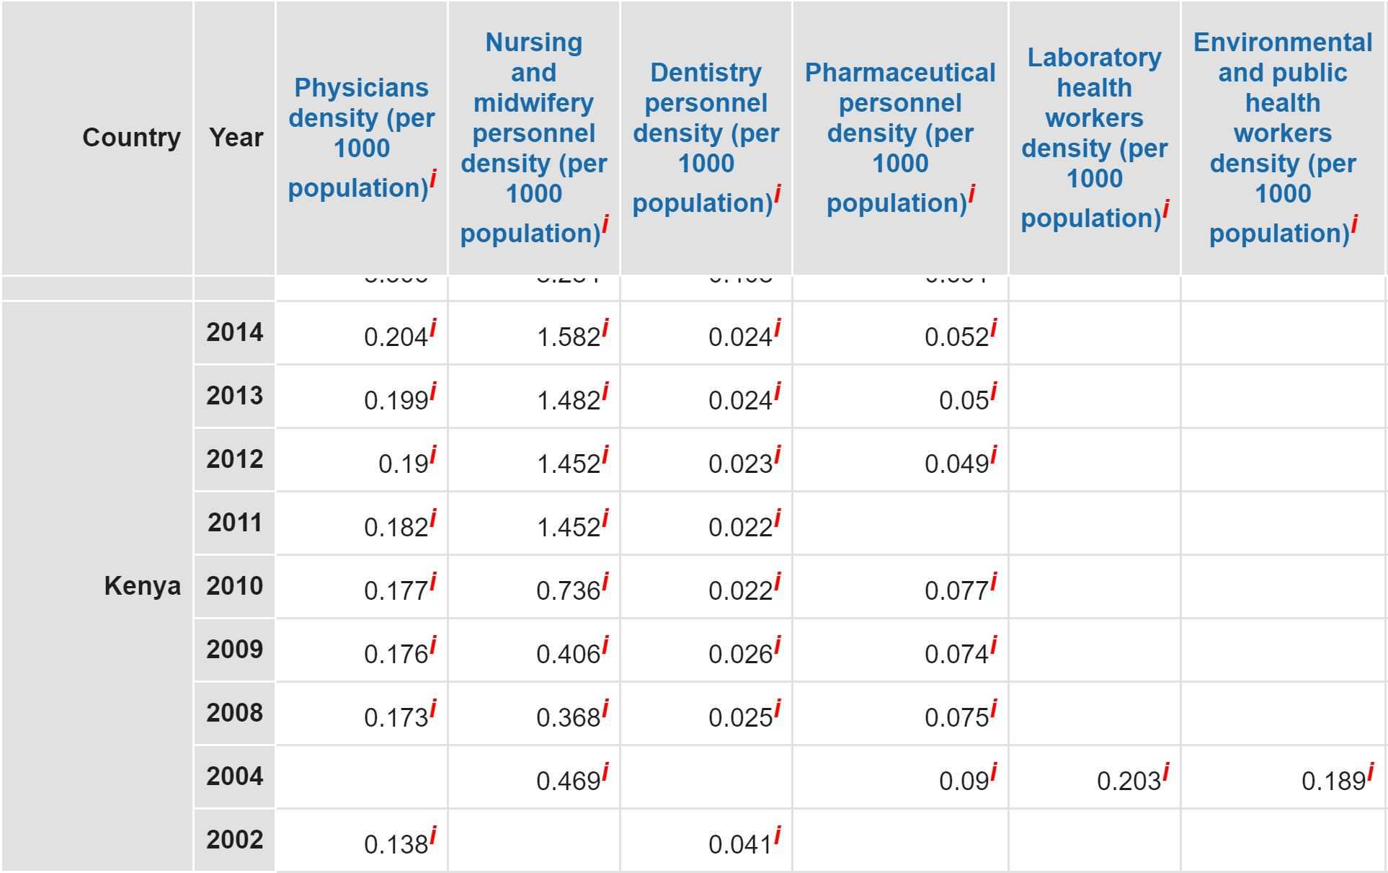
Equity Through Telemedicine
Severe and enduring shortage of healthcare workers

Slide 26
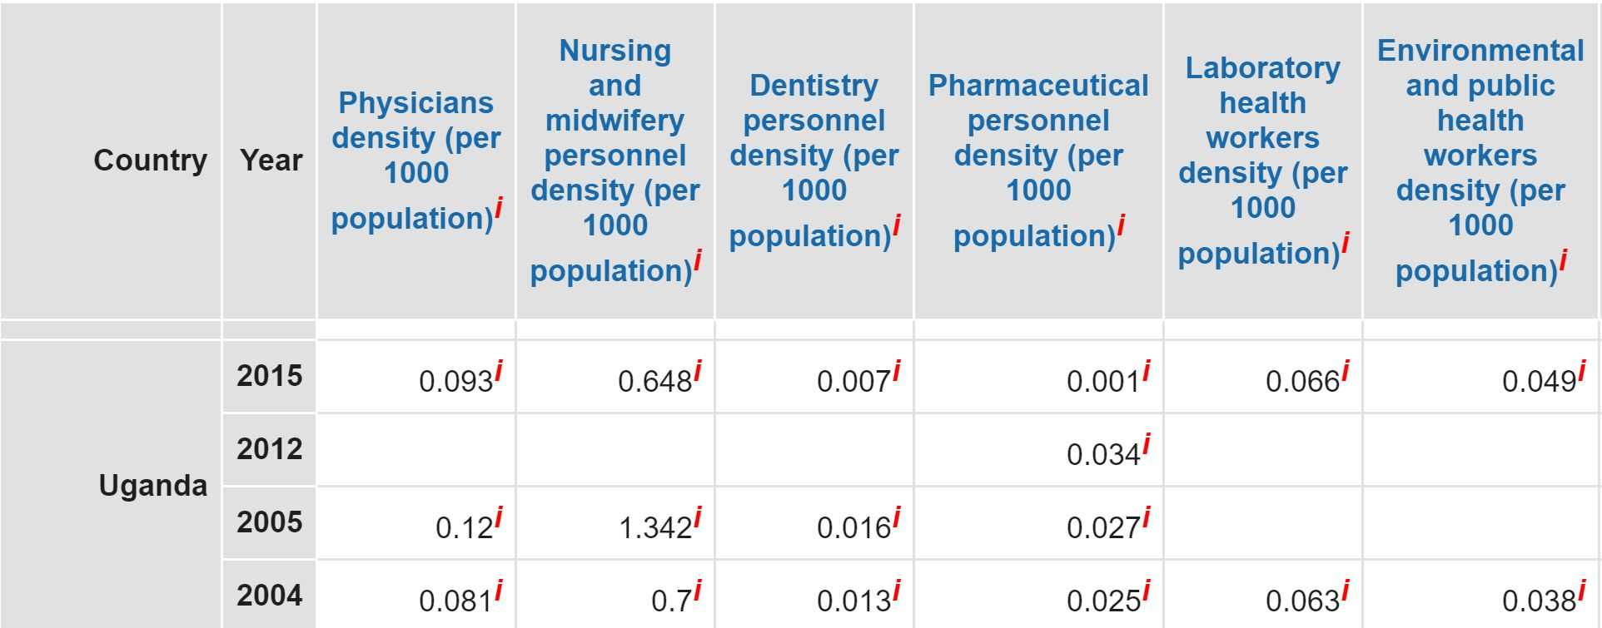
Equity Through Telemedicine

Slide 27
Telemedicine: The Uganda Experience
East African Telemedicine Project (HealthNet): 1983
The ITU Telemedicine Project (2000)
Africa Tele-dermatology Project (2007)
The Uganda Communication Commission and MoH eHealth Collaboration (2012)
UNICEF Karamoja Project: 2013
The Masaka Referral Hospital Mulago Hospital eHealth tie-up
Almost all have either withered and died or stagnated

Slide 28
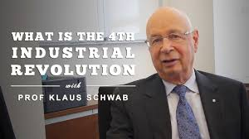
Distributed Ledger Technology / Blockchain: The Tech
“We stand on the brink of a technological revolution that will fundamentally alter the way we live, work, and relate to one another. In its scale, scope, and complexity, the transformation will be unlike anything humankind has experienced before”.
----Klaus Schwab, Founder and Executive Chairman, World Economic Forum
****

Slide 29
Blockchain Baby?!

Slide 30
Distributed Ledger Technology / Blockchain
A process of transacting and storing information on a decentralized, distributed ledger; information that is
reliable,
unchangeable, and
readily available to relevant individuals and entities anywhere in the world
In other words…
A blockchain is a shared, immutable record of peer-to-peer transactions built from linked transaction blocks and stored in a digital ledger
The data is in a network of hundreds or thousands of computers (nodes) distributed around the world and, crucially, there is no central entity (server)

Slide 31
Blockchain: The Technology

Slide 32
Blockchain: The Technology

Slide 33
Blockchain: The Technology
10 years old
There has been three generations
1st: Bitcoin
2nd: Ethereum
3rd: Cardano, EOS, Stellar etc.

Slide 34
DAG: The Technology
IOTA is slightly a lot different
Utilises the tangle rather than blockchain
Based on Directed Acyclic Graph (DAG)
DAG may have advantages particularly on scalability

Slide 35
The How…
Information input:
Information is put in the system,
run through a secure algorithm and
output with a unique algorithm.
That is the HASH

Slide 36
The term ‘blockchain’…
The hash is added to the ledger
The hash on the ledger is put in a block
The block is connected to the previous one and will be connected to the next one thereby –
creating a chain: The blockchain

Slide 37
The Technology
Security:
Transactions of any kind (data, financial etc.) are gathered in blocks which are secured on the chain using cryptography i.e. designed to be tamper-proof or, at the very least, extremely tamper-resistant

Slide 38
The Technology
Unlike the Internet…
…underpinned by TCP/IP technology where intermediaries are integral in the transaction or validation process
With blockchain, the P2P decentralised network has trust encoded in its protocol, does not rely on any 3rd party or validation = Trustless.

Slide 39
The Technology
Advantages
Much better transparency
Data Integrity
Traceability precision
Enhanced privacy
Reduced cost
Enhanced speed and efficiency

Slide 40
Blockchain deployment
Financial and banking industry – for transactions and cyber-security
Public sector: Estonia: Judicial, legislative, transport, security and NHS. Other countries: Dubai and Georgia – government data and records
IoT decentralised networks

Slide 41
Blockchain and Healthcare
The US has the highest per capita healthcare expenditure in the developed world despite absence of Universal Healthcare Coverage (UHC)
Most developed countries have some form of UHC
Common challenges include exorbitant administrative, operational and management costs

Slide 42
Blockchain-based EMR applications
A number of Distributed Ledger Technology (blockchain) platforms already available that are fit for eHealth /EMR purposes
Patient retaining control of the information and the sole ability to grant access, fully or partially, to healthcare professionals and/or others when the need arises
Any information entered is unalterable and permanent. It can be updated but cannot be deleted
With the individual’s consent (or from one with PoA), healthcare professionals or others can access the records.
Details of the access automatically recorded including the identity of the person accessing, the date and time, location, and duration

Slide 43
The Estonia experience
Estonia is the first country in the world to deploy blockchain technology to secure health records for each of its inhabitants
Runs a national health service providing universal healthcare to its citizens and residents financed through general taxation
The Estonia eHealth Foundation launched in 2005 runs the ENHIS whose projects include EHR, Digital Registration, Digital Images, and Digital Prescription
Deployed Guardtime’s Keyless Signature Infrastructure (KSI) blockchain technology to secure health records in 2007
KSI uses hash-function cryptography providing data authentication without reliance on centralised trust authorities

Slide 44
The Estonia experience
Access to one’s health records is through the eHealth Patient Portal using the National ID card .
Health Records that can be accessed by the individual consists of:
Illness data from healthcare system
Self-monitoring data
Wellness data from third parties
Data from social system
Screening remainders
Decision support
Self-care
Virtual health check

Slide 45
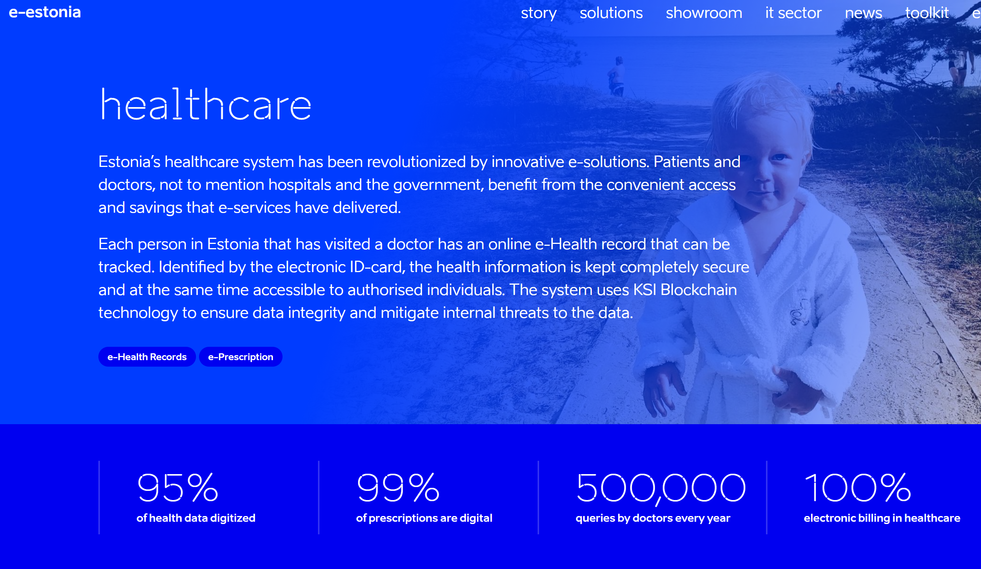
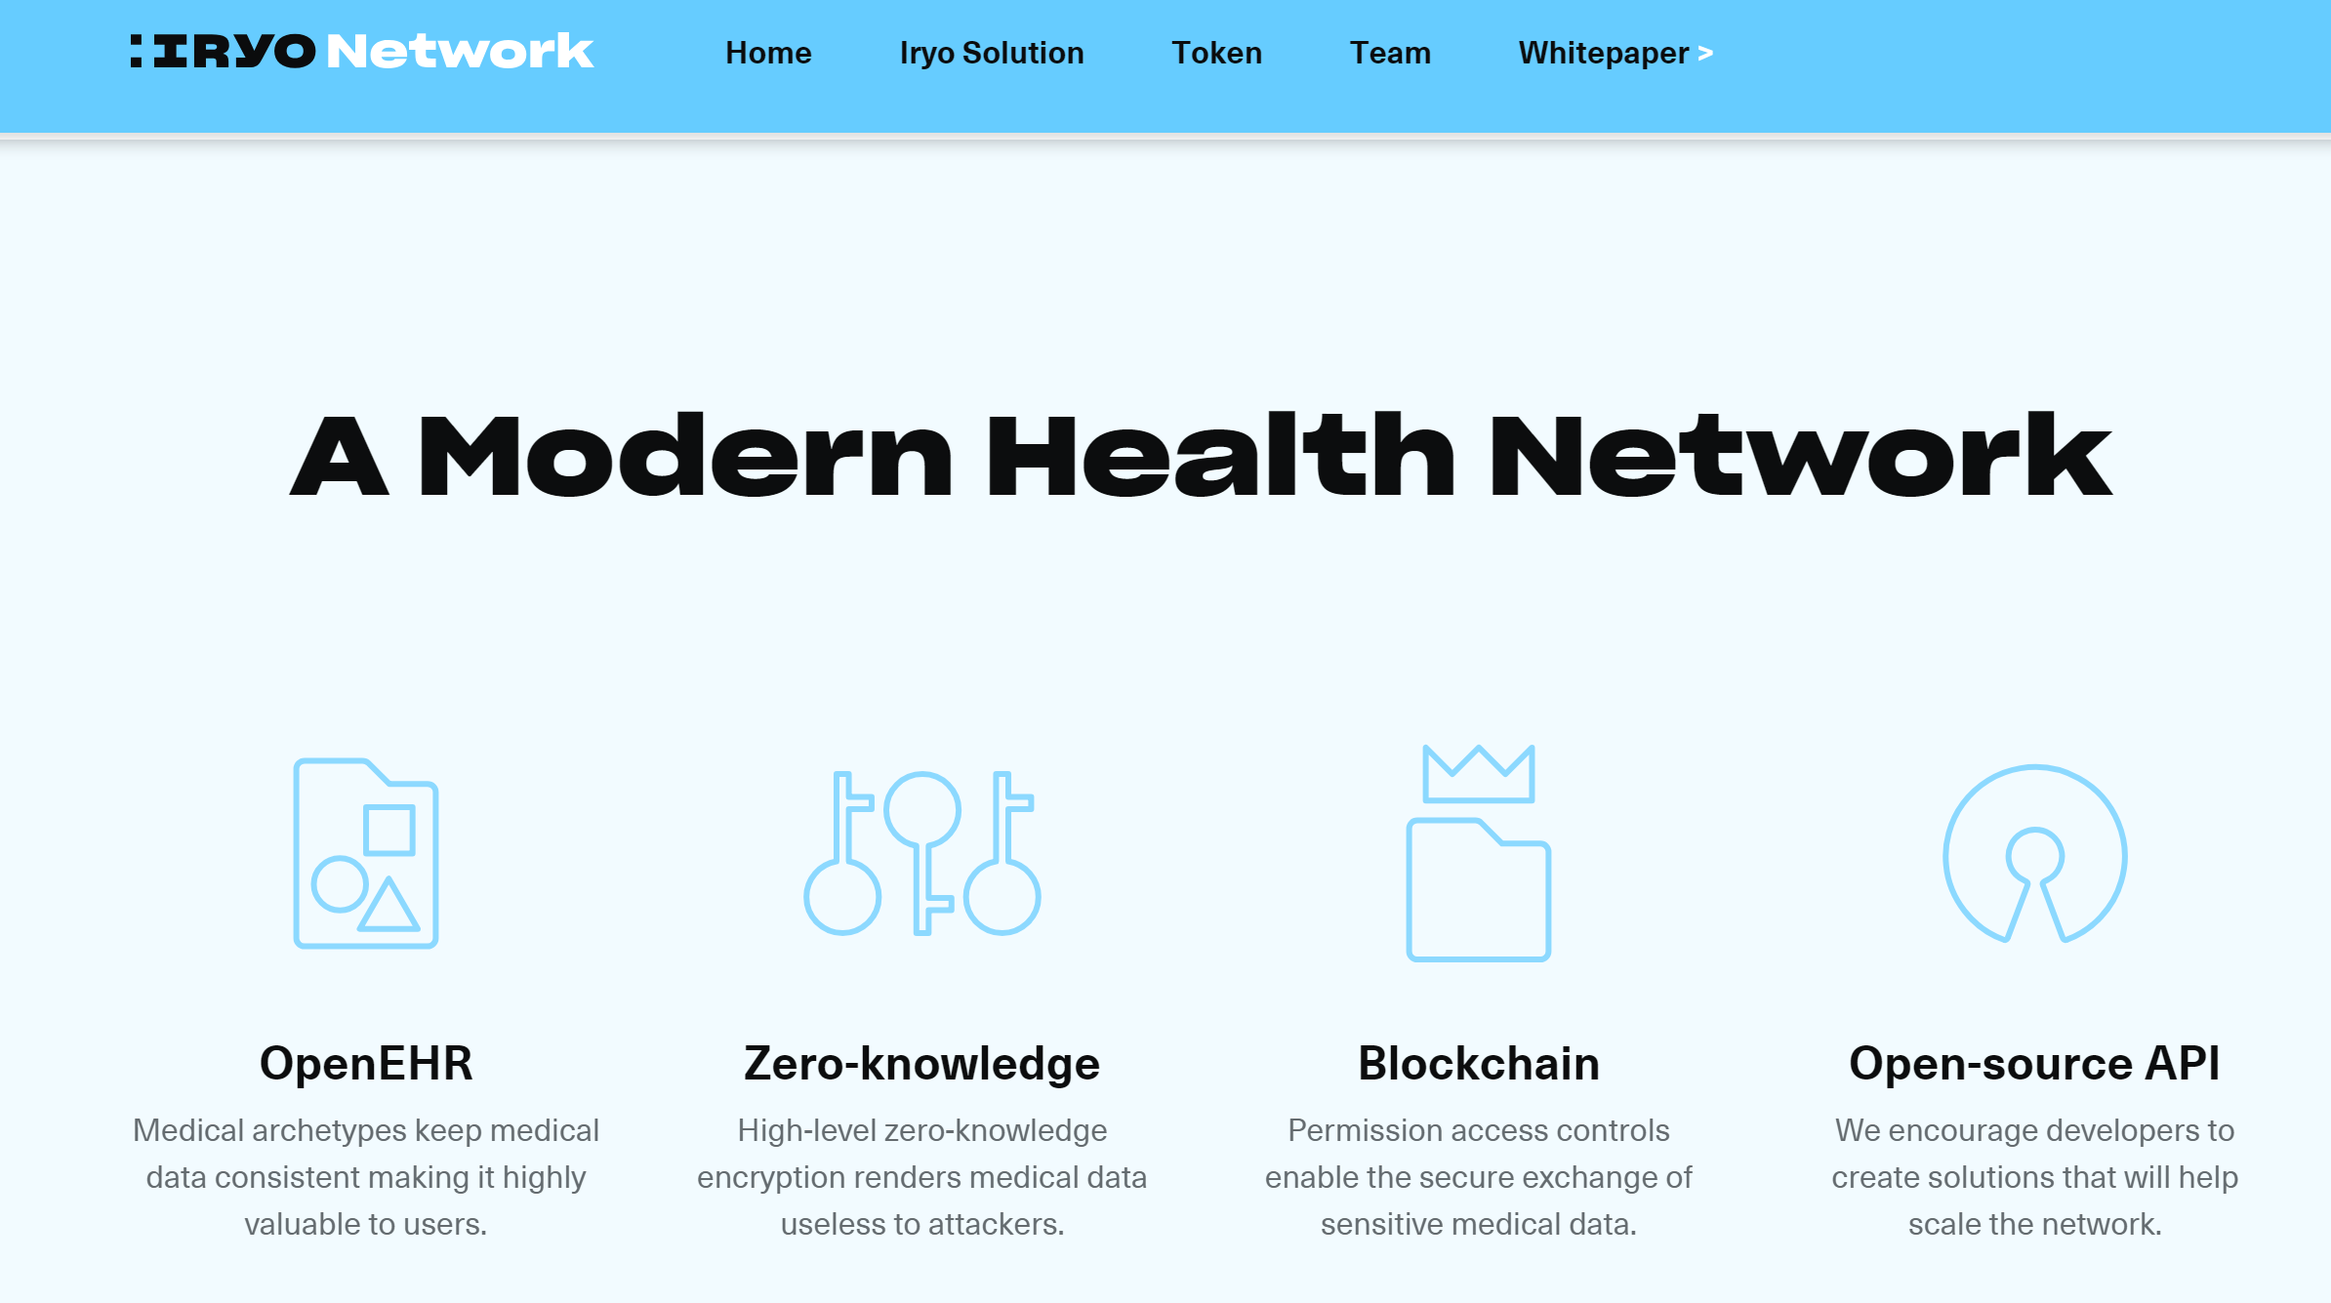
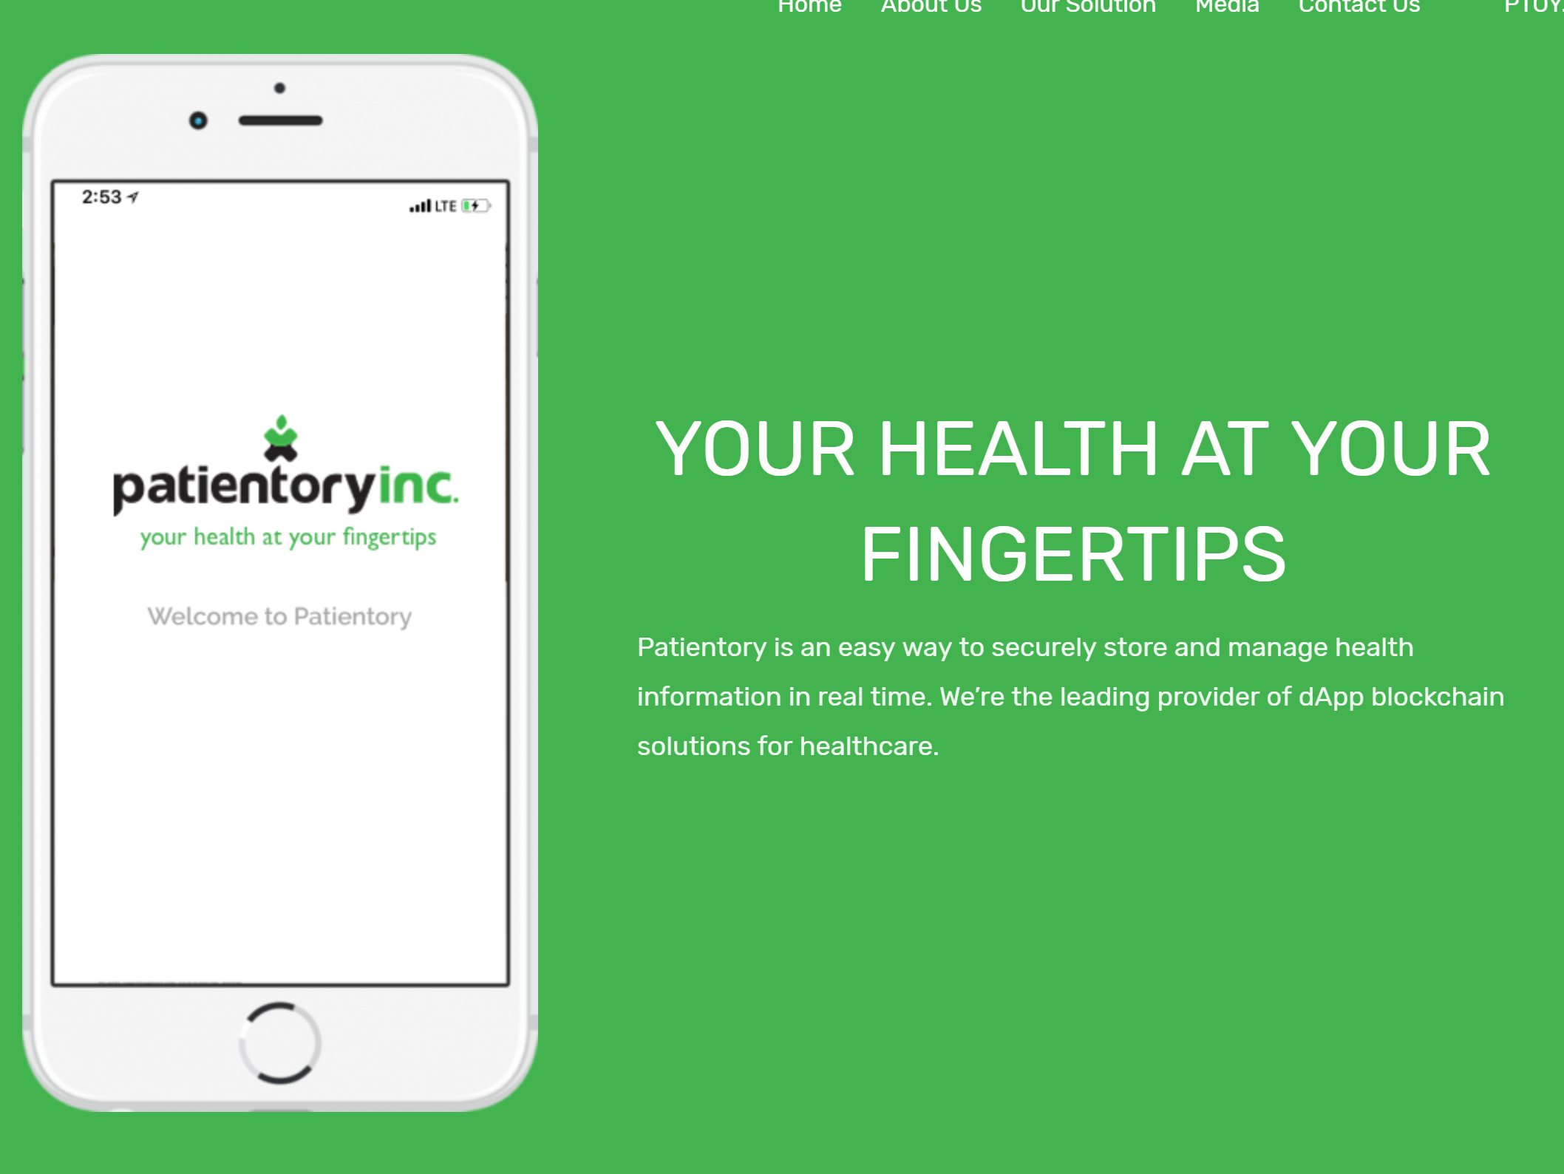
Blockchain medical records applications are already being launched across the world

Slide 46
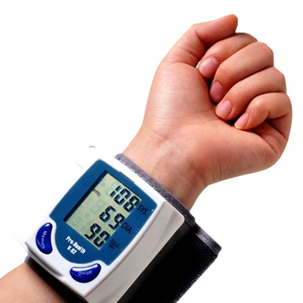
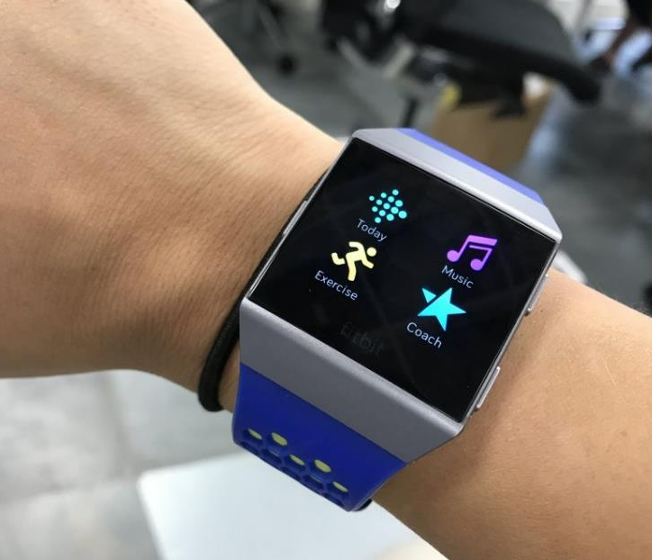
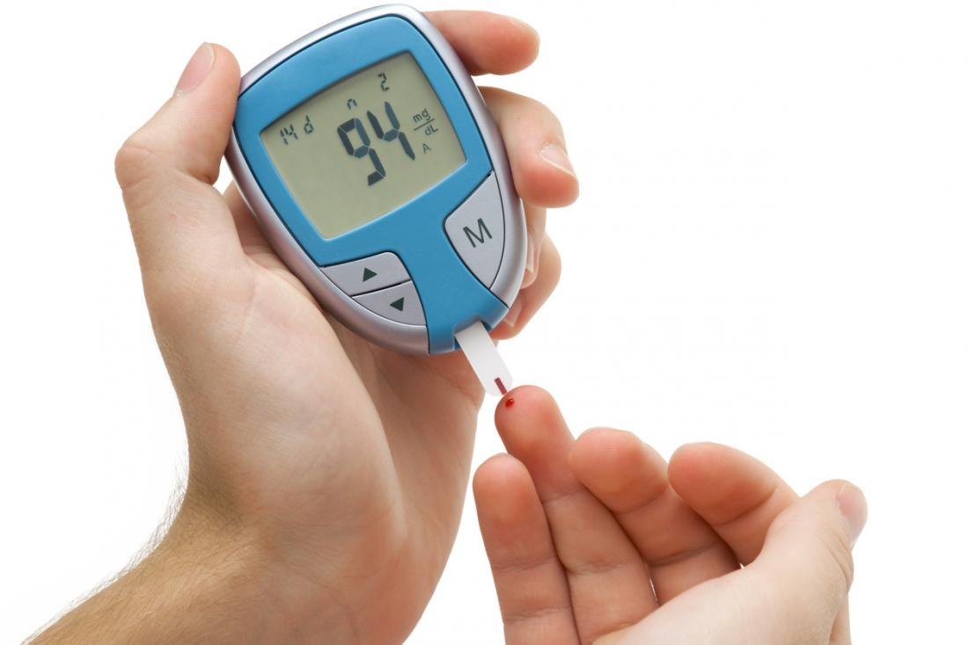
Blockchain applications’ potential
Integration
Blockchain applications ideal for integration with wearables and other mobile devices. Facilitation of health data input by the patient
Living platforms with ever-expanding functionality. The software’s API and SDK available to developers

Slide 47
DLT/Blockchain andTelemedicine
At the close of 2017, there were 135 live mobile money services found in 39 sub-Saharan countries with 122 million active accounts.
In Tanzania, as of early 2018, there were 23M regular internet users (40% of the population)
All 169 districts in Tanzania are connected to the broadband network
Smartphone adoption to reach 50% in sub-Saharan Africa in 2020
Increased network competition and cheaper smartphones driving transition to mobile broadband

Slide 48
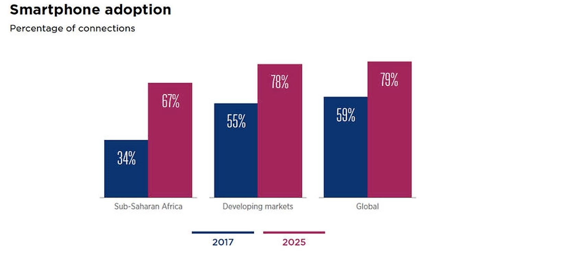
Conducive conditions

Slide 49
Blockchain and Smart Contracts
The blockchain smart contract functionality capable of effectively curbing fraud
A smart contract built on the single ledger shared by all concerned parties means there is transparency and the accuracy is not in dispute
Automation is based on the premise of consensus among all parties on the validity of transactions recorded on the blockchain.
The shared ledger is ‘append only’. The patient, the healthcare provider and the insurer have the same version of facts in the right chronology.

Slide 50
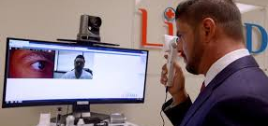
DLT/Blockchain and Telemedicine
DLT apps to facilitate consultations by patients with a specialist located anywhere in the country or further afield.
Telemedicine hitherto hampered by costly video-based telecommunication and inaccessibility of a patient’s medical records to the consulting physician
Ability to deliver services remotely is a strategic asset for any healthcare provider

Slide 51
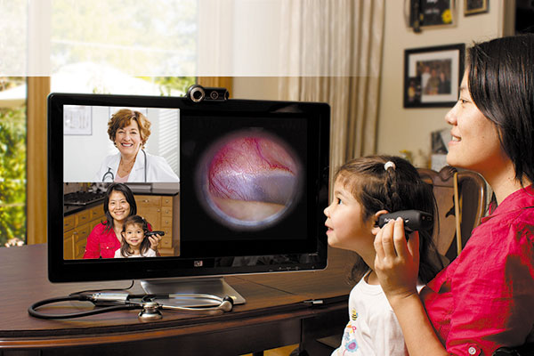
DLT/Blockchain and Telemedicine
Costly dedicated specialist equipment not necessary to establish this service

Slide 52
…to sum up

Slide 53
Benefits: healthcare provider
Instant access of patients’ complete medical records facilitating enhanced care quality
Reduced need for expensive servers and recurrent data security expenses translating into markedly reduced IT capital and maintenance costs
Enhanced quality and reliability of care quality data
Reduced medical errors and delayed intervention
Transformed engagement with partners and enhanced liquidity through automated settlements via smart contracts
Ability to expand reach through telemedicine services

Slide 54
Benefits: Government/Health authorities
Enhanced capacity for public health planning via reliable up to date comprehensive data
Enhanced capability for surveillance of drugs safety and effectiveness
Improved ability to monitor quality of care across service providers
Enhanced ability for more accurate modelling for risk and resource planning and allocation
Ability to reaffirm commitment to accuracy, timeliness, and shared-decision making as achievable care quality standards

Slide 55
Benefits: researchers/developers
Seamless access to real-time anonymised patient health data will save time, money and effort and greatly enhance research efficiency
Increased interoperability with similar dApps facilitating merging of data
Improved ability to develop and exploit neural networks
Improved ability to develop and deploy health monitoring Applications and wearables
Significantly improved opportunities for innovation due to reliable and comprehensive data that is instant, dynamic, and up to date

Slide 56
Benefits: patient
Retaining control of own medical records and guaranteed privacy
Enhanced security of own medical records
Portability hence instant access to own medical records whenever and wherever required
Enhanced ability to consult doctors/healthcare personnel of own choice
Ability to access telemedicine services, occasionally eliminating need for unnecessary / inconvenient and/or expensive travel
Potential to document own health information on official records
Potential for reduction of healthcare costs by eliminating need for unnecessary repeat tests

Slide 57
Video clip

Slide 58
Thank you

