Slide 1


Slide 2
7TH EAST AFRICA HEALTH & SCIENTIFIC CONFERENCE
DIGITAL HEALTH PLATFORMS FOR CONTINUOUS MEDICAL EDUCATION (CME) AND PATIENT CASE MANAGEMENT AMONG LOW CADRE HEALTH WORKERS IN UGANDA;
A RETROSPECTIVE REVIEW ANALYSIS.
BY
JOSEPH SSEBWANA
DIGITAL HEALTH ADVISOR.

Slide 3
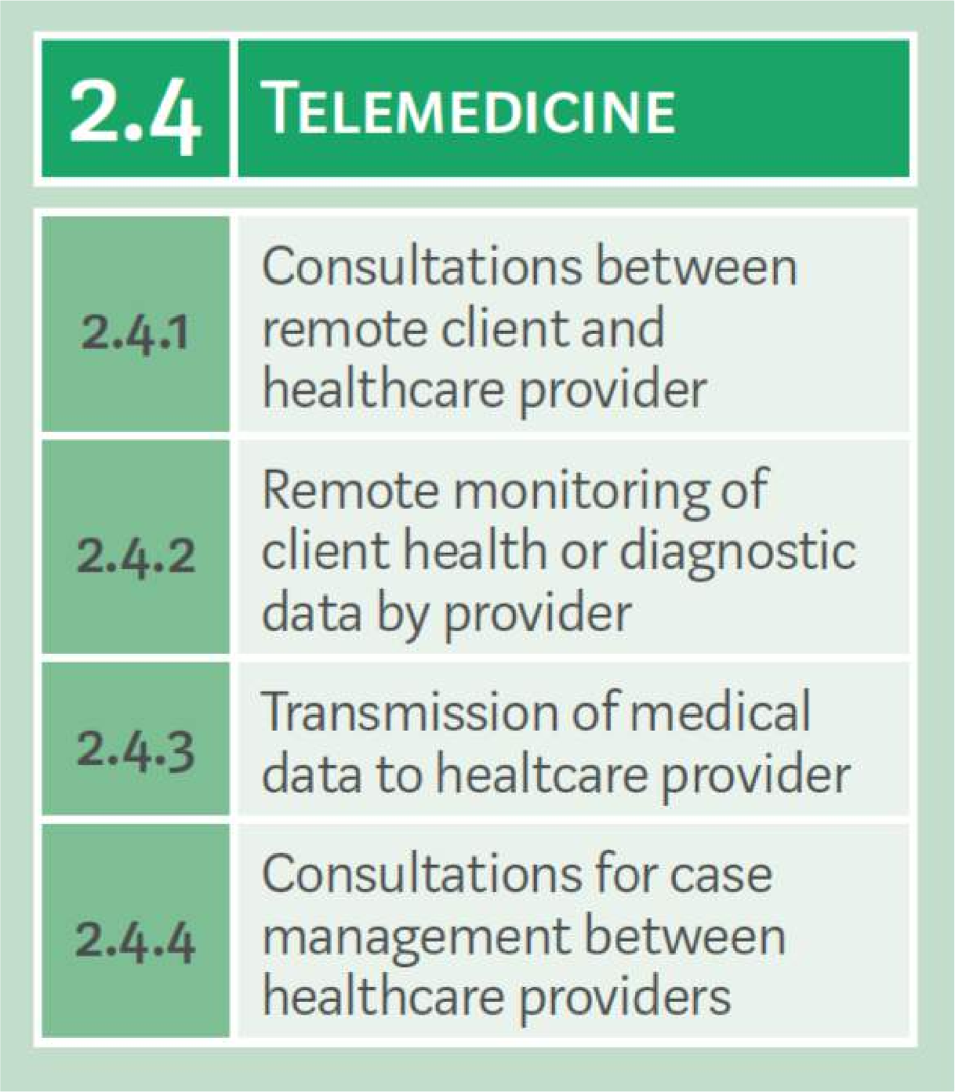
INTRODUCTION
Digital health involves provision of health services & health informatics through ICTs.
HCW: population 1.49 : 1000
WHO Recommends 2.3 : 1000
90% of CME providers Kampala
Hinders to license renewal
Source: Classification of Digital Health Interventions v1.0

Slide 4

METHODOLOGY
TMCG medical call centre
24/7 access to doctors.
Voice calls, SMS, Facebook, Twitter, WhatsApp, & video calls.
Accredited CME provider
A retrospective review of CME sessions and inquiries from HCW.
2016 to May 2018.
CME Points were awarded for participation in Video and conference CME sessions.
Quizzes before and after training

Slide 5
RESULTS
328 health workers contacted TMCG from 2016 to May 2018.

Slide 6
RESULTS
Average performance before and after CME sessions was 44% and 78% respectively.
83% of health workers (n=272) obtained required CME points for licence renewal.
78% (n=256) had actually renewed their practice licenses by May 2018.
All inquiries on case management were resolved and reviewed for completeness by external quality assurance team

Slide 7
DISCUSSION
The exponential rise in mobile phone ownership coupled with rising internet penetration.
Unique opportunity for low cadre health workers to utilise TMCG digital health platform to seek CME and consultations on complicated cases.
Performance trends continue to show improvement in post quizzes which indicates high levels of knowledge retention.

Slide 8
DISCUSSION
Digital health supports real time access to health information
Low cadre health workers take informed decisions.
Essential in improving their competence and quality of patient care.

Slide 9
RECOMMENDATIONS
EAC should fastrack integration of digital health in the general health care system.
To improve human resource capacity.
Quality of care.
Access to health services.

Slide 10
CONCLUSION
Digital health platforms provide a feasible portal for remote access to CME sessions and consultation on case management for low cadre health workers.

Slide 11
ACKNOWLEDGEMENT
THE MEDICAL CONCIERGE GROUP (TMCG) UGANDA
Management
Staff
USAID HIV/AIDS / HEALTH INITIATIVES IN WORK PLACE ACTIVITY (HIWA)
HIWA CONSORTIUM PARTNERS (TASO, UHMG, RTI, ECOTRUST)
WORLD VISION UGANDA
WORLD VISION USA

Slide 12
END
THANK YOU

