Slide 1
7th East African Health and Scientific Conference
The effectiveness of interactive messaging alert system on improving knowledge level on obstetric and newborn danger signs, service utilization and birth preparedness among pregnant women in Dodoma Municipal: A quasi-experimental study
1.Theresia J. Masoi : RN, Msc. Midwifery
2.Dr.STEPHEN KIBUSI (Phd )
School of Nursing and public health
The University of Dodoma-Tanzania
2019

Slide 2
Background 1/2
Appropriate utilization of antenatal care can prevent complications and ensures better maternal and child health care
Ensures early detection and management of antenatal risk factors, birth preparedness and complication readiness
Three core health sector strategies for reducing maternal and early neonatal deaths:
  Comprehensive reproductive health care;
  Skilled care for all pregnant women and
  Emergency obstetric care for all women and infants with life-threatening complications (World Health Organization, 2016)

Slide 3
Background 2/2
The underlying determinants of maternal death during pregnancy, childbirth and postpartum are affected by the three-delay;
  Identifying a life threatening event/danger signs and making the decision to go to the health facility
  Delay in reaching the health facility and
  Delay in receiving appropriate and adequate care at the health facility
  So this study aimed at testing the effectiveness of interactive messaging alert system on improving knowledge level on obstetric and newborn danger signs, service utilization, birth preparedness and complication readiness among pregnant women in Dodoma municipal

Slide 4
RESEARCH OBJECTIVES
Broad objective: To evaluate effectiveness of the interactive messaging alert system in improving knowledge on obstetric and newborn danger signs, Antenatal care service utilization and individual birth preparedness and complication readiness among pregnant women in Dodoma municipal.
Specific Objectives:
1.To assess the effectiveness of an IMAS on improving the level of knowledge on obstetric and newborn danger signs among pregnant/postnatal women.
2.To test the effectiveness of IMAS on improving individual birth preparedness and complication readiness among pregnant/postnatal women in Dodoma Municipal.
3. To evaluate the effectiveness of IMAS on improving utilization of the recommended antenatal care services among pregnant/postnatal women in Dodoma Municipal.

Slide 5
METHODOLOGY 1/2
Study design: A quasi-experimental, with a control group using quantitative research approaches. Pregnant women were followed from their first visit to the point of delivery. Knowledge on key danger signs, service utilization and birth preparedness were assessed at baseline and after delivery for both groups
Study area: Dodoma Municipality(six health facilities (among the region with high maternal mortality)
Study population: Pregnant/postnatal women who started their first antenatal visit below the first twenty weeks.
Sampling technique: Purposive sampling (to select Dodoma region, Dodoma Municipal and the health facilities). The study participants were selected Randomly both intervention and control.
Sample size: 450 participants (n = 150 intervention, n = 300 control).The intervention were matched to control by age, gravidity and education level at a ratio of 1:2
Data collection tools: Standardized Semi-structured Questionnaires, mobile phones and computerized database were used

Slide 6
METHODOLOGY 2/2
Definitions of variables
Dependent variables: Knowledge on obstetric and newborn danger signs, Antenatal Care service utilization, Individual Birth preparedness and complication readiness
Independent variable: Interactive messaging alert system(IMAS) and the
Covariates : Parity, Age, Gravidity, education level and marital status
Analysis: Analysis of covariance (ANCOVA),T test and simple and multiple linear regression were used to test the effectiveness of the intervention

Slide 7
The Intervention 1/5
Specially designed software automatically generated and sent health education text messages according to women’s gestation age
Key features of the intervention
Computerized database
Automated messaging
Interactive messaging
Linkage of ANC data to labor and delivery care
All the communication were recorded to the system database to identify the patterns of messages and the frequently asked questions

Slide 8
The Intervention 2/5
There were a total of 5400 messages sent to pregnant women and recorded in the system between March, 2018 to June, 2018 equivalent to 12 messages per participant with the feedback of 96.5% of pregnant mother texted back for appreciation or texted to ask questions.
There was a password that protected web user interface and enabled every user to access only the information required at his /her position in the system. So every user was assigned an account.

Slide 9
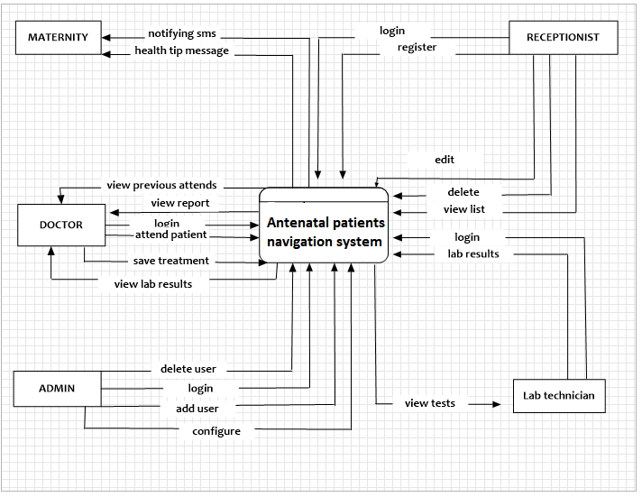
The flow chart diagram which depicts the flow of data and information in and outside the system 3/5

Slide 10
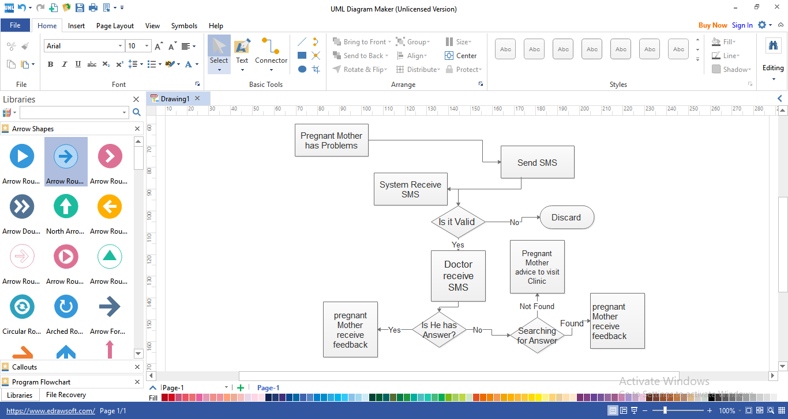
logical flow diagram which show how this SMS module for two ways worked 4/5

Slide 11
DEMOGRAPHIC AND OBSTETRIC CHARACTERISTICS (N=450)
VARIABLE | Intervention |  | Control |  | Total/out of 450 |  | X² P-value
 | n | % | n | % | n | %
Age <20 yrs 20-34 yrs ≥35 yrs | 21 111 18 | 14.0 74.0 12.0 | 61 212 27 | 20.3 70.7 9.0 | 82 323 45 | 18.2 71.8 10.0 | 3.256ª 0.196
Education status Primary education Secondary education College/University | 82 52 16 | 54.7 34.7 10.6 | 182 95 23 | 60.7 31.7 7.6 | 264 147 39 | 58.7 32.7 8.6 | 1.928ª 0.381
Gestation age at 1st visit 1-12 weeks 13-20 weeks | 56 94 | 37.3 62.7 | 136 164 | 45.3 54.7 | 192 258 | 42.7 57.3 | 2.616ª 0.106
Gravidity 1 2-4 ≥ 5 | 33 109 8 | 22.0 72.7 5.3 | 64 217 19 | 21.3 72.3 6.4 | 97 326 27 | 21.6 72.4 6.0 | 0.189ª 0.910

Slide 12
Overall scores on level of knowledge, IBPACR and ANC service utilization (N=450)
VARIABLE | Before intervention |  | After intervention
 | Control | Intervention | Control | Intervention
Knowledge Adequate knowledge Inadequate knowledge | 134 (44.7%) 166(55.3%) | 69 (46.0%) 81 (54.0%) | 144 (48.0%) 156 (52.0%) | 116 (77.3%) 34 (22.7% )
IBPACR Prepared Not prepared | 51 (17.0%) 249 (83.0%) | 30 (20.0%) 120 (80%) | 89 (29.7%) 211 (70.3%) | 106 (70.7%) 44 (29.3%)
ANC service utilization Received adequate services Received inadequate services |  |  | 173 (57.7%) 127 (42.3%) | 116 (77.3) 34 (22.7%)
Total n= | 300 | 150 | 300 | 150

Slide 13
Ancova results to compare the mean change on Knowledge of obstetric and newborn danger signs,IBPACR and ANC service utilization between Intervention and controls (N=450)
Before intervention |  |  |  |  |  | After intervention
Variables | Interv. |  | Control |  |  | Interv. |  | Control |  | P-value | Cohen’s d Effect size
 | X | Sd | X | Sd | P-val. | X | Sd | X | Sd
Knowledge | 4.78 | 3.227 | 4.71 | 3.382 | 0.826 | 9.531 | 2.666 | 6.518 | 4.304 | <0.001 | 0.85
IBPACR | 1.97 | 1.102 | 1.95 | 1.205 | 0.887 | 4.17 | 1.365 | 2.631 | 1.778 | <0.001 | 0.9
ANC utlz |  |  |  |  |  | 2.77 | 0.420 | 2.58 | 0.495 | <0.001 | 0.414

Slide 14
Conclusion and recommendation
The study findings of this study have revealed that Interactive messaging alert system yields better outcome to participants in the intervention group, in the part of health education as compared to conventional Antenatal care health education provided in our Antenatal care clinics.
Level of knowledge, Individual birth preparedness and Antenatal care service utilization was higher in the intervention group compared to the control group. This may help in reducing the effect caused by the first and second delay too.
Policy makers and planners in health related issues, should integrate a two- way communication systems in our Antenatal care clinics .

Slide 15


Acknowledgement
The project team would like to express its sincere thanks to the University of Dodoma management for sponsoring this important project. Without the grant offered by UDOM this work would have been impossible
The System is now online at ( http://dodoma-antinetal-pns.or.tz )

Slide 16
References
1. World Health Organization. WHO Maternal mortality Fact sheet. Geneva: media centre; 2016.
2. Ministry of Health Community Development Gender Elderly and Children (MoHCDGEC) [Tanzania, Mainland]. Tanzania Demographic and Health Survey and Malaria Indicator Survey (TDHS-MIS) 2015-16. Dar es Salaam, Tanzania, and Rockville, Maryland, USA; 2016.
3. Heredia-Pi IA, Servan-Mori E, Darney BG, Reyes-Morales H, Rafael Lozano. Measuring the adequacy of antenatal health care a national cross-sectional study in Mexico. Mexico: World Health Organization (WHO); 2016.
4. Xiong K, Kamunyori J, Sebidi J. The MomConnect helpdesk: How an interactive mobile messaging programme is used by mothers in South Africa. BMJ Glob Heal. 2018;
5.Ngabo F, Nguimfack J, Nwaigwe F, Mugeni C, Muhoza D, Wilson DR, et al. Designing and Implementing an Innovative SMS-based alert system (RapidSMS-MCH) to monitor pregnancy and reduce maternal and child deaths in Rwanda. Pan Afr Med J. 2012;13:31.
6.Lund S, Hemed M, Nielsen BB, Said A, Sadick K, Makungu MH R V. Mobile phones as a health communication tool to improve skilled attendance at delivery in Zanzibar a cluster-randomised controlled trial. Zanzibar: PubMed; 2012.

