Slide 1



Exploiting digital technology to map the burden and drivers of antibacterial resistance in East Africa
The 7th EAHSC
Wilber Sabiiti and the HATUA consortium
HATUA consortium: David Aanensen, Benon Asiimwe, Audia Atogo, Alison Elliot, Stephen Gillespie, Matthew Holden, Joel Bazira, Katherine Keenan, Mike Kesby, Gibson Kibiki, John Kiiru, Andy Lynch, Blandina Mmbaga, Stephen Mshana, Joseph Mwanga, Stella Neema, Alison Sandiman, Wilber Sabiiti, Suleiman Saidi, Derek Sloan, Anne Smith, John Stelling

Slide 2

HATUA
HATUA is a Swahili word for action. HATUA seeks to address the global antibacterial resistance (ABR) crisis through local action in East Africa, mapping the burden and drivers of disease to translate global strategy into local solutions
Team members in 5 countries, including Tanzania, Uganda and Kenya
@HATUA_Research

Slide 3
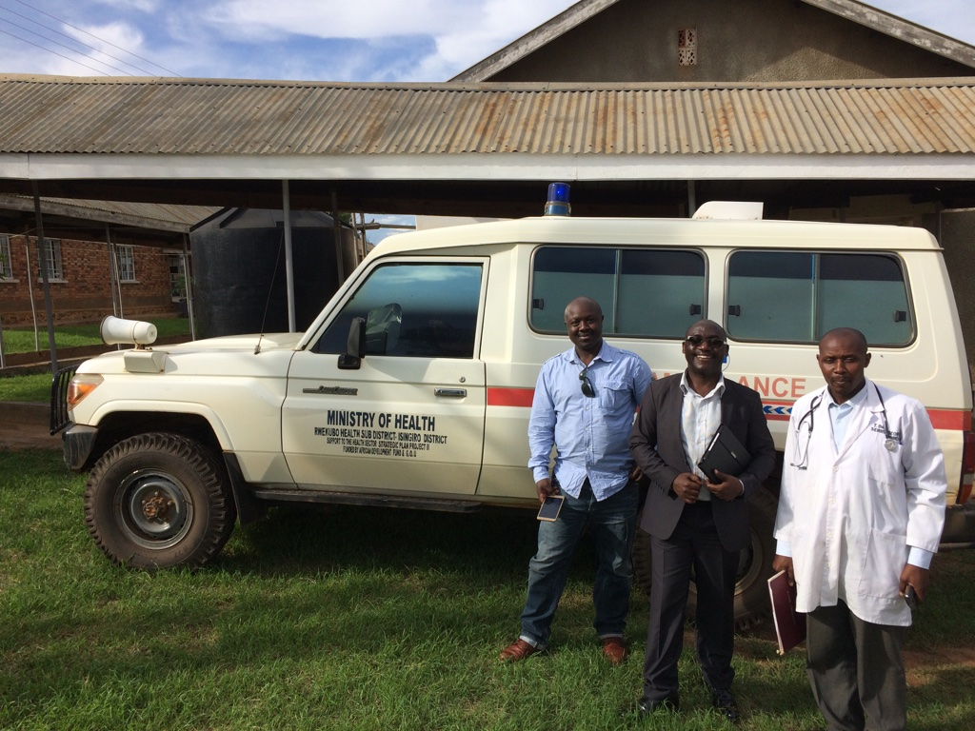
HATUA Development phase
  UK
  Benon Asiimwe visited Imperial College met with David Aanensen and team and and set up Epicollect survey project on mobile phones
  Mobile phones distributed to Uganda partners
  Uganda
  November 2017 trip to visit study hospitals in Isingiro district
  Meet staff introduce the project and invite them to participate
  Two level 3 hospitals, one level 4, one level 5
  Makerere University, Micro Lab, Kampala and UVRI-MRC, Entebbe
  Refine research questions
  Focus on Urinary Tract Infections

Slide 4
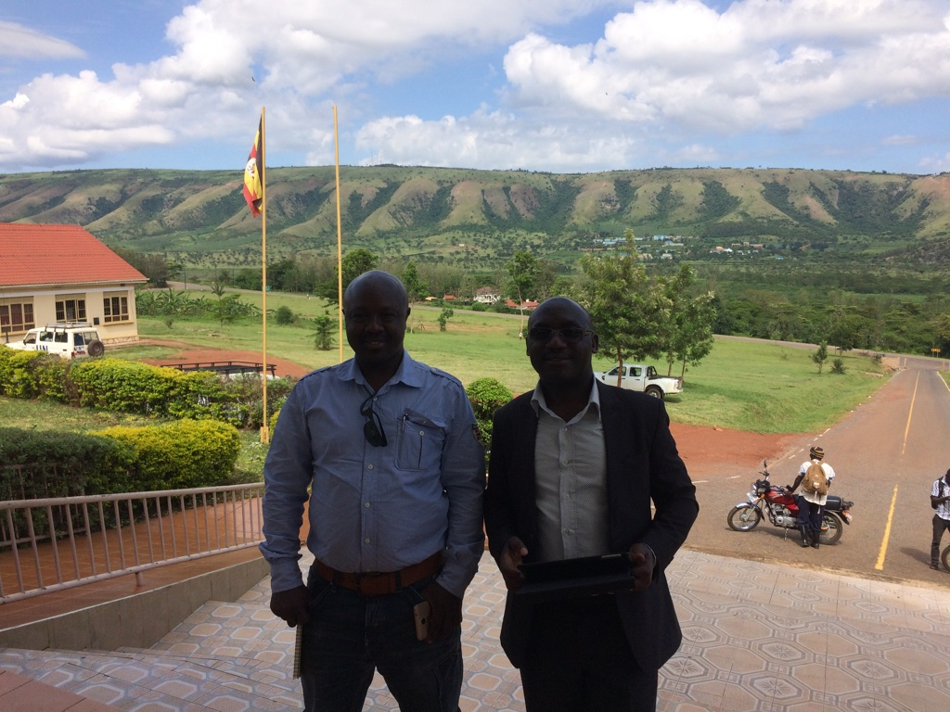
HATUA pilot work
Benon Asiimwe and John Kiiru, Wilber Sabiiti and Derek Sloan
Recruitment of 118 patients with symptoms of UTIs
Urine samples
Culture and Antibiotic Sensitivity Testing
  Mabarara University
Patient questionnaire
  Health seeking behavior
  Antibiotic behavior
Health worker questionnaire
  Patient scenarios
Follow up interviews of patients in community (33 patients)
  Social-economic and social-demographic data
Stella Neema - Focus group discussion

Slide 5
Urinary Tract Infection (UTI) patients in Isingiro District, Southern Uganda – the microbiology aspect
4 Hospitals
118 patients recruited
  109 confirmed positive
E. coli and K. pneumoniae were confirmed as the main uropathogens
  Extended Spectrum b-lactamase (ESBL) organisms in 17.7% of cases
  52% of ESBL bacteria displayed resistance to multiple antibiotic classes
96 isolates sent to St Andrews for Whole Genome Sequencing (WGS)
Phylogenetic and resistome analysis of UTI isolates

Slide 6
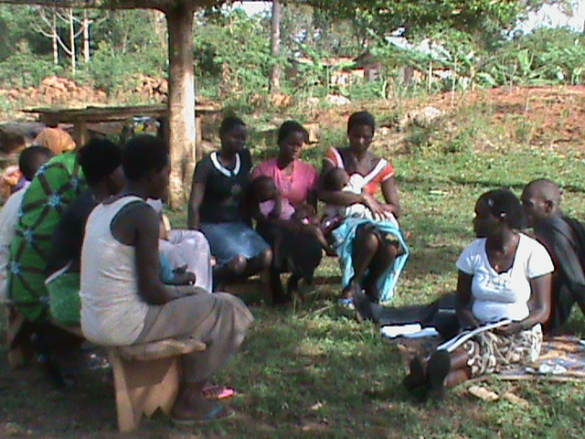
Urinary Tract Infection (UTI) patients in Isingiro District, Southern Uganda - the qualitative aspects
Different ways of accessing antibiotics
Different lived experiences
Methods of resort
  Trying different clinics or clinicians to get what they want
  Farmers inventing their own drug combinations
The community have their ways of naming and identifying drugs e.g gombiatic
Antimicrobial resistance is an abstract term but communities have their way of expressing what drug resistance is.
Important to understand these perspectives if interventions are to be effective.

Slide 7

https://microreact.org/

Slide 8

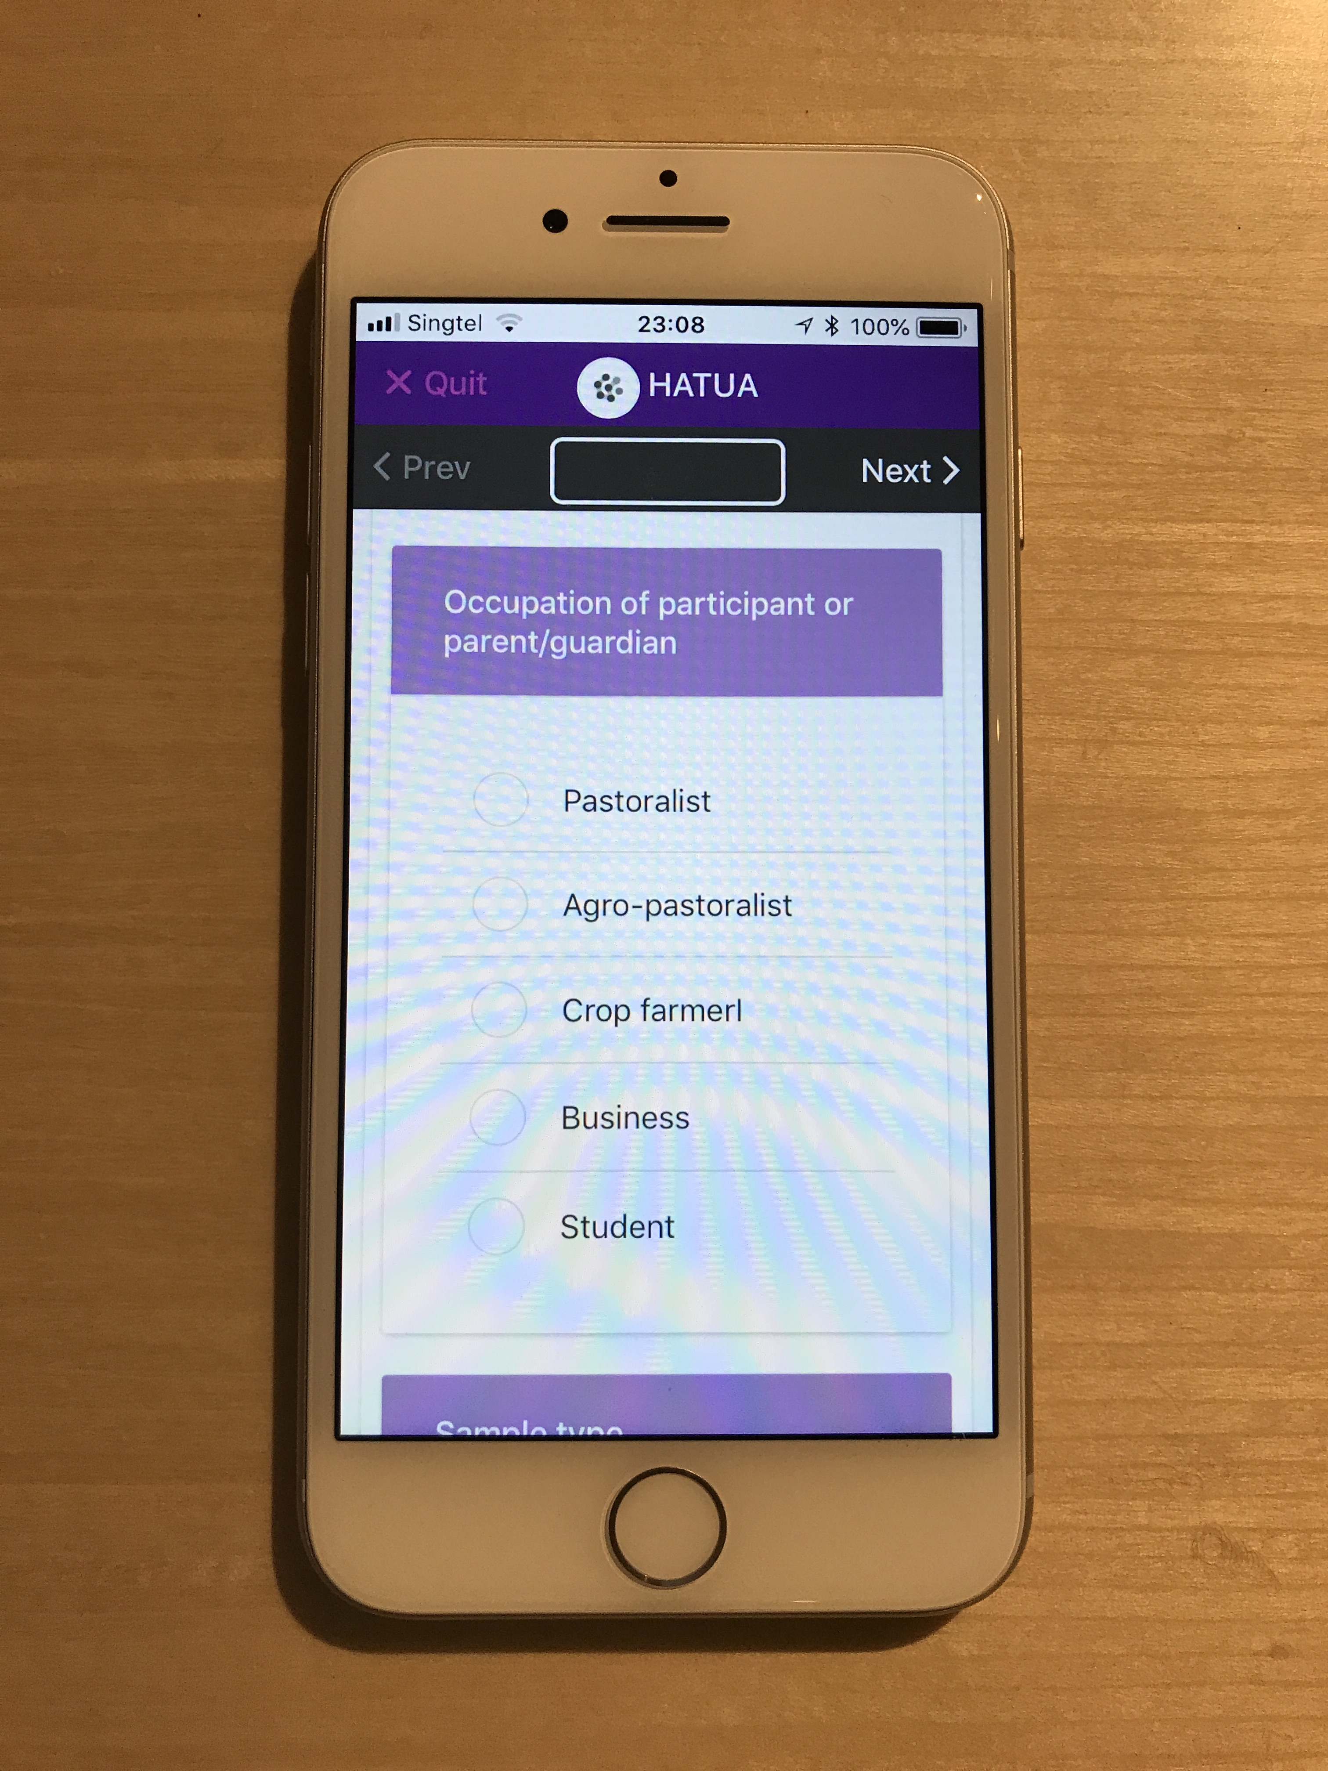
Used to gather quantitative data in Isigingiro
  Patient questionnaire
    Health seeking behavior
    Antibiotic behavior
    Basic socio-demographic data
  Health worker questionnaire
    Patient scenarios
  Community follow-up questionnaire
      Socio-demographic data
      Socio-economic data
  Microbiology lab data
    Culture and Antibiotic Sensitivity Testing

Slide 10
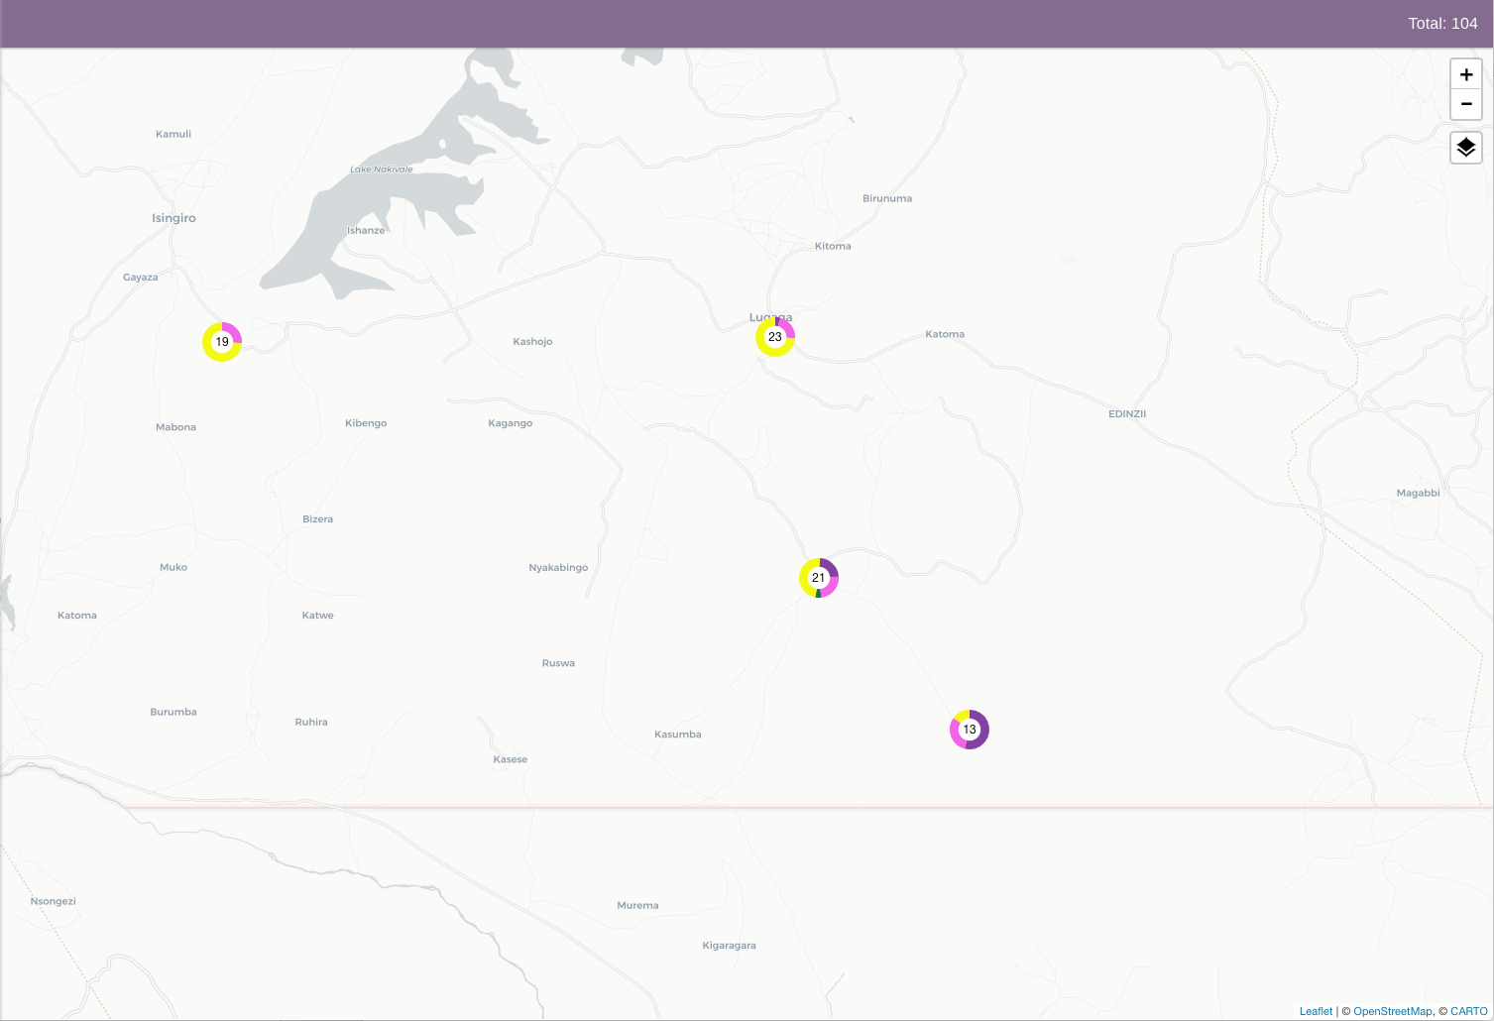
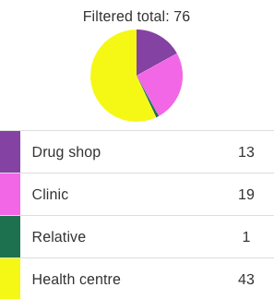
Where did you get the medication from?

Slide 11


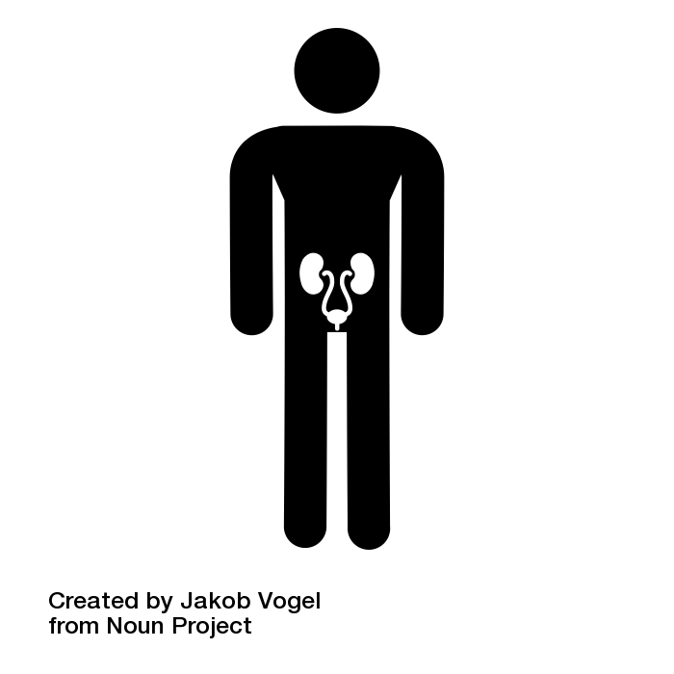

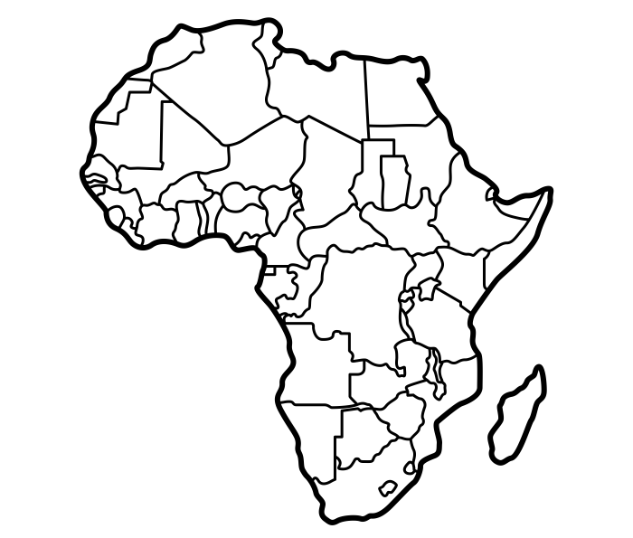




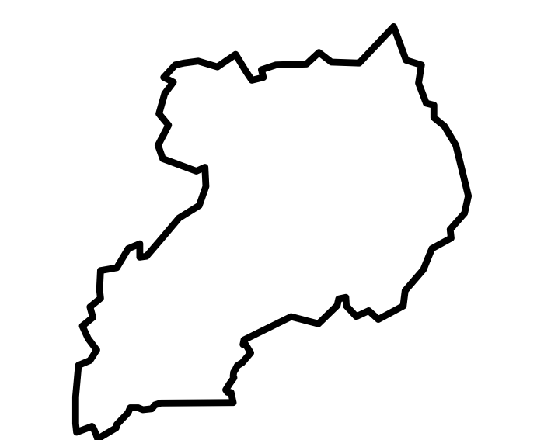



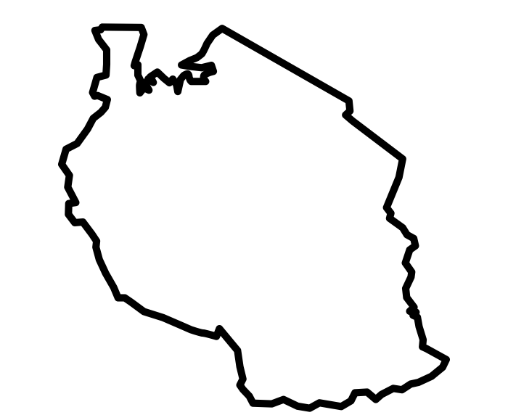
Holistic Approach To Unravel Antibacterial resistance in East Africa (HATUA) consortium
WS1
HATUA Management
Kenya
Disease and Therapy Landscape
WS2
Disease and therapy Landscape
WS6
Integrated Design, Data Capture, Analysis and Dissemination
WS3
Pathogen
Uganda
Patient
Pathogen
WS4
Patient
Tanzania
WS5
Community
Community
Work Package (WP)
WP Study Areas

Slide 12
HATUA is examining the possible contributions of three potential ABR drivers:
Inappropriate provision of antibiotics
Ineffective treatment due to wrong choices of antibiotics
Incomplete knowledge of proper use of antibiotics

Slide 13
Urinary Tract Infection (UTI) provide a clinical prism through which we can observe the problem of ABR and interrogate associated drivers
UTIs are common and are poorly treated
Treatment seeking behavior among patients can be poor
Urine is an easy sample to obtain and pathogen identification readily available
UTI pathogens include important ABR targets: such as ESBL-producing Enterobacteriaceae

Slide 14
Disease and Therapy Landscape
Pathogen
Patient
Community

Slide 15
Tools that HATUA will use
Microbiological culture
Antimicrobial Sensitivity Testing
Genome sequencing
Geospatial mapping using mobile phones
Quantitative interviews
Qualitative interviews
Focus group discussions
Bayesian network analysis

Slide 16
Treatment seeking behavior and attitude to antibiotics
Recruit 1800 UTI patients in Healthcare settings
  Patient Questionnaire in the clinic
    Socio-demographic characteristics
    Recent clinical history
    General health and healthcare
    Knowledge and attitudes about medication
Follow up of UTI patients to the community
  Household Questionnaire
    Household composition and member characteristics
    Household health and healthcare
    Animals
    Attitudes of respondent to antibiotics
    Environment

Slide 17
Antibiotic availability and usage
Geospatial mapping of antibiotic sellers
Mystery client study
Interviews with antibiotic sellers
Simulated clinical case studies
Interviews with doctors and healthcare professionals

Slide 18
Characterizing the pathogen
From the patient
Urine
Culture and identification
Antibiotic Sensitivity Testing
Whole genome sequencing
From the Homestead
Environmental and animal faecal samples
Culture and enrichment for multidrug resistance isolates

Slide 19
Interdisciplinary working in ABR
New Materialist Approach
Empiric
ABR
Social
Clinical information
Culture
Antibiotic Sensitivity Testing
Whole Genome Sequence
Quantitate surveys
Qualitative interviews
Ethnographic studies

Slide 20
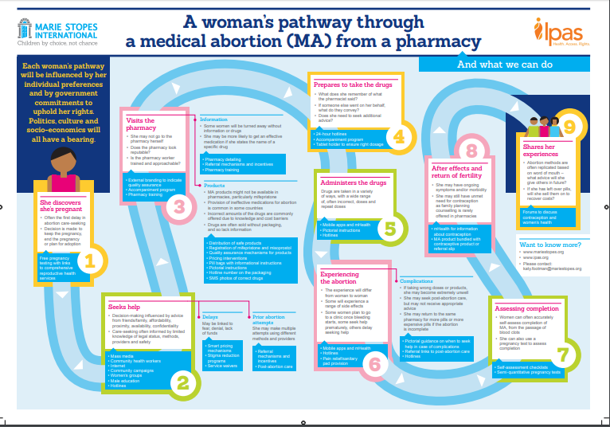
The patient pathway for UTI
What are the various patient pathways to treatment and how do they intersect with ABR?
What barriers prevent people from taking more clinically ideal pathways to treatment and how might these be addressed?
From Katherine Keenan

Slide 21
HATUA consortium activities
1800 patients
3 countries
3 study areas per country
2 visits per study area
Diagnostic scenarios, and Mystery client, N=90 (30 per country, 10 per site)
Community interviews, N=90 (30 per country
Community Dialogues

Slide 22
WS2
Disease and Antibiotic Landscape
HATUA : capturing the patient pathway
Antibiotics
Mystery
shopper
UTI
Healthcare providers
Interviews
Interviews
Supplier Advice
Availability Mapping
Treatment Decision Mapping
Recruitment
WS4
Patient
WS3
Pathogen
Interviews
Sample
Patient
Culture
Socio-demographics & socio-economics
Antibiotic History
Clinical History
WS5
Community
Pathogen
Identification
Whole Genome Sequencing
Antibiotic Sensitivity testing
Treatment Seeking pathway
Burden of resistance
Genomic epidemiology
Patient and Contacts
Genetic basis of resistance
Pathogen
Within host diversity
Origins
UTI
Antibiotics
Interviews
Reservoirs
Behavior & Attitudes
Culture
Human
Environment
Length of Infection
WS5
Community
Capability
Motivation
Opportunity
Animal
WS4
Patient
WS3
Pathogen
WS4
Patient

Slide 23
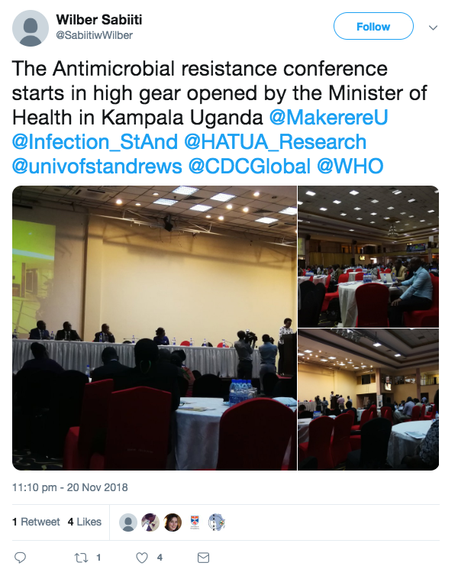

Slide 24
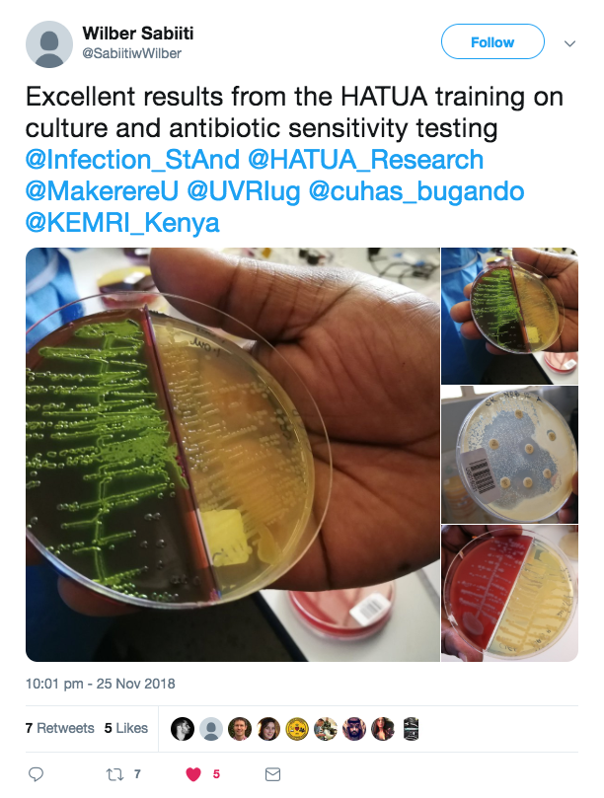

Slide 25
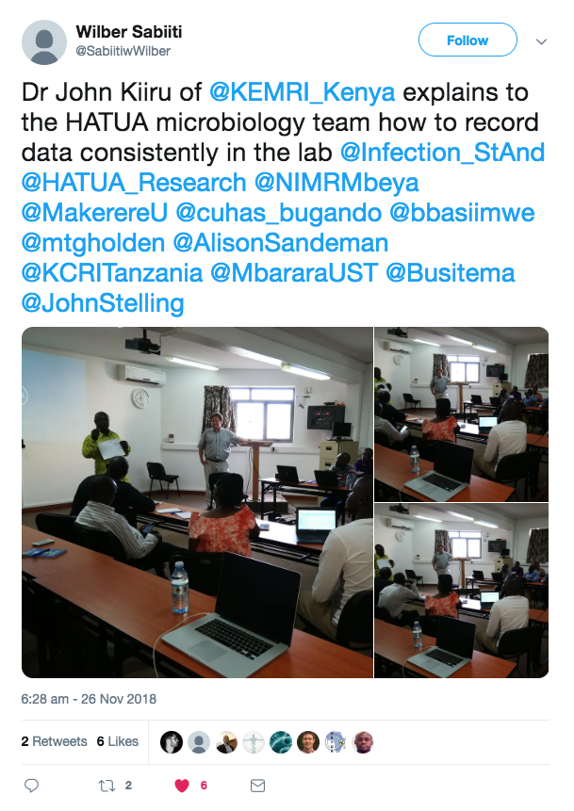

Slide 26
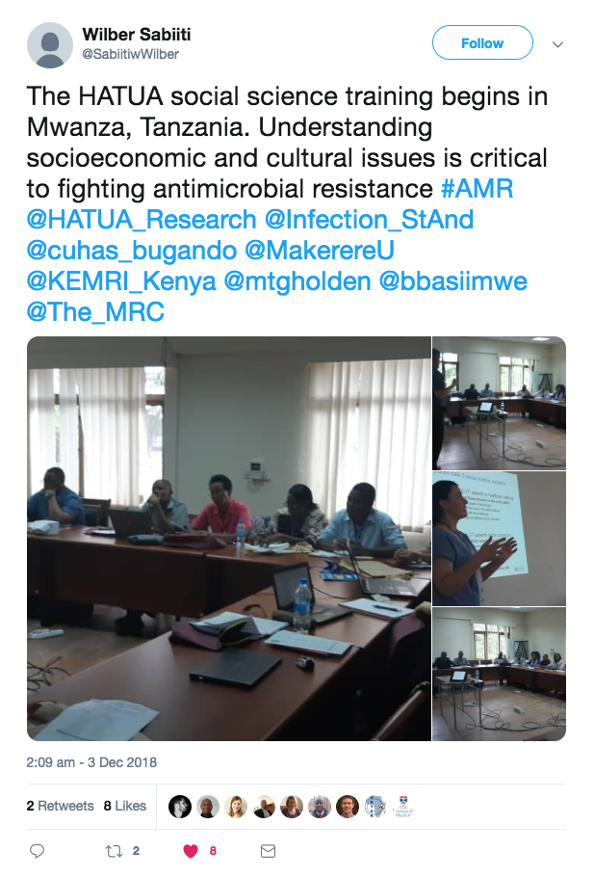

Slide 27
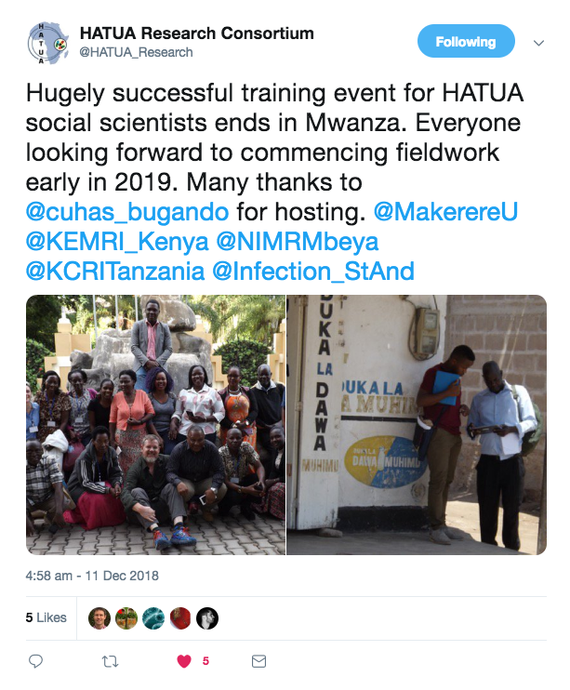

Slide 28
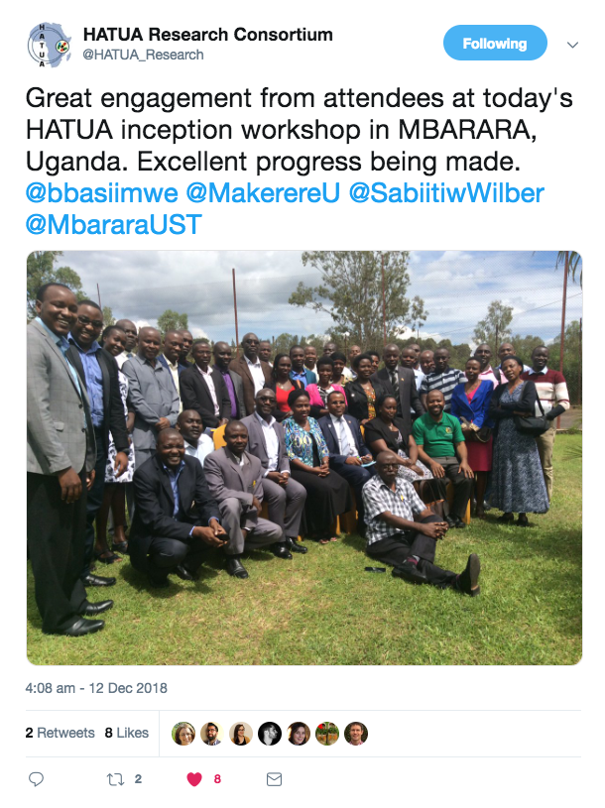

Slide 29
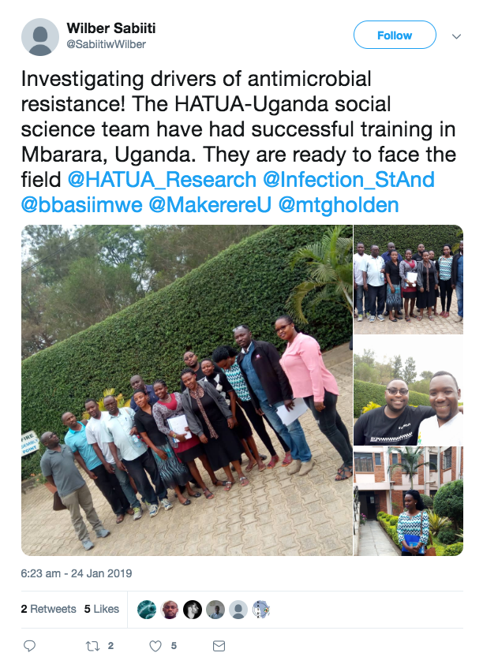

Slide 30
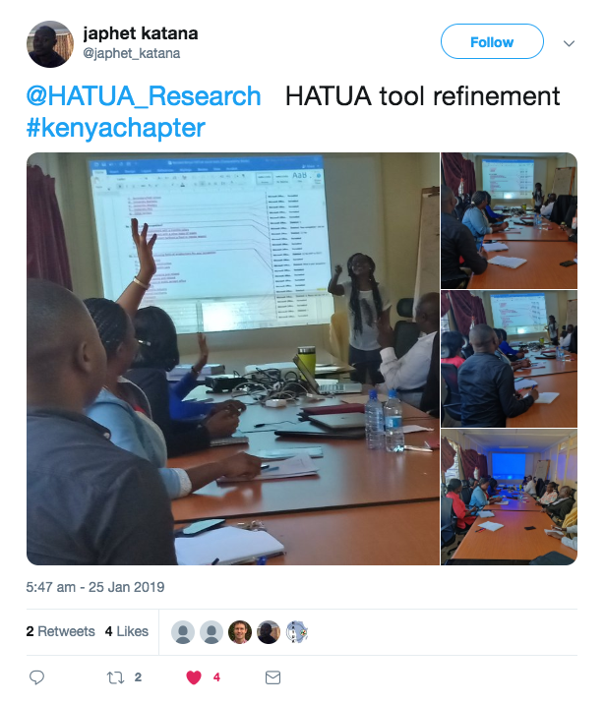

Slide 31


HATUA is the result of a team effort
Catholic University of Health and Allied Sciences (CUHAS)
Prof Stephen Mshana
Dr Joseph Mwanga
Kilimanjaro Clinical Research Institute (KCRI)
Prof Blandina Mmbaga
East African Health Research Commission (EAHRC)
Prof Gibson Kibiki
Makerere University
Prof Stella Neema
Prof Benon Asiimwe
Uganda Virus Research Institute – MRC (UVRI-MRC)
Prof Alison Elliot
Kenya Medical Research Institute (KEMRI)
Dr John Kiiru
Dr Audia Atogo
Dr Suleiman Saidi
University of St Andrews
School of Medicine
Dr Wilber Sabiiti
Prof Stephen Gillespie
Dr Derek Sloan
School of Geography
Dr Mike Kesby
Dr Katherine Keenan
School of Mathematics and Statistics
Prof Andy Lynch
School of Biology
Dr Anne Smith
Sanger Institute
Centre for Pathogen Genome Surveillance
Prof David Aanensen
Brigham and Women's Hospital, Boston
Dr John Stelling

