Slide 1


7th East African Health and Scientific Conference
Theme: “Technology for health systems transformation and attainment of the UN-Sustainable Development Goals”
A template-based mHealth approach to digital record keeping from paper documentation for Sickle Cell Disease
Authors: Bernadette Kleczka^{1,2,3}, Raphael Sangeda^{1,2}, Julius Maleto^{1,2}, Michael Marx³, Pratap Kumar^{4,5}, Julie Makani^{1,2}
Department of Haematology and Blood Transfusion, Muhimbili University of Health and Allied Sciences, Tanzania
Sickle Cell Programme, Muhimbili University of Health and Allied Sciences, Tanzania
Institute of Public Health, University of Heidelberg, Germany
Health-E-Net Limited, Nairobi, Kenya
Institute of Healthcare Management, Strathmore University, Kenya

Slide 2
Background
Continuous measurement and interpretation of clinical data is a prerequisite for improving clinical outcomes
EMR systems are still largely limited to hospitals in low-income countries, and paper-documentation is widely used
Electronic medical systems need to fulfil the following requirements:
  Low-cost
  Easily sourced/supported locally
  Easily adaptable to different requirements/uses
  Simple to use with minimal training
  Integrated with clinical decision support
Combining mobile technology with paper-documentation provides a powerful tool to store and manage clinical data

Slide 3
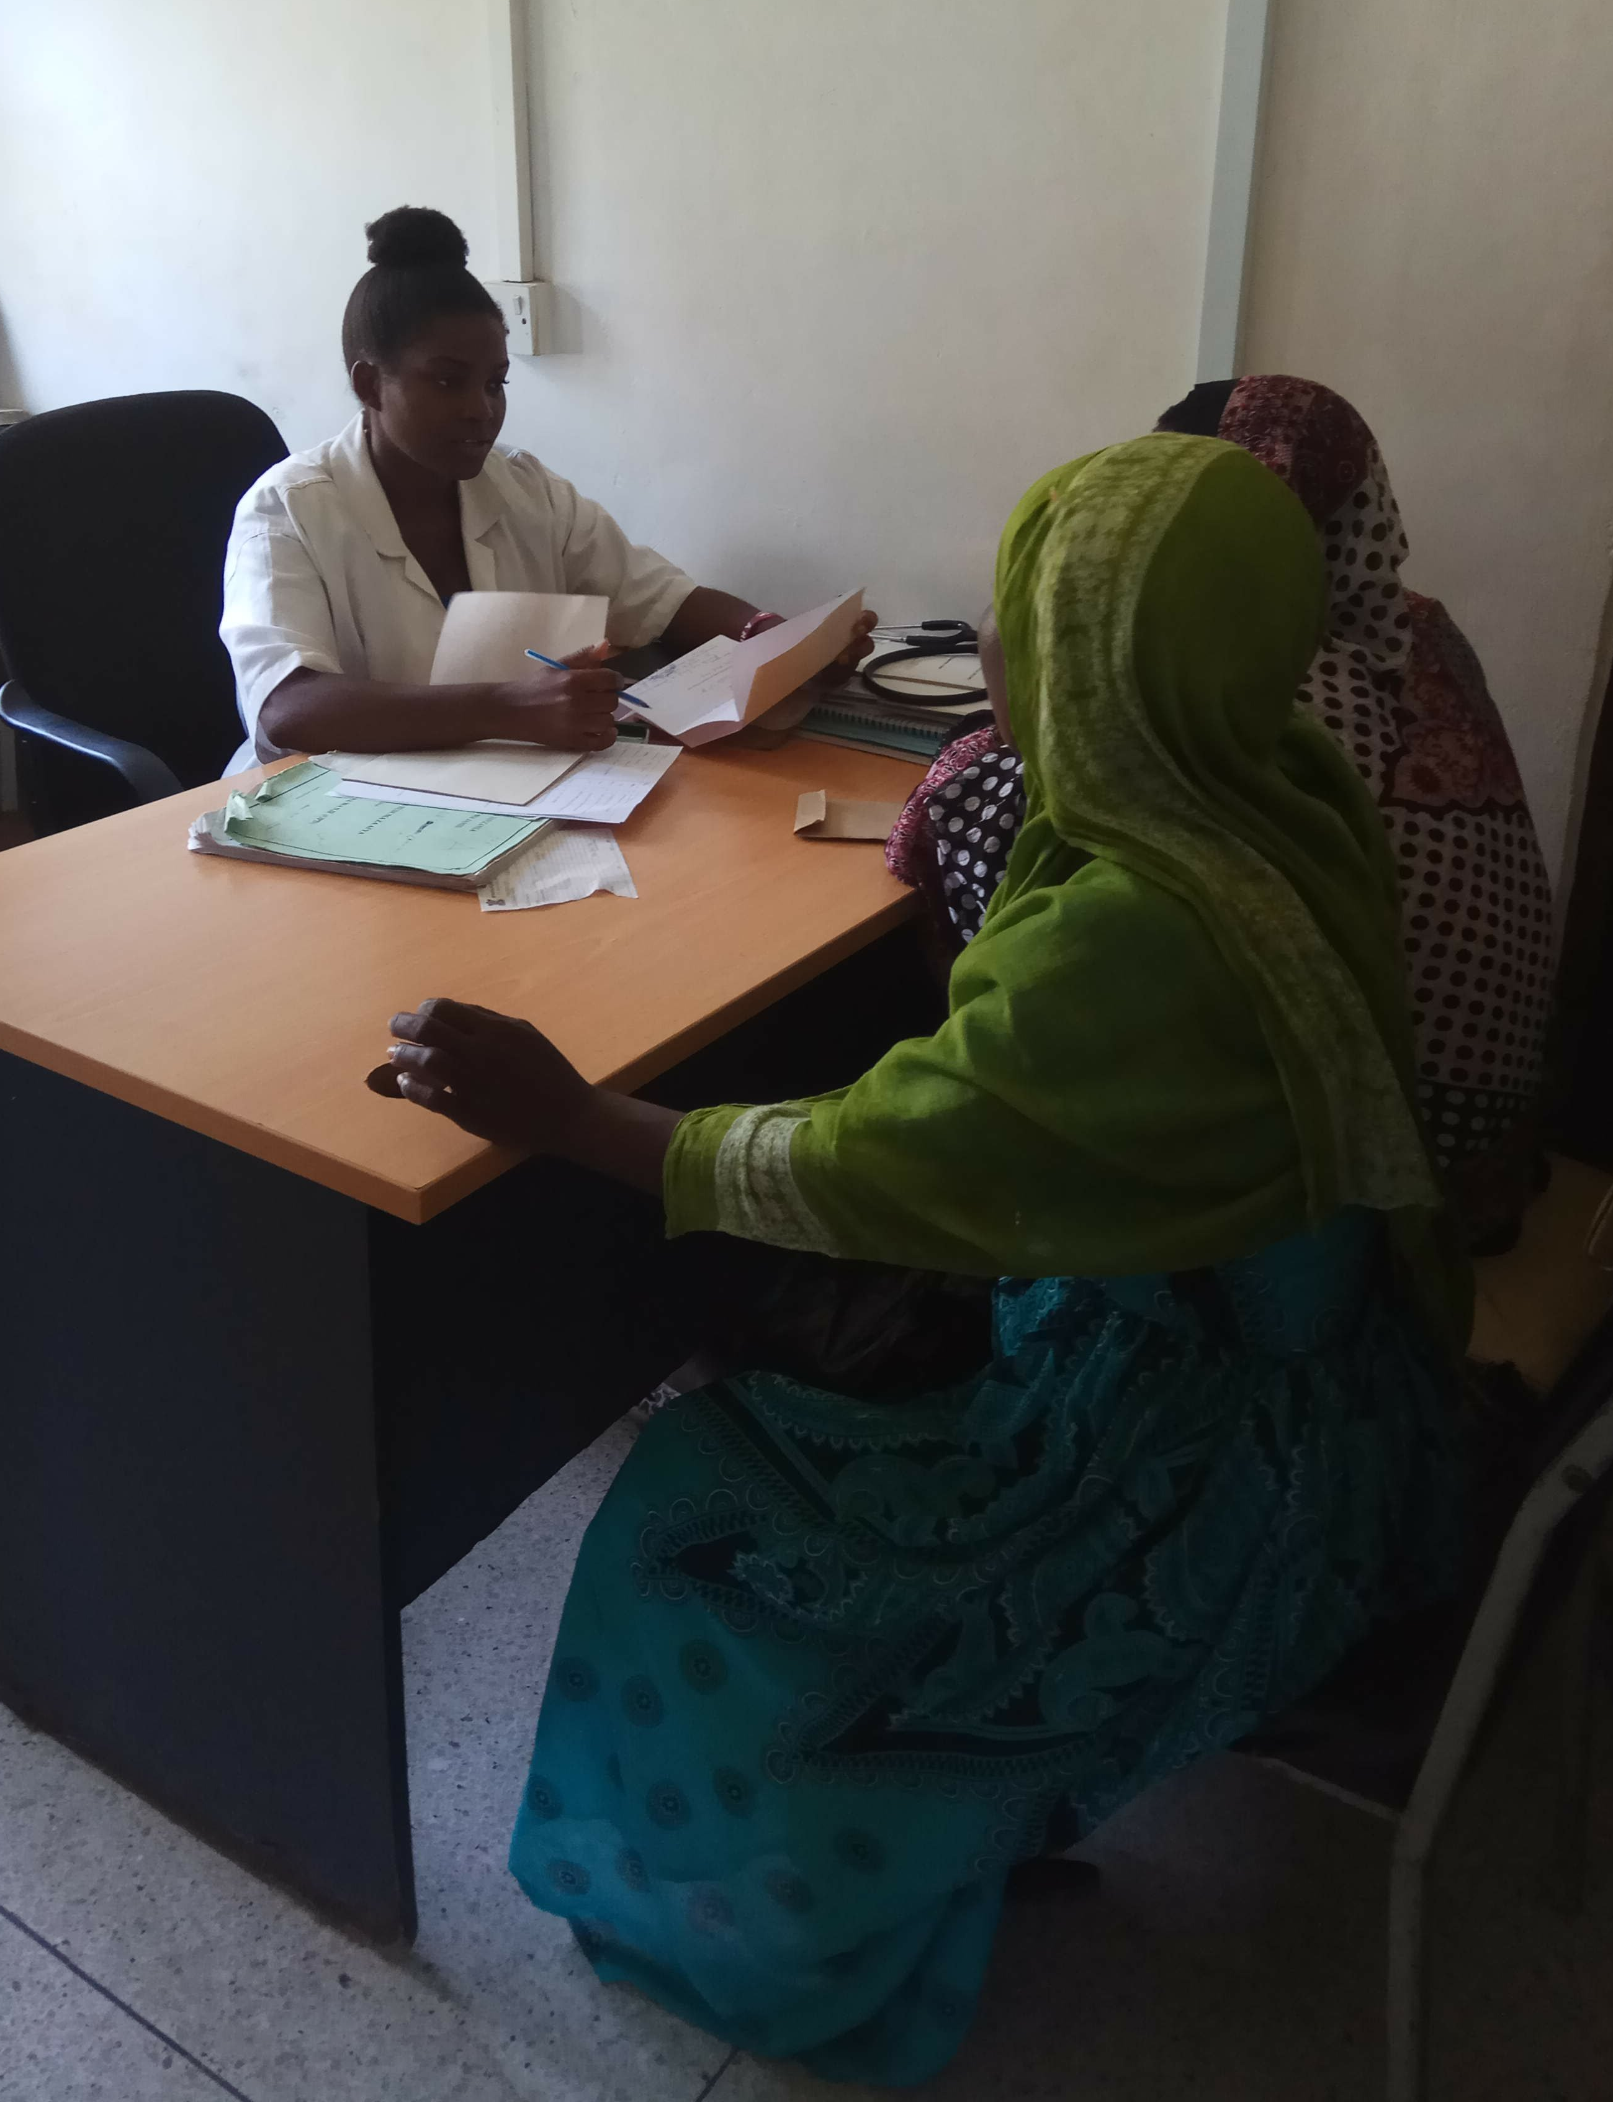
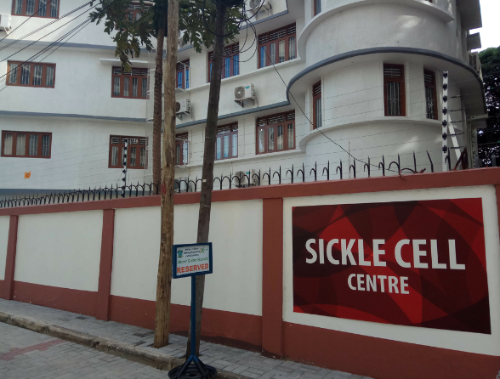
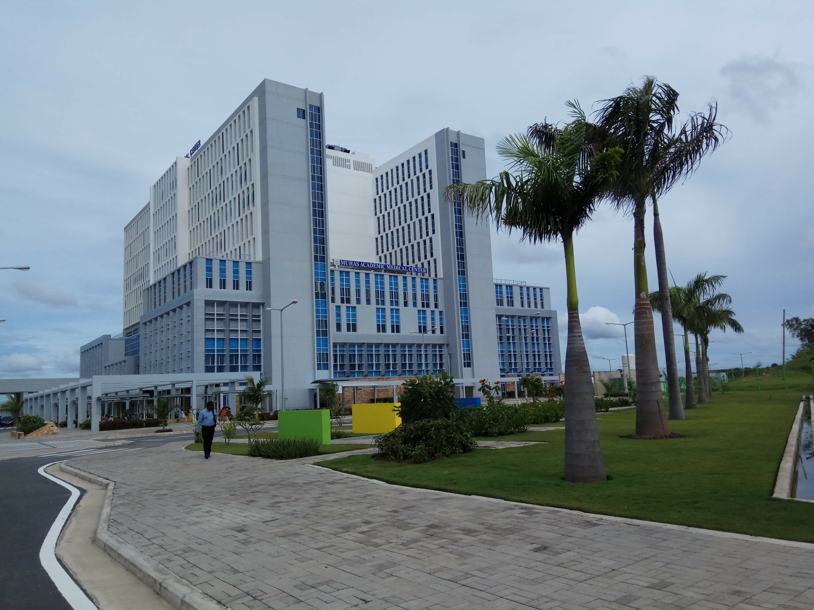
The Sickle Cell Programme at Muhimbili University
Provides a comprehensive framework for research, integrated into provision of healthcare, health worker training, and advocacy in SCD.
Currently one national and three regional referral hospitals run Sickle Cell Clinics supported by the Sickle Cell Programme.
1,337* patients have been enrolled for regular follow up at the Sickle Cell Clinics within the Sickle Pan-African Research Consortium (SPARCO).
During this pilot implementation study templates will be introduced at three Sickle Cell Clinics in Dar es Salaam.
* 23rd Jan 2019

Slide 4
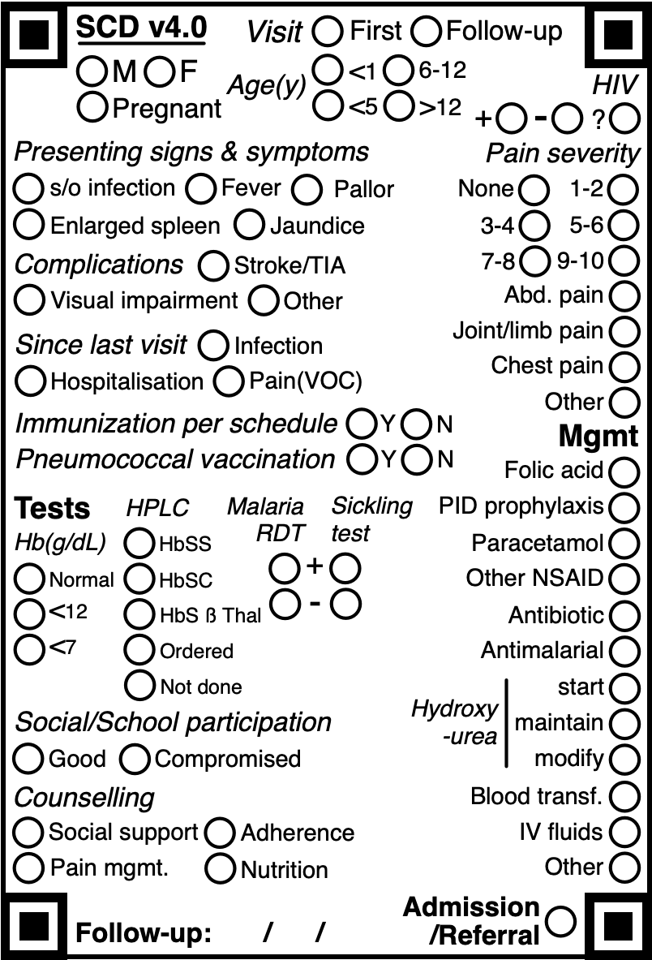
Why templates? Clinical decision support and link to digital data from paper
Clinical decision support
Data management
Templates contain optical mark recognition technology for easy digitization with mobile phone cameras
A web-based application compiles the data under a unique patient identifier into a mobile Electronic Medical Record (EMR) System
Data can be captured offline, and automatically synchronized whenever internet is available
Templates are filled in the patient-facing setting
Templates are condition-specific and serve as checklists to improve documentation in four dimensions:
General patient data Assessment,
Testing,
and Management

Slide 5
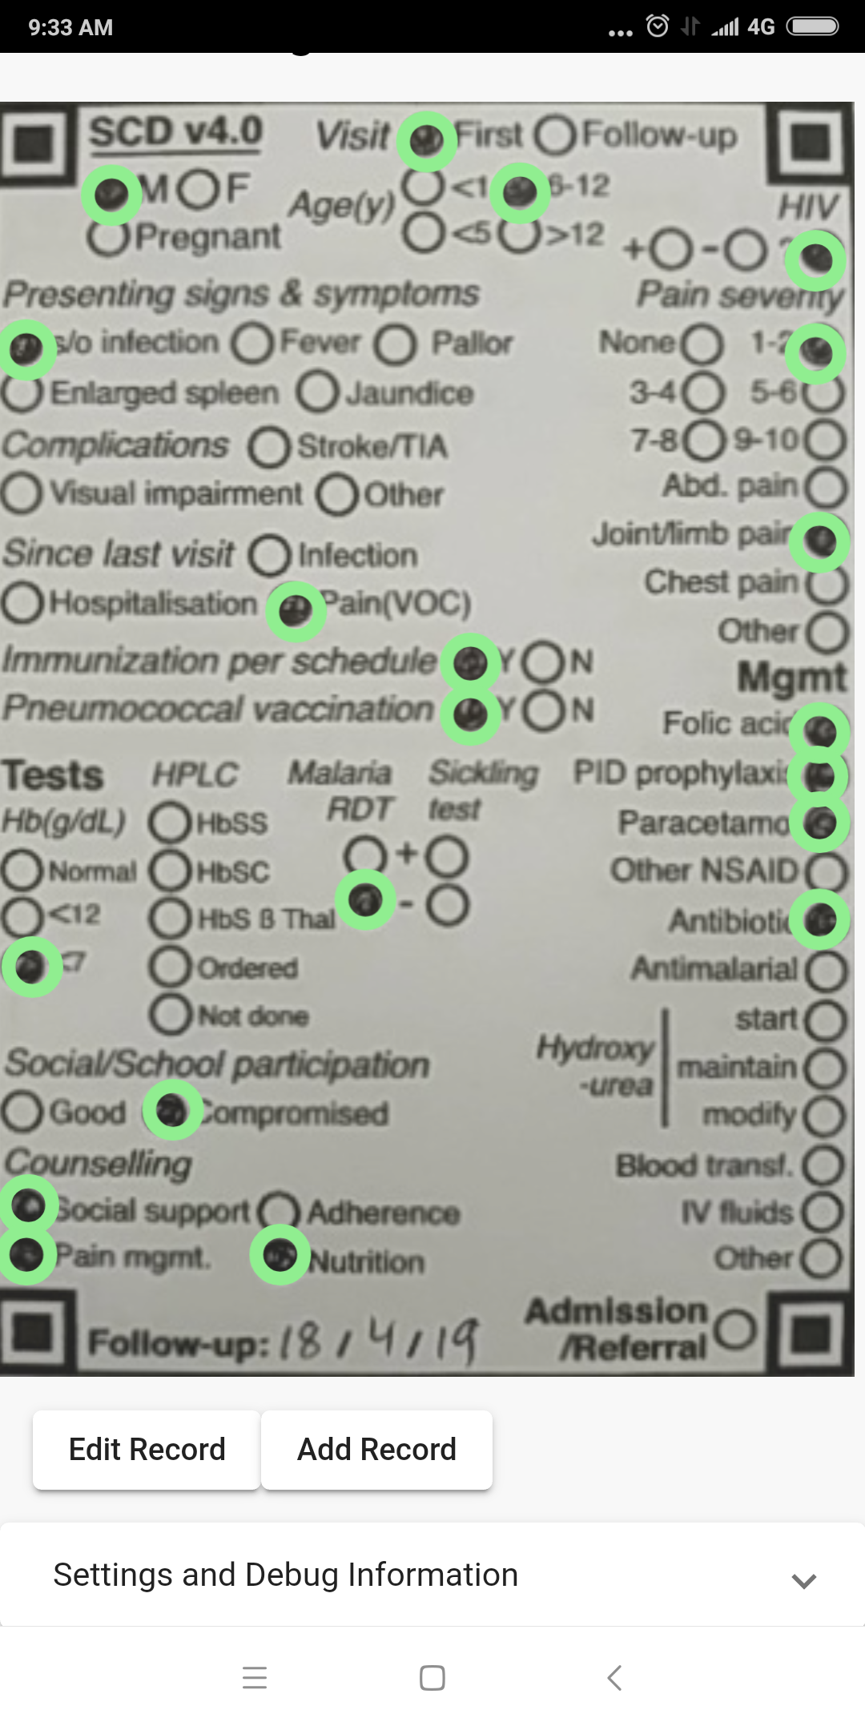
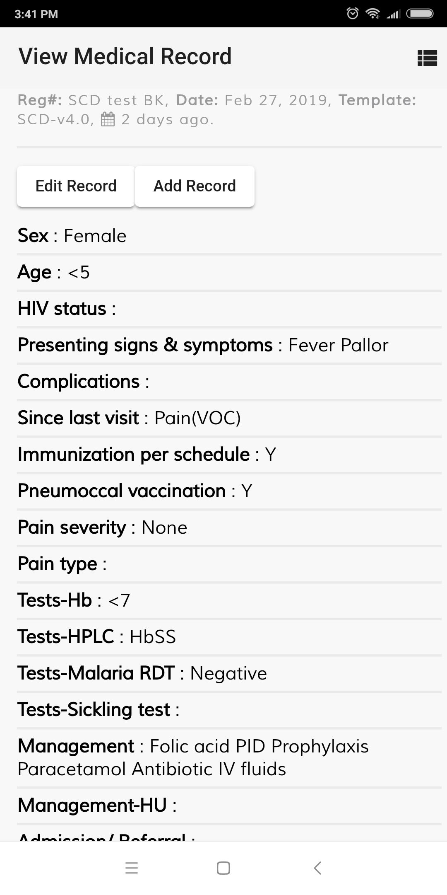
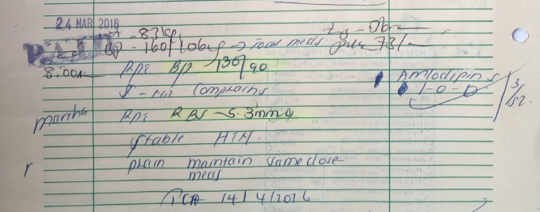
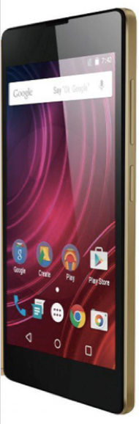
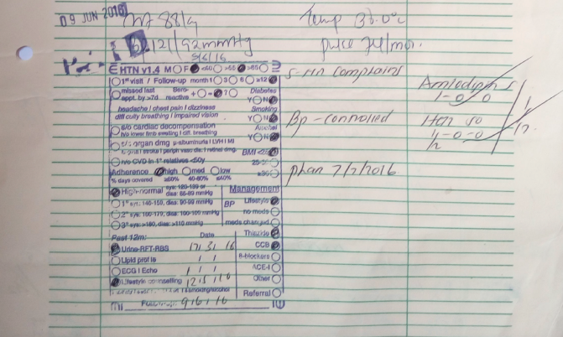
Paper-to-EMR system – How it works

Slide 6
Overview of the pilot implementation study
1. Objective
To improve the continuum of care for patients with Sickle Cell Disease
Continuum of care
Paper-based case documentation
Template use
Digitisation with mobile phone
Storage, Analysis & Review on a mobile EMR
2. Methods
Implement template use at three Sickle Cell Clinics in Dar es Salaam
Extract clinical data from paper into a mobile EMR system
Compile data for analysis into a dashboard
3. Expected outcomes
Improved availability of routine clinical data for clinicians and researchers
Improved completeness of documentation of evidence based management

Slide 7
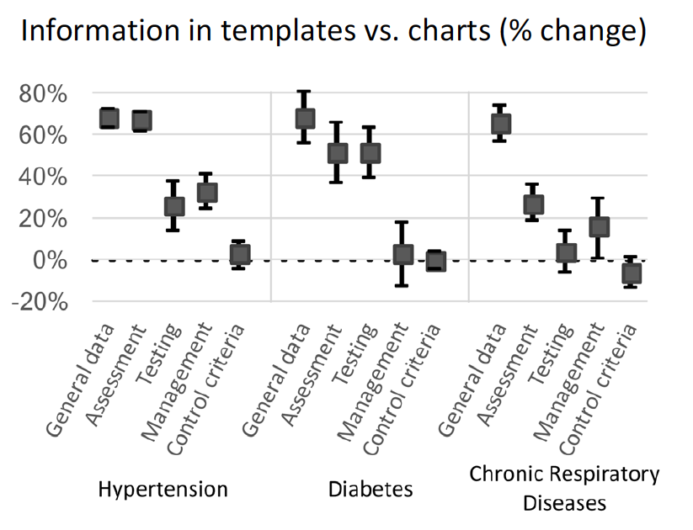
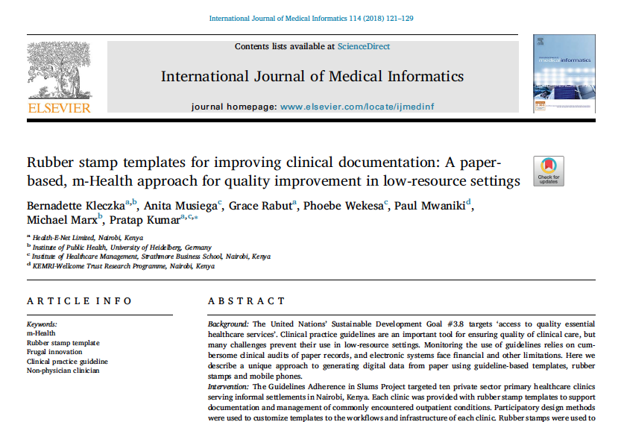
Impact on improving clinical documentation

Slide 8
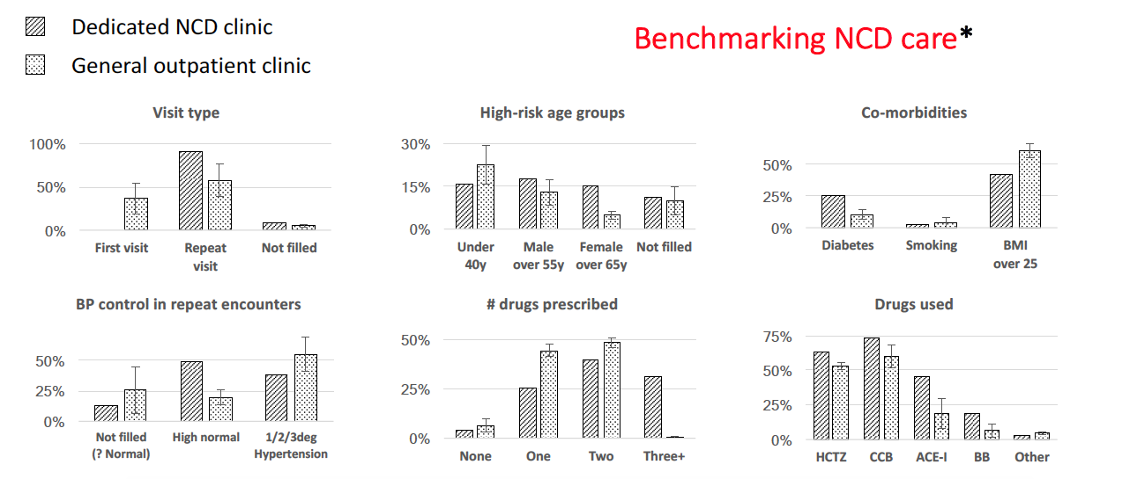
Making data available for clinical management and research Data from Nairobi

Slide 9
Conclusions
Templates can be used as checklists to improve evidence-based documentation in chronic diseases like Sickle Cell Disease
Combined with mobile technology templates offer a simple tool for digitization from paper
The intervention can be integrated into existing workflows and adapted to context
Offline-first technology reduces technical barriers caused by poor connectivity
This pilot implementation study aims to assess usability and effectiveness of the intervention for Sickle Cell Disease in Tanzania

Slide 10




Thank you!
Asanteni!
Julie Makani
Raphael Sangeda
Clara Chamba
Julius Maleto
Michael Marx
Pratap Kumar
William Wamwalo
Phoebe Wekesa
John Bayne
Arafa S Said
Jill Kent
And all our patients
Presenter: Bernadette Kleczka
bernadette.kleczka@gmail.com

