Slide 1
Finding every mother:
Improving maternal healthcare outcomes in BRAC Manoshi through biometrics
Sebastian Manhart
Chief Operating Officer
The 7th EAHSC
March 2019

Slide 2
Over 30% mother in Bangladesh slums never see a health worker.
(National Institute of Population Research and Training, 2012)

Slide 3
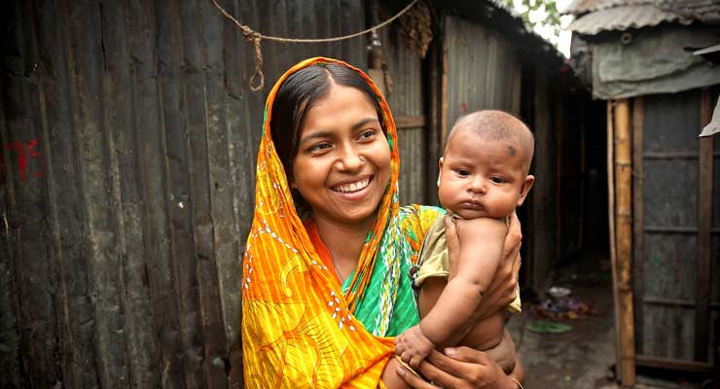
About BRAC & Manoshi
BRAC promotes a broad concept of health among disadvantaged communities.
Manoshi started off as a pilot initiative in 2005 in one northern district of Bangladesh. Expanded across 14 rural districts and 11 city corporations, providing access to quality MNCH services to rural and urban slum population.
eHealth was initiated to digitise the health services by collecting, recording and preserving household information.

Slide 4
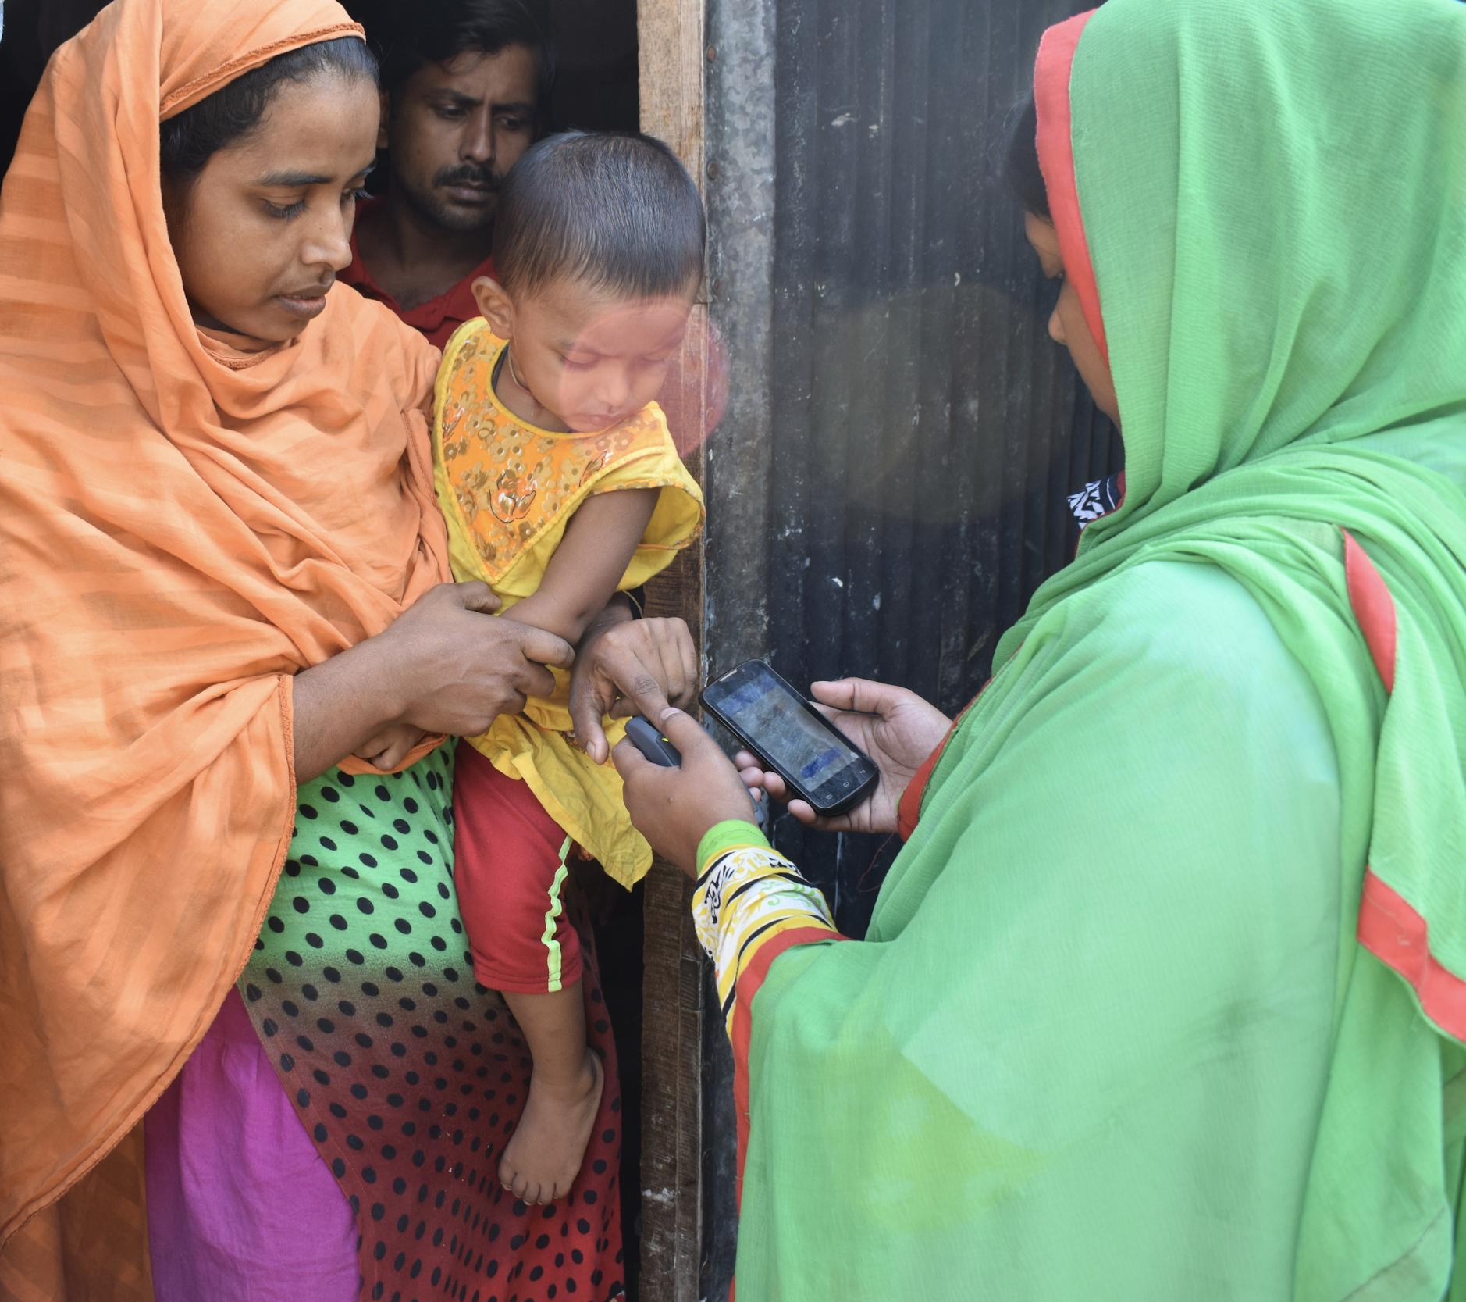
About Simprints
A non-profit technology start-up from the University of Cambridge.
Impact driven organization offering biometric identification solutions to Government and NGOs to improve delivery of essential services for last-mile beneficiaries.
Currently uses fingerprints; working on development of AI-based face and palm recognition solutions.
Could be integrated with existing mobile data collection platforms (e.g. CommCare, OpenSRP, SurveyCTO).

Slide 5
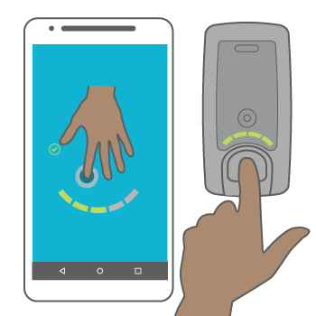
How Simprints ID solution works?
Simprints Database
Client’s Database

Slide 6
Key features of Simprints solutions
PRIVACY & DATA SECURITY
WORKFLOW & INTEGRATION SUPPORT
HARDWARE
TRAINING & ROLLOUT SUPPORT
CLOUD SERVICES & TECH SUPPORT
DUPLICATION ANALYSIS

Slide 7
BRAC Manoshi Evaluation Results

Slide 8
Project Details
2016-2017, a longitudinal study funded by DFID and GIF
Uniquely identify patients and link every medical record to fingerprint
4 Slums in Dhaka; 22,000 mothers
3 Program Officers; 40 Health Workers
Simprints ID integrated to BRAC’s existing eHealth platform

Slide 9
Methodology
Quasi-experimental design
Baseline data collection before intervention roll out (Dec 2016/ Jan 2017) and endline 18 months later (June 2018).
Sample: 800 mothers i.e. beneficiaries of Manoshi program (Treatment: 400, Control: 400)
Out of 12 slums, 4 slums were selected as treatment (Simprints), and 4 slums as control (similar geographic and demographic profile); 100 mothers were randomly selected from each slum at baseline. For the endline, T: 342, C: 458.
Data collection
Female researchers used a pre-tested, semi-structured questionnaire; routinely monitored by BRAC RED team

Slide 10
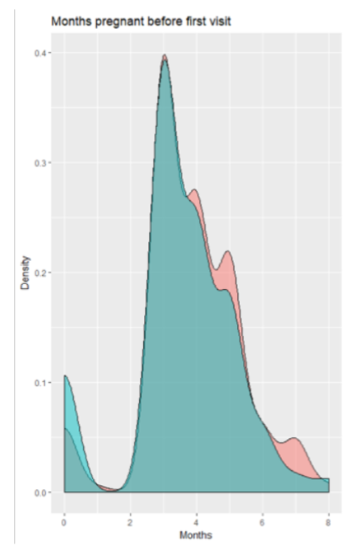
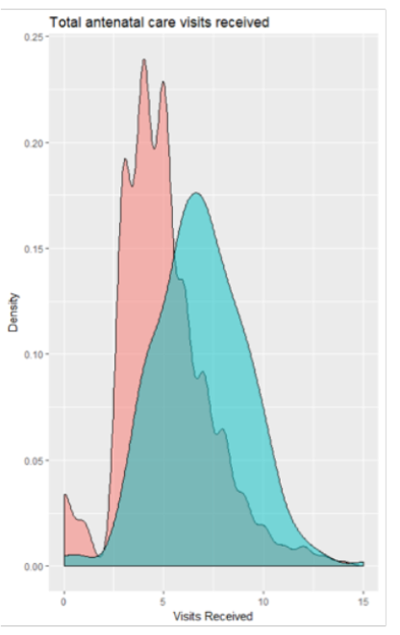
Maternity care
38% more ANC visits on average than those in the control group
27.64% more women in Simprints group had complete birth plans
8.74% more women in the Simprints group had a skill attendant at birth
Figure 1: Number of months pregnant before first visit (left), distribution of ANC visits received (right)

Slide 11
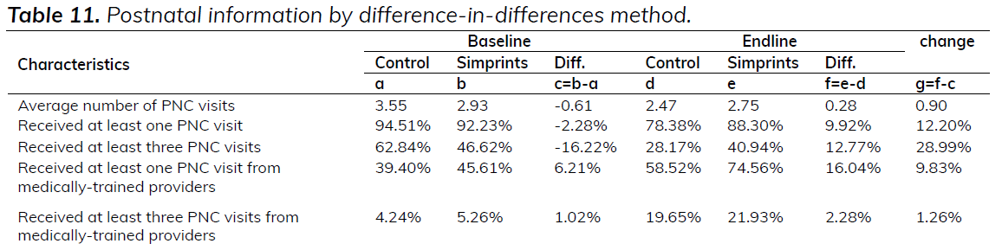
Neonatal care

Slide 12
Summary
38% more ANC visits
Women in the Simprints group received substantially more ANC visits, and significantly more women had comprehensive birth plans and a skilled attendant at birth.
19% more newborns received care by trained providers
In the Simprints group, newborns received better essential newborn care and more postnatal visits, and 27.64% more women had comprehensive birth plans.
3,885 preventable neonatal deaths uncovered
Simprints data revealed tens of thousands of preventable deaths and instances of morbidity as well as lost programme funding.

Slide 13
Other Lessons
Facilitating accurate linking of a beneficiary to their health records during a health visit.
Allowing managers to identify gaps in the ANC/PNC visit schedule.
Enabling better monitoring of SKs to confirm they are conducting their visits.
Other factors - the implementation of new technology has been recognised as empowering frontline workers.

Slide 14
Transition to Scale
SL@B provided 2 Million USD to scale-up the programme under TTS
Apr 2018 - Mar 2021 (3 years)
2.1 Million Mothers and Children
850 health workers; 8,500 health volunteers
BRAC is revamping its mHealth platform and rolling it nationwide
Simprints will be deployed in 20% coverage areas

Slide 15
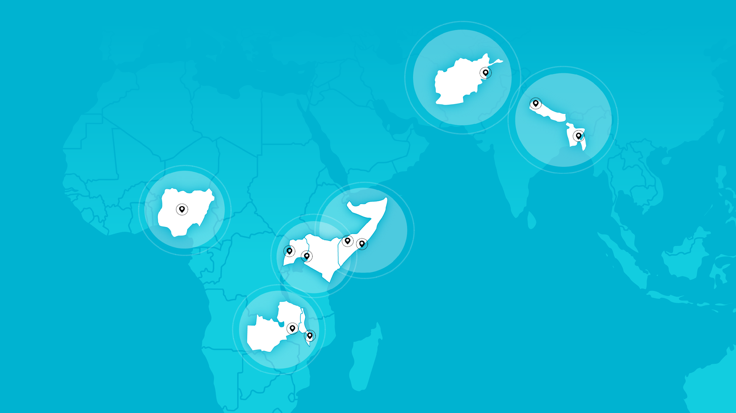
Our partners and footprints
10 countries
4.1m beneficiaries

Slide 16
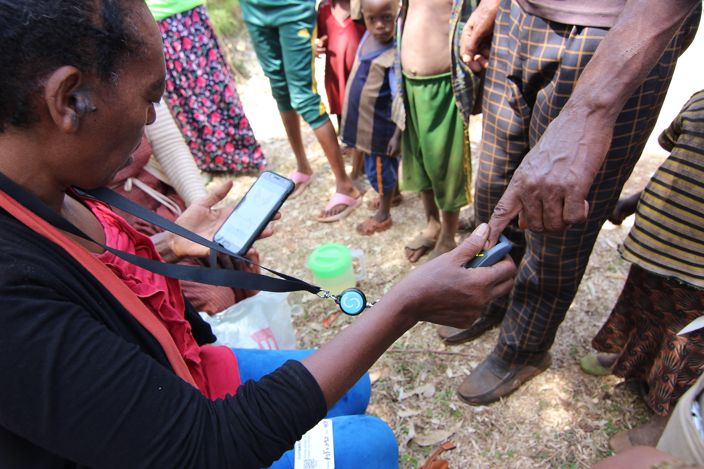
Mass de-worming initiative Case study: Ministry of Health, Ethiopia
Highly ambitious project to demonstrate the feasibility of breaking transmission of parasitic worm infections (schistomiasis and soil transmitted helminths) at a large scale through mass drug administration (MDA). Between July 2018 and June 2022, the programme will cover a total of 15 districts reaching over 2m people of all ages.

Slide 17
Thank you!

