Slide 1
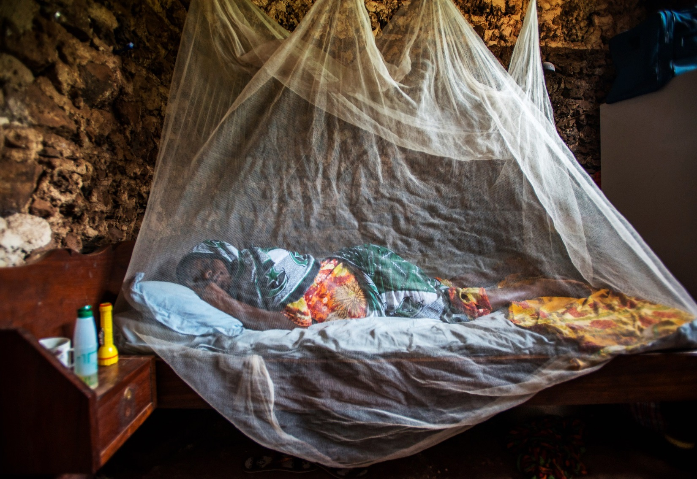
The 7th EAHSC meeting. 27-29 March, 2019, Dar es Salaam
Trends of malaria case and foci data in the elimination setting of Zanzibar
Humphrey Mkali¹ (MSc), Abdullah S. Ali², Abdul-wahid Al-mafazy², Mohamed H. Ali², Erik Reaves³, Naomi Kaspar⁴, George Greer⁴, Wahida S. Hassan², Rebecca Price¹, Jeremiah Ngondi¹, Richard Reithinger¹
1. RTI International, Dar es Salaam, United Republic of Tanzania 2. Zanzibar Malaria Elimination Programme, Ministry of Health, Zanzibar, United Republic of Tanzania 3. Malaria Branch, Division of Parasitic Diseases and Malaria, Centers for Disease Control and Prevention, and US President’s Malaria Initiative, Dar Es Salaam, Tanzania 4. US President’s Malaria Initiative, United States Agency for International Development, Dar es Salaam, United Republic of Tanzania.

Slide 2

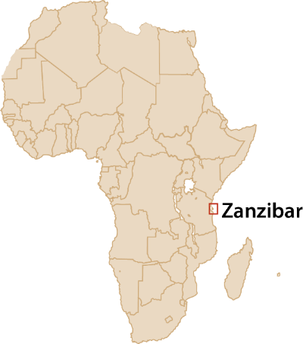
Elimination in action: the case of Zanzibar
Socio-demographics
2 large islands (Unguja, Pemba)
1.3M population
15 min by air / 2 hrs from Dar-es-Salaam
Epidemiology
Transmission is perennial, with seasonal peaks
Most cases are due to Plasmodium falciparum (66.4%), followed by P. malariae (33.0%) and P. ovale (0.6%)
Primary vector is Anopheles arabiensis (92.5%)
Challenges
# cases associated with travel from mainland Tanzania
Population’s decreasing perception of malaria risk
Decreasing effectiveness of vector control
Using finite resources more effectively

Slide 3
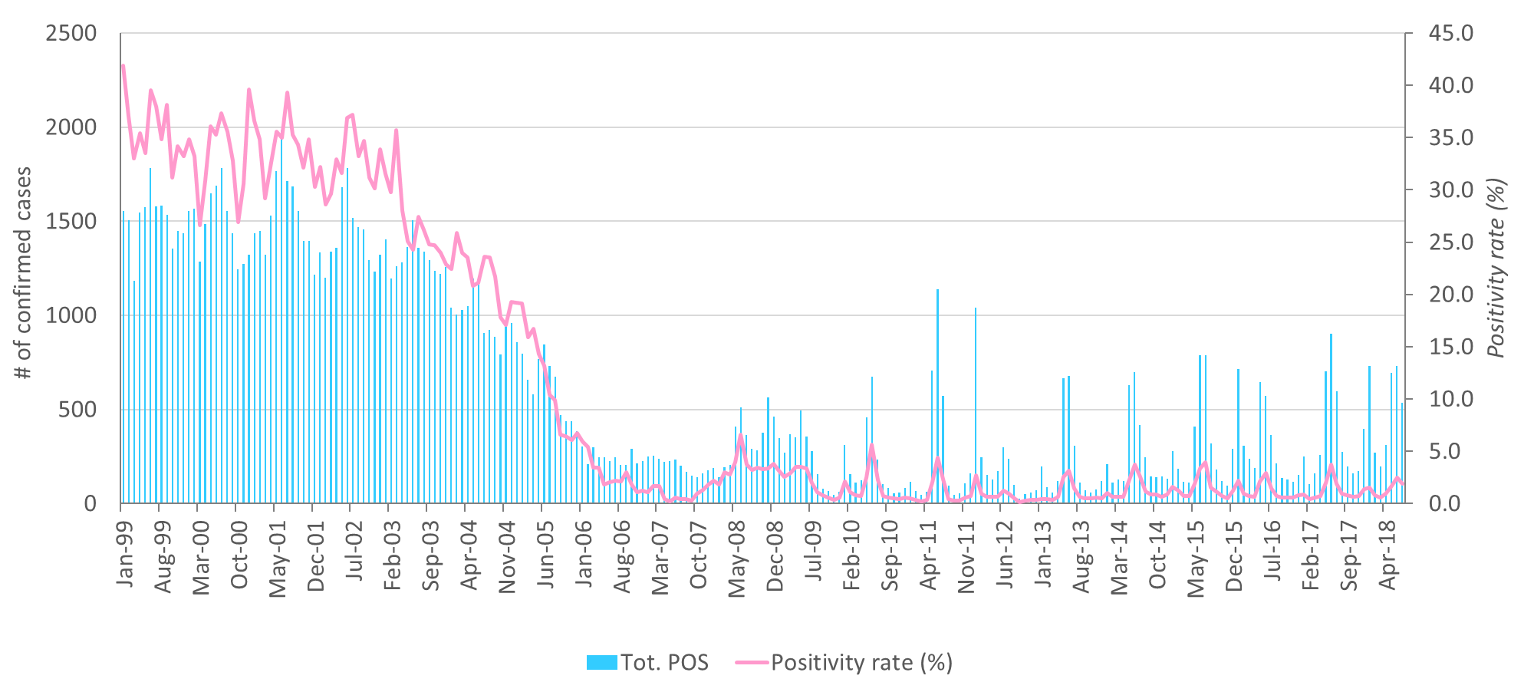
History of malaria prevention, control and elimination

Slide 4
Annual malaria confirmed cases by type of detection 2008–2018

Slide 5
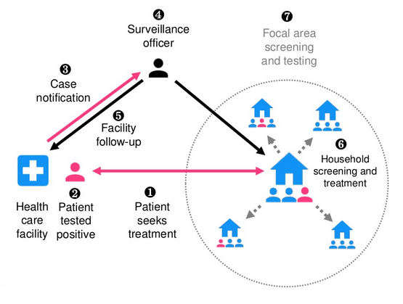
Surveillance platform: case detection, notification, follow-up

Slide 6
Definitions
Characterization
  Case: Patient demographic information, diagnosis, treatment and travel history
  Foci: Location of actual or potential breeding site, likely vectors and behavioral characteristics
Classification
  Case: Imported, introduced, indigenous, induced or relapsed according to WHO definitions (1).
  Foci: Active, non-active residual and cleared according to WHO definitions (1).
  (1) WHO (2017). A Framework for Malaria Elimination. Geneva: WHO. Available at: http://www.who.int/malaria/publications/atoz/9789241511988/en/

Slide 7
Methods and Results (1)
Data from Jan 2017 – Sept 2018 was extracted from case and foci investigation database.
  Data analysis was performed using MS Excel
  Maps were created using QGIS
In 2017, a total of 4,144 malaria cases were notified, of which (9.7%) 406 cases were investigated and classified.
61.8% cases were classified as imported, 35.2% cases as indigenous, 2.5% cases as introduced and 0.5% cases as induced.
In 2018, a total of 4,581 malaria cases were notified, of which (30.5%) 1,399 cases were investigated and classified.
63.6% cases were classified as imported, 34.0% cases as indigenous, 2.1% cases as introduced and 0.2% cases as induced.

Slide 8
Cases investigated January 2017 – September 2018

Slide 9
Results (2)
In 2017, a total of 35 foci were investigated and classified, 68.6% foci were classified as active and 31.4% foci were classified as non active residual.
In 2018, a total of 185 foci were investigated and classified, 67.1% foci were classified as active and 32.9% foci were classified as non active residual.

Slide 10
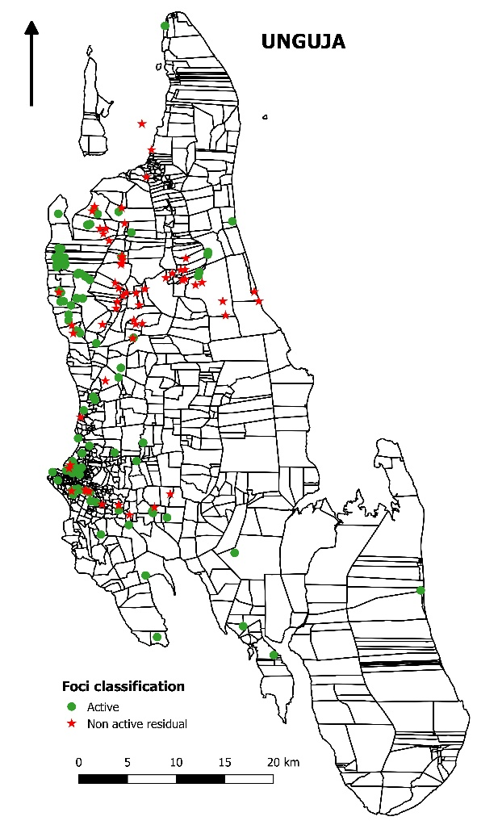
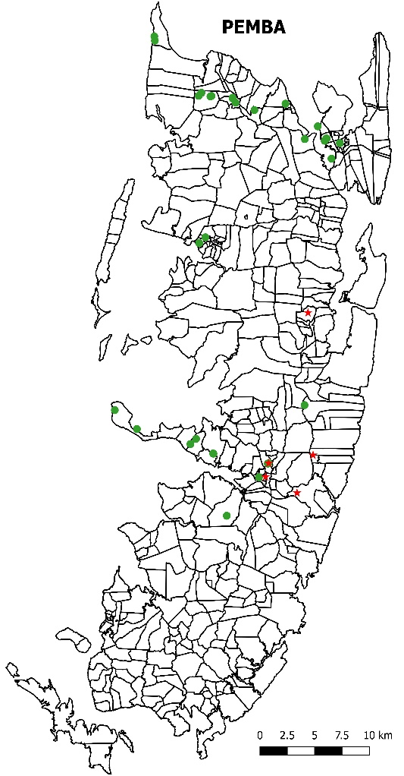
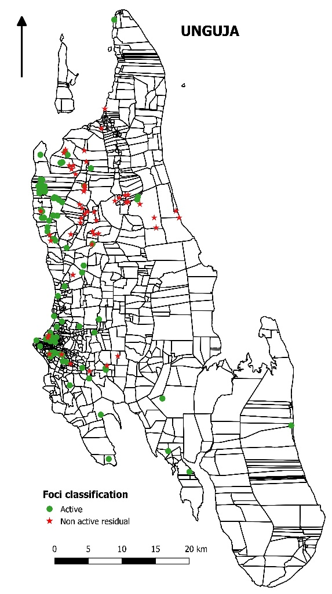
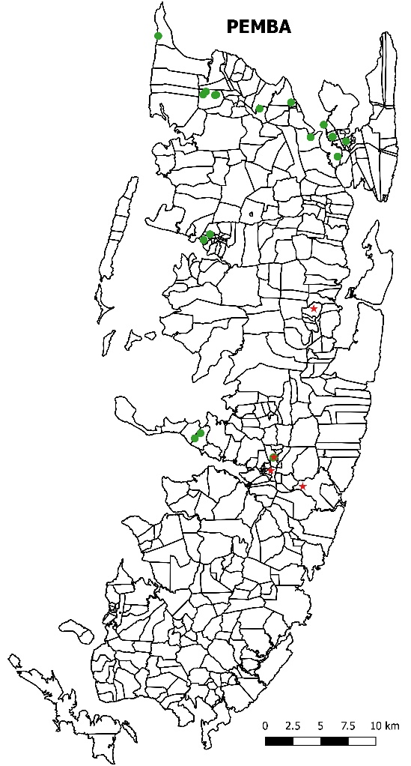
Locations of foci identified in 2017 and 2018
2017
2018
10

Slide 11
Conclusion
Zanzibar has started to conduct case and foci investigation aligned with the WHO Elimination Framework since 2017.
Challenges:
Only 20 – 60% cases classified
Recommendation: Integrate case classification and foci investigation in existing routine malaria surveillance platform.

Slide 12




Acknowledgements
This work was supported by the President's Malaria Initiative via the United States Agency for International Development (USAID).
The opinions expressed herein are those of the authors and do not necessarily reflect the views of the President's Malaria Initiative via the US Agency for International Development, or other employing organizations or sources of funding.

