Slide 1







The 7th EAHSC
From data to information: Learning from the Regional Action through Data experience in East and West Africa
Joel Lehmann, MA (presenter)¹, Uche Nwokenna MD, MPH¹, Ahmed Bashir, MD ²,
Osman Bilail, MD ², Frank Adjei-Banin, MSc ¹, Geoffrey Arunga, BSc ^{1 *}
PENDING TEAM REVIEW AND FINAL MODIFICATIONS
1. Broadreach Consulting LLC
2. Intergovernmental Authority on Development (IGAD)
[*Academic qualifications for some co-authors to be confirmed]

Slide 2
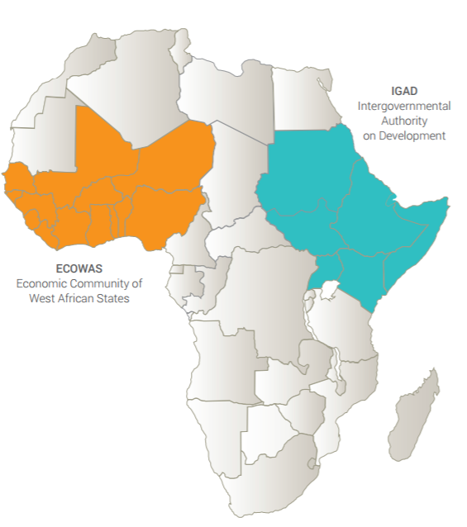
PENDING TEAM REVIEW AND FINAL MODIFICATIONS
About Regional Action through Data (RAD)
A consortium of five organisations to enhance data use for health governance and practice at the regional level in Africa.
Evidence and insights to support health
governance, coordination and collaboration
at a regional level.
Continuity of healthcare services across borders
through provider-level information exchange.
In addition to the Intergovernmental Authority on
Development (IGAD), the West Africa Health organisation
(WAHO) is also part of the consortium.

Slide 3
PENDING TEAM REVIEW AND FINAL MODIFICATIONS
What is RAD trying to achieve?
RAD was co-created by the consortium partners to answer a call of the USAID Bureau for Africa to strengthen the capacity of key African institutions and networks to influence the policies and programs and development partners.
RAD seeks to…
Contribute to improved health outcomes by enhancing how data is used to achieve results.
Answer to specific health priorities and needs of regional economic communities and their member states
Leverage technology, including advanced analytics and tailored information design and dissemination

Slide 4
PENDING TEAM REVIEW AND FINAL MODIFICATIONS
Objectives of the initial landscape analysis in the IGAD region
The mandate of IGAD implies that data will be utilized with a perspective beyond individual countries - but it has provide value at the level of constituents (member states)
A structured landscape assessment study sought to understand national health priorities, decision-making processes and the data ecosystems
Key research questions addressed
  What is the decision making processes at the national level?
  What are the potential needs for data and information from the region?
  Are there important existing projects that are related to the scope of RAD?

Slide 5
PENDING TEAM REVIEW AND FINAL MODIFICATIONS
Methodology
Countries covered for physical interviews: Uganda and Kenya
Data collection method: Semi-structured qualitative interviews, individually or in groups
Participants: Leading or designated key informants in national health programmes
  National TB, Malaria, Immunization, RH MCH programmes (per availability)
  MoH HIS Departments
  Disease Surveillance and Response Units
  (For sub-purpose 2, visits and interviews at the facility-level at border sites)
Data processing: Verbatim transcription of audio-recording, or detailed notes for all interviews
Analysis: Thematic coding and analysis in report of operational findings (qualitative analysis)
Additional validation of findings in Sudan and during TWG meeting
Dissemination: Findings are predominantly for project use; plan to make report publicly available.

Slide 6
PENDING TEAM REVIEW AND FINAL MODIFICATIONS
Key finding about decision-making process: It’s interactive
Strategic decision-making in Kenya and Uganda is often an inclusive, deliberative process as opposed to top-down decision-making
The development of a cycle strategy is typically preceded by a review of monitoring and evaluation indicators collection of data from multiple sources including surveys and field visits. Developing a new plan can take 6-12 months and involves consultation of multiple stakeholders
It is not necessarily a search for a “single objective truth”; multiple perspectives and needs are accommodated
Operational and clinical decision-making are guided by domain or programme-specific cyclical strategies, annual work plans, and technical policies
Regular review meetings in teams to discuss progress and potential correctional and supervisory measures

Slide 7
PENDING TEAM REVIEW AND FINAL MODIFICATIONS
Key findings about information tools in use
Evidence is an important part of decision-making
Routine data (DHIS2) used for burden of disease and service coverage, resource prioritization. Example data-to-action tools for routine data:
Regional data and information sharing is not fully structured or planned. It often happens during regional thematic meetings or conferences through physical interactions
Uganda | Kenya
RMNCH Scorecards Emergency Operations Centre (EOC) Epidemiological bulletins
- Maternal and perinatal mortality report & printed dashboard - Lives-saved Tool (LiST) - District Leagues Table | - TIBU Dashboard - HIV Situation Room - FP Commodity Dashboard - Malaria surveillance bulletin

Slide 8
PENDING TEAM REVIEW AND FINAL MODIFICATIONS
Findings on thematic priorities for information from the region
Information for operational planning | Information for strategic planning
Outbreaks or suspected cases of epidemic-prone diseases close to national borders Quantification of migratory flows and service utilization across the border to allow for better planning Information about cases of insecticide and antimalarial drug resistance Immunization coverage rates in border areas DR and MDR TB burden in neighbouring countries Easy access to information/summaries on treatment guidelines and policies in the region | Lessons learned from the introduction of new policies and guidelines Population beliefs, attitudes and practices for populations who live close to the border or with a similar culture to the population in country Good practices and cost-effective approaches to solve common problems, such as the coordination and data collation for maternal health, TB case detection Clear information about the cost of successful interventions in other countries Availability of specialized and highly specialized medical services in various countries

Slide 9
PENDING TEAM REVIEW AND FINAL MODIFICATIONS
Conclusions for the use of technology: General
To fully leverage available technology, need to further facilitate a routine processes information sharing at the regional level e.g. related to potential outbreaks (polio is already happening) or drug/insecticide resistances.
Routine sharing of national experiences with new policies or intervention approaches would provide added value to other REC members
Financial information should be included where possible
Quantifiable regional health indicators can be used for countries to contextualize their status and progress, and for regional harmonization of priority-setting and interventions

Slide 10
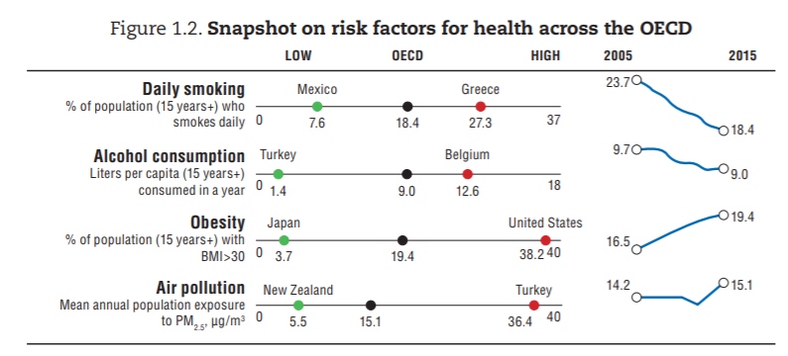
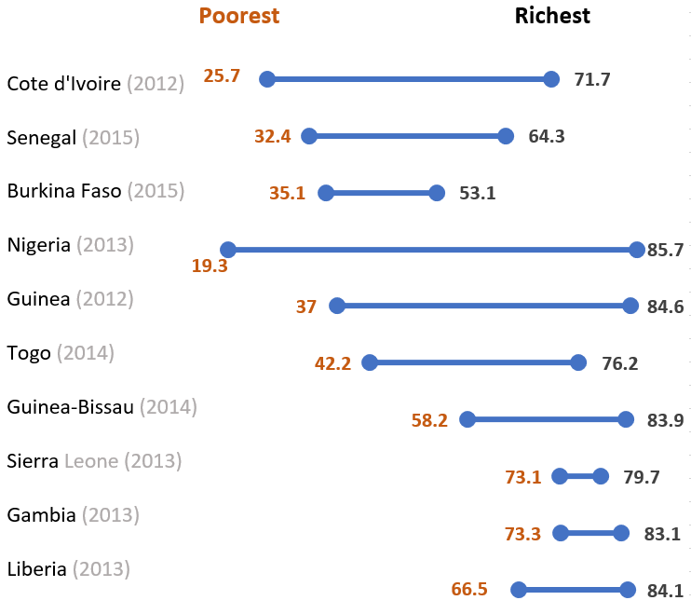
Examples of regional data contextualization (OECD, ECOWAS)
PENDING TEAM REVIEW AND FINAL MODIFICATIONS
Equity in ANC Coverage (4 visits) First and last wealth quintile
[Sources to be added]

Slide 11
PENDING TEAM REVIEW AND FINAL MODIFICATIONS
Conclusions for the use of technology: Information products
Information products must take complex decision and deliberation processes into consideration; technology should enable information-sharing in group settings, and facilitate finding of a common ground.
Scorecards / peer comparison methods appear to work as an approach to provide additional meaning to data
For some information, only data from the immediate neighbouring countries is relevant (e.g. outbreaks, migration flows); for others insights, data from the whole region is useful.
Technology should therefore allow for targeted sharing of regional information at the country- (or even individual) level.

Slide 12
PENDING TEAM REVIEW AND FINAL MODIFICATIONS
Acknowledgements
[List or persons and institutions involved to be inserted before conference; to include Ministries of Health in Kenya, Uganda, Sudan; RAD Steering Committee and Technical Working Groups; IGAD, Duke and Jembi teams and other organizations and individuals involved.]
USAID Disclaimer: The creation of this material was made possible by the generous support of the American people through the United States Agency for International Development (USAID). The contents are the responsibility of Broadreach LLC and partners, and do not necessarily reflect the views of USAID or the United States Government.

Slide 13
Appendix
PENDING TEAM REVIEW AND FINAL MODIFICATIONS

Slide 14
PENDING TEAM REVIEW AND FINAL MODIFICATIONS
Policies & standard procedures | Typical process in Uganda Discussion in MOH technical working groups Technical department review and approval Senior management review and approval Partners’ Advisory Committee review (HIPAC) Top management review and endorsement Discussion by cabinet, parliament (if applicable) --> Along the way: Formal/informal consultations with stakeholders from related sectors, civil society coalition and private health sector organisations (to prepare a smooth implementation) Typical process in Kenya Preparation in MOH internal technical team Review in multi-stakeholder technical working group Interagency Coordination Committee (ICC) review Review and approval by MOH Senior Management --> Laws that need to go to parliament typically lead by MOH division for standards and regulation
Operational planning & execution | Regular meetings to discuss current situation and plan for the operational execution in the subsequent cycle. Some of the meetings specifically mentioned (varies between programmes) Monthly divisional meetings (in Uganda) Quarterly review meetings (national/sub-national) Review meetings every 6 months Annual Health Forum and/or Summit

