Slide 1

Geographical and behavioral risks associated with Schistosoma haematobium infection in an area of complex transmission
7th East African Health & Scientific Conference Dar es Salaam - Tanzania 27th – 29th March 2019
Teckla Angelo1,2, Joram Buza¹, Safari M. Kinung’hi², Henry Curtis Kariuki³, Joseph Rogathe Mwanga², David Zadock Munisi¹ and Shona Wilson⁴
Department of Global Health, School of Life Sciences and Bioengineering, Nelson Mandela African Institution of Science and Technology, P. O. Box 447, Arusha, Tanzania.
National Institute for Medical Research, Mwanza Centre, P. O. Box 1462, Mwanza, Tanzania.
Kenya Methodist University, School of Medicine and Health Sciences, P.O. Box 267, Meru, Kenya.
Department of Pathology, University of Cambridge, Tennis Court Road CB2 1QP, United Kingdom.

Slide 2
Presentation outline
Background
Problem statement and justification
Objectives of the study
Methodology
Results
Discussion and conclusions

Slide 3
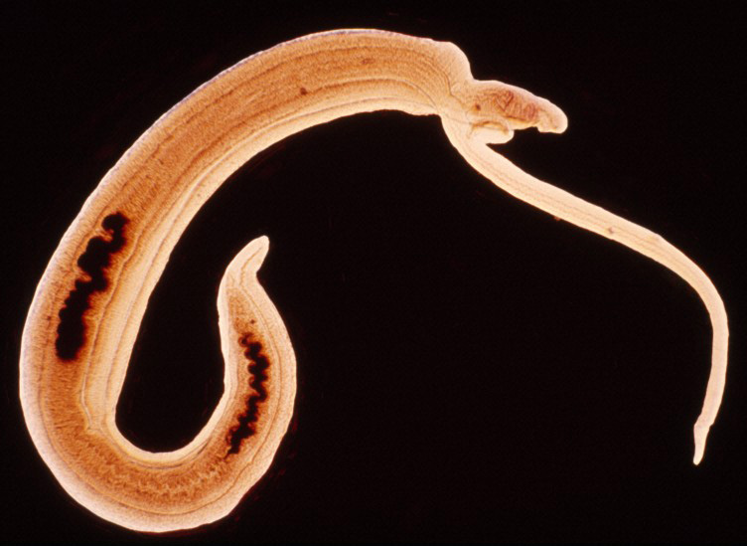
Background
Schistosoma haematobium, is a digenetic trematode that causes urogenital schistosomiasis in humans
affecting 112 million individuals in more than 53 endemic countries (Botelho et al., 2018)
85% of cases are from SSA (King et al 2011)

Slide 4

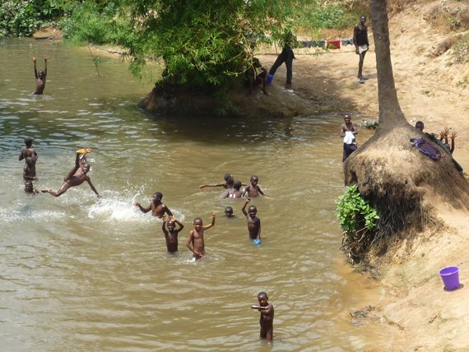

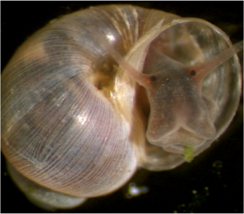
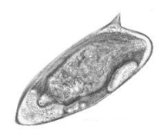
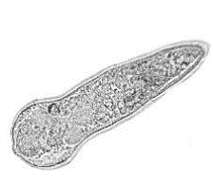
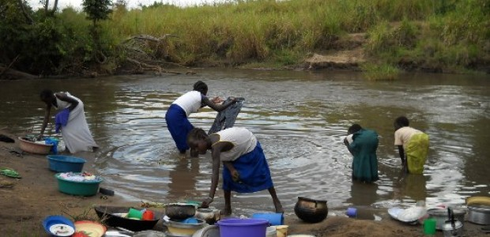
Background
In poor sanitation,
Human direct water contact (cercariae)
lacking access to clean safe water

Slide 5
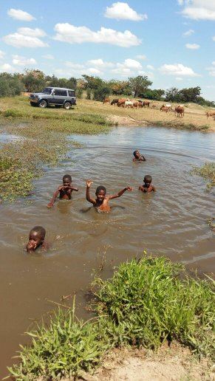
Background cont…
  Risk group are
      school children
      Adolescents
      Fisherman
      farmers
      women of child bearing age
  Pathological effect of Urogenital schistosomiasis
      Haematuria
      kidney damage
      lesions in the bladder
      Infertility
      bladder cancer
      death

Slide 6
Problem statement and Objectives
Studies on micro-geographical schistosomiasis transmission patterns reveal that there is discrepancy in infection intensities among households that is mainly associated with
  diverse water contact behavior
  the distribution of snail hosts
In Shinyanga transmission of urinary schistosomiasis is complex, occurring within networks of temporary ponds, and streams requiring potential tools necessary for the detection of transmission hotspots
Objectives
To understand the micro-geographical patterns in transmission of urinary schistosomiasis, in Shinyanga
To investigate the combiniation of school-aged parasitological surveys with malacology surveys, behavioral questionnaires and GPS mapping of household, with the intention of determining their usefulness as tools for identifying transmission hotspots.

Slide 7
Methodology
Study site, design and sampling procedures
The study was a prospective longitudinal parasitological and malacological survey conducted in Ikingwamanoti village
A cohort of 282 school children aged 6 to 14 years were randomly selected to be recruited in the study
Urine samples, were collected and recorded at different time points
Malacological studies involved snail sampling on monthly basis
Snail sampling sites were conveniently identified through conversation with local leaders based on human activities conducted in the area

Slide 8
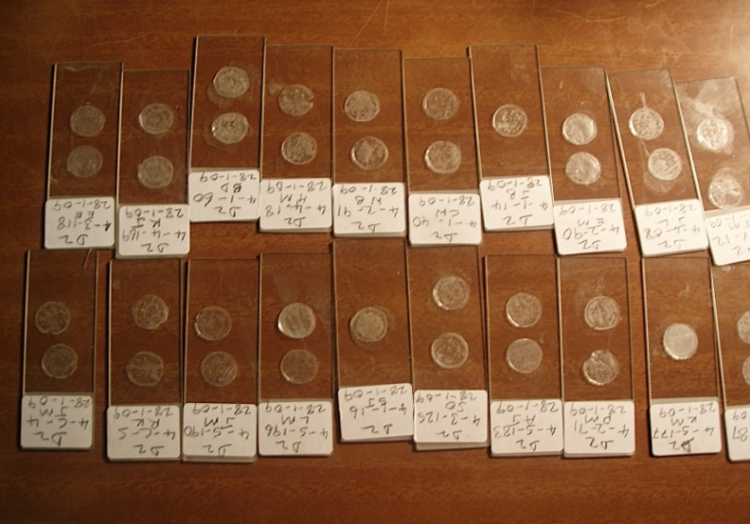
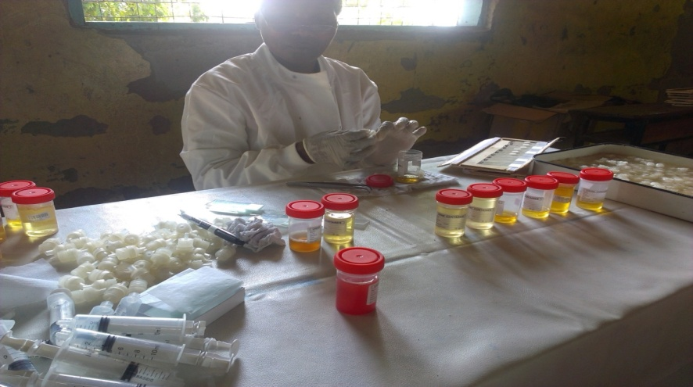
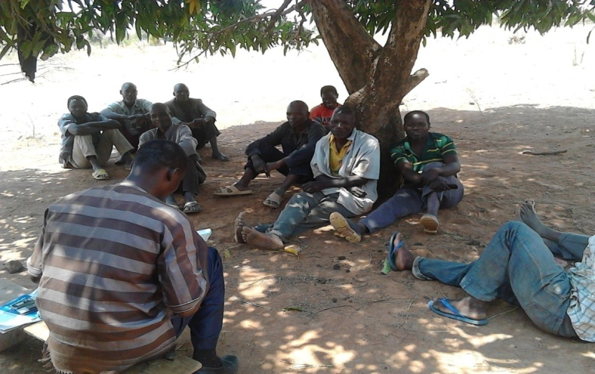
Methodology cont…
Parasitological examination of S. haematobium
Urine filtration

Slide 9
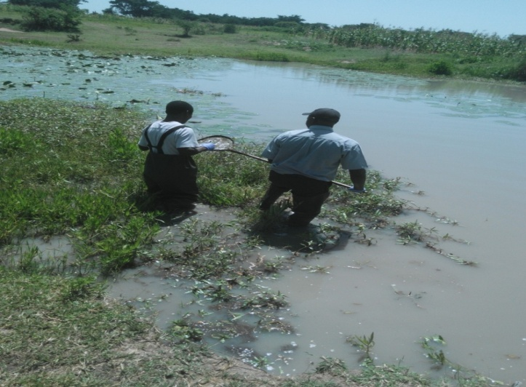
Methodology cont….
Malacological surveys
  Ikingwamanoti 7 habitats with 30 sites
Snail collection
  Using a handheld scoop one person
  collects snails for about 10 minutes per site
Household Mapping
Each households of each child attending Ikingwamanoti Primary School was mapped using a hand held GPS.
Household and snail sampling site co-ordinates, were imported in ArcView software.
For each habitat, a central co-ordinate was assigned from those of the associated snail sampling sites, using visualization from satellite images to guide the assignment
. The distances of school-childrens’ residence from these snail habitats were calculated and the children assigned to the nearest habitat .

Slide 10
Results
Pre-treatment infection and one-year post-treatment prevalence of S. haematobium by demographic characteristics
 | N |  | Pre-treatment |  |  | Re-infection
 |  |  | Number(%) | OR (95% CI) | P-value | Number (%) | OR (95% CI) | P-value
Sex
Girls | 146 |  | 37 (25.34) | 1 |  | 7(4.79) | 1
Boys | 104 |  | 50 (48.08) | 2.57(1.49–4.50) | 0.0001 | 35 (33.65) | 8.95(3.94–23.15) |  | 0.0001
Age (years)
6–8 | 87 | 17 (19.54) |  | 1 |  | 12 (13.79) | 1
9–11 | 84 | 31 (36.90) |  | 2.38 (1.19–4.91) | 0.01 | 15 (17.85) | 1.24 (0.49–3.11) |  | 0.648
12–14 | 79 | 39 (49.37) |  | 3.75 (1.88–7.73) | 0.0001 | 15 (18.98) | 1.17 (0.47–2.93) |  | 0.734

Slide 11
Results cont…
Water contact activities as risk factors for infection and re-infection
Water contact activity | No. of individuals (%) | OR (95% CI) | P-value
Livestock watering | 203 (81.2) | 1.22 (0.60–2.58) | 0.596
Fetching water | 209 (83.6) | 1.16(0.52–2.69) | 0.725
Swimming | 60 (24) | 0.85(0.43–1.63) | 0.627
Irrigation | 95 (38) | 0.99 (0.56–1.76) | 0.979
Crossing water | 179 (71.6) | 1.13 (0.60–2.14) | 0.715
Paddy farming | 129 (51.6) | 1.28 (0.72–2.26) | 0.397
Other | 99 (39.6) | 1.33 (0.75–2.35) | 0.325

Slide 12
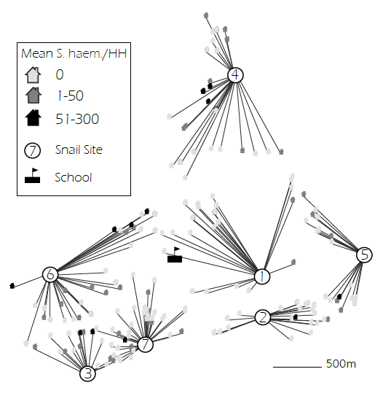
Results cont…
Household allocation to snail site and mean household intensity of S. haematobium infection

Slide 13
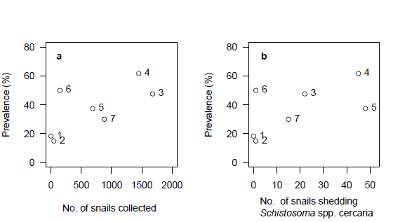
Results cont…
S. haematobium pre-treatment infection in relation to snail habitats

Slide 14
conclusion
Interaction between malacological surveys with cercarial shedding combined with GPS mapping in endemic settings can help detection of transmission sources even in areas wih complex transmission networks

Slide 15




Acknowledgement
NM-AIST
NIMR

