Slide 1
March, 2019
The 7th East African Health and Scientific Conference
Innovative Approaches to Cross-Border Health:
Case of Cross-Border Health Unit Model
Muroki, D.; Kitungulu, B.; Oindo, M.; Kamau, L. (FHI 360)

Slide 2
CB-HIPP Goal and Result Areas
Goal: Catalyze and support sustainable and African-led regional health development partnerships to improve health outcomes
RA 3: Strengthened leadership and governance by intergovernmental institutions
RA 2:
Alternative health care financing models identified, implemented and tested
RA 1: Increased access to and uptake of integrated health and HIV/AIDS services
Mandate:
USAID in consultation with EAC mandated CB-HIPP to define, implement, document and disseminate lessons learned on sustainable models for cross-border health service delivery to meet the unique needs of mobile and cross-border populations living and traveling along major cross-border regions of Eastern Africa.

Slide 3
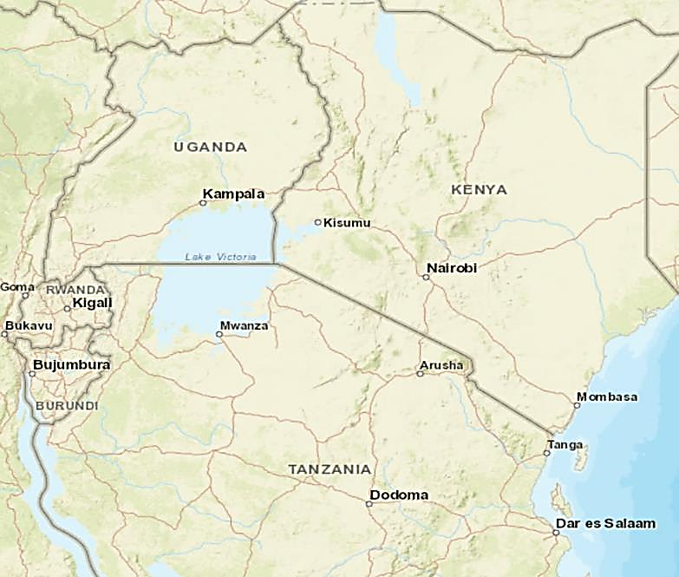
CB-HIPP Cross-Border Sites
Land Cross-Border Learning Sites
1. Busia, Kenya/Uganda
2. Malaba, Kenya/Uganda
3. Gatuna/Katuna, Rwanda/Uganda
4. Holili/Taveta, Tanzania/Kenya
5. Rusumo, Rwanda/Tanzania
Wet Cross-Border Learning Sites
6. Sio Port/Victoria/Majanji, Kenya/Uganda
7. Muhuru Bay/Kirongwe, Kenya/Tanzania
8. Kabonga/Kigoma Region, Burundi/Tanzania
9. Kasensero/Kagera Region, Uganda/Tanzania
10. Gisenyi/Goma, Rwanda/DRC
1
2
6
9
7
10
3
5
4
8

Slide 4
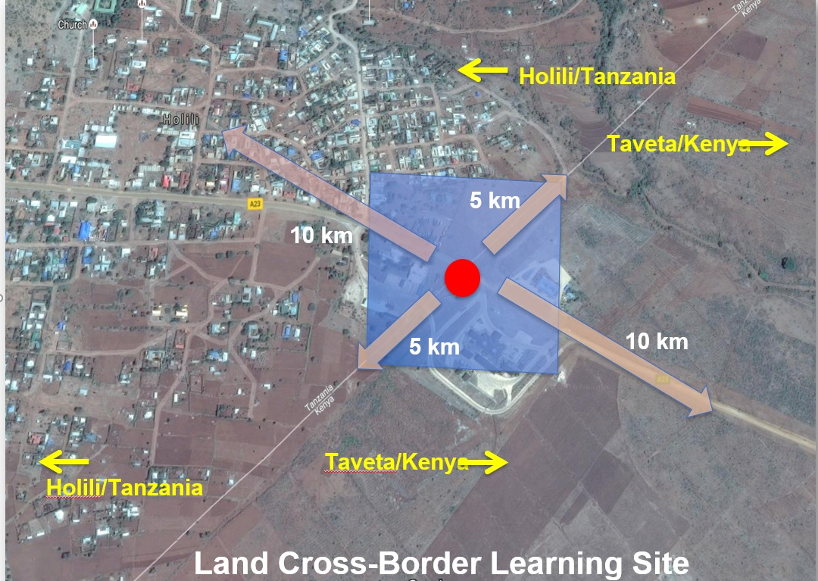
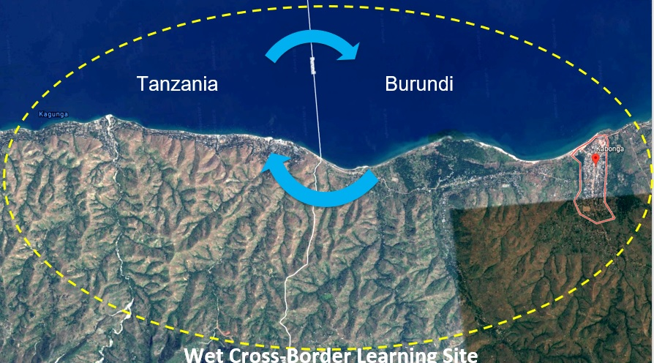
Standard CB-HIPP Cross-Border Learning Site

Slide 5
Background/Introduction
National health systems at border areas serve common cross-border mobile populations
Limited communication/collaboration with each other on health service delivery
Lack of formal cross-border facility-facility linkage and cross-border referral and tracing mechanism
Differing standards of treatment care and management, e.g., HIV testing services, antiretroviral therapy (ART) and tuberculosis across countries
Absence of regional guidance on prevention, treatment and management of HIV and AIDS for mobile and cross-border populations that include ART refills

Slide 6
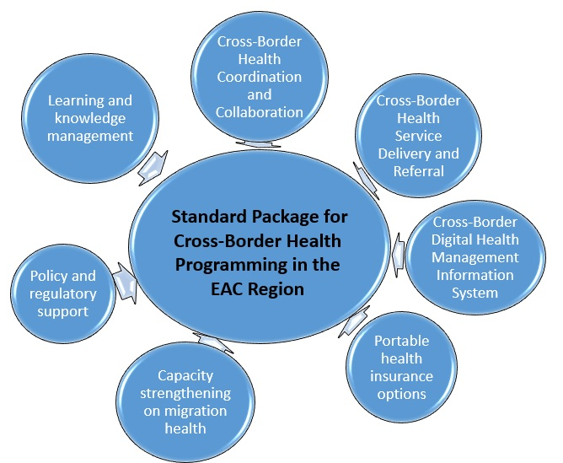
Methods used to define Standard Package for cross-border health
Stakeholder engagement at regional, national, site level for buy-in and ownership
Comprehensive site assessments
Extensive Intra and Inter-Partner States’ dialogue and consultation on cross-border health priorities and policy actions

Slide 7
Cross-Border Direct Service Delivery and Referral: CBHU Model
Cross-Border Health Unit
Cross-Border Peer Educator
Community Health Extension Worker/Community Health Worker Supervisor
Focal Person(s) at Health Facility
Health Records Information Officer
Health Facility
In-Charge
Innovative model for cross-border health direct service delivery and referral across HIV and other treatment cascades
6 CBHUs established at CB-HIPP cross-border sites in Kenya, Uganda and Tanzania
CBHUs working with 35 health facilities on either side of the border

Slide 8
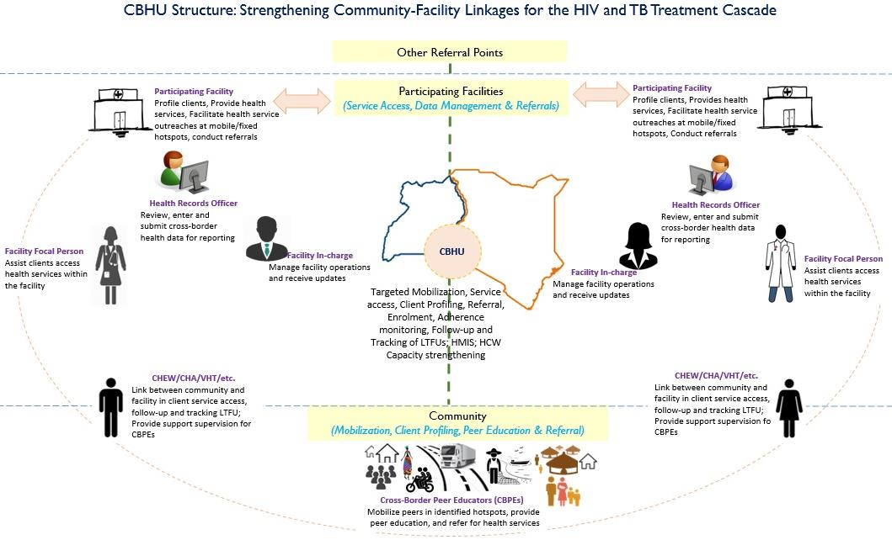
Cross-Border Direct Service Delivery and Referral: CBHU Model contd.
Facilitates a formal process for cross-border health access
Strengthens community-facility linkages for service delivery and access
Documents and tracks cross-border service delivery
Provides a platform for capacity strengthening for health care workers and community volunteers

Slide 9
Case study PNS/ICT Network, Malaba CBHU (December 2018)
Index Client
Ugandan, resident in Malaba Uganda, ever married, female sex worker
SP1
Sexual Partner
A Kenyan from Kitale, married, long distance truck driver who crosses the border weekly
Sexual Partner
Sexual Partner
Sexual Partner
A Ugandan from Malaba, married, long distance truck driver who crosses the border monthly
SP2
Sexual Partner
A Kenyan from Nairobi, married, long distance truck driver who crosses the border weekly
SP3
Sexual Partner
Sexual
Partner
Sexual Partner
A Ugandan from Malaba, married, general population but has never crossed the border
SP4
SP6
Sexual Partner
A Kenyan from Nakuru, married, long distance truck driver who crosses the border weekly
Sexual Partner
Sexual
Partner
Sexual Partner
A Ugandan from Masaka, married, long distance truck driver who crosses the border monthly
SP5

Slide 10
Results
CBHU model has provided platform for coordination and collaboration across border health facilities and county/district health management teams
Developed site directories with relevant contacts of key stakeholders on either side of the border for ease of communication
Established WhatsApp groups to facilitate real-time communication to teams across borders
Conducts monthly meetings to review data, discuss demand creation strategies with high yield and HCWs from border facilities exchange information on defaulters and LTFU that require following up
CBHUs have facilitated targeted service delivery through static facility sites and community-based outreaches for mobile and cross-border populations
Through CBHUs’ cross-border peer educators, the project has identified and mapped high-yield hotspots across cross-border sites, e.g., Kenya/Uganda border sites
Strengthened community-facility and facility-facility linkages for improved cross-border service delivery and referral and support to health facilities with specific focus on defaulter tracing and loss-to-follow-up on either side of the border.
CBHU supported Sio Port Sub-County Hospital trace 137 defaulters and 51 lost to follow-up PLHIV who were reinstated back into care in Sio Port and other preferred health facilities between January 2017 and December 2018.

Slide 11
Discussion/Recommendation/Conclusion
Through CBHUs, the project has demonstrated potential to link clients of mobile populations to HIV services in the EAC region adding value to respective bilateral programs
CBHU Model has potential for replication but within a policy framework
Development of regional cross border health policy and programming is a laborious process and all players need to be cognizant of geo-political realities
Cross-border health policy and programming can contribute to HIV and TB epidemic control as well as disease surveillance, prevention and management; disease outbreak preparedness and response.
Innovative strategies for health service delivery in these cross border areas is replicable for other mobile populations including internal mobility

Slide 12
Acknowledgement

