Slide 1



THE 7TH EAST AFRICAN HEALTH AND SCIENTIFIC
CONFERENCE
27th – 29th March 2019
Nyerere International Convention Centre (NICC)
Dar es Salaam, Tanzania
Makerere University Centre for Health and Population research (MUCHAP)
‘’Is an electronic health records system(EHRS) possible at community level? A case of embedding EHRS within the health and demographic surveillance site in rural Eastern Uganda.’’
Dan Kajungu, PhD, Collins Gyezaho, Davis Natukwatsa.

Slide 2
Morbidity Surveillance
The collection, analysis and interpretation of data on individuals or groups to detect the occurrence of certain events and their putative causes for
  prevention or control of certain diseases and other health conditions,
  formulation of interventions, and
  evaluation of the impact of programs
Generally, surveillance requires three functions in this sequence: (1) data collection, (2) analysis and interpretations, and (3) decision making
Morbidity data -derived from regularly available sources such as health centers /hospitals, industry and schools. Morbidity data may also be obtained via surveys of representative samples of populations -- e.g., HDSS, National Health Interview Survey, etc.

Slide 3
GOAL
A full integration of surveillance platform data with Health Facility data capable of timely delivery of high quality cause or pathogen-specific mortality and morbidity data.
Objectives
To strengthen the collection of morbidity and mortality data on defined HDSS population thru. linkage of these data to demographic data of residents in the HDSS
To setup a system that monitors in real-time the disease burden, drug utilization, health-seeking behavior, ante and postnatal care, vaccination, contraceptive use, risk factors, adverse drug events, morbidity trends and patterns in a population cohort in rural Uganda
To build capacity for pharmacovigilance (passive & active) and Pharmacoepidemiological studies on drugs and vaccines

Slide 4



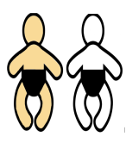












Health and Demographic Surveillance System
.
HDSS equation for the denominator
Verbal Autopsy on all deaths
WHO tools, 2016
Out-migrate after 4 months
Exit
Dynamic Cohort
Initial Census
(Unique ID given)
(Rural/Urban/
Peri-Urban)
Enter
In-migrate after 4 months
Follow up of pregnancies and their outcomes

Slide 5
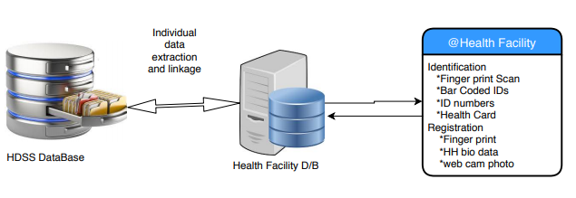
Individual records Collection Process

Slide 6
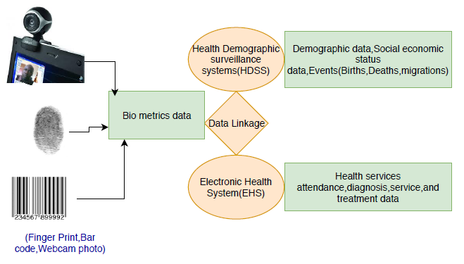
Data Linkage system
Clinical evaluation, diagnostics, medicines prescribed and vaccines, ANC, Immunization and other health data

Slide 7
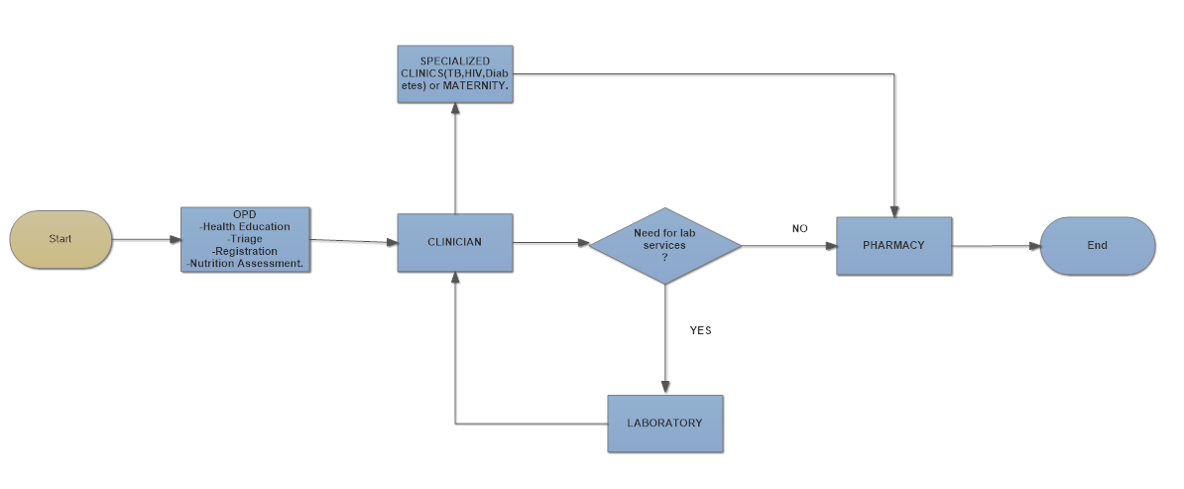
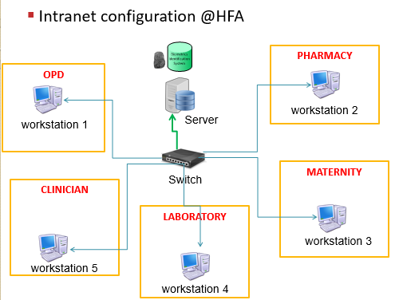
Patient flow and LAN @Health Facility
Out Patient Department (OPD), Triage, Laboratory, Clinics, Pharmacy, Maternity, Vaccinations

Slide 8
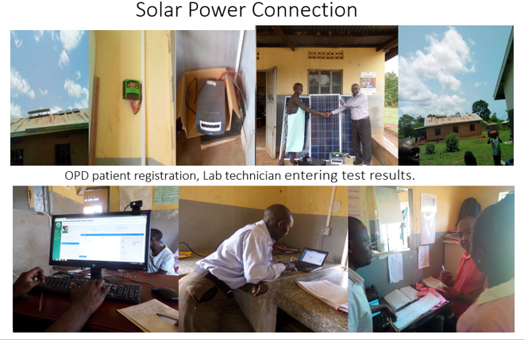
What is involved in setting up the system
Solar system (not national electricity grid), Inverter, Server, Portable Notebook computers, Networking (switch, cables etc.), Printing health cards (Identifier information), Barcode scanner, System programming (software development), Training , Health workers motivation

Slide 9
REPORTS/OUTPUTS
7290 patient visits have been recorded in the system (Since July 2017)
1980 patients data have been linked to the HDSS data using the HDSS unique identifier.
One health facility covered and planning to extend to five HCs in the HDSS

Slide 11
Benefits of the system to stakeholders
Healthcare workers
Medicines Stock control at Pharmacy
Report generation (weekly, monthly, annually, quarterly etc.)
Computer skills
Access to patient medical history by clinicians improves patient care.
Patients
Patients no longer have to carry exercise books.
Reduced time spent at the facility.
Researchers and health system (DHO,MOH…etc)
HDSS provides accurate denominator when calculating disease prevalence.
Collect real-time patient data, including healthcare data related to vital statistics, disease incidence, outbreaks, and public-health emergencies by village and Location.
Understand population Health Status/trends and outcomes.
Disease burden data helps in planning for health services
Evaluation of risk factors for illness and ADRs, e. g nutritional or socioeconomic status

Slide 12
Conclusions
Routine morbidity surveillance information is vital in planning for health products at facility, enhances adherence to guidelines and most importantly, informing policy and guiding future health care interventions.
A good linkage system between HF morbidity data and HDSS population helps to answer scientific questions on determinants of health outcomes.
Strengthens the health facilities and provide quality morbidity and mortality data.

Slide 13









Collaborators and partners
Districts leadership –Technical and political (Iganga & Mayuge)
Healthcare providers at Busowobi HC III
Community members in Iganga Mayuge HDSS

