Slide 1
7TH EAST AFRICAN HEALTH AND SCIENTIFIC CONFERENCE
DAR ES SALAM-TANZANIA 2019
MONITORING OF EMERGENCY OBSTETRICAL CARE
BY DIGITAL MAPPING SYSTEM IN BURUNDI
SYLVESTRE BAZIKAMWE, DEPARTMENT OF OBSTETRICS/GYNECOLOGY.
RAMADHAN NYANDWI, DOCTORAL SCHOOL
PROSPER NIYONGABO, NATIONAL INSTITUTE OF PUBLIC HEALTH,
EUGENE NDIRAHISHA, DEPARTEMENT OF INTERNAL MEDICINE

Slide 2
Monitoring of Emergency Obstetrical Care
In Health Facilities by Digital Mapping System in Burundi
Outline
Context
Material and Methods
Results and Comments
Conclusion

Slide 3
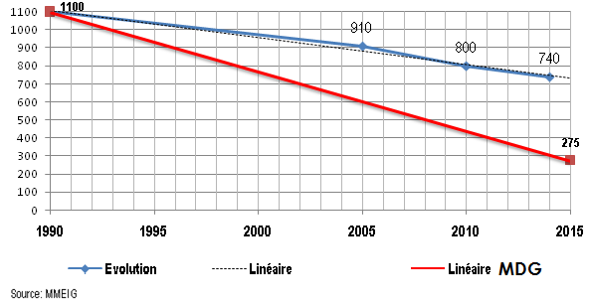
Monitoring of Emergency Obstetrical Care
by Digital Mapping System in Burundi
Context
Burundi has a slow regression of the maternal mortality rate according to the follow-up achieved by UN population division
.
Trends in maternal Mortality in Burundi

Slide 4
Monitoring of Emergency Obstetrical Care
by Digital Mapping System in Burundi
Context (cont’d)
During the period from 2010 and 2016 many interventions have been done by the government of Burundi to lower the rate of maternal deaths. (source: Burundi National Reproductive Program annual reports)
In 2016-2017 a new DHS was done in Burundi which found that the Maternal Mortality rate was 334/100.000 Live Births (Burundi DHS 2016-2017)
This maternal mortality remains too High and the country didn’t achieve the OMD 4 and 5
.

Slide 5
We needed to change strategy to have excellent
geographic coverage In Emoc in Burundi.
Replacing the "all-everywhere " that has not yielded sufficient results
with "excellence in some key places" to improve the
quality of care, especially for the ability to deliver EmOC to contribute to the achievement of the Sustainable Development Goals (SDGs).
.

Slide 6
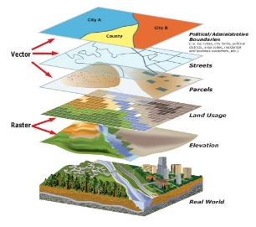
Implementation of National Maternity Network in Burundi
Basic Information
EmOC Network Design
Implementation of EmOC monitoring
1
2
Data Analysis
Response
Data Collect
Advocacy
Design
National Strategic Plan
EmOC National Needs Assessment
DHS, SARA
3
Prioritization and
Mapping of EmoC Facilities
Periodic Review of the performance and improvement of system – Monitoring Evaluation –
Monitoring Response tool
Implementation
Team
Mentorship
National EmOC
Model
Geographic information System (GIS)
Data collect sheet’
Data Analysis Tool

Slide 7
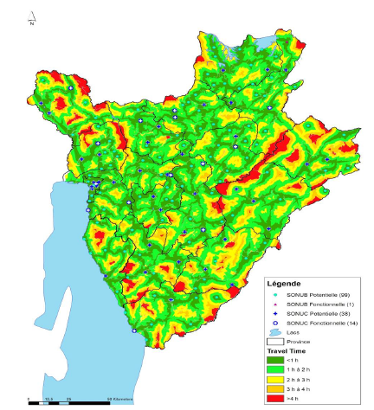
Burundi EmOC coverage Map

Slide 8
Monitoring of Emergency Obstetrical Care
by Digital Mapping System in Burundi
The aim was : To determine physical access to Facilities Strengthened in Emergency Obstetrical Care by geographic areas with High Density of Population (In average time of 2 hours or less).
2. Material and Methods
Prior to this study, a selection and prioritization of some Health Facilities have been done using AccessMod 5.0; in the purpose of the national policy which was to reinforce few Health Facilities in EmOC with high impact national wide (The Emoc Maternity Network).

Slide 9
Monitoring of Emergency Obstetrical Care
by Digital Mapping System in Burundi
2. Material and Methods (cont’d)
Then, the Emoc Maternity Network was monitored
for the period from January to March 2018 using:
EmOC signal functions (Basic and Comprehensive)
Geographic localization by density of Population (GPS)
Maps were generated in Quantum GIS 2.18.
Data base in Excel Sheet and QGIS Table

Slide 10
Monitoring of Emergency Obstetrical Care
by Digital Mapping System in Burundi
3. Results and comments
52 Hospitals and 60 Health Centers have been monitored:
Among Hospital: 9 (17%) delivered the total of 9 Comprehensive EmOC signal functions (9 functions), whereas 98% hospitals offered 5 signal functions or more.
On the other hand, 1 (2%) Health Center performed the total of 7 Basic EmOC signal functions and
22 (37%) Health Centers offered at least 5 Basic EmOC functions during the period of the monitoring.

Slide 11
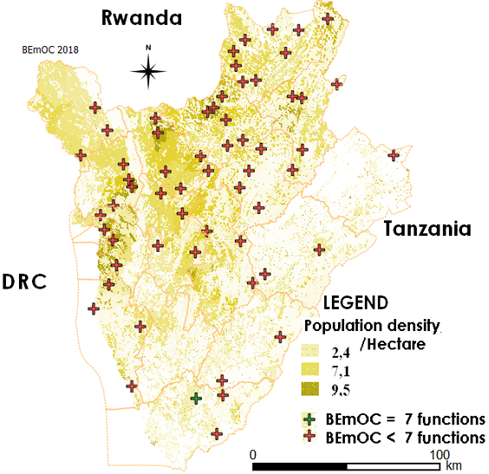
Map of BEmOC Facilities in Burundian Network

Slide 12
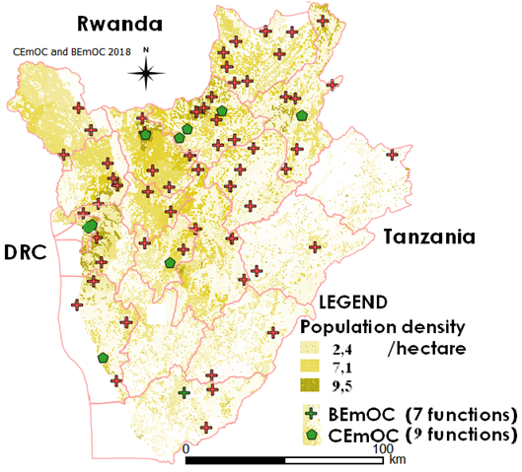
Map of BEmOC and CEmOC Facilities in Burundian Network

Slide 13
4. Conclusion
The EmOC functions coverage is not enough; only few of Health Facilities deliver the total EmOC signal functions.
There is a need to reinforce the health facilities in area with high density of population in order to lower the global maternal mortality rate.
To satisfy this need government and its partners would play a key role.

Slide 14
ACKNOWLEDGEMENT
We thank all who participated in this survey especially the UNFPA Burundi as well as the EAHRC for this great opportunity to share experience and practices
Without forgetting the audience for your attention during this presentation

