Slide 1
Event Title: The 7th EAHSC Development of Tanzania Health Sector Enterprise Architecture Presenter: Oswald Luoga Organization: PATH March 27th to 29th
DATA USE PARTNERSHIP
February, 2018

Slide 2
Background
Tanzania has made tremendous progress in eHealth over the last ten years, with development and roll-out of different systems.
With the increase investment on the system there should a guideline to insure the investment align with the Health sector goals, vision and mission

Slide 3
Background
DUP project led by Government of Tanzania is developing Enterprise architecture as way to ensure the investments in Information technology are aligned and focus on improving client experience.
The project is Implemented by Ministry of Health Community Development Gender Elderly and Children and President Office Reginal Administration and Local Government with technical assistance from PATH

Slide 4
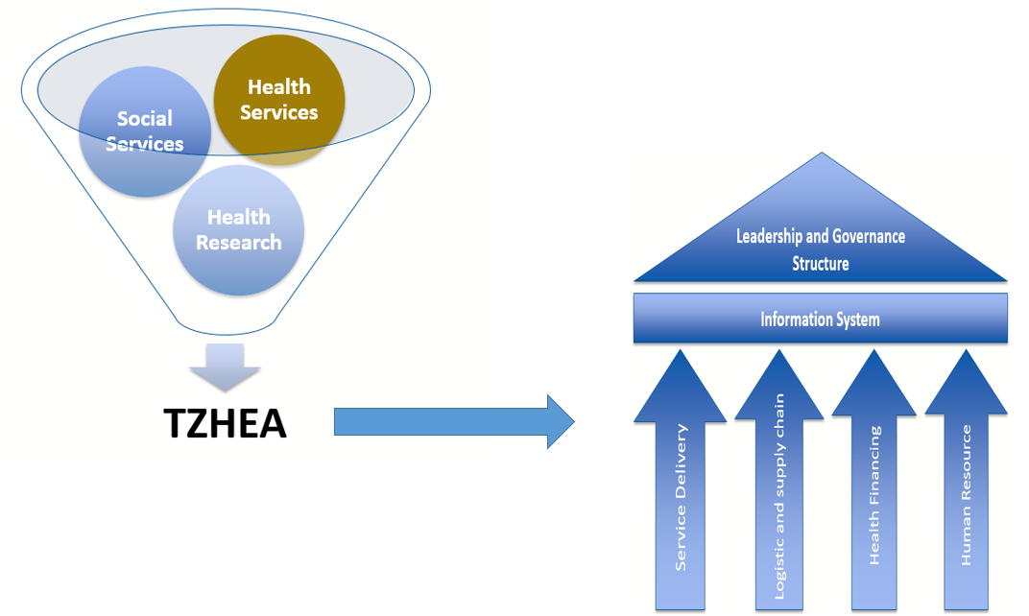
Scope of the TZHEA

Slide 5
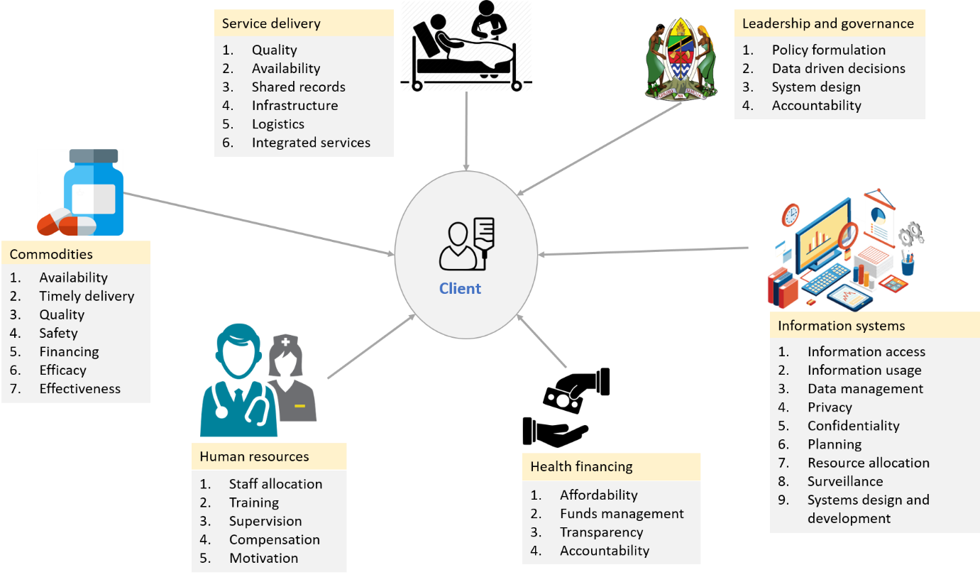
Scope of TZHEA
TZHEA will focus on six WHO building blocks
Commodities
Service delivery
Human resource
Health financing
Information systems
Leadership and governance

Slide 6
Approach
TOGAF Framework will be used to develop Health Enterprise Architecture.
Build capacity of Government staff who will lead the development of TZHEA
6 Government staffs are TOGAF certified
The TZHEA is developed with the client centric approach, looking how the technology will support citizen
Each of WHO building block will undergo through phases of Architecture Development Methodology cycle.
Strategy: crawl_walk_run_fly

Slide 7
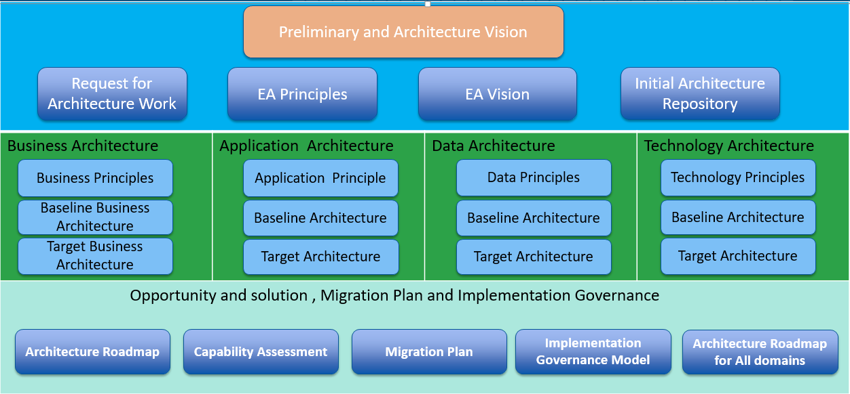
Deliverable Framework

Slide 8
Deliverable Framework
Preliminary: Done
Request for Architecture Work
Architecture Principles
Architecture Governance Framework
Initial Architecture Repository
Architecture vision: Done
Statement of Architecture work (Project plan, schedule, communication plan)
Architecture vision
Architecture definition document

Slide 9
Deliverable Framework
Business Architecture
Business architecture components and Architecture roadmap (AS IS and TO BE Architectures)
Data Architecture
Data standards
Data Architecture components and roadmap
Application Architecture
Application Architecture components and roadmap
Technology Architecture
Technology Architecture components and roadmap

Slide 10
Deliverable Framework
Opportunities and solution
Draft Requirement specification
Capability Assessment
Architecture Roadmap
Architecture Change management
Signoff Architecture contract by stakeholders
Compliance assessment
Change requests
Architecture-compliant solutions deployed
Architecture Governance

Slide 11
Expected Outcome
When TZHEA is implemented we expect below outcome:
Eliminate duplication of efforts
Common frame of reference
Cost savings
Need for increased business and IT alignment
Provide holistic vision
Existence of the siloed systems

Slide 12
Questions?

