Slide 1
Suit for Automated Global Electronic bioSurveillance, free software tools for Disease surveillance in developing countries.
Derrick Emmanuel Mimbe
Program Manager
Emerging Infectious Diseases Program (EIDP), MUWRP
7th EAHSC

Slide 2
BACKGROUND
Public health surveillance is undergoing phenomenal changes due to advances in Information and Communication Technology (ICT).
The Suite for Automated Global Electronic bioSurveillance (SAGES), is an open-source collection of modular, flexible, freely-available software tools for electronic disease surveillance that can be used in resource-limited settings.
The SAGES tools are interoperable, can interface with existing surveillance systems and provide a platform for efficient resource use and better compliance with WHO International Health Regulations.

Slide 3
OBJECTIVE
To describe SAGES system that can interface with existing surveillance systems and provide a platform for efficient resource use.

Slide 4
METHODOLOGY (1)
The SAGES tools comprise of three stages;
data collection
analysis
visualization and communication.
These are compatible with surveillance needs and different ICT infrastructure levels.

Slide 5
METHODOLOGY (2)
SAGES is designed to work with a simple cell phone or an Android smartphone placed at health facilities.
Aggregate data that is normally summarized in a logbook, is sent via SMS to a receiver Android smartphone, and fed into a database on a server.
A customized version of the Open Electronic Surveillance System for Early Notification of Community based Epidemics (OpenESSENCE) data analysis and visualization application, is used to monitor disease syndromes and diagnoses to help rapid identification of unusual disease events in the population.

Slide 6
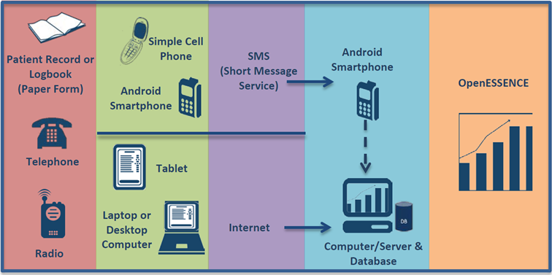
SAGES ARCHITECTURE (1)

Slide 7
SAGES ARCHITECTURE (2)
Health Centre 1
Headquarters
Simple
SMS Phone
Health Centre 2
Simple
SMS Phone
Central Server
Internet
Health Centre 3
Simple
SMS Phone
Android
Smart Phone
General Hospital 1
SMS
Simple
SMS Phone
General Hospital 2
USB
Simple
SMS Phone
Regional Hospital
Simple
SMS Phone
National
Hospital
Simple
SMS Phone
Headquarters
Reporting and Analysis
Training School
Simple
SMS Phone

Slide 8
Health Unit Daily Aggregate Surveillance Report
Date: 21/09/12 |  |  |  | Status | Code | No. |  | Status | Code | No.
General | Code | Value |  | Adult | ADL. |  |  | Children | CH.
Health Unit: | HU. | BT1 |  | Symptom | Code | No. |  | Symptom | Code | No.
Health Unit Code: |  |  |  | Fever/Chills | MFV. |  |  | Fever/Chills | CFV.
Sub-County: |  |  |  | Bruising | MBR. |  |  | Bruising | CBR.
HSD: |  |  |  | Rash | MRA. |  |  | Rash | CRA.
District: |  |  |  | Headache | MHA. |  |  | Headache | CHA.
Parish: |  |  |  | Sore Throat | MSR. |  |  | Sore Throat | CSR.
 |  |  |  | Cough | MCO. |  |  | Cough | CCO.
Programmatic Info | Code | No. |  | Nausea/Vomit | MNV. |  |  | Nausea/Vomit | CNV.
New OPD Visits | NO. | 16 |  | Diarrhea | MDI. |  |  | Diarrhea | CDI.
Return OPD Visits | RO. | 0 |  | Diagnosis | Code | No. |  | Diagnosis | Code | No.
Total Deaths | TD. |  |  | Lab(+) Malaria | MLM. | 10 |  | Lab(+) Malaria | CLM.
Maternal Deaths | MD. |  |  | Clinical Malaria | MCM. | 12 |  | Clinical Malaria | CCM.
Perinatal Deaths | PD. |  |  | Dysentery | MDY. |  |  | Dysentery | CDY.
 |  |  |  | SARI | MSA. |  |  | SARI | CSA.
 |  |  |  | Acute Flaccid Paralysis | MAF. |  |  | Acute Flaccid Paralysis | CAF.
 |  |  |  | Bacterial Meningitis | MMG. |  |  | Bacterial Meningitis | CMG.
 |  |  |  | Cholera | MCH. |  |  | Cholera | CCH.
 |  |  |  | Guinea Worm | MGW. |  |  | Guinea Worm | CGW.
 |  |  |  | Measles | MME. |  |  | Measles | CME.
 |  |  |  | Neonatal Tetanus | MNT. |  |  | Neonatal Tetanus | CNT.
 |  |  |  | Plague | MPL. |  |  | Plague | CPL.
 |  |  |  | Rabies | MRB. |  |  | Rabies | CRB.
 |  |  |  | Typhoid Fever | MTF. |  |  | Typhoid Fever | CTF.
 |  |  |  | Yellow Fever | MYF. |  |  | Yellow Fever | CYF.
 |  |  |  | Urethritis | MUR. |  |  | Urethritis | CUR.
 |  |  |  | Syphilis | MSY, |  |  | Syphilis | CSY,
 |  |  |  | OTHER DX? | ----- | ----- |  | OTHER DX? | ----- | -----
SMS: 210912.HU.BT1.NO.16.RO.0.MLM.10.MCM.12.

Slide 9
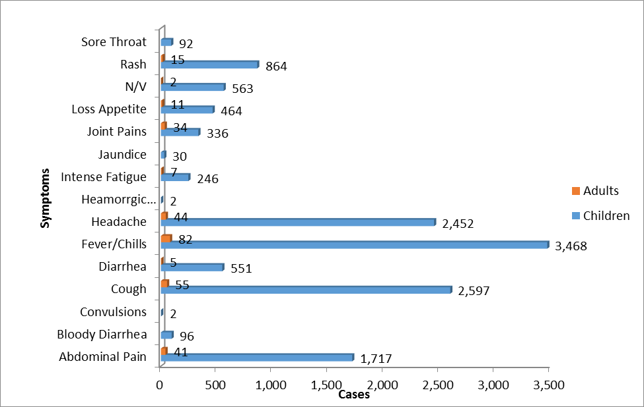
RESULTS (1)
Health Facility 1
Results from the health facility above indicated that the major symptoms above were fever/chills, cough and headaches, with these affecting mostly children.

Slide 10
RESULTS (2)
Pilot activities provided valuable insight into how electronic disease surveillance systems can be successful in resource limited environments.
The system can send patient information daily to the headquarters via SMS, using standardized texting protocols and abbreviations at a minimal cost.

Slide 11
AMR CONCLUSION : Reserve Antibiotics
The SAGES system is intended to enhance electronic disease surveillance capacity in resource-limited settings.
This suite of tools will improve and provide real-time disease reporting and timely response.

Slide 12
Acknowledgments
Department of Defense – Armed Forces Health Surveillance Branch – Global Emerging Infections and Surveillance System (AFHSB-GEIS).
Johns Hopkins University – Applied Physics Laboratory.
U.S. Army Medical Research Directorate-Kenya.
Uganda Peoples’ Defense Forces.
Makerere University Walter Reed Staff

Slide 13
Thank you !!

