Slide 1
March, 2019
7TH EAST AFRICAN HEALTH & SCIENTIFIC CONFERENCE
27th - 29th March 2019
Strengthening Capacity of Cross-Border Health Units (CBHU) to use Technology for HIV Prevention and Treatment
Kitungulu, B.; Muroki, D.; Oindo, M.; Kamau, L.; Juma, D.; (FHI 360)

Slide 2
CB-HIPP Goal and Result Areas
Mandate
USAID in consultation with EAC mandated CB-HIPP to define, implement, document and disseminate lessons learned on sustainable models for cross-border health service delivery to meet the unique needs of mobile and cross-border populations living and traveling along major cross-border regions of Eastern Africa.
Goal: Catalyze and support sustainable and African-led regional health development partnerships to improve health outcomes
RA 3: Strengthened leadership and governance by intergovernmental institutions
RA 2:
Alternative health care financing models identified, implemented and tested
RA 1: Increased access to and uptake of integrated health and HIV/AIDS services

Slide 3
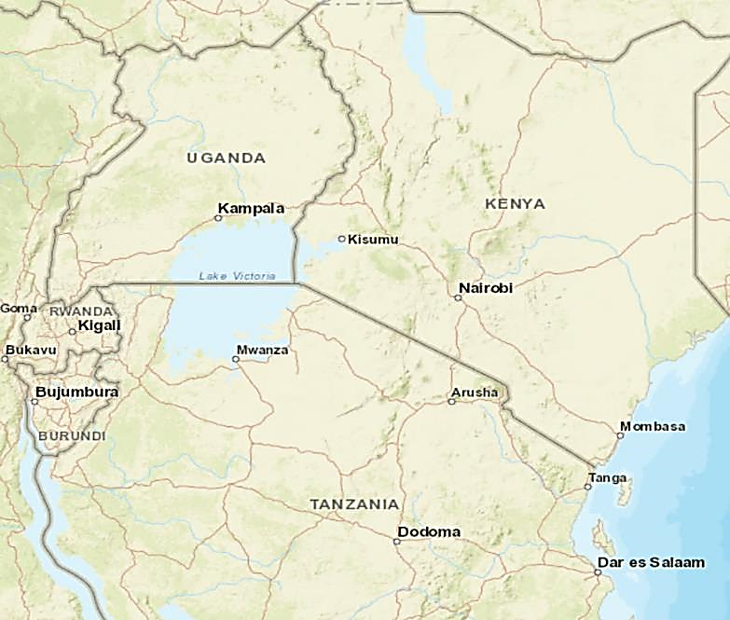
CB-HIPP Cross-Border Sites
Land Cross-Border Learning Sites
1. Busia, Kenya/Uganda
2. Malaba, Kenya/Uganda
3. Gatuna/Katuna, Rwanda/Uganda
4. Holili/Taveta, Tanzania/Kenya
5. Rusumo, Rwanda/Tanzania
Wet Cross-Border Learning Sites
6. Sio Port/Victoria/Majanji, Kenya/Uganda
7. Muhuru Bay/Kirongwe, Kenya/Tanzania
8. Kabonga/Kigoma Region, Burundi/Tanzania
9. Kasensero/Kagera Region, Uganda/Tanzania
10. Gisenyi/Goma, Rwanda/DRC
1
2
6
3
9
7
10
5
4
8

Slide 4
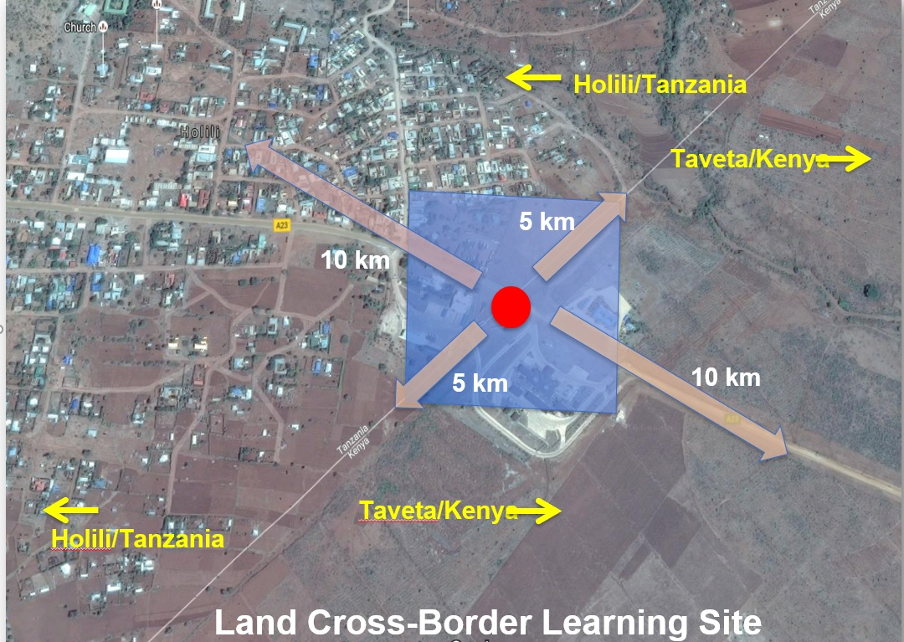
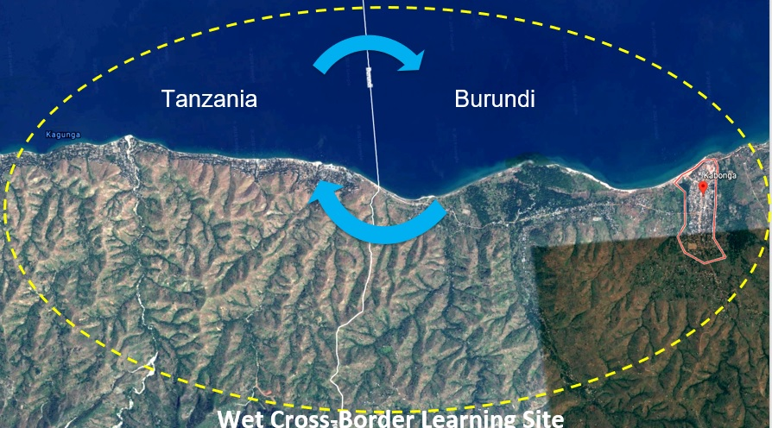
CB-HIPP Cross-Border Sites

Slide 5
Background
Clients cross borders to access health services; however, this information is not captured
Lack of data on transnational access impedes continued care, decision-making and resources allocation
National MoH tools lack indicators to capture mobility - nationality, residence, target population etc.
Different country specific facility-based approaches are used to identify non-national PLHIV
Higher defaulter rates and loss-to-follow-up are reported at border facilities for clients enrolled on, e.g., ART and TB treatment across the border

Slide 6
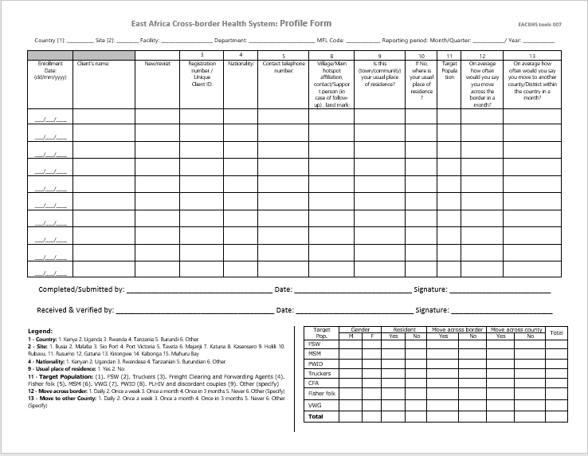
Materials and Methods
CB-HIPP reviewed 35 border health services and adapted cross-border reference tools, linked HIV testing services (HTS) registers to profiles to collect mobility data
CB-HIPP developed a cross - border database for managing data generated from the manual tools on the two sides of the border

Slide 7
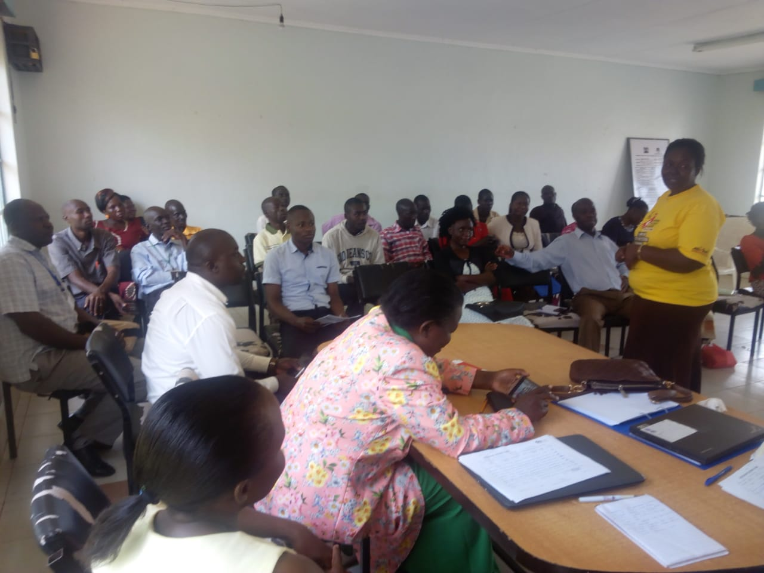
Results
Through the innovative cross-border health unit (CBHU) model, CB-HIPP has profiled 2,585 mobile and cross-border populations since February 2017, linking them to services at 16 border facilities in five cross-border sites in Kenya, Tanzania and Uganda.
Data is used by respective CBHUs in joint cross-border monthly meetings to enhance structured collaboration and to inform discussions on health service delivery to mobile and cross-border populations.

Slide 8
Results (February 2017-February 2019)
Description | Records
Mobile and cross-border populations profiled at the community | 2,585
Mobile and cross-border populations referred to facilities for services | 644
Profiled clients receiving health services | 4,791
Clients referred between facilities (within and beyond a country) | 235
Clients followed-up/traced (within and outside the country) | 145
Specific services received:
STI screening: 1,752
FP/RH: 1,525
HTS: 552
MNCH/ANC: 207
GBV: 53
Other services: 688

Slide 9
Discussion, Conclusion & Recommendation
A digital cross-border health information system (HMIS) embedded in national health systems is essential for documenting and tracking transnational access of health services
To provide timely data on demand and access to cross-border health services, EAC Partner States need to harmonize data collection tools and profile mobile and cross-border populations
Building on the CBHU tools and database, a cross-border digital health platform will improve data access and strengthen structured collaboration between EAC partner states to improve service delivery for mobile and cross-border populations
A regional digital HMIS should be anchored in policy and aligned with national HMIS for efficacy and sustainability, including electronic medical records (EMRs)
Current project initiatives have provided key learning to inform regional digital HMIS considerations in support of a regional service delivery framework, including bilateral partnerships across partner states

Slide 10
Acknowledgement

