Slide 1
Technologies and Approaches for Disease Surveillance, Outbreak Detection and Response and; Cross-border Mobility and Disease Tracking
Esron D. KARIMURIBO
7th EAHRC Dar es Salaam 27-29 March, 2019

Slide 2
Disease Surveillance and Challenges
The ongoing systematic collection, analysis, and interpretation of outcome-specific data for use in the planning, implementation, and evaluation of public health practice (Thacker, 2000)
Capture of disease events
Timeliness
Completeness
Then so what?...... (IDS vs IDSR)-RESPONSE component

Slide 3
Disease Surveillance Continuum (WHO, 2007)
Response
Trend monitoring
Intervention Evaluation
Monitoring progress towards Control
Early Warning
Disease Outbreak
Management
Outbreak Detection
During
After
Before

Slide 4
Embracing One Health to support EBS and IBS
Standard: Public health
Community
Primary health care facility
District
Regional
National
Global platforms-WHO
Standard: Animal health
Community
Livestock Field Officers
District-Zonal Veterinary Centres
Regional Veterinary Offices
National
Global platforms-OIE

Slide 5
Targeting community and Cross-border levels to impact regional and global scales
To work across human and animal health sectors to fight disease epidemics.
To develop ICT tools to support data capture, reporting and feedback at health facility and within the community (feed into the official national human and animal health information systems).
To strengthen cross border collaboration to fight epidemics in shared ecosystems.
Addressing Community Level One Health Security
Increased rate and volume of international travel influence the speed of pathogen spread:
need to outsmart disease spread

Slide 6
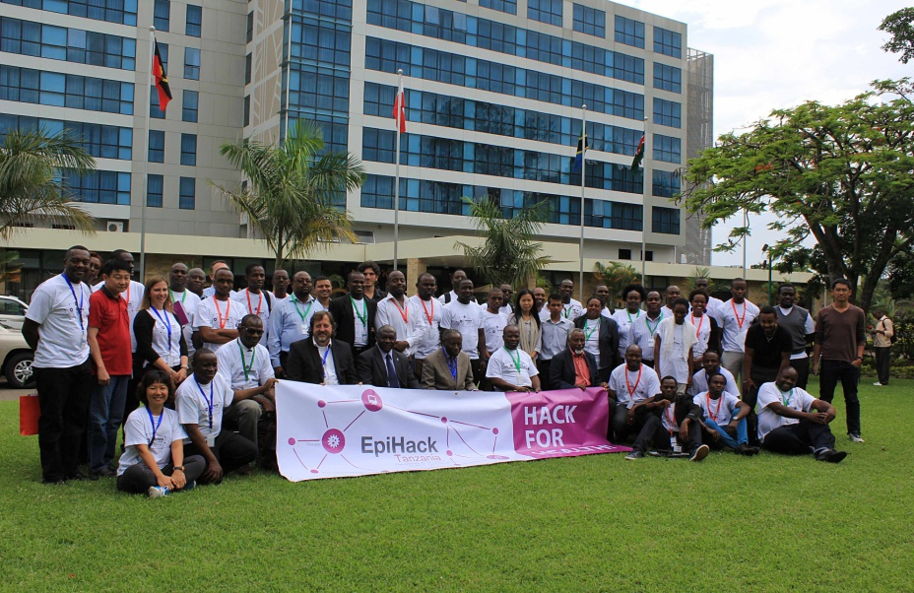
Genesis of innovative technologies (AfyaData)
First EpiHack event in Africa convened Arusha, Dec 2014,
66 specialists (Medical, Veterinary and ICT programmers) from 14 countries

Slide 7
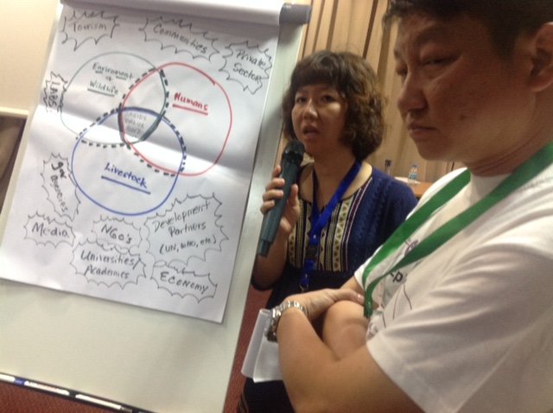
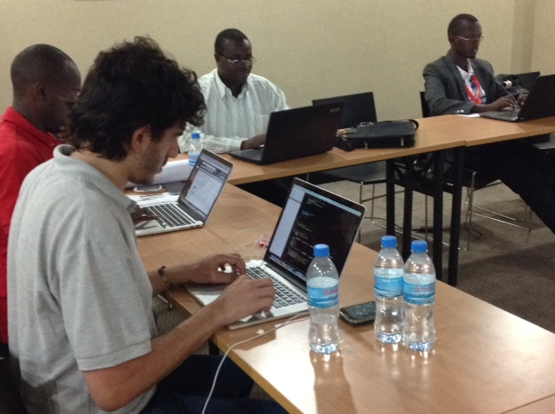
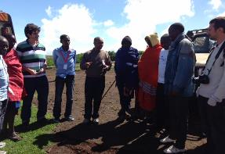
EpiHack to Design Solutions for Existing DS Challenges

Slide 8
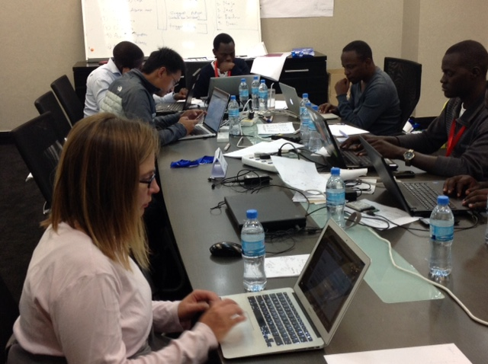
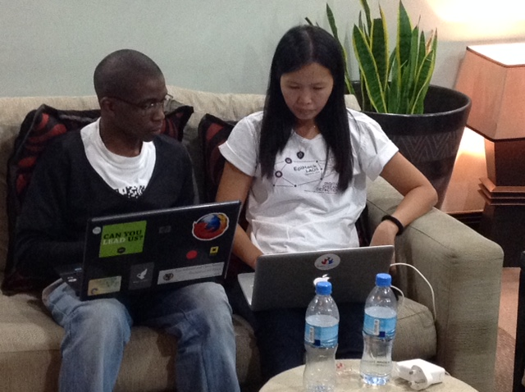
Prototypes developed based on User Challenges
Facility-based disease reporting system (IBS);
Community-based participatory disease surveillance (EBS);
feedback: two-way communications;
Contact tracing;
Information sharing between sectors and neighbouring countries

Slide 9
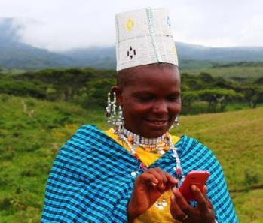
Towards Community Level and Cross-border Disease Detection, Response and Management
AfyaData

Slide 10
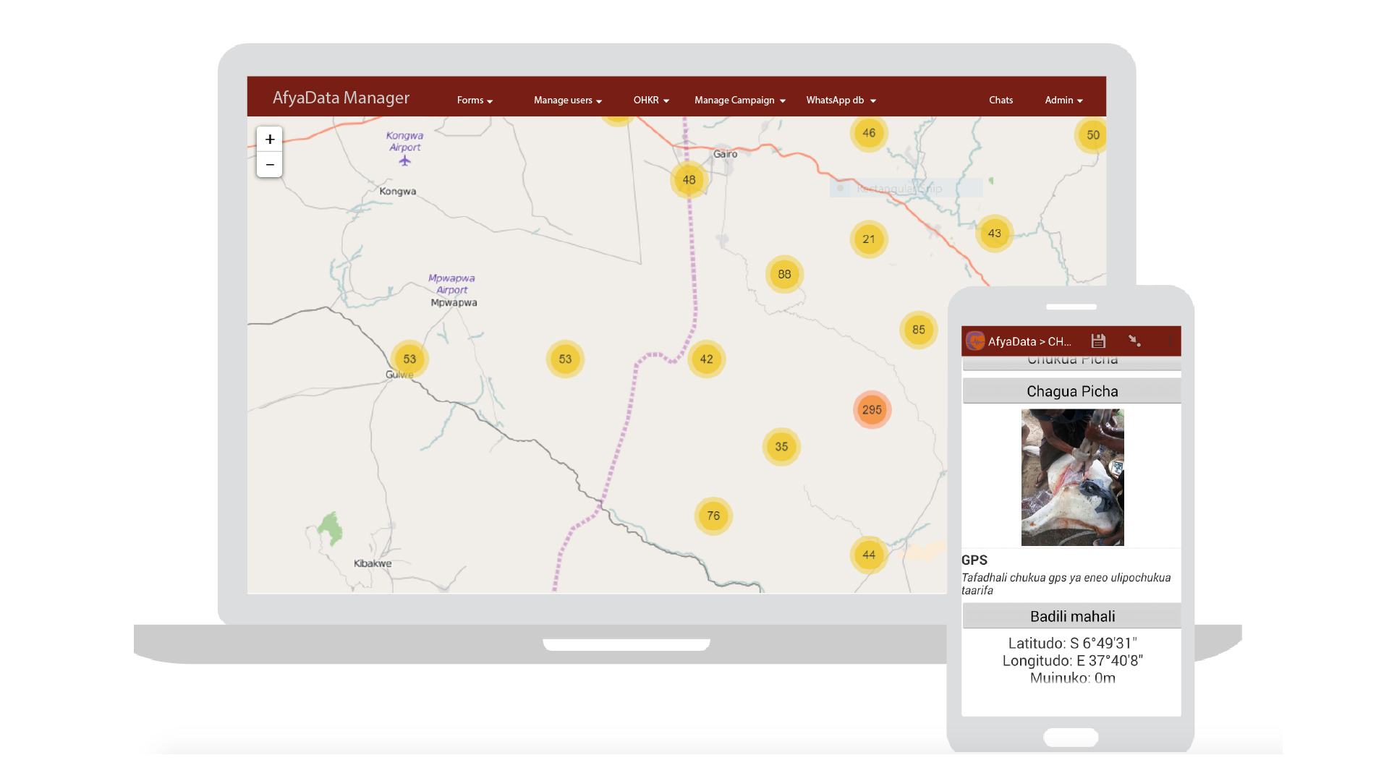
> what is AfyaData
Mobile App
Web App
AfyaData is a set of digital tools that eases the collection, analysis, documentation and feedback of public health events

Slide 11
Basic configuration of AfyaData

Slide 12
AfyaData functionalities
Open source
Multiple surveys
Easy form distribution
GPS, Image, barcodes
Powered by One Health Knowledge Repository
Prompt analysis & visualization
Integrate data from multiple sources
Compatible with existing surveillance systems
Early warning short message service
Sample tracking: cholera surveillance model
Multilingual
Client-based customization
Specific access code
Interactive feedback
Research data

Slide 13
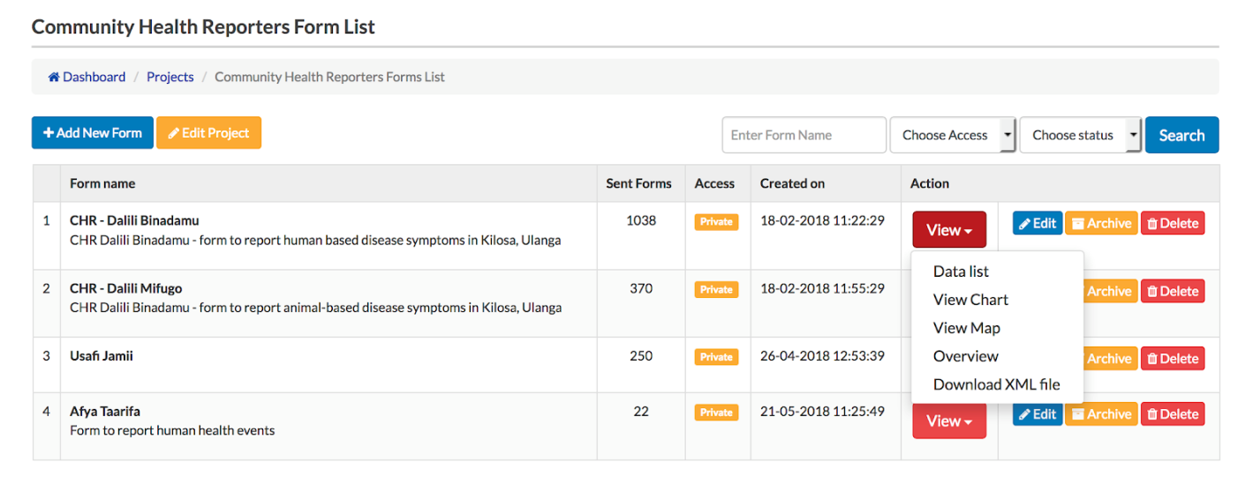
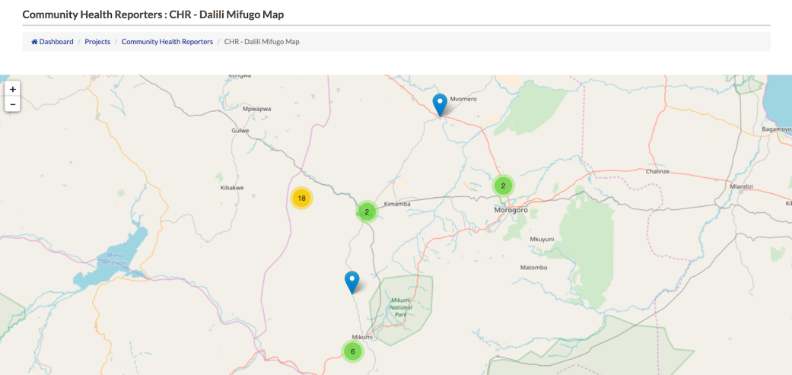
Data Management
View
Raw Data
Maps & Charts
Manage
User permissions
Triggers & Alerts
Interact
Data collectors
External systems via APIs

Slide 14
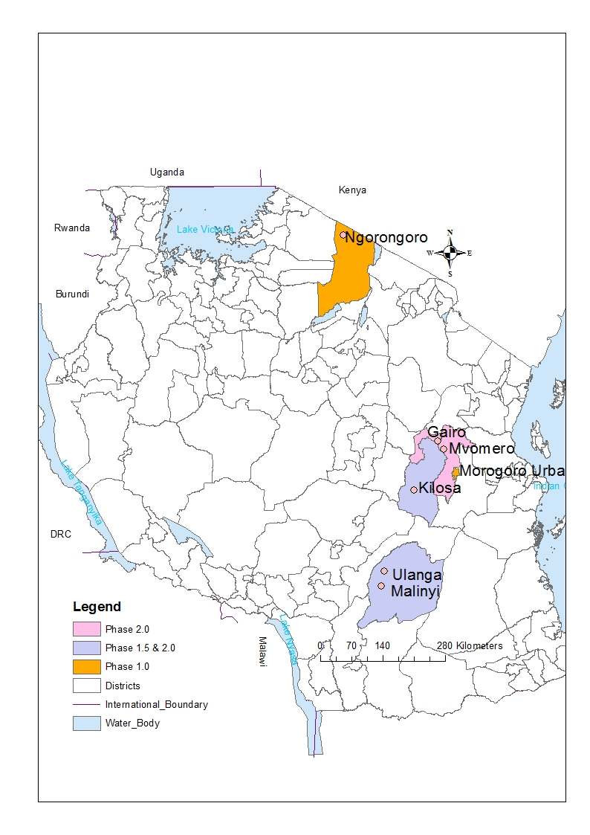
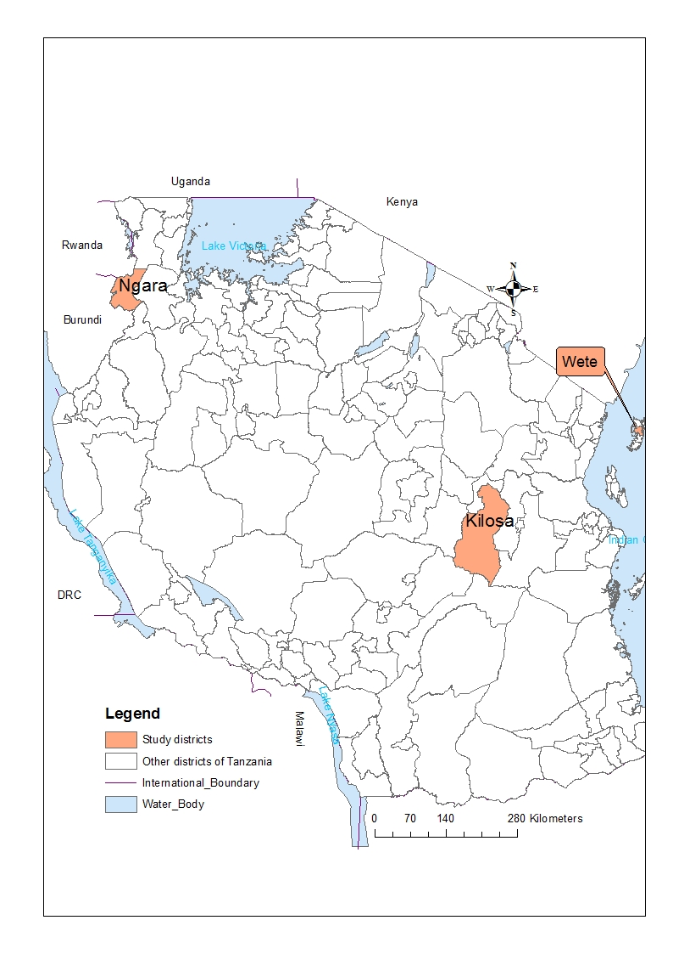
AfyaData use in disease surveillance
General disease surveillance and other health related events

Slide 15
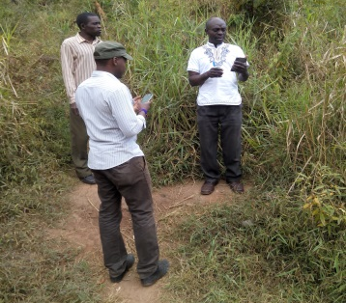
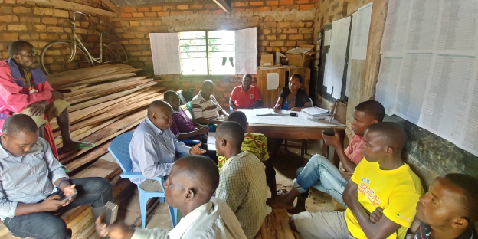
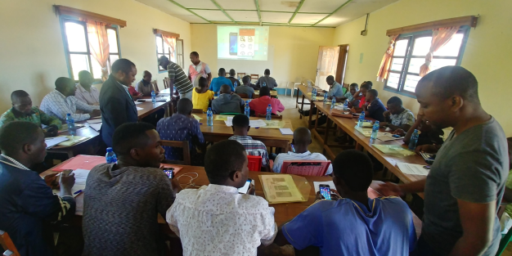
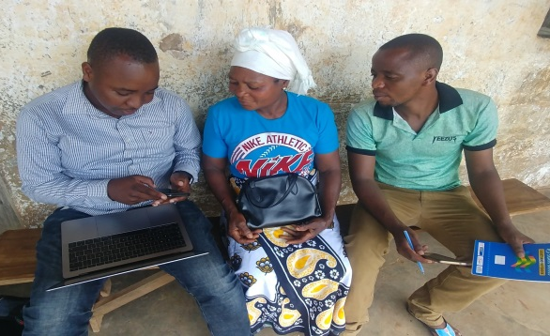
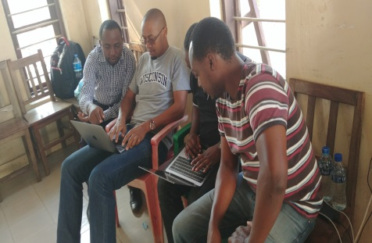
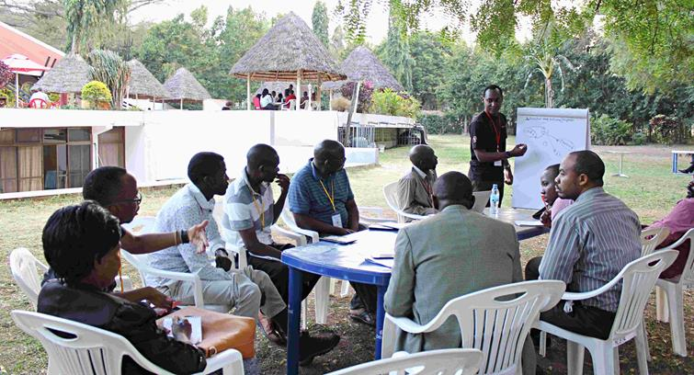
AfyaData deployment and monitoring strategies
1.Site assessment
2.Recruitment of CHRs
3.Collection of baseline data
4.Training of stakeholders: One Health approach
7.On-site technical solution
8.Performance appraisal
5.Technology backstopping
6.Opinions from community members
Trained CHRs (114), Health care workers (83), LFOs (78), Livestock keepers (54), Researchers (16), Wildlife Rangers (8), DVOs (6), DMOs (2), IDSR focal person (2), Wildlife Ecologist (1) & Wildlife Veterinarian (1) from Ulanga, Kilosa, Malinyi, Ngara, Pemba, Unguja and Zanzibar (365 trainees)

Slide 16
AfyaData layout, deployment and communication strategy
Response Team
Response
Reporting
Notification/Alert
One Health Disease Surveillance Model
Data Analysis
CHRs
Feedback
> 400 readers in the world
OHKR

Slide 17
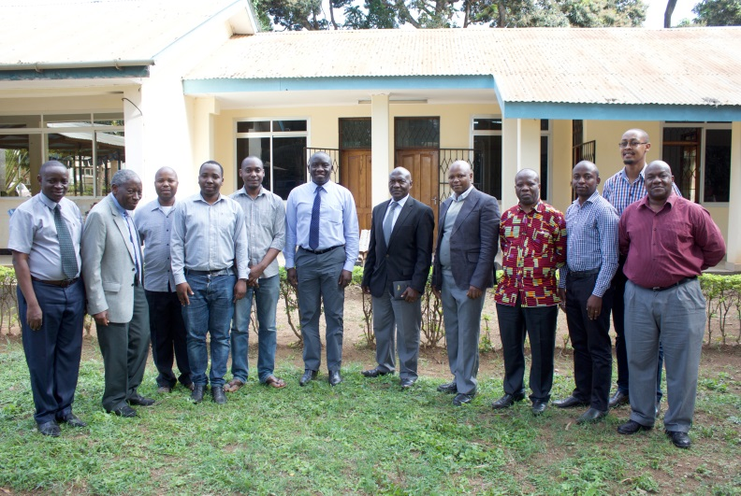
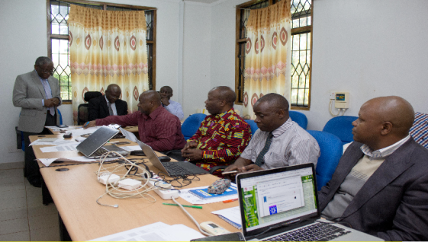
Stakeholders Engagement: Governance Committee
Project Management is through a National Advisory Committee
Headed by The former CMO/Deputy PS-PM
The Head of Local Government Health Systems
National Livestock Epidemiologist
Assistant Director of Disease Surveillance MoHCDGEC

Slide 18
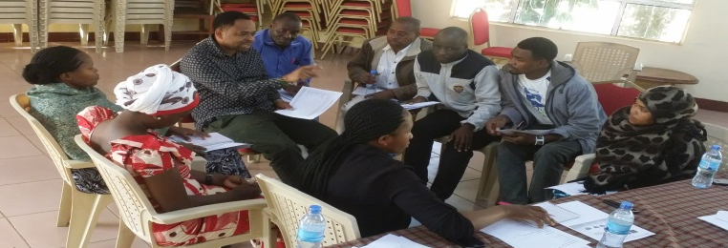
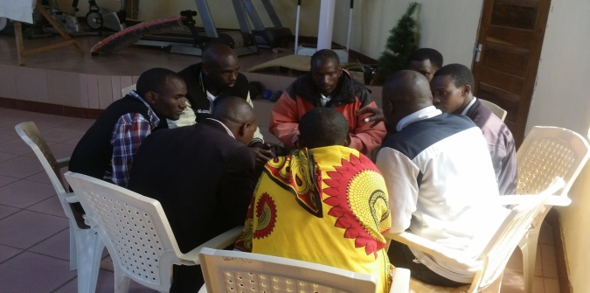
Stakeholders engagement at different levels…
Engagement with district officials
Engagement with clinicians at primary health care facilities and LFOs at ward level
Engagement with community members

Slide 19
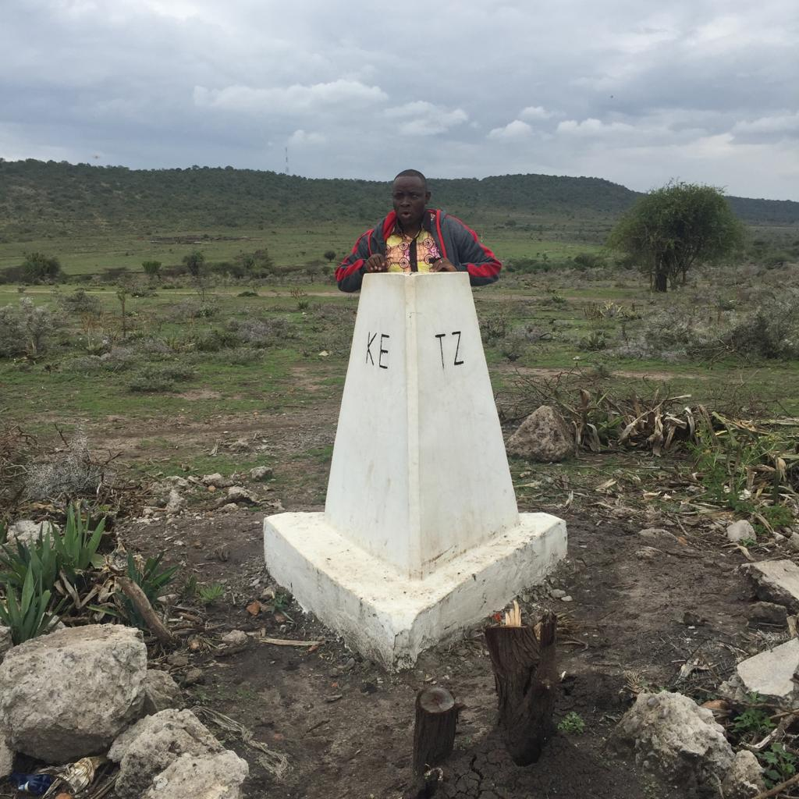
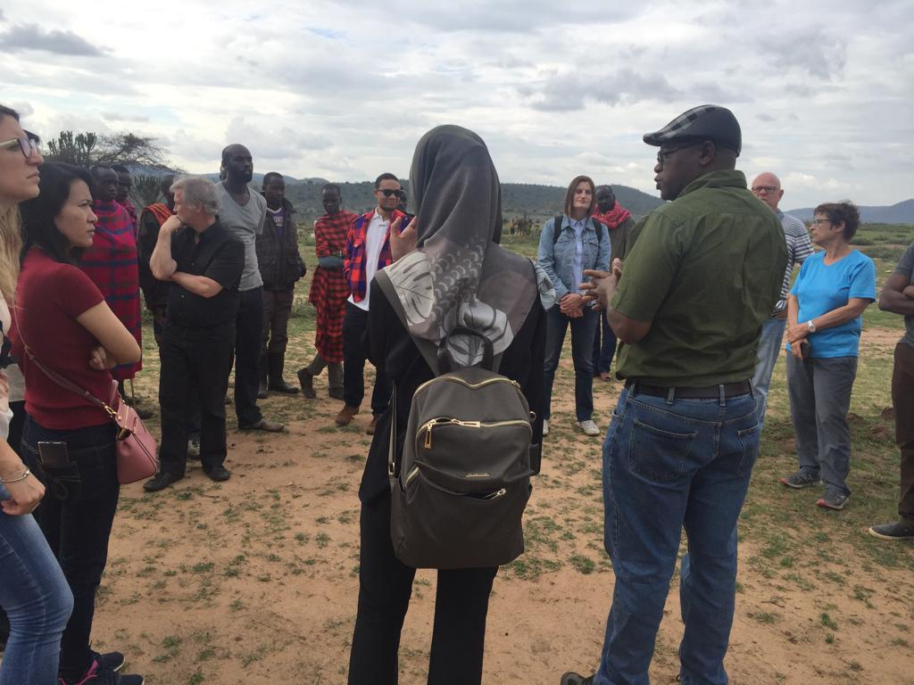
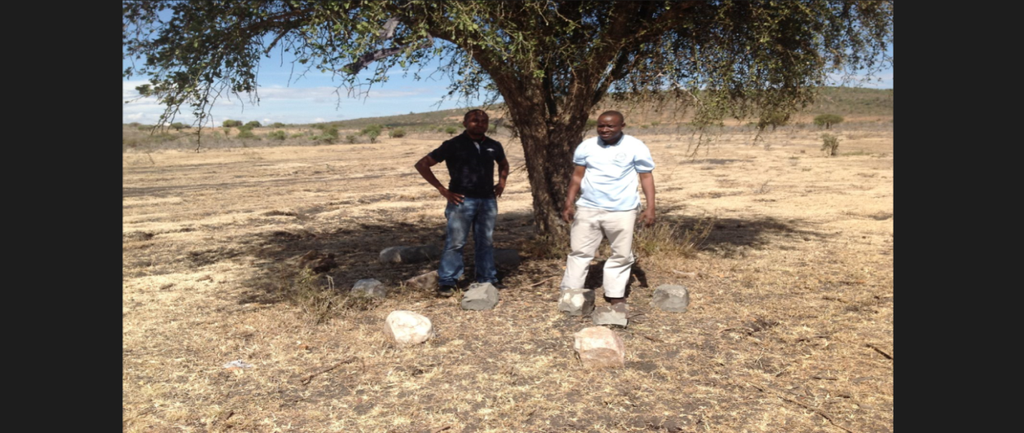
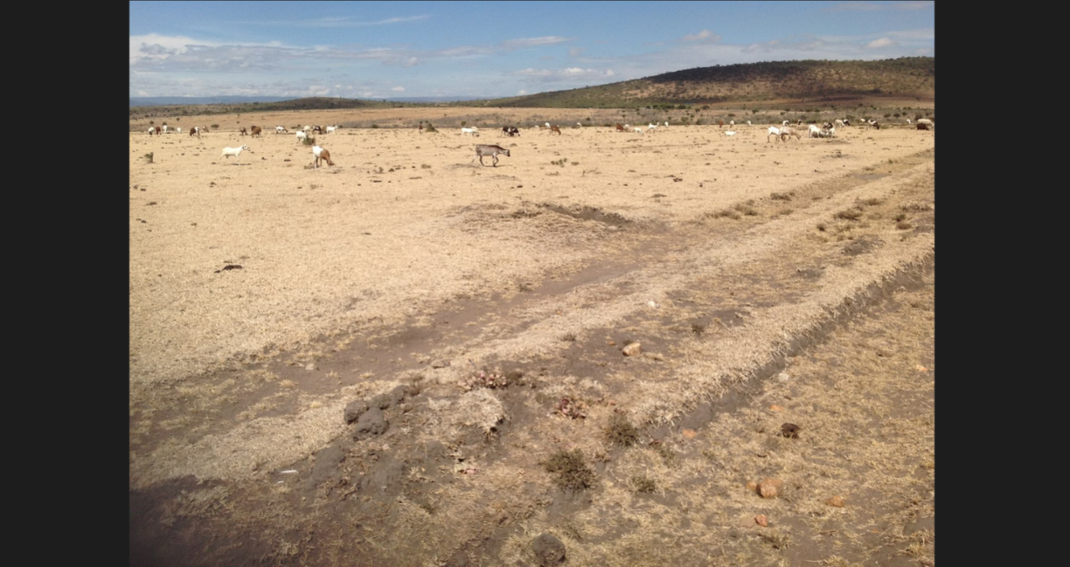
Cross-border and Regional support
Where do I (We) Belong?

Slide 20
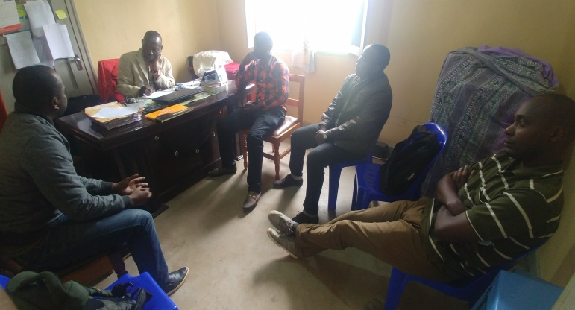
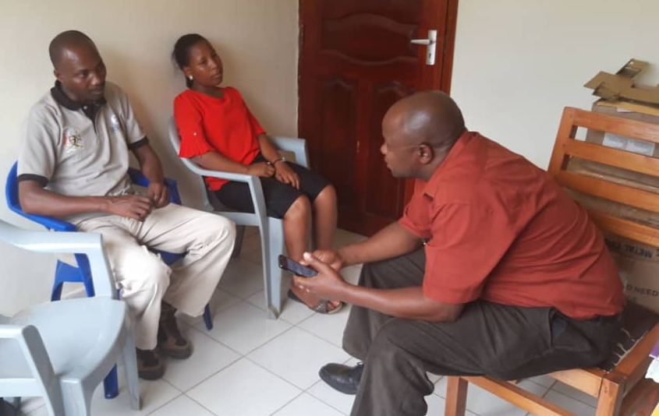
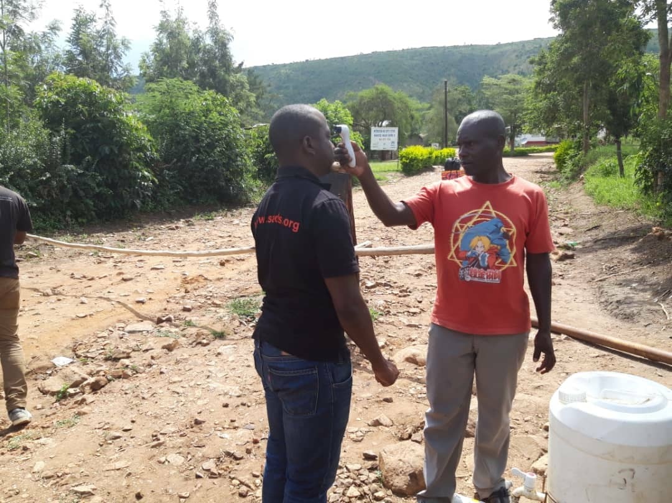
Cross-border ecosystems
Kyotera Uganda
Isingiro Uganda
Cross-border ecosystems:
Isingiro (Uganda)-Kyerwa(Tanzania)
Kyotera (Uganda)-Misenyi (Tanzania)
Muyinga (Burundi)-Ngara (Tanzania)
Narok (Kenya)-Ngorongoro (Tanzania)
In collaboration with EAIDSNet/ECSA through CORDS

Slide 21
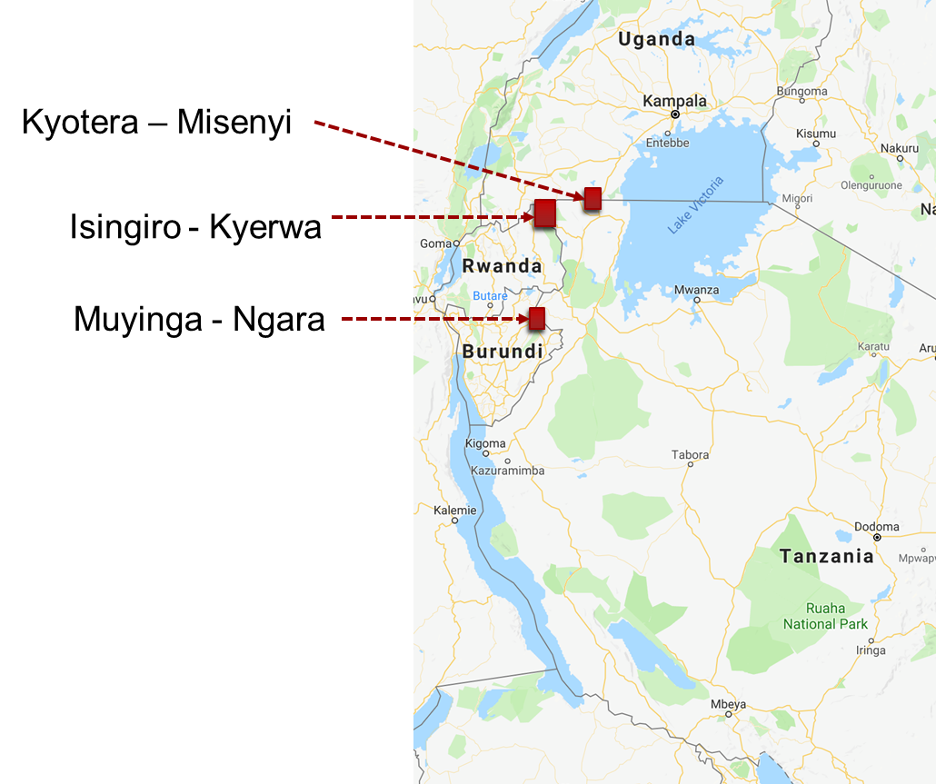
Cross-border Disease Surveillance: INP sites and disease outbreaks

Slide 22
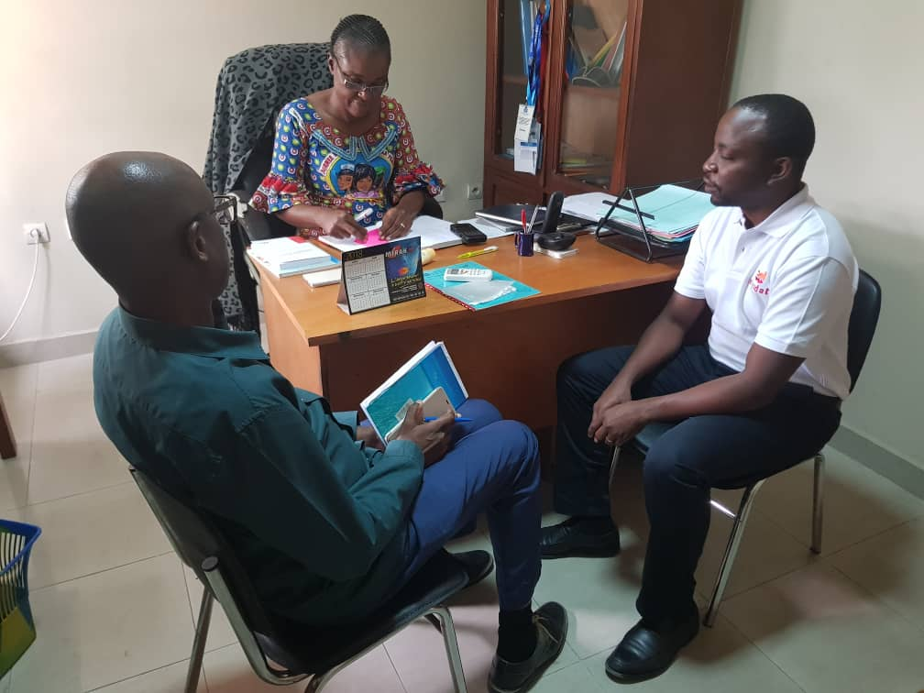
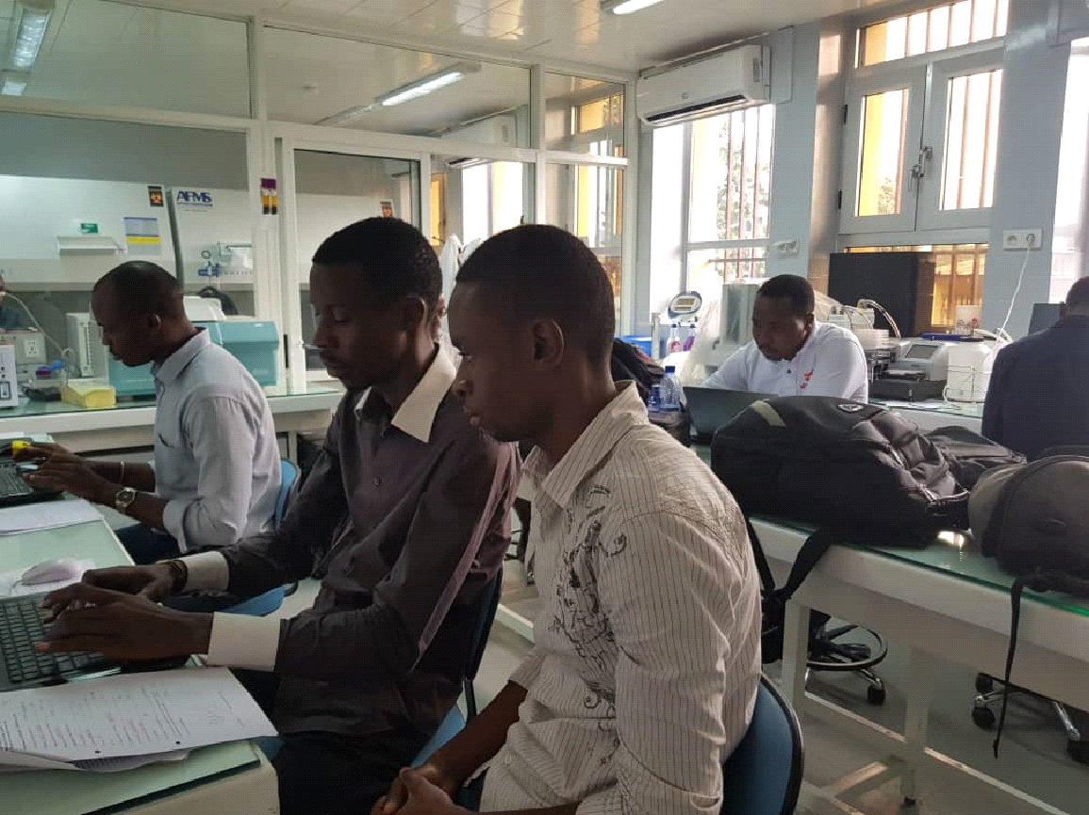
Ebola Virus Disease surveillance in DRC

Slide 23
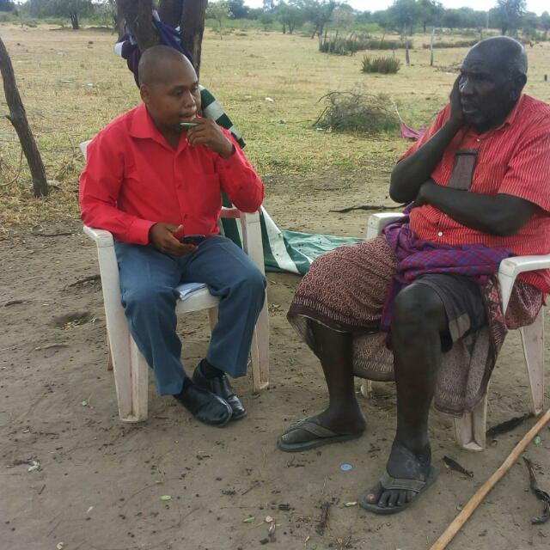
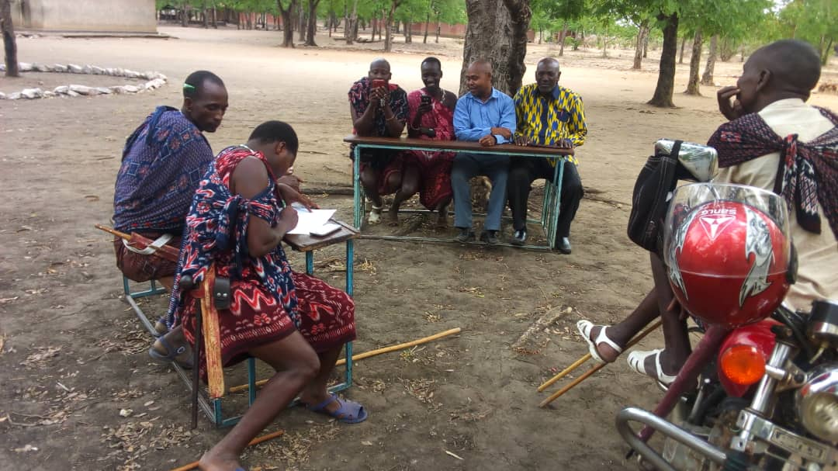
Farm level to global level strategy
FAO: AfyaData (Community to district)….EMA-i (district to global scale
Livestock keepers to assuming participatory role

Slide 24
SUCCESS STORIES
A mysterious disease that killed > 1,000 goats and sheep (confirmed as PPR/CCPP diseases)
Impetigo-like outbreak in school children
Suspected rabies cases in cattle (confirmed to be East Coast fever infections)
Climate change-induced behavior change in baboons feeding on livestock and humans.
FMD outbreak in Ulanga district

Slide 25
ACKNOWLEDGEMENTS
Government of the United Republic of Tanzania (through MoH, MoLF and OR-TAMISEMI)
IDRC
Ending Pandemics (formally: Skoll Global Threats Fund)
Sokoine University of Agriculture
National Institute for Medical Research

Slide 26
Thank you

