Slide 1


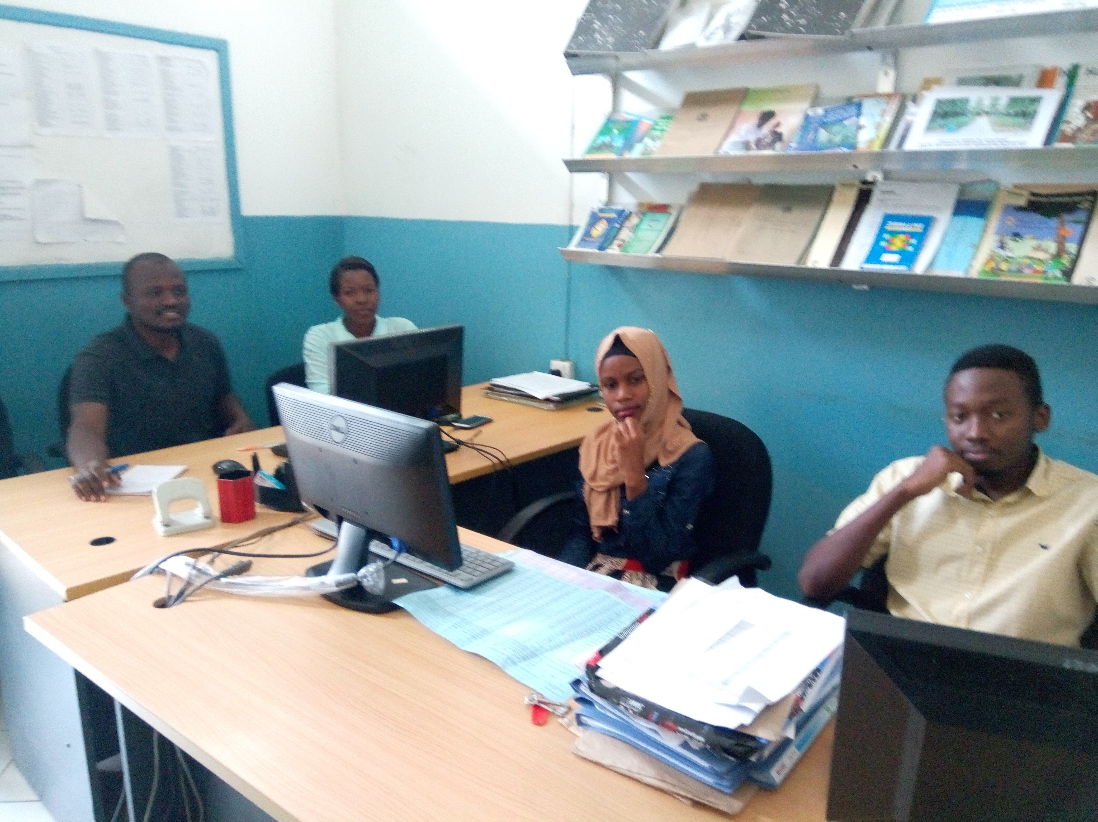
The Role of Electronic Medical Records Systems on Supporting Routine Health Data Reporting at the Facility Level
Bigten Kikoba
bigtenkikoba@gmail.com
University of Dodoma

Slide 2
Introduction
Health Management Information System (HMIS) is critical for improved healthcare service delivery
However, the collection and reporting of routine health data at the facility level is pierced with data quality challenges
  Lack of accurate and timely data
  Counting values in daily registers is error prone and innefficient
  Data reporting to DHIS2 still a challenge
  (Kariuki et al., 2016)
What about the facilities using electronic systems (EMR)?

Slide 3
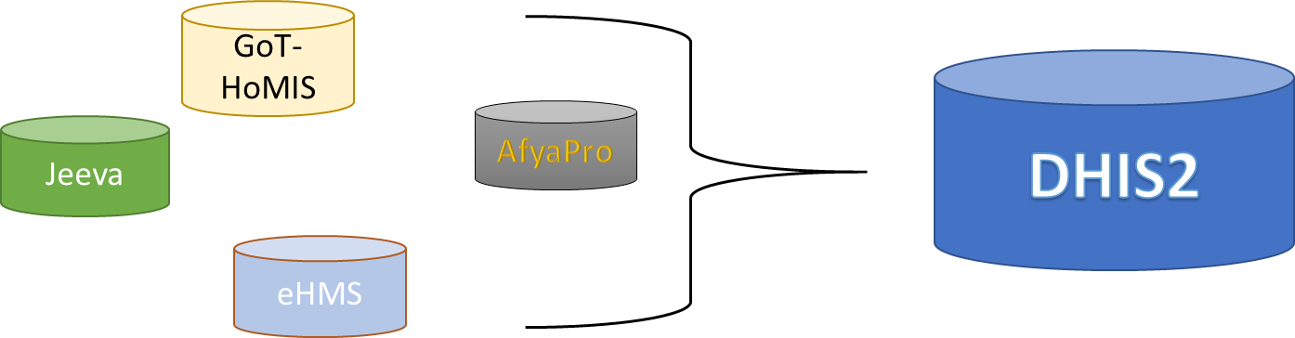
Objective
Recently healthcare sector is investing much in digital platforms
We now have improved ICT infrastructure in Health facilities, but
What about Contents?
Therefore, we evaluated the contribution of electronic medical records (EMR) systems on collection, aggregation and reporting of routine health data at health facilities

Slide 4
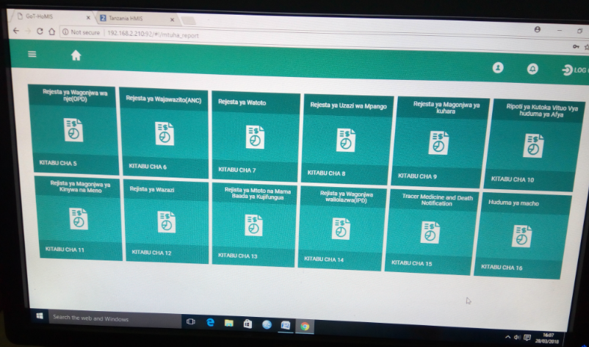
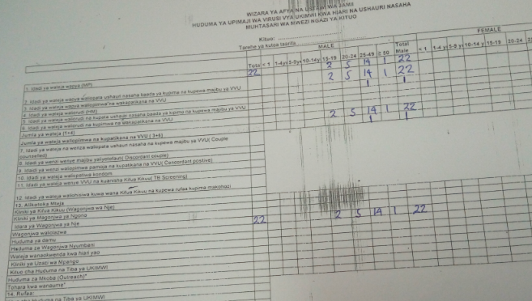
Study methods
The study adopted a mixed method research design
The data were gathered from five tertiary hospitals. Hospitals were selected based on the availability of EMR system
Observation and document review
  Was involved in last year February monthly OPD and IPD report preparation at Amana
  Reviewed eHMS and DHIS2 reports in systems
  Was involved on preparing March OPD report at Tumbi Hospital
  Reviewed GoT-HoMIS reports and DHIS2 reports

Slide 5
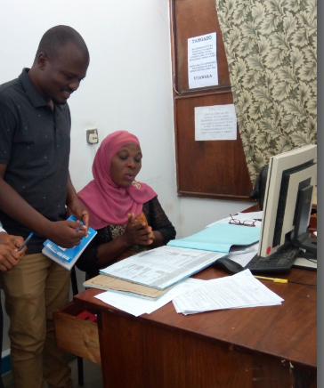
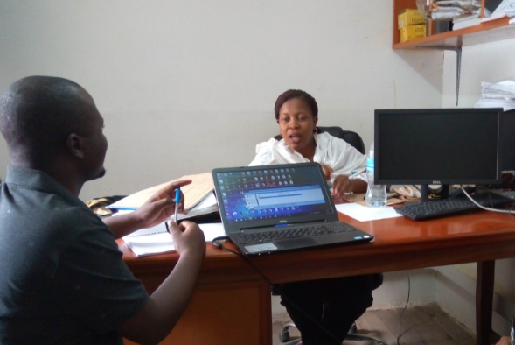
Data Collection
Interviews and group discussion
Type of Organization | Institute/Organization | EMR used | Number of interviewee
Health Facilities Software development Management | Muhimbili National Hospital Amana referral Hospital Mnazi mmoja health Center Tumbi Reg. Referral Hosp Morogoro Reg ref. hospital Mbeya Referral Hospital HISP team UCC NPK GPITG MoHCDGEC ICT Depart MoHCDGEC eHealth unit Ilala Health Statistic Office | Jeeva eHMS and CTC CTC GoT-HoMIS AfyaPro Care2x DHIS2 Developers FHR Implementer AfyaPro Developer eHMS Developer Support DHIS2 Support EMR Data management | 2 10 3 6 2 2 2 2 2 3 3 3 2
Total |  |  | 42

Slide 6
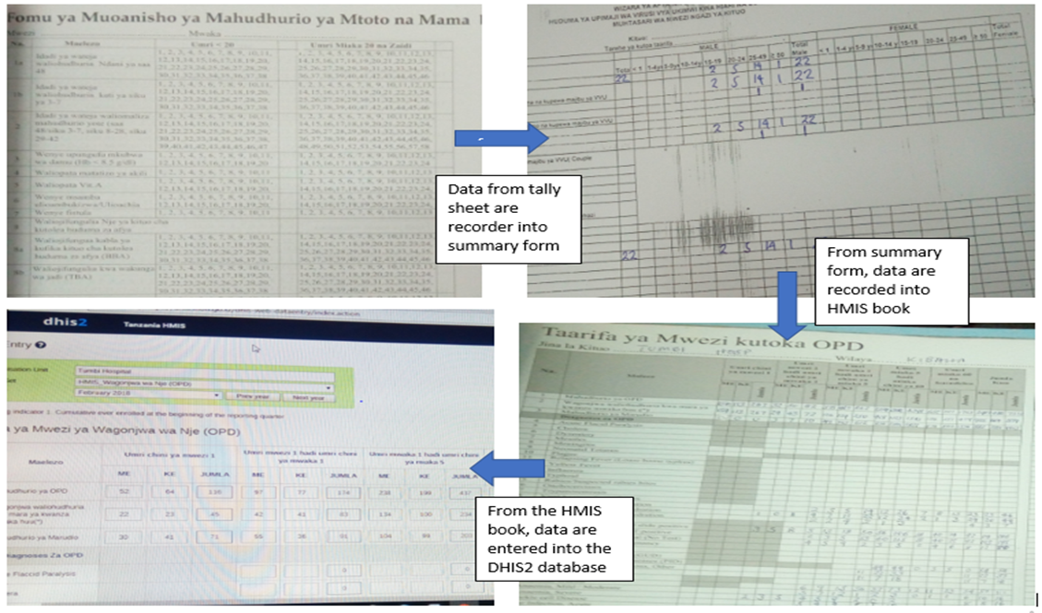
Findings and Discussion
Health Facilities still make manual reporting
Routine health reports rely on the manual MTUHA reporting books i.e.
    registers,
    tally sheets and
    summary forms
“When reporting OPD data, each department submit their summary form in my office, what I do is putting them together into the HMIS book 5 and then start data entry into the DHIS2. The system (GoT-HoMIS) is not much relied on because the data are under reporting, but I usually compare the values before I submit the report”
Hospital data officer

Slide 7
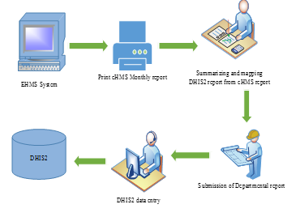
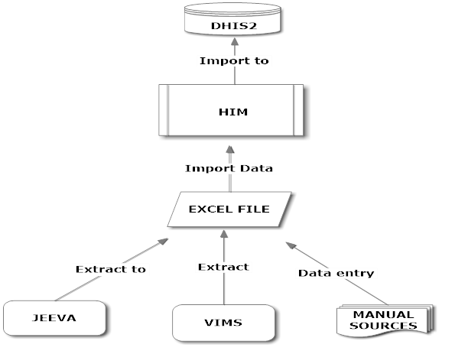
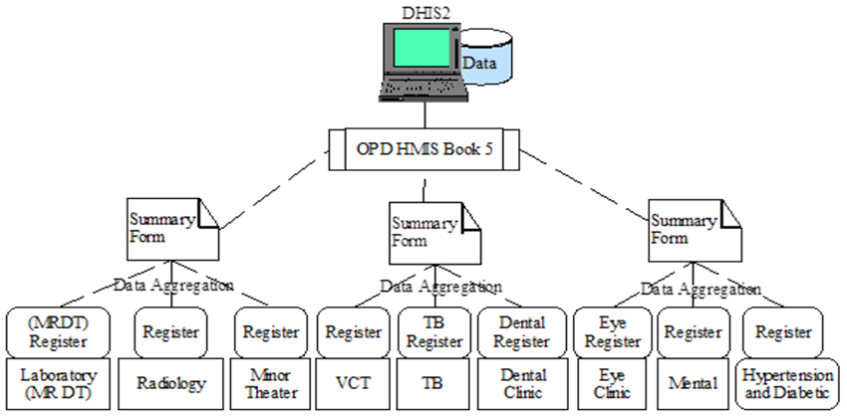
Each facility has a unique way of aggregating data from different sources before entry to DHIS2. Some facilities systems have MTUHA forms designed
Amana
MNAZI MMOJA
Muhimbili
Morogoro

Slide 8
Different in values between systems
Report show miss-matching of values of the same data element in two systems for November and December report

Slide 9
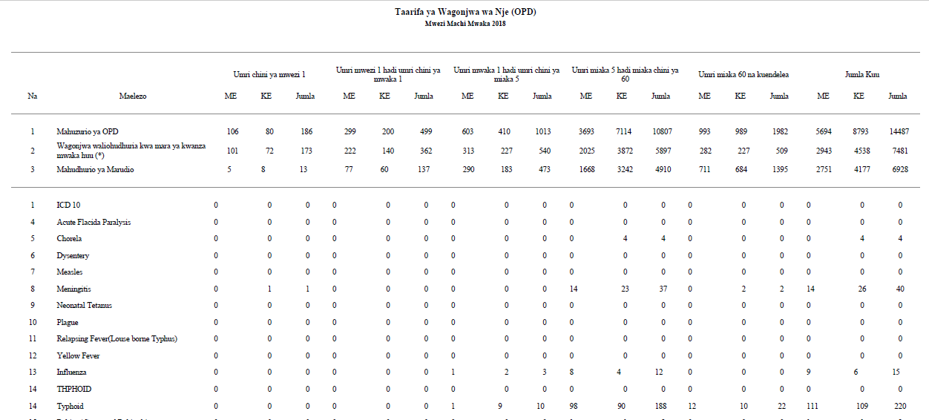
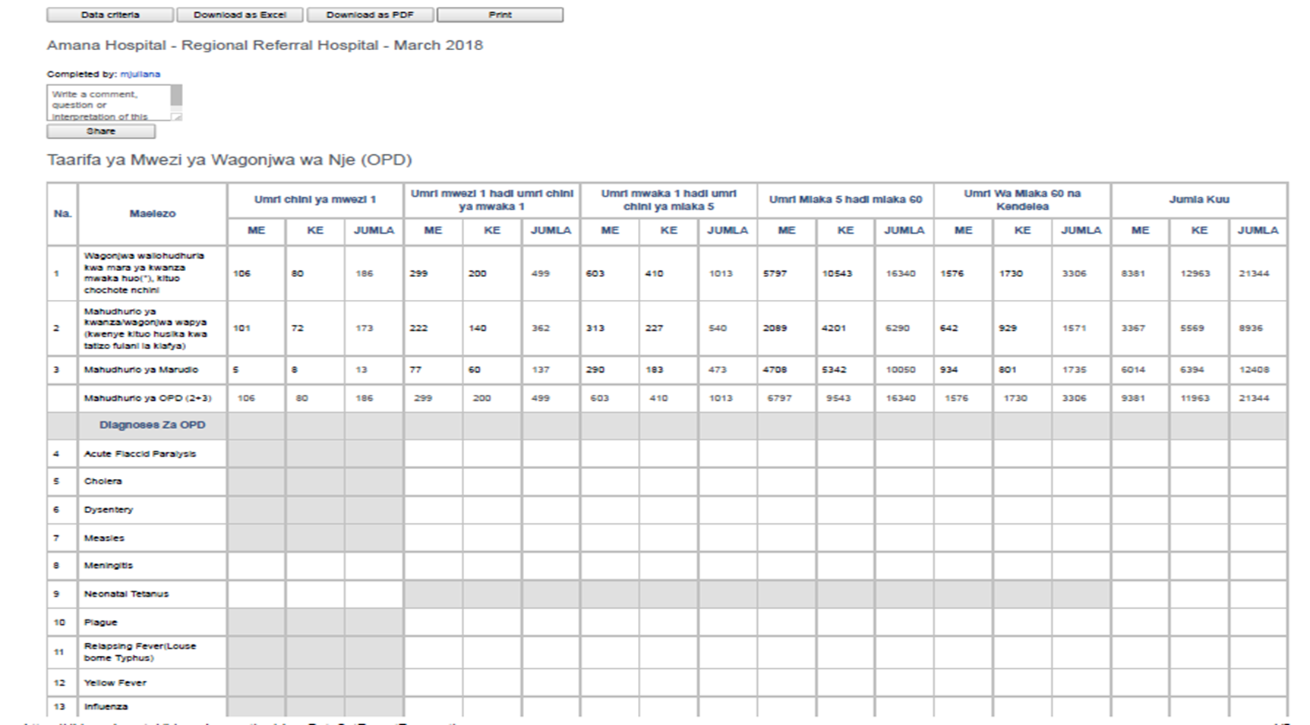
Some data element in the hospital systems have data values but not reported in the DHIS2 at all
DHIS2 REPORT
EMR REPORT

Slide 10
Still some data elements receive data from both manual and electronic system. Leading to overreporting and under reporting of the two systems

Slide 11
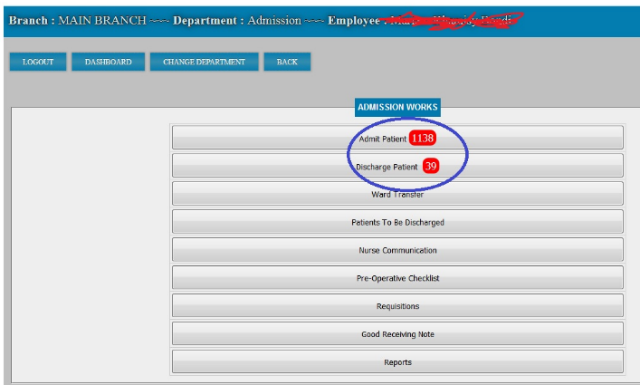
EMR – HMIS Reporting Challenges
Poor EMR use by Physicians (lack of enough knowledge to use the electronic systems) leads to inconsistency of data.
For example, IPD section shows1138 patients were to be checked in by Doctor but not confirmed by nurse in charge

Slide 12
EMR – HMIS Reporting Challenges
Arithmetic formula when querying data from the EMR into the HMIS designed templates. EMR require doctors to do two diagnosis, i.e. the provisional diagnosis which is a prior diagnosis before laboratory confirmatory results and second is the final diagnosis resulted from laboratory confirmation
Missing diagnosis values in the electronic system reading to a physician forced to record irrelevant data
Increase the prevalence of wrongly recorded disease and reduce prevalence of the missing disease.
Electricity is an issue reading to delay of service. Example, when visiting one of the facilities, it happens electricity cut off although the hospital had a backup generator it took almost 15min before the system is stable and resume of services
Two or more EMR running parallel at the same hospital

Slide 13
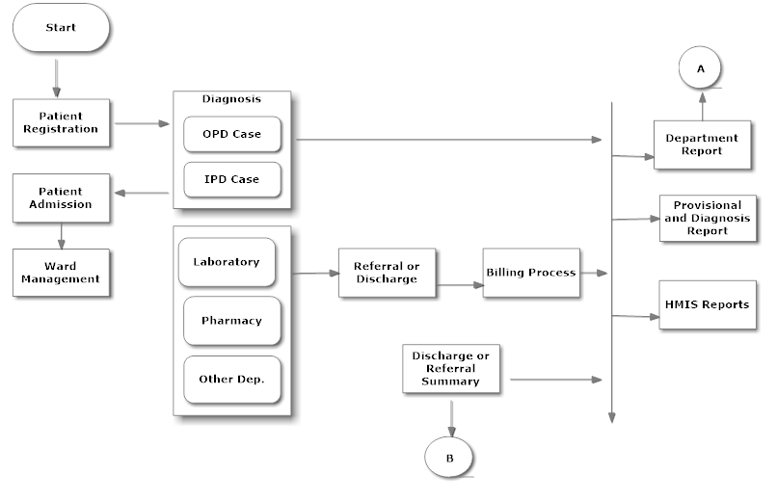
Conclusion
Improved ICT infrastructure in Health facilities, what about Contents?
To improve EMR usability in HMIS reporting, we propose EMR data flow as per diagram bellow

Slide 14
Recommendation
For HMIS to recognize the EMR as the primary source of data, standardization of EMR especially on MTUHA reports should be done
Health facility should refine their policy on management of EMR, not basing on clinical operations only
Having a stand by generator as a power backup source when the normal TANESCO electricity goes off would serve
Also more alternatives can be added, such as using battery powered laptops and tablets, installing ups systems and car batteries as power backup when main power fails

Slide 15
Thank you!
Acknowledgement
University of Dodoma
Supervisors, Dr. Ellen Kalinga & Dr. Juma Lungo
CBC team, Prof. Flora and Dr. Nima

