Slide 1
THE 7TH EAST AFRICA HEALTH SCIENTIFIC CONFERENCE – 27TH TO 29TH MARCH, 2019
THE IMPACT OF MEDICINES REGISTRATION MANAGEMENT INFORMATION SYSTEM IN REGULATORY DECISION MAKING: EXPERIENCE FROM TANZANIA FOOD AND DRUGS AUTHORITY
Dr. Shani M. Maboko
Drug Registration Officer
Tanzania Food & Drugs Authority

Slide 2
Outline
Background
Study objectives
Methodology
Results
Conclusion
Acknowledgement

Slide 3
Background
MRE is critical in ensuring that medicines in our market meet acceptable levels of quality, safety and efficacy.
TFDA has been implementing MIS systems since 2004
Initial system: Regsoft
MIS
IMIS from 2014;
sophisticated data management tool with links to other regulatory modules such as GMP, I & E
Has been expanded to cater for other areas of MA (query responses, promotional materials)

Slide 4
Objective
To streamline MRE processes thus increasing efficiency and ultimately ensuring quality, safety and efficacy of medicines:
Receive all applications electronically
Ensuring proper payment
Process applications from receiving to granting
Safe storage of application data
Tracking progress of applications
Ensure accountability of regulators
Ease of roles and responsibility of MRE section (updating registers, monthly reports)

Slide 5
Methodology
MRE system development
Developed based on requirements of users (registration officers)
SOPs
Guidelines and Regulations
Registration data from 2013/14 up to 2017/18 was analysed;
Registration module
Stages of evaluation: new applications submitted in 2017/18 were followed from referencing to granting
Performance reports
Monitoring and evaluation

Slide 6
Cont..
Revenue reports
Retention fees collected from 2014 – 2016 were analysed

Slide 7
Results
The overall registration system is fully operational and is in line with relevant Regulations, SOPs and guidelines.
Referencing
Invoicing
Accounting
Receiving
Data entry
Evaluation
Auditing
Review (TC)
Granting

Slide 8
Results cont...
Tracking of timelines and progression of applications can be done

Slide 9
Results cont..
Automatic processes:
Notification of Applicants once the application has passed receiving and granting
Update of live register of registered medicines which is publicly available through www.tfda.go.tz
Change of status for products that have expired and hence blocking importation
Flagging of fees defaulters

Slide 10
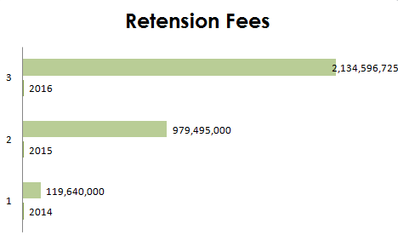
Results cont...
Increase in revenue collection

Slide 11
Conclusion and recommendations
The system was instrumental in attainment of WHO ML3 as it has improved management of applications for registration as well as collection of revenue for the Authority

Slide 12
Acknowledgements
TFDA Management Team
TFDA Manager for ICT and Statistics

Slide 13
Thank you (Asante)
Mt. Kilimanjaro

