Slide 1
THE 7th EAHSC Usability of redcap in multisite clinical trials in Kilimanjaro, Tanzania
Mtesha BA, Ngowi KM, Pima FM, Mmbaga BT, Sumari-de Boer IM

Slide 2
Introduction
We have two clinical trials.
One trial: conducted to improve adherence among people living with HIV (PLHIV) in Kilimanjaro, Tanzania.
Two Sites involved
KCMC Hospital
Majengo HC
Second trial: Improve adherence by using digital technology among TB patients.
All clusters found in Kilimanjaro region involved.

Slide 3
Challenges facing: TRIALS
Cost: Human resources, transport, paper-printed(CRF)
Data quality-fixing queries, security
Storage: Scalability difficult
GCP compliancy issues

Slide 4
Innovation…
Redcap.
Research electronic data capture.
Building and Managing online database.
Created at Vanderbilt University, 2004.
The software is free.
Login remotely.

Slide 5
Objective.
To determine usability of redcap in two clinical trials in Kilimanjaro, Tanzania.

Slide 6
Material and methods
Redcap used in two clinical trial.
Building database.
Data collection.
Query Management.
Databases set up and Data collection/entry.
DMU of Kilimanjaro Clinical Research Institute (KCRI)
Tablets with android platforms by nurse counselors.
Ethnographic Observation.
We used observation to investigate usability.

Slide 7
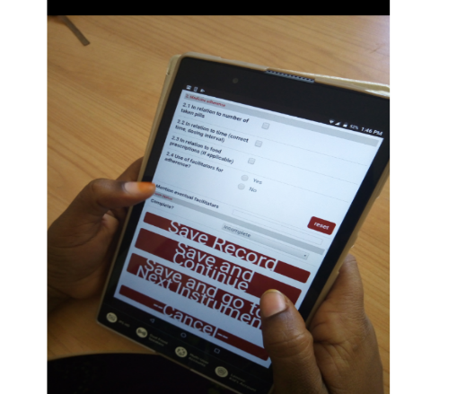
Redcap server at KCRI
Study site
Send Data
Download update data
Solving queries
Research
team

Slide 8
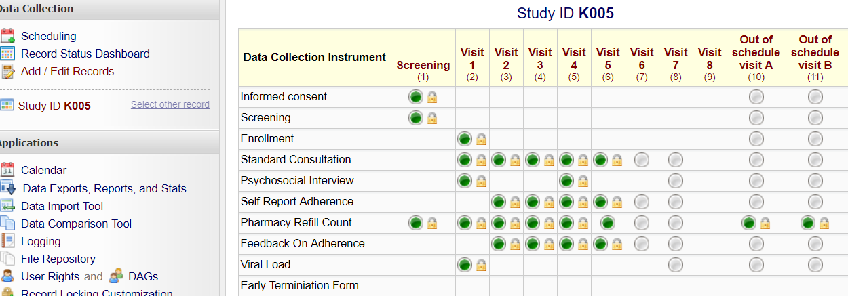
Material and methods
Databases
Single participant
All participants

Slide 9
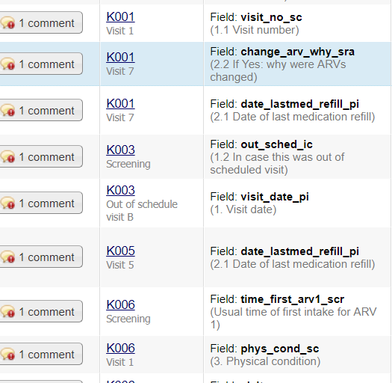
Material and methods
Data collection &
queries management
Redcap Queries
Data collection

Slide 10
Results of first trial
Query outcomes
Easy to create and solve query by using Redcap.
We have 260 HIV patients which is ready entered to the database.
Over 3000 queries raised and also solved on time.

Slide 11
Results of first trial
Nurses found use of redcap feasible don’t want to go back to paper.
Only costs are purchasing of tablet.
No programmer involved to build database.
Nurses are satisfied with data entry mode on tablets.
Data can be easily downloaded in different formats for analysis.

Slide 12
Results for second trial
Tuberculosis trial.
Database completed.
Training done.
Nurses are satisfied.
We expected 660 participant in this trial.
185 Site included.
Forms were developed through different CRF: Screening, Enrolment, Laboratory, Standard consultation, Feedback and stigma.

Slide 13
Discussion
Observation and qualitative method used.
Query management should be possible through tablets.
Save time and cost.
Quality and security.

Slide 14
Conclusion and Recommendation
Redcap was found usable.
We recommend trials in resource-limited settings to use Redcap.

Slide 15
Acknowledgment
Participants of both sites.
Study teams
Data management Unit of KCRI
Administrative Unit of KCRI
Funders

