Slide 1
USING MHEALTH TECHNOLOGY TO IDENTIFY AND REFER SURGICAL SITE INFECTIONS AMONG WOMEN WHO UNDERGO CAESAREAN SECTION IN RURAL RWANDA: A RANDOMIZED CONTROL TRIAL
Theoneste Nkurunziza, MSc, MPH
Health Research Manager, Partners In Health/Inshuti Mu Buzima
7th East African Health & Scientific Conference
March 27-29th 2019

Slide 2
Background
Surgical Site Infections (SSIs) are the most common healthcare-related infection.
LMICs disproportionately affected.
Rate of post-operative SSI between 7.1 and 30.9%.
SSIs lead to:
Considerable morbidity and mortality.
Longer hospital stay.
Increased cost.
In Rwanda 13% of deliveries are done through a c-section.
No standard post-discharge F/U.
High rate of post-discharge SSI.
Abbas & Pittet, 2016; Chu et al., 2015; Mpogoro et al., 2014, Rwanda DHS, 2014-5

Slide 3
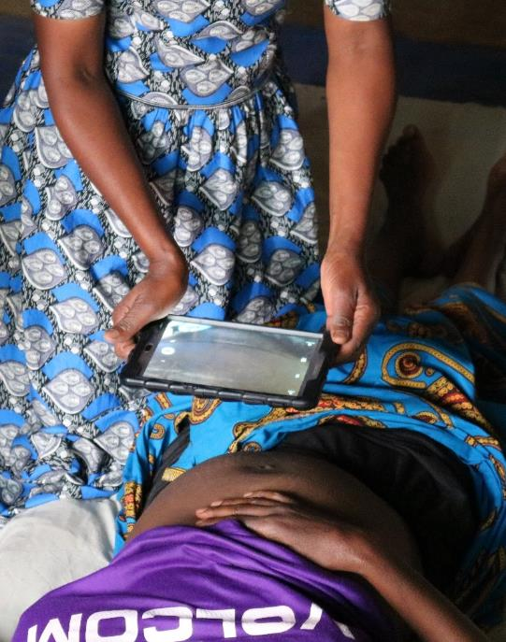
Study objective
We evaluated whether the use of mHealth technology by community health workers (CHW) could increase c-section patients’ return to care.
Approach:
Follow up among surgical patients leveraging:
Community Health Workers (CHWs)
Mobile technologies

Slide 4
Study Phases
SSI Screening Protocol development
Optimization
Standard of Care
Arm 1
CHWs + Home Visits + Protocol
Arm 2
CHW + Phone Calls + Protocol
Phase 1:March-October 2017
Phase 2: November 2017-October 2018
Notes:
First we tested the use of SSI screening protocol by CHWs and their ability to correctly diagnose SSI, next we optimized the screening protocol was then use in phase 2.
Then we randomized patients receiving surgery at KDH to one of three arms – standard of care and the two intervention arms. At the conclusion of the study, we compared rates of return and severity of SSI at return among the three arms and reported process indicators describing the implementation of the CHW-mHealth interventions in the two intervention arms *Am 1& 2.

Slide 5
Methods
Patients were randomized to study arms.
Intervention arms:
Home visit (Arm 1): n=335 (32.7%)
Phone call (Arm 2): n=334 (32.6%)
Non-intervention (Arm 3): n=356 (34.7%).
CHW conducted an mHealth-supported SSI screening for intervention arms (1&2).
Outcome: Rate of return to care within 30-days post-surgery.
Analysis:
Logistic regression model

Slide 6
Results
Majority (n=549, 53.4%) aged 22-30 years.
67.9% (n=696) with primary education.
Received interventions:
294 (87.8%) from Arm 1
226 (67.6%) from Arm 2.
Returned to care: 99.2% (n=889)
Mostly (89.4%) for routine wound change.
96 women (10.9%) were diagnosed with SSI.

Slide 7
Results
Table 1: Determinants of return to care among c-section patients
 | AOR | CI95% | P-value
Study arms
Standard care | Reference
Home visit | 0.92 | (0.56- 14.92) | 0.95
Phone call | 0.21 | (0.02- 1.89) | 0.165
Education level
Primary education | Reference
No education | 0.34 | (0.03- 3.87) | 0.386
Secondary education | 0.24 | (0.04- 1.47) | 0.123
University education | 0.07 | (0.01- 0.82) | 0.034

Slide 8
Discussion
The return rate of over 99% reflects:
Strong health system
Patients’ compliance to routine wound check after discharge.
The specific interventions did not improve rate of return as these rates were already high.

Slide 9
Rational for use of mHealth technology
Return to care rate in this population was unknown prior to study implementation.
We had hypothesized that mHealth technology could improve not just return to care but also make return more timely.
High rates of SSI (10.9%)& the cost for transport is a predictor of SSI.
It makes these follow-up visits financially burdensome on patients.
The use of CHWs and mobile technology to further decentralize post-discharge follow up at the patient's home seems feasible and beneficial to relieve financial and geographical barriers.

Slide 10
Conclusions & Recommendation
Almost all women returned to care regardless of SSI screening through home visit or phone call.
We are exploring whether shifting postoperative follow-up to the patient’s home using telemedicine approach is feasible.

Slide 11
Acknowledgments
Co-authors:
Fredrick Kateera, Robert Riviello, Teena Cherian, Rachel Koch, Madgalena Gruendl, Jonathan Nkurunziza, Laban Bikorimana, Patient Ngamije, Erick Gaju, Georges Ntakiyiruta, Bethany Hedt-Gauthier.
Study staff: Edison Nihiwacu, Bahati Ramadhan,Leila Dusabe, Marthe Kubwimana.
Collaborators:
Kirehe DH DG
Partners In Health Kirehe site Leadership
Kirehe District Leaders
Funding: NIH R21EB022369

Slide 12
THANKS! Q&A

