Slide 1
The 7th EAHSC
The community-based health program perfomance improvement with motivational p4p strategies
Kafwimi, Neema
D-tree International
www.d-tree.org

Slide 2
Outline
Introduction
Methodology
Results
Challenges
Lessons learnt
Takeaways

Slide 3
Pay for performance models-p4p
What is p4p?
Transfer of money or material goods conditional on taking a measuarable action or achieving a pre-determined perfomance targert (Source: Oxman and Fretheim, 2008)
Incentives on the supply side(providers) or the demand side (clients)

Slide 4
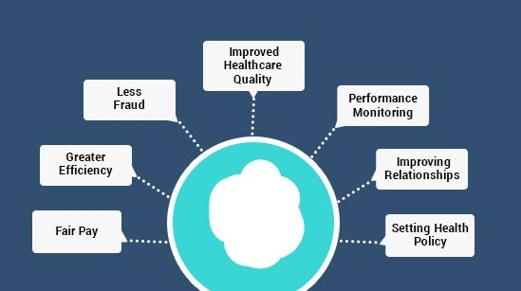
Pay for performance models: Objectives
Improve quality and efficiency of care
Promote positive health outcomes
Increase uptake of services

Slide 5
Pay for performance models-p4p
What are the different types of p4p models?
Targeted performance criteria e.g. patient outcomes, visits done, no. of registrations etc.
Incentives vs. disincentives
How does p4p fit within community health programs?
Family planning community programs
Maternal and neonatal health programs
Infectious disease control programs

Slide 6
Case Study: Implementation of pay for performance model in community based family planning program

Slide 7
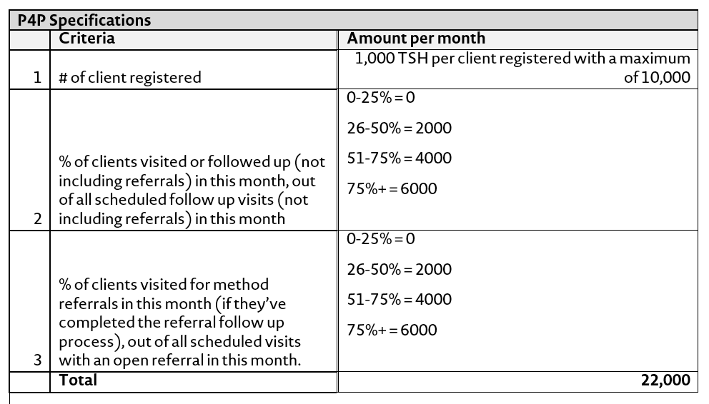
Methodology
Pay for Performance Design Process:
Identify the program’s needs/challenges
Design criteria and incentives to address the need
Implement the incentive plan for the program
Develop a system to track performance targets

Slide 8
Program background
Packard E3 – Family planning
Objective: Improve the quality of family planning counseling services and client satisfaction through the use of a mobile phone application.
Location: Shinyanga, Tanzania
Period: May 2014 - present
Users: 240 CHWs, and 60 Supervisors
Pathfinder PHE Family planning
Objective: To increase uptake of family planning services through the use of a mobile phone application.
Location: Kigoma, Katavi, Arusha and Manyara (Tanzania)
Period: Oct 2018 - present
Users: 176 CHWs, and 40 Supervisors

Slide 9
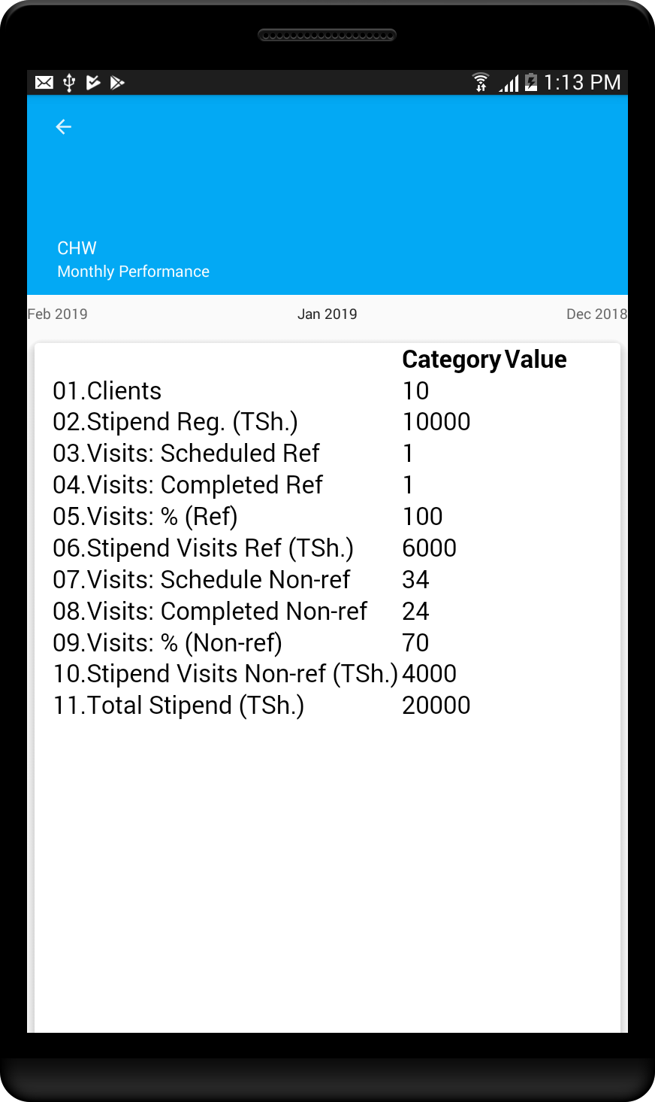
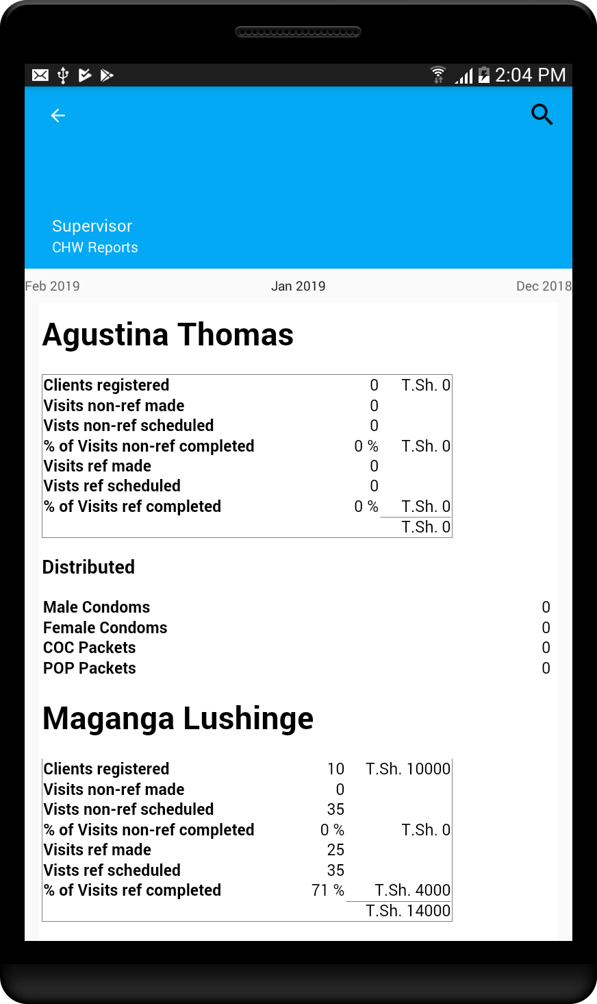
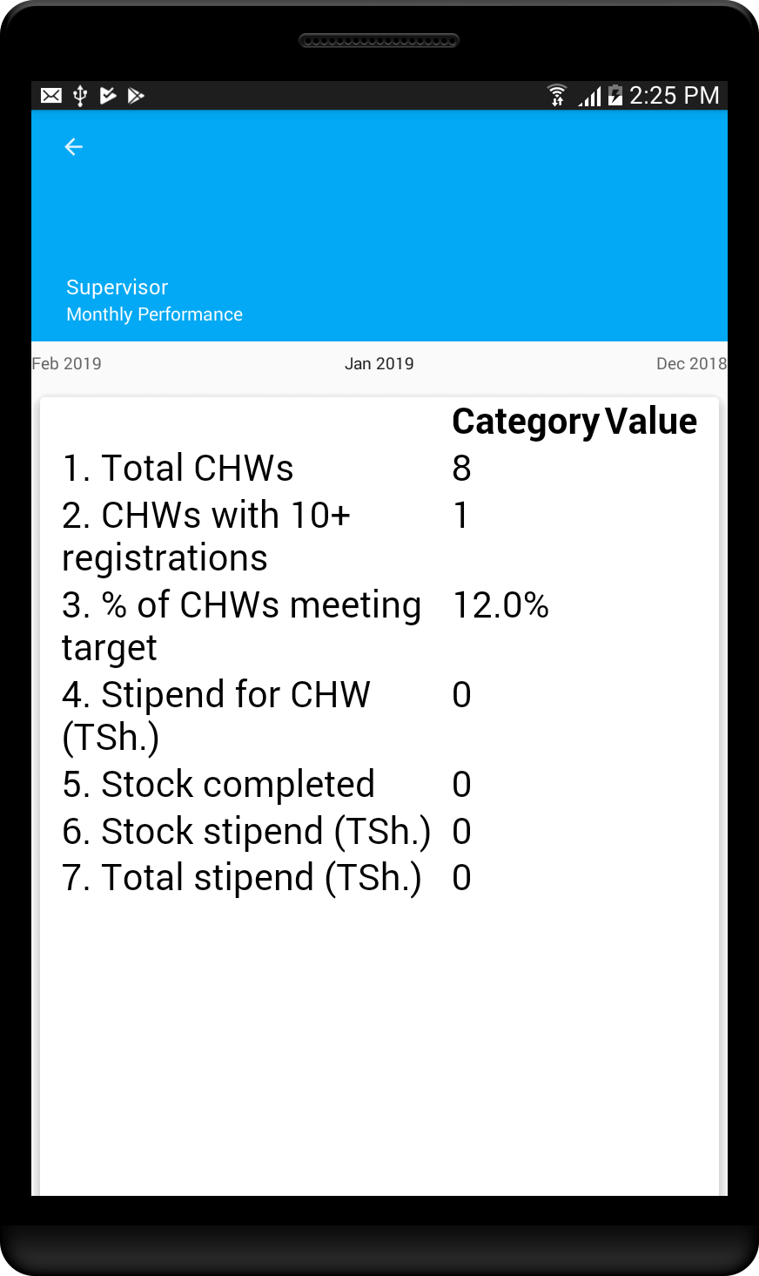
Methodology: On device reports
CHW Application
CHW Reports
Supervisor Application
Supervisor’s p4p report

Slide 10
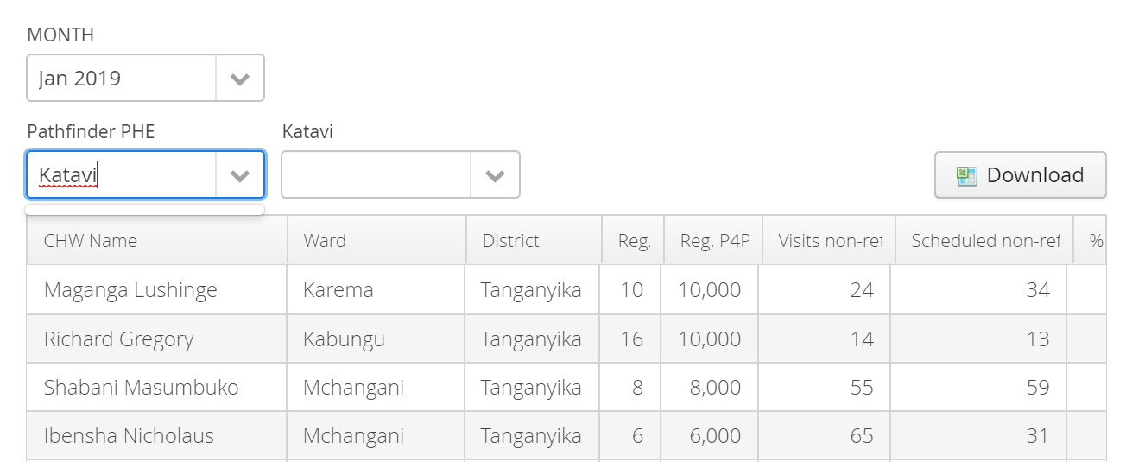
Methodology: Dashboard reports

Slide 11
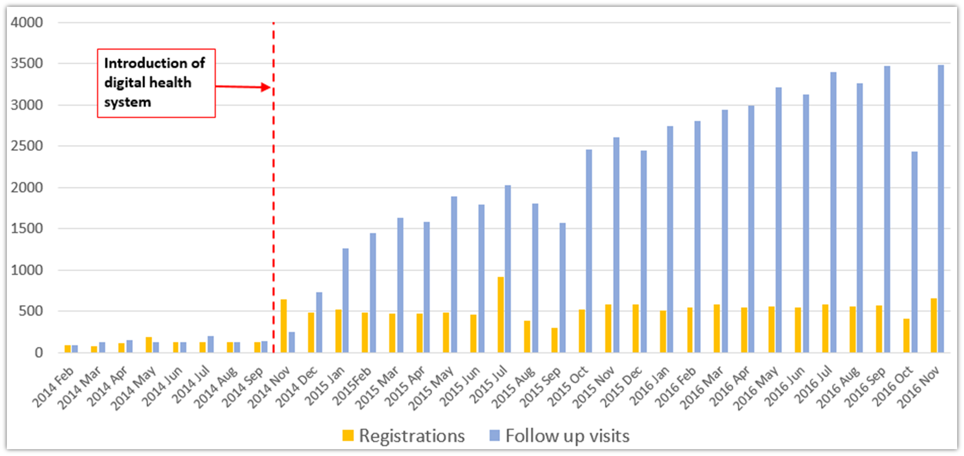
Results
Packard E3 – Family Planning
5x increase in the number of monthly registrations
15-fold increase in the number of follow-up visits
CHW performance after the introduction of mobile Family Planning application and pay for performance scheme in Shinyanga District Council, Tanzania. February 2014-November 2016

Slide 12
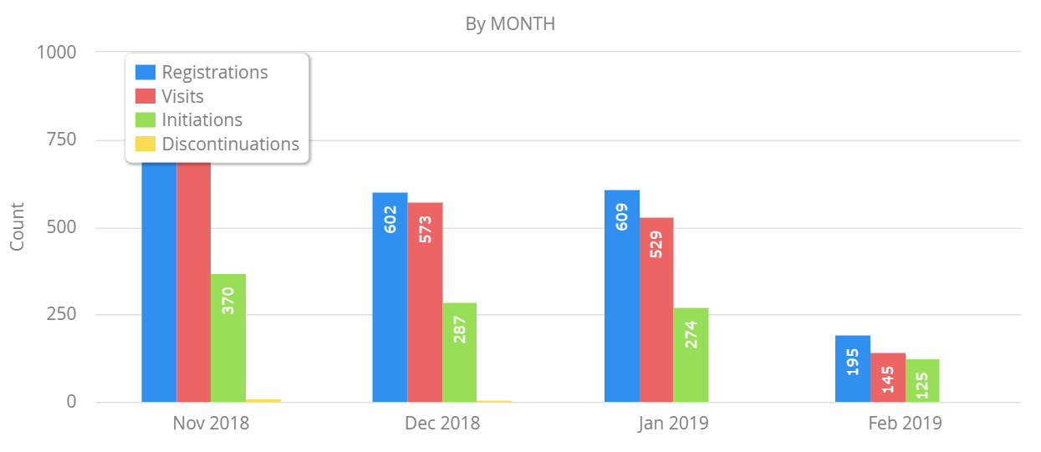
Results
Pathfinder PHE Family Planning
CHW performance after the introduction of mobile Family Planning application and p4p in Kigoma,Katavi, Arusha and Manyara. November 2018 – February 2019
Notes:
Number of users and clients supported by the system

Slide 13
Challenges
Involvement of different stakeholders with different conflicting perspectives on performance targets.
Gaming of the system by CHWs e.g. manipulating performance targets and fabricating data.
Lessons Learnt
Listen to different perspectives and reach a consensus that’s reasonable and feasible on ground.
Develop a data integrity and quality assurance plan to identify suspicious data
Implement regular planned follow up visits with CHWs

Slide 14
Takeaways
A strong design process is key to a successful p4p model.
The model has proved to dramatically increase CHWs motivation and performance, resulting in improved health services delivery. The system show success across 800 CHWs, which indicate large potential for other programs to use performance based incentive schemes.
Considerations for program teams to include comprehensive pay-for-performance models in community health programs in order to achieve program targets.

Slide 15
Acknowledgements
Litner, Rebecca D-tree International
Kahamba, Gloria D-tree International
Mwaikokesya, Erika HJFMRI

