Slide 1
The 7th EAHSC
Cross-Border Disease Management
Kyle Hutchinson
Senior Business Analyst
BroadReach

Slide 2
Context
Background
Objectives
Results
Conclusion
Solution

Slide 3
Background
The Regional Action through Data (RAD) program is a 5-year cooperative agreement, funded by the USAID Africa Bureau
Led by BroadReach in partnership with WAHO, IGAD, Jembi Health Systems and Duke University
Aims to strengthen the use of data to drive performance in healthcare service delivery, and thus improve health and development outcomes in Sub-Saharan Africa (SSA), by leveraging analytics and technology to improve evidence-informed decision-making.

Slide 4
Background
Disrupting current models of healthcare, changing how and why data is collected, analysed and then used to achieve results.
At the macro level to aggregate information from disparate sources to provide regional and national level decision-makers the right information to make evidence-informed, data driven decisions around strategy, policies and resource allocation
At the patient-provider level, to ensure that appropriate data is collected and used for evidence-based patient care and to ensure continuity of care

Slide 5
Background
The RAD program was realized through a co-creation process, with user-centred design as a fundamental guiding principle.
Thus, early stakeholder engagements in year 1 of the RAD program highlighted:
Epidemic-prone disease as the priority focus area for West Africa; and
The need to reduce the overall epidemic-prone disease burden throughout the ECOWAS region.

Slide 6
Objectives
The objective of the subsequent research effort was to therefore understand:
Existing practices and associated challenges regarding disease surveillance and response efforts in the region; and
How the RAD program might enable the West African Health Organization (WAHO) to better support member states in their efforts to reduce the epidemic-prone disease burden throughout the ECOWAS region.

Slide 7
Methods
Rapid site assessments were carried out in Cote d’Ivoire, Ghana and Togo, which involved:
Semi-structured qualitative discussion guides;
Individual and group discussions;
Verbatim transcripts of all interviews; and
Qualitative content analysis.

Slide 8
Results
Extensive cross-border movement of people throughout the ECOWAS region, as a result of the freedom of movement policy, which exacerbates the high epidemic-prone disease burden in West Africa.
Use of informal channels, such as WhatsApp, by the surveillance units to communicate information on epidemiological events.
A relative absence of policies in Togo, Ghana and Cote d’Ivoire related to cross-border information sharing.

Slide 9
Conclusion
While national disease surveillance and response systems are established, there is a need to formalize and further strengthen disease surveillance and response efforts in cross-border settings in terms of information sharing and the coordination of response efforts.

Slide 10
Solution
Challenge: Reducing the burden of epidemic-prone disease across the ECOWAS region
Extensive cross-border movement of people throughout the ECOWAS region
Exacerbates the high epidemic-prone disease burden in West Africa
Solution: Vantage Disease Management Solution
Configured for the cross-border context
Works in conjunction with the WAHO regional data platform (DHIS2) by leveraging the weekly data submitted by member states
Formalize and further strengthen disease surveillance and response efforts in cross-border settings in terms of information sharing and the coordination of response efforts.

Slide 11
Solution
The Cross-border disease threat solution involves automated, weekly emails that can be distributed to relevant stakeholders inclusive of natural language:
Alerts and epidemic alerts in relevant cross-border districts; and
Recommended World Health Organization (WHO) responses.

Slide 12
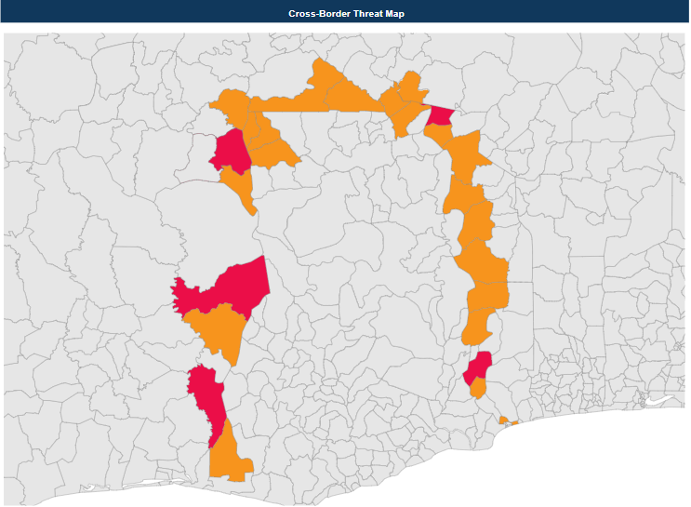
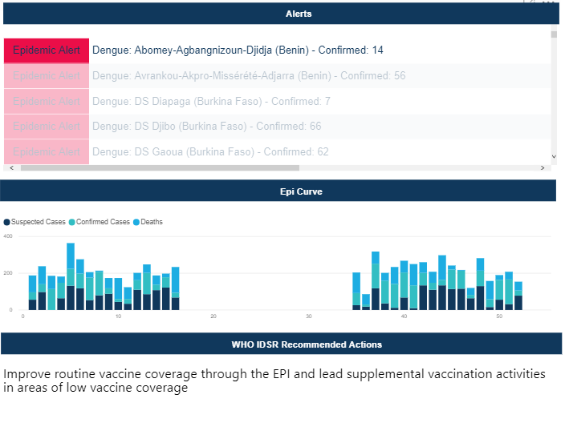
Solution
The cross-border disease threat solution also involves an accompanying dashboard that can be accessed by following a link in the email, which includes
An interactive map highlighting district-specific threats,
Associated natural language alerts and epidemic alerts,
Epi-curves; and
Relevant WHO recommended responses.

Slide 13
Solution
The cross-border disease threat solution is conceived to ultimately support the:
Timely identification of emerging cross-border epidemic threats
Sharing of relevant information across international borders; and
Subsequent coordination of recommended World Health Organization (WHO) responses between member states.

