Slide 1
DIGITISATION OF THE IMMUNOHISTOCHEMISTRY RECORDS’ MANAGEMENT SYSTEM
THE 7TH EAST AFRICAN HEALTH AND SCIENTIFIC CONFERENCE (EAHSC)
AT THE MOI TEACHING AND REFERRAL HOSPITAL (MTRH) KENYA
DR. KIRTIKA PATEL, BSc MSc PhD DIC
ASHWINDER SINGH, MEDICAL STUDENT (YEAR V)
DR. KIBOR KEITANY KIBET
DR. NAFTALI BUSAKHALA
DR. FREDRICK CHITE ASIRWA
MOI UNIVERSITY, SCHOOL OF MEDICINE, ELDORET, KENYA
MOI TEACHING & REFERRAL HOSPITAL, ELDORET, KENYA

Slide 2
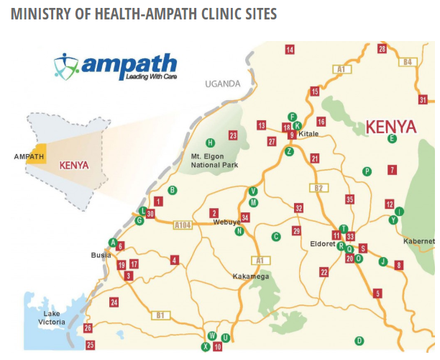
INTRODUCTION
AMPATH-UofT. (n.d.). Ministry of Health - AMPATH Clinic Sites. Retrieved from AMPATH-UofT Web Site: http://ampath-uoft.ca/about-us/activities/map/

Slide 3
INTRODUCTION
Immunohistochemistry (IHC) – diagnostic tool on the basis of the characteristics of intracellular and/or cell surface proteins
Prognosis & predicted markers, choice of management, response to therapy, residual disease burdens identifiable, e.g. HER2 and breast cancer
East Africa crude incidences of cancer – 81.6 per 100000; Kenya 95.9 per 100000 – GLOBOCAN 2012 (Ferlay, et al. 2013)
Challenges in developing countries, e.g. Kenya – high incidences of cancer with very limited availability of such services (coupled with high cost burdens at Private facilities)
Ferlay, J., Soerjomataram, I., Ervik, M., Dikshit, R., Eser, S., Mathers, C., . . . Bray, F. (2013). Cancer Incidence and Mortality Worldwide: IARC CancerBase No. 11. Retrieved from GLOBOCAN 2012 v1.0: http://globocan.iarc.fr

Slide 4
IHC at MTRH developed as part of AMPATH Oncology Programme – only public health facility with modality in region; started 2012
Standard SOPs in place to guide testing and reporting; Standardisation met by oversight through local and international partner staff, inclusion of UKNEQAS (Patel, et al., 2016)
No standardised data recording, management and analysis system; records maintained at receipt/issue registers, files with patient report copies
Overall, prone to loss of statistical information, misuse; true utility of modality in setting underappreciated
Patel, K., Strother, R. M., Ndiangui, F., Chumba, D., Jacobson, W., Dodson, C., . . . Smith, J. W. (2016). Development of immunohistochemistry services for cancer care in western Kenya: Implications for low- and middle-income countries. African Journal of Laboratory Medicine, 1-7.

Slide 5
OBJECTIVES
To develop a records management tool for the entry, storage and retrieval of immunohistochemistry records at MTRH
To analyse the immunohistochemical tests performed at MTRH and describe its utility

Slide 6
METHODOLOGY
Retrospective descriptive study – January 2012 to November 2017
Data capture tool designed using Microsoft® Excel® after identifying commonly required parameters; minimum to include patient demographics, gross and histological details of H&E, IHC markers tested, supportive impressions, diagnoses and conclusions
Spreadsheet designed with above fields and all records populated according to headers
Clustering into categories of diagnoses, with cluster frequency analysis as per diagnosis

Slide 7
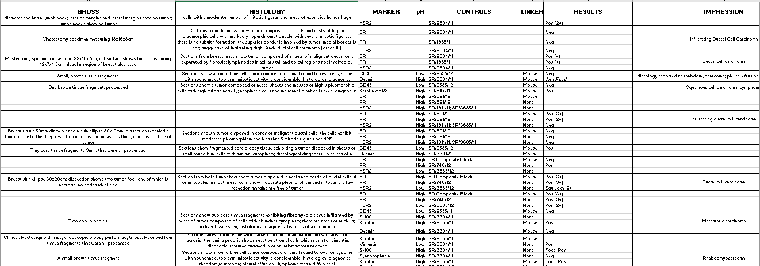
RECORDS’ MANAGEMENT SYSTEM (RMS) - TEMPLATE & FIELDS

Slide 8
RESULTS & DISCUSSION

Slide 10
DIAGNOSES CLUSTERED AS “OTHERS”
Hemang-ioma
Neuro-
fibromatous
Lesion
Pheochromo-
cytoma
Retino-
blastoma

Slide 11
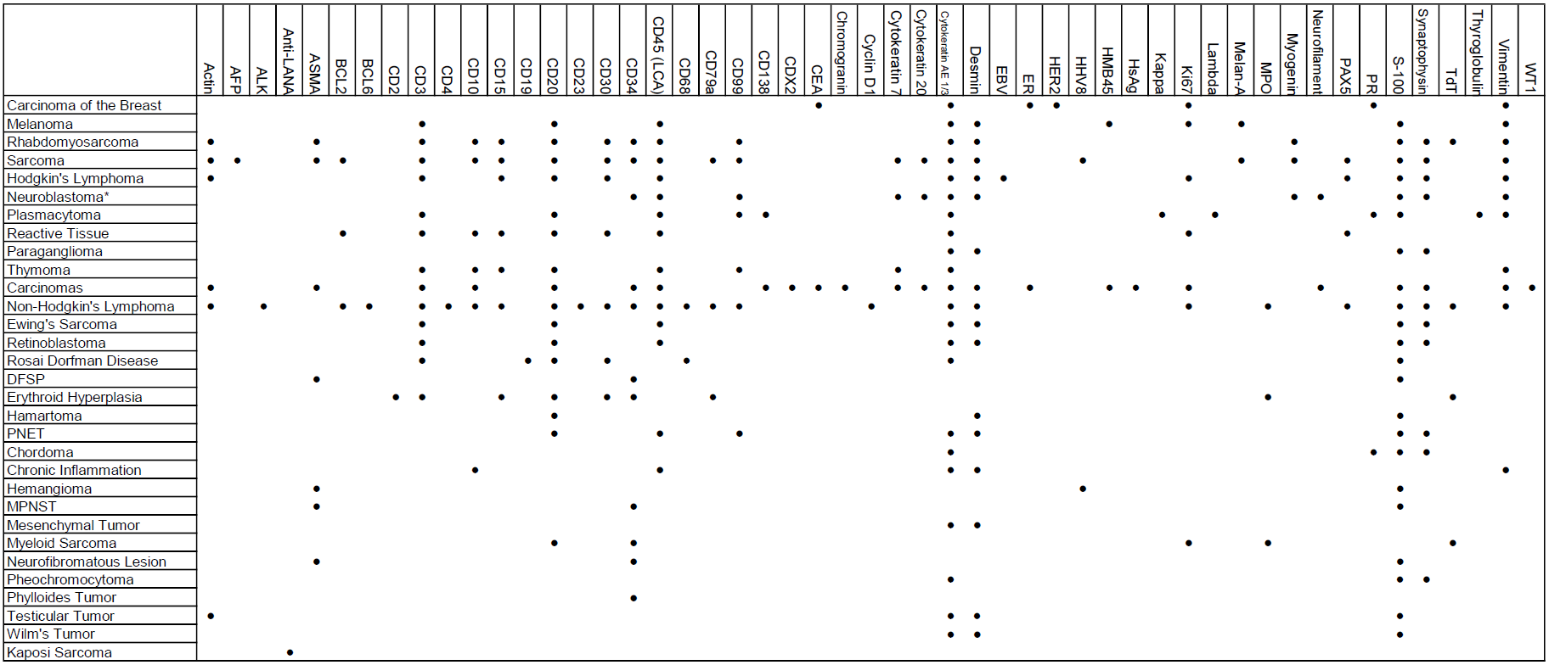
MARKERS USED FOR THE DIAGNOSES FROM THE RECORDS’ MANAGEMENT SYSTEM

Slide 12
True utility of modality only realisable with organisation of data that is easily interpretable – modelled on approach with minimal cost burden with most healthcare facilities in LMICs now having basic computer equipment
System requiring minimal additional informatics’ training for continuous data entry
Provisions for storage of picture information – H&E, IHC micrographs; ease of consultancy with distant based pathology advisory staff

Slide 13
CONCLUSION
Demonstrate the true value of maintaining digitised records even in resource-limited settings
Even basic spreadsheet software such as in this case are able to maintain structured records where limitation to invest in specialised health management software systems
Demonstrates ease of integration into central health facility/national health data management software once in place

Slide 14
Ease of linkage to other database software such as Microsoft Access (in case stand-alone user interface needs to be set up)
Clarifies role of modality in management approach for oncology – aid in clinical diagnosis which can be ambiguous
Summation of multitude of diagnoses that can be arrived at even with limited marker reagents available, as is case in the setting

Slide 15
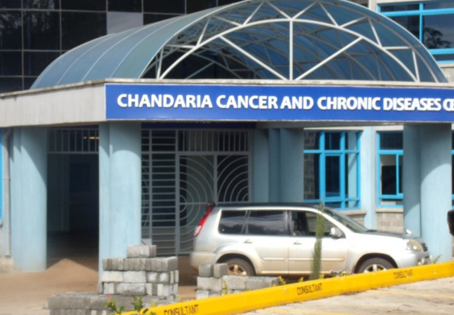
ACKNOWLEDGEMENTS

