Slide 1
The 7^{Tth} EAHSC Evaluation of cytokines in PBMC supernatants for the diagnosis of tuberculosis
Margaretha Sariko^{1,2,3}, Athanasia Maro^{1,2}, Jean Gratz^{1,5}, Eric Houpt⁵, Riziki Kisonga^{1,4,} Stellah Mpagama^{1,4}, Scott Heysell⁵, Blandina T. Mmbaga^{1, 2,3#}, Tania A. Thomas^{5#}.
1. Kilimanjaro Clinical Research Institute, Moshi, Tanzania
2. Kilimanjaro Christian Medical University College, Moshi, Tanzania
3. Kilimanjaro Christian Medical Centre, Moshi, Tanzania
4. Kibong’oto Infectious Diseases Hospital, Kilimanjaro, Tanzania.
5. University of Virginia, Charlottesville, USA
# These authors contributed equally

Slide 2
Outline
Introduction
Antibody Lymphocyte Supernatant(ALS).
Cytokine responses
Results

Slide 3
Introduction cont…………
Kozakiewicz et al., 2013

Slide 5
Introduction
TB Diagnosis is still difficult.
Need of alternative sample for diagnosis.
Rapid and a cheap diagnostic and monitoring tool for TB are highly needed.

Slide 6
Methodology
This was a case control study .
Two groups of adults participant; TB Cases enrolled at KIDH and Hospitalized controls were enrolled at KCMC.
The collected samples were processed at KCRI/Biotechnology

Slide 7
Methodology
The sample used is the PBMC supernatant.
Cytokine/chemokine/ growth factors measured in duplicate using the Bio-Plex Pro Human Cytokine 27- Plex, Group I kit
Luminex platform (Bio-Plex 200, Bio-Rad).

Slide 9
Analysis plan
Description of the demographic characteristics of the patient.
Comparison of the cytokine levels at between TB cases and hospitalized.
Compare cytokine at baseline and week 4 of treatment among TB cases.
To evaluate cytokine models together with ALS if can improve ALS results
Notes:
Determine to use cytokine results with ALS TO SEE IF THERE IS BASIC IN IMPROVING als ALONE

Slide 10
Notes:
45 ds and 21 mdr, 7 clinically diagnosed

Slide 11
Figure 1: Unstimulated PBMC cytokine response among TB Cases versus Hospitalized Controls.
TB cases are shown in green and healthy controls in red. Data presented in pg/ml. Lines show the median with interquartile ranges. Mann-Whitney U test was used for comparison between groups, Bonferroni correction was applied and the p-value of 0.002 was considered significant.

Slide 13
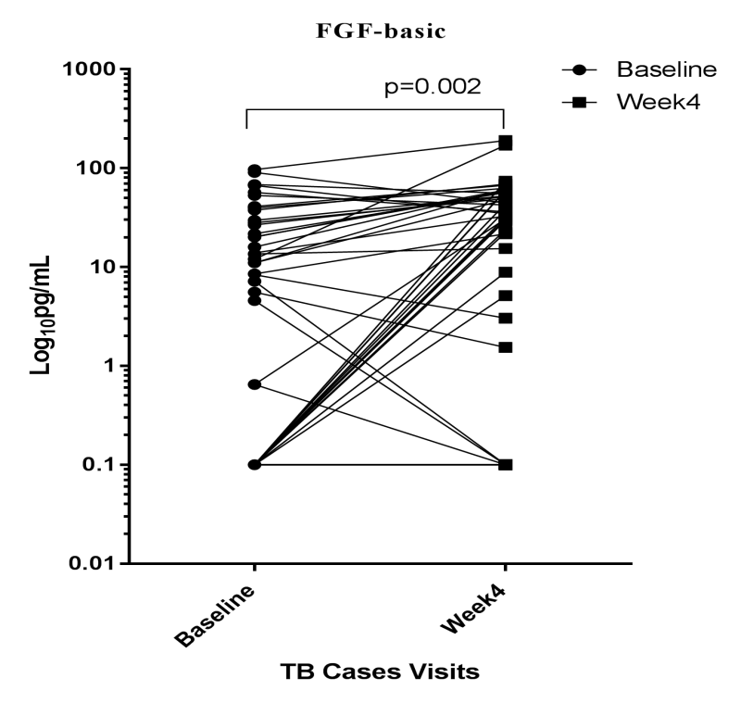
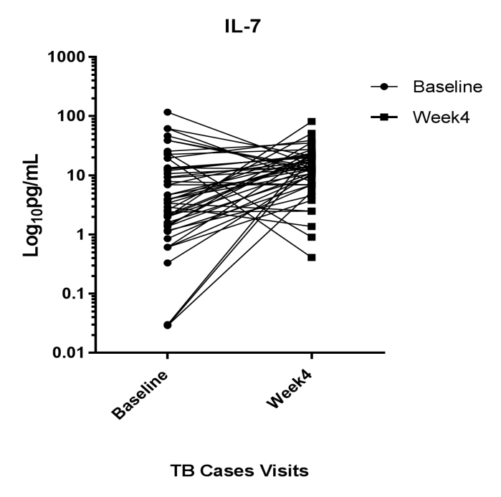
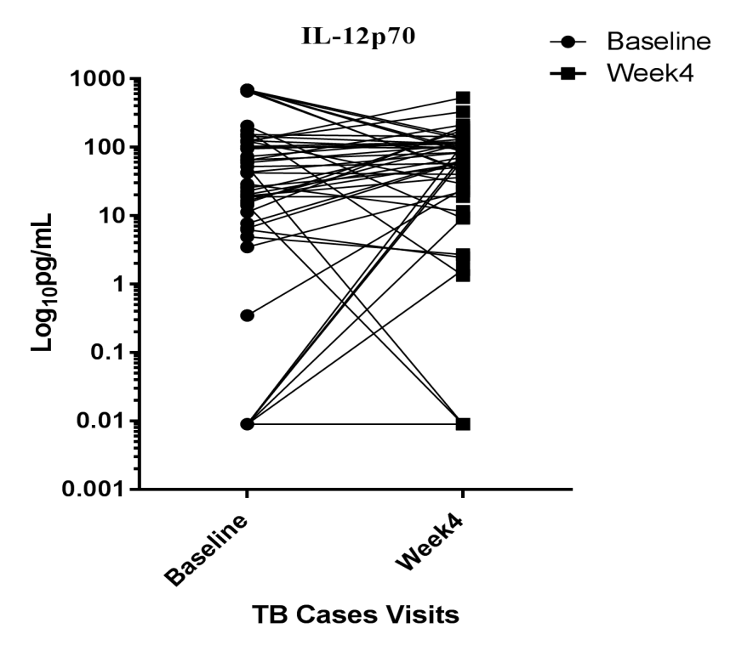
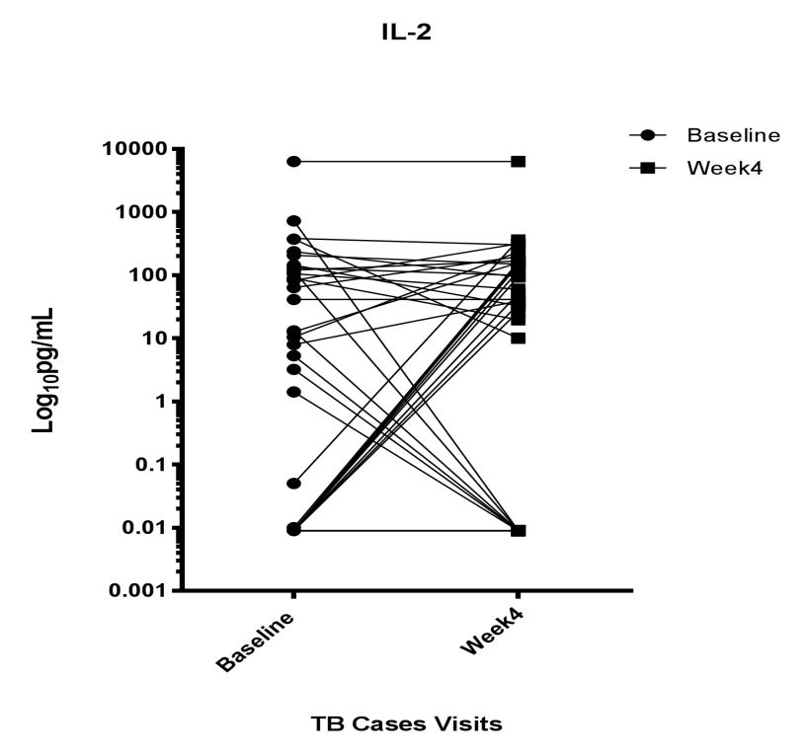
FIGURE 2 continue…

Slide 15
Conclusion
Most of the cytokines were low in TB cases compare to the hospitalized controls.
When we compare the cytokine levels between baseline and week 4 of treatment none of the cytokines showed a significant difference.
ALS continue to show a significant power in diagnosis over cytokine when used in combination or single.

Slide 16
Acknowledgement
Academic Centre for Evidence Based Health Interventions
an institution of the Good Samaritan Foundation

