Slide 1

every person counts
www.simprints.com
www.simprints.com

Slide 2

Finding every mother:
Improving maternal healthcare outcomes in BRAC Manoshi through biometrics
Christie Civetta
Impact Partnerships Manager
christie@simprints.com
The 7th EAHSC
March 2019
www.simprints.com
www.simprints.com
www.simprints.com
www.simprints.com
www.simprints.com

Slide 3

Over 30% of mothers in Bangladesh slums never see a health worker.
(National Institute of Population Research and Training, 2012)

Slide 4
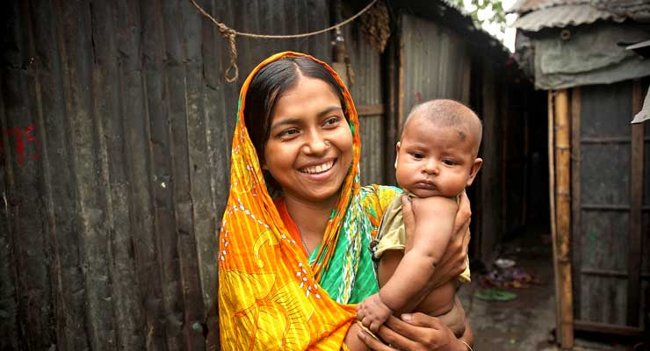
About BRAC and Manoshi
BRAC promotes a broad concept of health among disadvantaged communities.
Manoshi started off as a pilot initiative in 2005 in one northern district of Bangladesh. Expanded across 14 rural districts and 11 city corporations, providing access to quality MNCH services to rural and urban slum population.
eHealth was initiated to digitise the health services by collecting, recording and preserving household information.
www.simprints.com

Slide 5
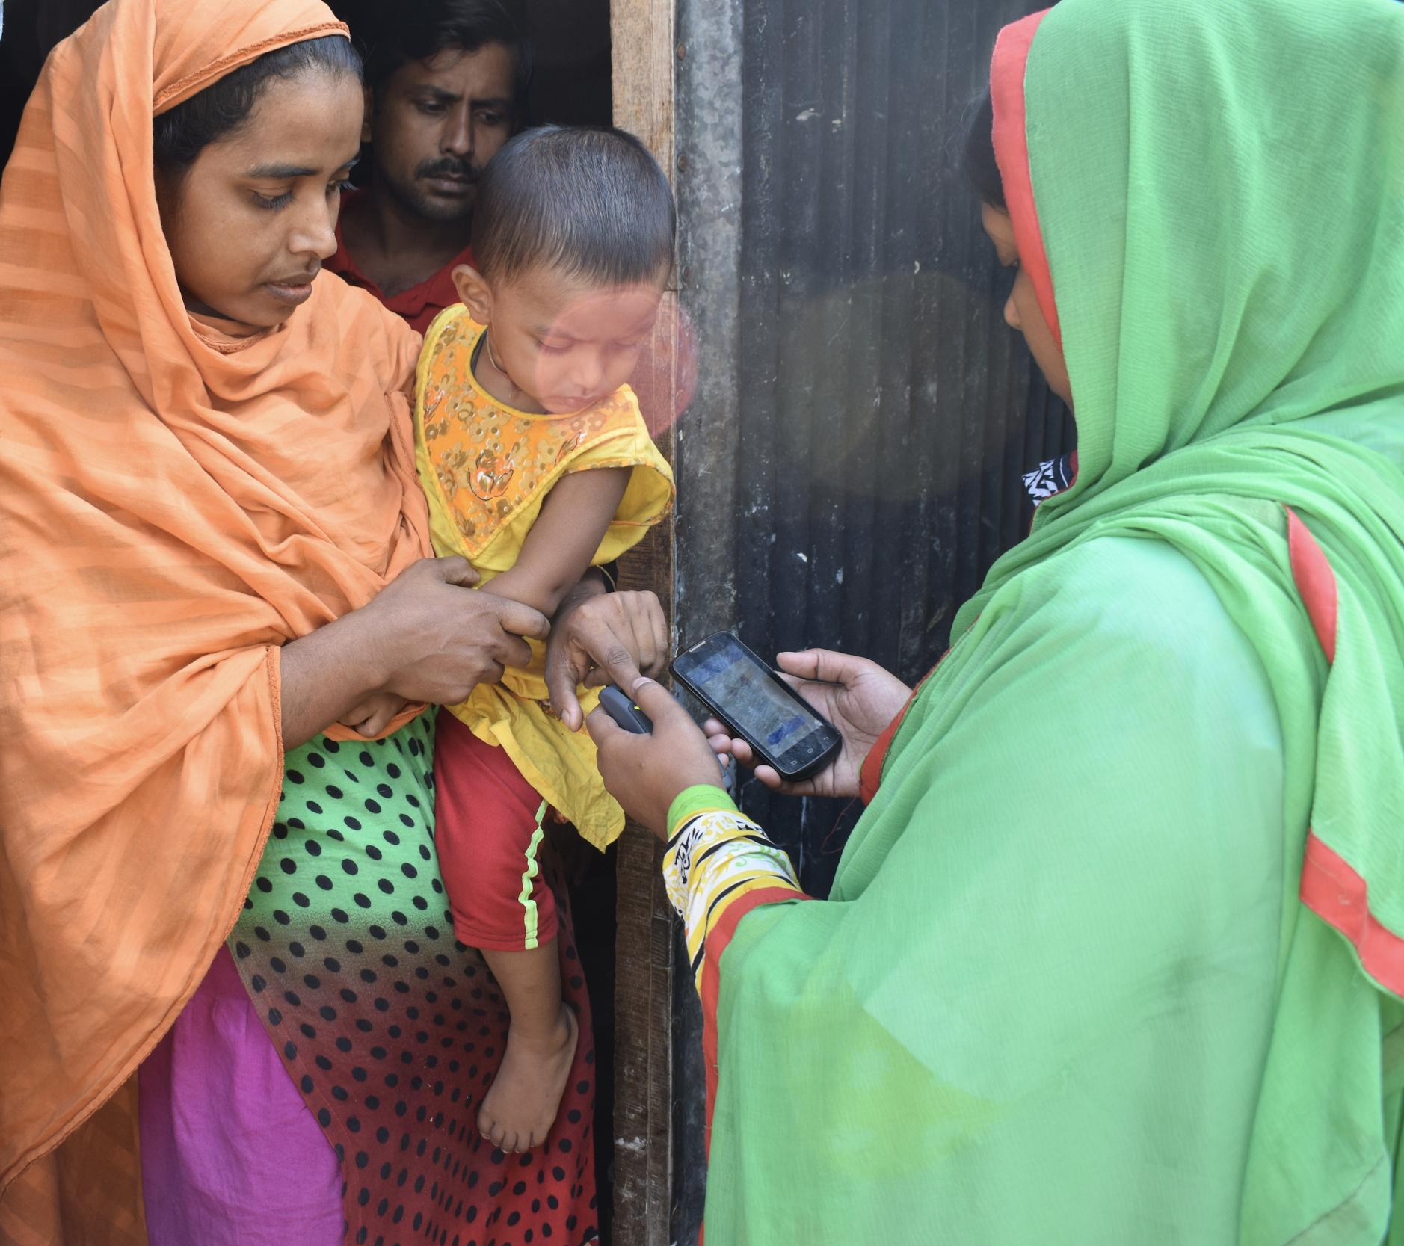
About Simprints
A non-profit tech4dev company from the University of Cambridge.
Impact-driven organization offering biometric identification solutions to Governments and NGOs to improve delivery of essential services for last-mile beneficiaries.
Currently uses fingerprints; working on development of AI-based solutions.
Can be integrated with existing mobile data collection platforms (e.g. CommCare, OpenSRP, SurveyCTO).

Slide 6
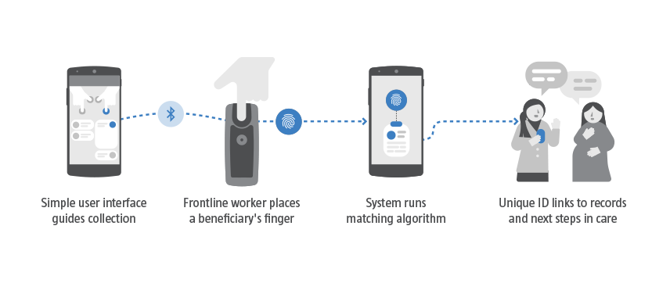
How does the Simprints ID solution work?
Can be seamlessly integrated into any existing workflow and application
Rugged, waterproof, mobile fingerprint scanner built for the toughest conditions on the front lines
Offline or online. Rapid matching that reduces errors and improves accuracy, compliance, and quality
Fingerprint serves as a globally unique and secure ID that cannot be forgotten or lost
www.simprints.com

Slide 7
Key features of the Simprints solution
PRIVACY & DATA SECURITY
WORKFLOW & INTEGRATION SUPPORT
HARDWARE
TRAINING & ROLLOUT SUPPORT
CLOUD SERVICES & TECH SUPPORT
DUPLICATION ANALYSIS

Slide 8
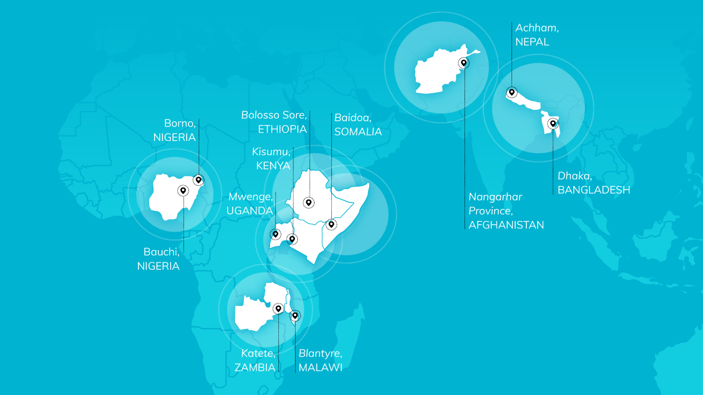







Global Deployments
11 countries
250,229 beneficiaries
4.1m beneficiaries scale-up by 2021

Slide 9
BRAC Manoshi

Slide 10
Project Details
A longitudinal study funded by DFID and GIF conducted in 2016-2017
Uniquely identified patients and linked every medical record to fingerprints
Rolled out in 4 Slums in Dhaka, reaching 22,000 mothers
Involved 3 Program Officers and 40 Health Workers
Simprints ID was also integrated to BRAC’s existing eHealth platform

Slide 11
Methodology
Quasi-experimental design
Baseline data collection before intervention roll out (Dec 2016/ Jan 2017) and endline 18 months later (June 2018).
Sample: 800 mothers i.e. beneficiaries of Manoshi program (Treatment: 400, Control: 400)
Out of 12 slums, 4 slums were selected as treatment (Simprints), and 4 slums as control (similar geographic and demographic profile); 100 mothers were randomly selected from each slum at baseline. For the endline, T: 342, C: 458.
Data collection
Female researchers used a pre-tested, semi-structured questionnaire; routinely monitored by BRAC RED team

Slide 12
Summary of Results
38% more ANC visits
Women in the Simprints group received substantially more ANC visits, and significantly more women had comprehensive birth plans and a skilled attendant at birth.
19% more newborns received care by trained providers
In the Simprints group, newborns received better essential newborn care and more postnatal visits, and 27.64% more women had comprehensive birth plans.
3,885 preventable neonatal deaths uncovered
Simprints data uncoveredtens of thousands of preventable deaths and instances of morbidity as well as $479,320 in lost programme funding due to service efficiency.
Notes:
38% more ANC visits on average than those in the control group
27.64% more women in Simprints group had complete birth plans
8.74% more women in the Simprints group had a skill attendant at birth

Slide 13
Other Lessons
Facilitating accurate linking of a beneficiary to their health records during a health visit.
Allowing managers to identify gaps in the ANC/PNC visit schedule.
Enabling better monitoring of SKs to confirm they are conducting their visits.
Other factors - the implementation of new technology has been recognised as empowering frontline workers.
Notes:
SL@B provided 2 Million USD to scale-up the programme under TTS
Apr 2018 - Mar 2021 (3 years)
2.1 Million Mothers and Children
850 health workers; 8,500 health volunteers
BRAC is revamping its mHealth platform and rolling it nationwide
Simprints will be deployed in 20% coverage areas

Slide 14

Thank you!
Christie Civetta
Impact Partnerships Manager
christie@simprints.com

