Slide 1
The 7th EAHSC
Mobile WACh NEO:
Engagement and satisfaction of pregnant and postpartum women with a two-way SMS service to improve neonatal outcomes.
AUTHORS
Jennifer A. Unger¹, Keshet Ronen¹, Brenda Wandika (BScN-UoN)², Claire Rothschild¹, Jay Shih¹, Lusi Osborn², Dalton Wamalwa², Maneesh Batra¹, Wangui Muthigani³, Grace John-Stewart¹, John Kinuthia²
^{AFFLIATE INSTITUTION}
¹ University of Washington, Seattle, WA, USA, ² Kenyatta National Hospital, Nairobi, Kenya
Contact: brandarl2015@gmail.com

Slide 2
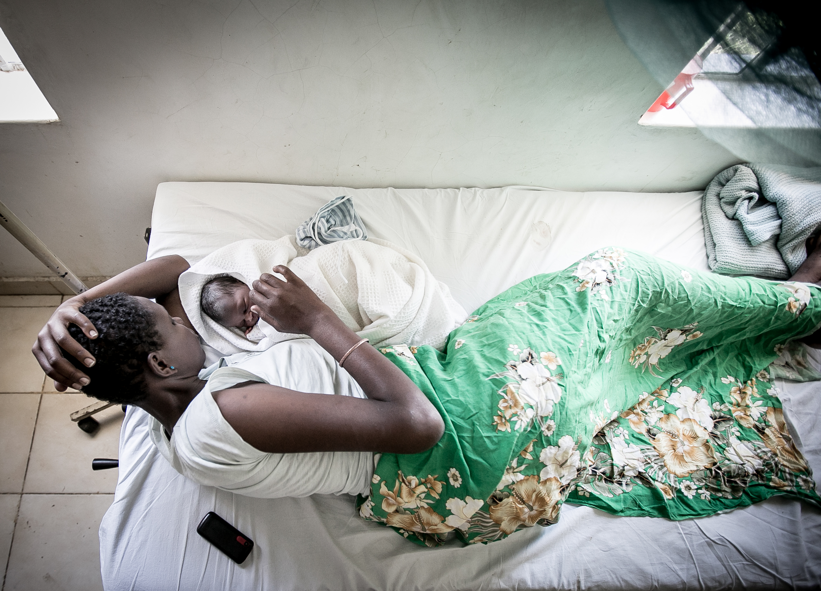




Mobile WACh NEO
Communication empowering mothers and newborns
Remotely connecting mothers and babies to a care provider during the most vulnerable hours before and after birth.
Mobile WACh NEO
Communication empowering mothers and newborns
Remotely connecting mothers and babies to a care provider during the most vulnerable hours
All identifiable persons in photos provided verbal consent
Notes:
Thank you to the event planners and East African E-Health community for inviting us to introduce our project Mobile WACh NEO- Communication Empowering Mothers and Mothers and Newborns.
This study is a collaboration between Kenyatta National Hospital and the Kenyan Ministry of Health and the University of Washington in the USA

Slide 3
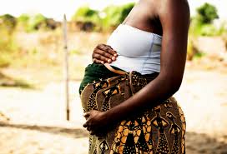
We need innovative solutions for maternal and neonatal health
293,000 women still die each year from complications childbirth (IHME, 2014)
Almost half of the estimated 6.9 million deaths under 5 occur in the first four weeks of life (WHO, 2012)
Neonatal mortality rate in Kenya remains 26.8 deaths per 1,000 live births (KDHS, 2014)
The majority of these deaths are preventable
  Access to skilled birth attendant
  Access to early neonatal care
  Access to EMONC
  Access to postnatal care including family planning
Supports and empowers patients; generates demand for healthcare
Improves health system efficiency and capacity
Notes:
We continue to need innovative solutions for Maternal and neonatal health.
Globally almost 300,000 women die each year from complications of childbirth
Almost half of the 6.9 million deaths under the age of 5 occur in the neonatal period
And in many places in sub-Saharan Africa the neonatal mortality rates are stagnant or only very slowly declining. In Kenya the rate remains high at 26.8 deaths per 1,000 live births
The majority of these deaths for mothers and newborns are preventable with access to services such as skilled birth attendants, early neonatal care, emergency obstetrical and neonatal care and postnatal care, especially family planning.

Slide 4



Remote engagement
with woman (weekly SMS)
Identification of birth partner
Delivery site
Transport plan
Childcare plan
Improved delivery experience and birth outcomes
Delivery
Remote neonatal assessment
and referral advice (daily SMS)
Feeding issues
Movement
Fever
Fast breathing
Severe chest indrawing
Convulsions
Jaundice
Improved neonatal health and survival
Remote contraceptive counseling and decision support (weekly SMS)
Post Neonatal Period
Assessment of knowledge/
preferences
Intentions
Experience
Partner disclosure
Myths
Personalized
recommendations
Improved uptake of appropriate contraception
Human –Computer Hybrid Communication solution
Notes:
This slide shows an overview of the Mobile WACh Neo intervention.
Our plan is to use 2-way interatctive SMS to provide tailored support in 3 strategic domains which have the greatest impact on maternal and child health:
facility delivery planning
clinical assessment of neonates and the postpartum mother,
and contraceptive decision support.
In late pregnancy, women join the program and receive weekly SMS focused on birth planning, ANC visit reminders and screening for danger signs.
After delivery, for the first 2 weeks, messaging is daily. These messages use clinical algorithms to assess the health of the mother and neonate and identify those with illness. Neonates with concerning clinical assessments are immediately referred to a facility.
From 2 to 12 weeks postpartum, messaging is weekly, with a focus on contraceptive support and counseling.
All messages contain a question or prompt to respond, and women can send messages to the nurse at any time. The nurse responds during business hours.

Slide 5
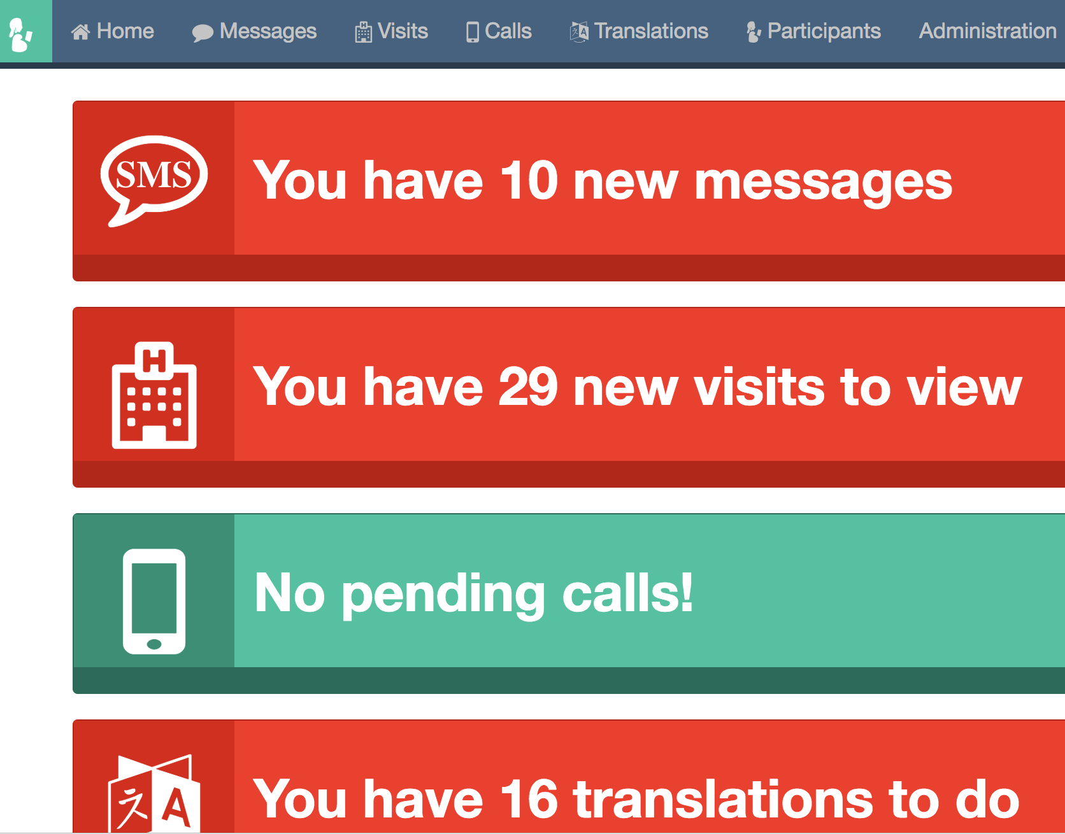
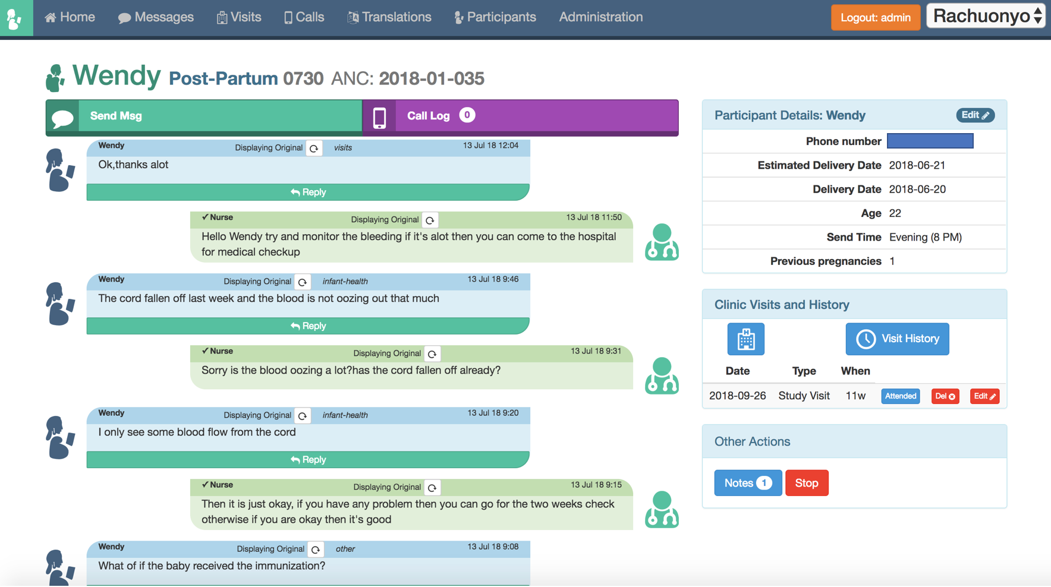
Mobile WACh’s user-friendly platform facilitates personalized interaction and robust data
Notes:
This is a screenshot of the Mobile WACh Neo interface used by the clinician to manage messaging.
You can see on the right the clinician sees a summary of the participants information. In this conversation we see that the woman reports that her 4-day old baby has a fever and the nurse refers her to the clinic.

Slide 6
Personalized messages focus on improving health outcomes
Antenatal care
{PATIENT NAME}, this is {NURSE NAME} from {CLINIC NAME}. Make sure you come in 4 times for antenatal care. We check your blood to see if it is enough, check for any problems and help you prepare a birth plan. The 4th visit includes checking that the baby is in a good position. Do you have any questions or concerns? Are you feeling the baby move often?
Facility delivery
{PATIENT NAME}, this is {NURSE NAME} from {CLINIC NAME}. It is safest for all women to deliver in a health facility because health workers have the skills and equipment needed to help ensure a safe delivery and a healthy baby. Where do you plan to deliver?
Exclusive breastfeeding
{PATIENT NAME}, this is {NURSE NAME} from {CLINIC NAME}. Breastfeeding a baby immediately after birth helps the milk come. The first yellow sticky milk has many vitamins & protects the baby from illness. Milk has all the water the baby needs, avoid other liquids. Are you planning to breastfeed?
Notes:
They go out in two other different languages-Swahili, Luo.

Slide 7

Mobile WACh allowed timely identification of infant illness
My baby- has not pee now 4 24 hrs (11:59 AM)
Results of this conversation:
Severely ill infant identified
Urgent referral and plan made
Information conveyed efficiently
Is the baby moving? Breastfeeding? Has she gone to the toilet? (12:06 PM)
She had a flu bt the breast feeding is not as usual? She is not moving mch and water toilet. (12:10 PM)
Does she feel hot? How long is she on the breast? Can you use your phone timer to count the number of breaths she is taking in a minute? Watch her chest rise and fall and count how many in one minute. (12:15 PM)
She nt feel hot. She is breathing lk vry second. (12:27 PM)
Pauline, please bring your baby to Ahero County Hospital where you come for ANC. She needs to be seen urgently as she likely has an infection. How will you arrive? Is someone else at home? I will inform the hospital you are coming. (12:32 PM)
Notes:
In reviewing the messages from Mobile WACh1, we observed that the intervention allowed timely identification of infant illness, and referral to clinic care when needed.
In this conversation we see the mother reporting that her infant is not urinating. The nurse asks a series of questions over the course of 30 minutes to determine the severity of the baby’s condition and ultimately refers her to the clinic for urgent care. Here, Mobile WACh brought the benefit of a healthcare worker into the woman’s home.
So we see that the
This provided the inspiration for Mobile WACh Neo

Slide 8
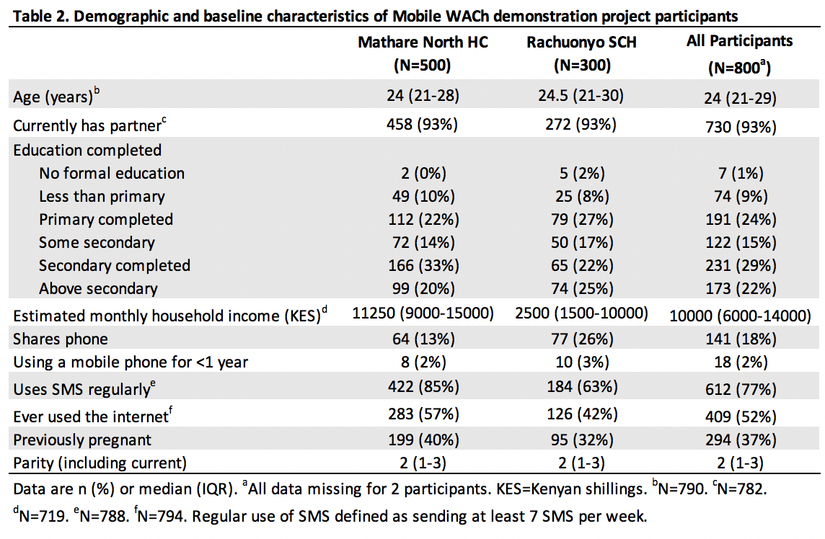
Participant characteristics.

Slide 9
Participant utilization and satisfaction
Indicator | n | Percentage
Reported consulting nurse | 466 | 71.2
Consult topics Pregnancy Infant Postpartum FP | 407 387 25 158 | 62.1 59.1 38.2 24.1
Consult was helpful | 425 | 100
Would recommend the program | 639 | 97.6
Would like to continue the program | 648 | 98.9

Slide 10
Figure 2: Rates of facility delivery are higher among MWN participants compared to historical data

Slide 11
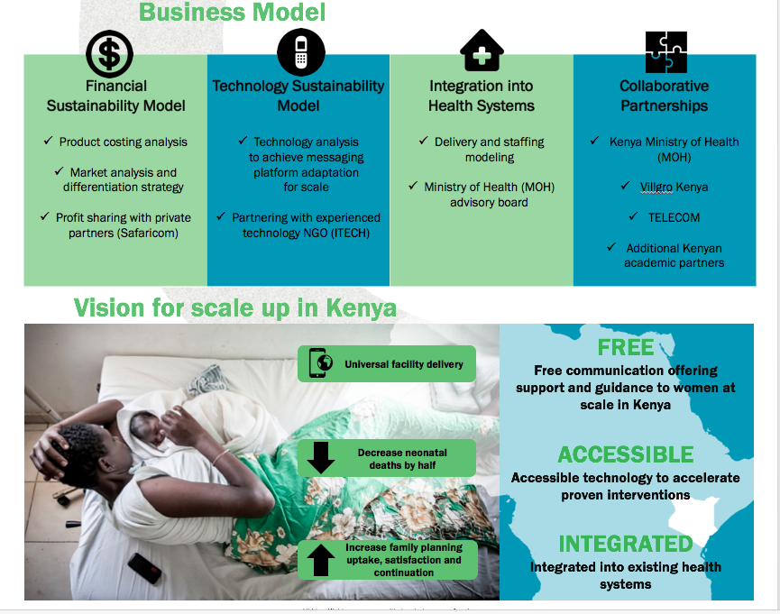
Notes:
In order to maximise our potential impact, we are designing Mobile WACh Neo for scale and sustainability. Our USAID-funded project addresses the scalability and sustainability of the MW model with three targeted interwoven strategies:
Development of a Business Plan for Mobile wach
Road map and buy-in for integration of MWN platform within the Kenya MOH maternal, neonatal, and child health (MNCH) and e/mHealth strategies
MWN Demonstration Project which will allow for testing MWN in a real life clinic environment, outside of the resource intensive research study environments, and enable costing analysis for the project.
Our vision is that Mobile WAChNeo will be:
Free to women in Kenya
Accessible and easy to enroll in
Integrated into existing health system

Slide 12
Mobile WACh NEO is an impactful, integrated intervention ready for scale
Mobile WACh NEO
Proven Impact
- Demonstrated effectiveness in improving mHealh outcomes in rigorous evaluation
Community-Based
- Provides beneficiaries with remote access to local nurses
Integrated
- Integrated into existing health systems
Collaborative Partnerships
- Kenya MoH
- Kenya MoH e/mHealth Working Group
-Safaricom
Notes:
This intervention, unlike many mHealth projects was rigorously evaluated, is community based and integrated into existing health care systems.
We are working to achieve collaborative partnerships in order to arrive at a sustainable model.

Slide 13

Mobile WACh NEO can support health systems to deliver critical care at low cost
Value for End-Users
Value for Care Providers
Value for Government/NGOs
Free
Interactive two-way SMS communication
Remote access to trained nurses
Focus on neonatal period
Expanded capacity to support and track more women and infants in need
Scalable project with direct impact on improvement of Sustainable Development Goal 3

Slide 14
CONCLUSION.
Our results suggest that women are highly engaged with MWN particularly pregnancy and infant consultations.
MWN two-way SMS communication is an acceptable, feasible and efficient way to provide information and tailor advice
This approach is a low cost innovation that may impact maternal and neonatal outcomes

Slide 15
ACKNOWLEDGEMENTS
Thank you!
Kenyatta National Hospital/University of Nairobi
John Kinuthia
Dalton Wamalwa
Wangui Muthigani
Brenda Wandika
Jennifer Unger
Keshet Ronen
Grace John-Stewart
Alison Drake
Trevor Perrier
Maneesh Bantra
PRESENTER: Brenda Wandika
Notes:
I’d like to thank the Mobile WACh team, at KNH, UoN, UW and University of Cape Town.
I’d also like to thank the Ministry of Health.
Finally I’d like to thank the study participants.

