Slide 1
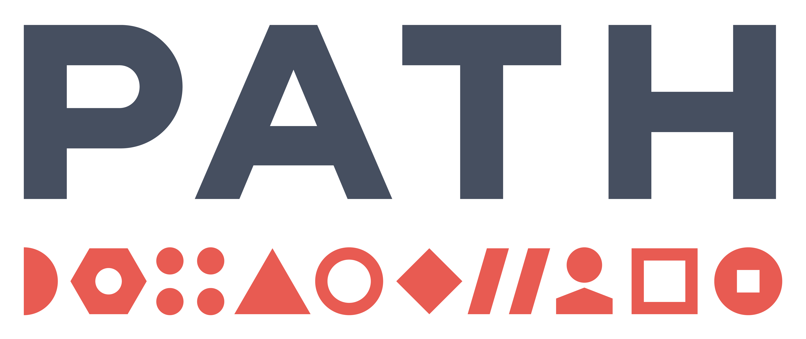
March 28, 2019
Modeling the impact of harmonized regulatory systems on lives saved in Eastern and South Africa
7th East African Health & Scientific Conference
Presenter: Tara Herrick, Pauline Irungu
Co-authors: Jenny Blair, Sarah Gannon, Claire Wingfield

Slide 2
1
Background
2
Context
3
Methods
4
Results
5
Recommendations

Slide 3
Background
In Africa, lack of harmonised regulatory processes is a critical barrier to timely access to essential medicines. Different regulatory processes result in delays for researchers and manufacturers, who must navigate multiple regulatory systems to register the same health product across multiple countries.
Need
Without regulatory harmonisation, the average registration time for medicines in the East African Community is two years. Regional regulatory harmonisation could accelerate this review timeline by 40% to 60%.^{1,2}
The AU Model Law,³ adopted in January 2016, provided a framework for member states to increase collaboration, strengthen regulatory capacities, and accelerate product registration. However, implementation will require sustained and long-term commitments, funding, and political action.
Evidence
Purpose
The purpose of this study was to model the potential health impact of increasing regulatory harmonisation across two regional economic communities in sub-Saharan Africa.
http://www.nepad.org/resource/situation-analysis-study-medicines-registration-harmonisation-africa-final-report-east.
https://pink.pharmaintelligence.informa.com/PS119980/Janssen-Pilot-Speeds-Up-African-Approvals-As-Harmonization-Project-Expands.
AU Model Law: African Union Model Law on Medical Products Regulation. While this law is not the most appropriate guide for all countries, which may already have regulatory systems in place that are more advanced, it is a good guide for countries that are in need of assistance and guidance.

Slide 4
Context
Regulatory harmonization can involve…
Sharing of information such as inspection findings between regulatory authorities
Aligning safety and efficacy standards and processes used to assess and monitor research and products
Conducting joint reviews of research protocols and product dossiers and inspections of research and manufacturing sites
Mutual recognition of assessments and inspections conducted and decisions made by other regulatory authorities
Benefits for CONSUMERS
Expands access to essential health technologies
Benefits for PUBLIC SECTOR
Strengthens capacity and infrastructure
Benefits for PRIVATE SECTOR*
Streamlines data collection and processes
Increases choice
Improves quality of technologies
Enables a greater scope and reach
Reduces delays
Improves quality assurance
Reduces costs
Accelerates approval processes
Clarifies regulatory pathways
*Private sector actors represent regulatory sponsors. Sponsors are entities that initiate and take responsibility for clinical investigations, and request the authorization of new health tools from regulatory authorities. Sponsors include pharmaceutical companies, academic institutions, private organizations, etc.

Slide 5
Methods
Regions
Products
Model
Lives Saved Tool (LiST)
East African Community (EAC)
Zazibona
Model results analyzed from 2018–2023
Peak coverage of 20% increase over the baseline estimated to occur 5 years after launch
Three scenarios were run:
Status quo launch time (no regulatory harmonisation)
One year faster (with regulatory harmonisation)
Two years faster (with regulatory harmonisation)
Timeline and Scenarios
Amoxicillin photo: Health Communication Capacity Collaborative website. https://sbccimplementationkits.org/demandrmnch/about-amox/.
Carbetocin photo: Widmer M, Piaggio G, Nguyen TMH, et al. https://www.nejm.org/doi/full/10.1056/NEJMoa1805489.

Slide 6
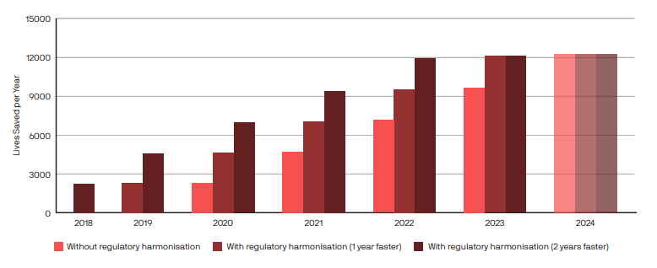
Results
Total annual lives saved from launching amoxicillin dispersible tablets and heat-stable carbetocin in the EAC and Zazibona from 2018-2023:
Total incremental lives saved (1 year faster): 11,778
Total incremental lives saved (2 years faster): 23,391

Slide 7
Recommendations
Accelerating access to two products due to regulatory harmonisation could lead to > 23,000 lives saved in Eastern and Southern Africa. In order to fully realize this potential health impact across Africa, sustained commitments—political, financial, and technical—are required from policymakers and donors alike.
Ensure all regulatory phases and functions are harmonised across products
Domesticate the AU Model Law in all AU member states
Invest in regulatory harmonisation domestically and across Africa to enable scale-up

Slide 8
Tara Herrick
therrick@path.org
Pauline Irungu
pirungu@path.org
Link to complete PATH publication:
https://www.path.org/resources/making-case-how-regulatory-harmonisation-can-save-lives-africa/
Link to the Lives Saved Tool (LiST):
https://www.livessavedtool.org/
For more information contact:

Slide 10
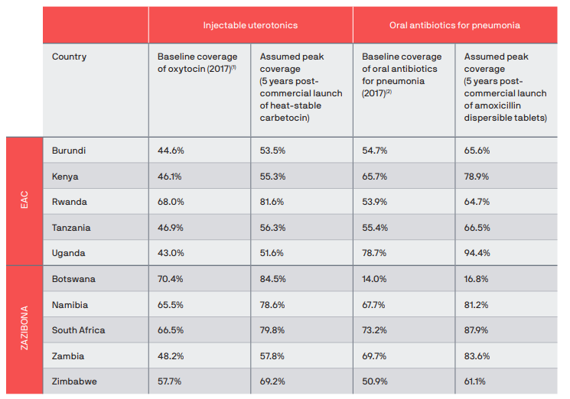
Appendix 1: Coverage rates
Baseline and peak coverage rates of interventions in the Lives Saved Tool
Baseline coverage rates in LiST for heat-stable carbetocin are for active management of the third stage of labor, which includes oxytocin. Oxytocin is a similar injectable uterotonic to carbetocin and is currently available in some settings to prevent and treat postpartum hemorrhage.
Baseline coverage rates in LiST for amoxicillin dispersible tablets are for oral antibiotics for pneumonia (e.g., syrups). These represent other oral formulations of amoxicillin that are currently available in some settings for treatment of childhood pneumonia.

Slide 11
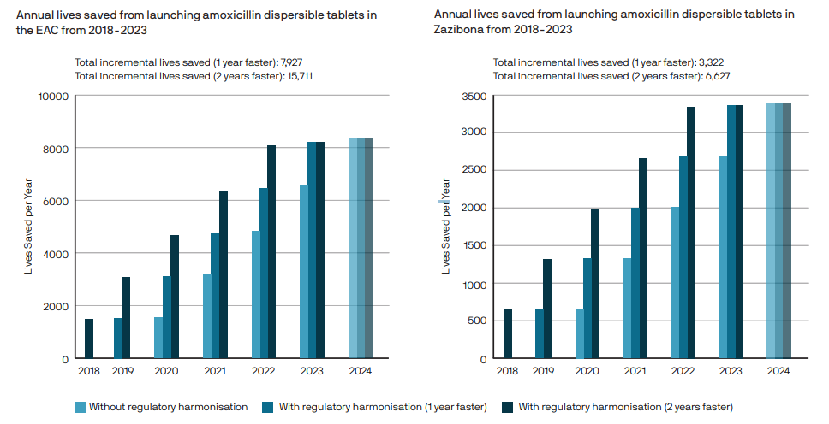
Appendix 2: Amoxicillin results
Modeling results demonstrating the potential impact of regulatory harmonization for amoxicillin dispersible tablets

Slide 12
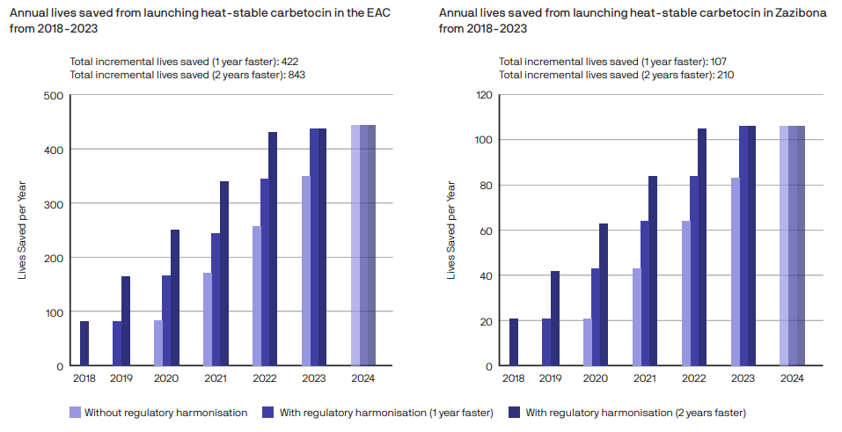
Appendix 3: Carbetocin results
Modeling results demonstrating the potential impact of regulatory harmonization for heat-stable carbetocin

Slide 13
Appendix 4: Model limitations
For both medicines, it is recognized that registration is only one necessary component in launching a product and that registration alone does not guarantee these medicines will become available.
This analysis assumes that heat-stable carbetocin will reach regulatory milestones and begin its global launch in 2018. However, it is possible that this launch may be delayed or not occur.
Amoxicillin dispersible tablets were already available in some markets when this analysis was undertaken, but given the need to scale more broadly, it was selected for this analysis.
These two medicines alone do not represent the total impact of regulatory harmonisation; they are designed to be used as case studies to highlight what is possible for select emerging medicines.
Regulatory harmonisation efforts have improved since the modeling exercise occurred, thus the baseline model scenario may underestimate the recent progress.

