Slide 1
The 7th EAHSC
Molecular Characterization and Phylogenetic analysis of Wuchereria bancrofti in human blood samples from Malindi and Tana River Delta, endemic regions in Kenya
  Nancy M Kinyatta, MSc.
  Researcher, Kenya Medical Research Institute
  Wambua Lillian², Mutahi Wilkinson ², Mugasa Claire³
  Affiliated Institutions;
  1 Kenya Medical Research Institution, Centre for Biotechnology Research and Development,
  P.O Box 54840-00200, Nairobi- Kenya
  2 University of Nairobi- School of Biological Sciences 30772-00100, Nairobi, Kenya
  3 Makerere University Kampala- College of Veterinary Medicine, Animal Resources and Biosecurity, 7062, Kampala, Uganda
by

Slide 2
Background- 1; Lymphatic filariasis (LF) Disease
Commonly referred to as elephantiasis is a disfiguring and disabling disease caused by filarial nematode worms
Transmitted by mosquitoes of Anopheles ,Aedes, Culex and Mansonia species
LF remains a major public health problem with 128 million people estimated to be infected in 83 countries and nearly 1.2 billion people at risk
LF is endemic in coastal Kenya, with a current prevalence range of 1.7-6.3 % (Njenga et al. 2017)
Parasites of Wuchereria bancrofti, Brugia malayi and B. timori species are the most common with W. b causing 90% of LF infections
It is ranked as the leading cause of permanent and long-term disability.
World Health Organization (WHO), in 2000 launched the Global Programme to Eliminate Lymphatic Filariasis (GPELF)

Slide 3
Background-2
Treatment is by MDA with combined single dose of Alb., DEC. & Ivermectin
Progress towards this goal is promising, with 3.9 billion doses of medicine distributed to people in 65 countries by 2016
20 Countries had progressed to the post-MDA surveillance phase by 2016 and 52 required further rounds of MDA
Genetic information of parasites is essential for identifying targets for drug development and the potential of drug resistance.
Through genotyping W. bancrofti populations we can get information that is likely to contribute to elimination success.
Genetic polymorphisms have been identified that can be used to evaluate population structure and to characterize infections.
This study is important to track any genetic change in Kenyan W. b stains
Genetic changes may also interfere with the DNA detection

Slide 4
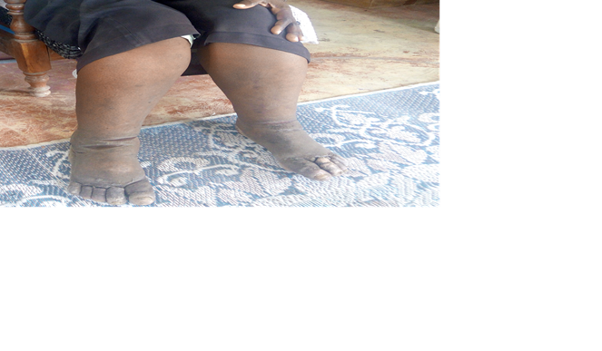
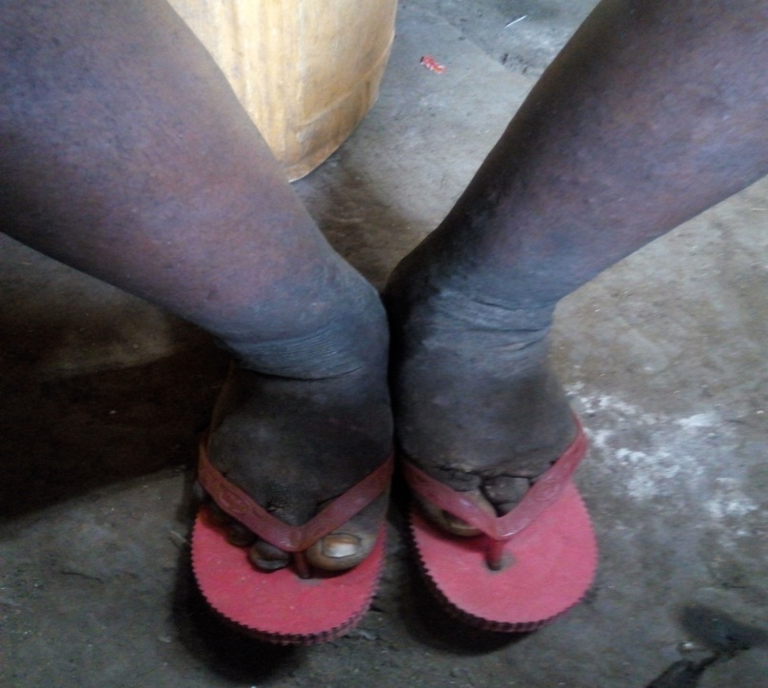
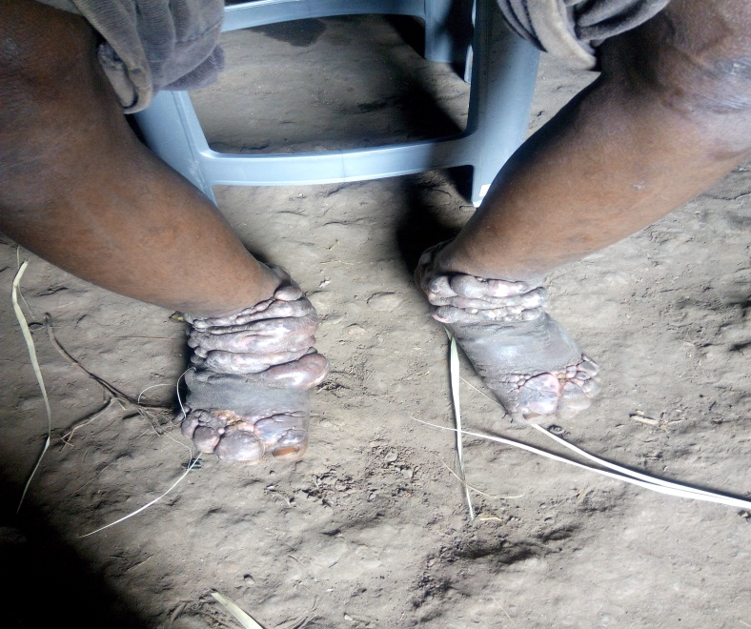
Background-3; Chronic symptoms
Source; Nancy 2018, Tana Delta

Slide 5
Methodology-1
Archived samples collected from Mpirani Malindi in 2002, 2004 and 2011
And Kipini in Tana River Delta in 2008 and 2011
The initial prevalence was 22.2% at Malindi and 26. 5% at Tana River Delta
Seventeen positive samples were selected through PCR amplification and sequenced

Slide 6

Methodology-3;
Figure 1:
Discard
No DNA
DNA present
PCR amplification
Gel electrophoresis
Sample selection and DNA extraction
Sequences analysis by MEGA7
Sanger sequencing, alignment and editing
DNA cleaning & quantification

Slide 7
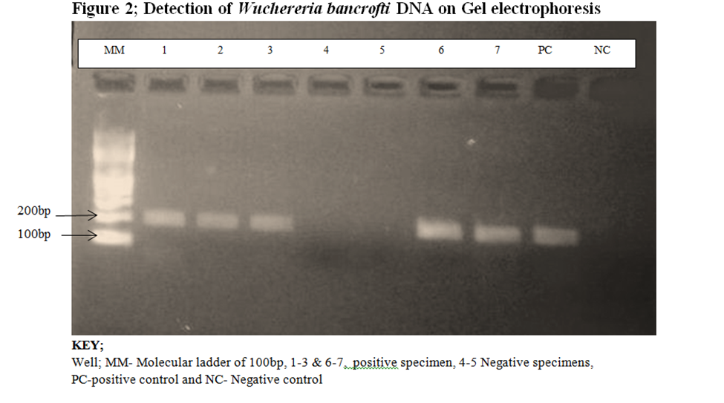
Results-1:
PCR product

Slide 8
Results-2
Table 1: Sequences BLAST results on NCBI
Sample ID | Gene description | E-value | % Identity | Accession No.
ML1 | W. b genomic assembly W. b Jakarta Scaffold WBA contig 0011217 | 8e-44 | 98 | LM012589.1
ML3 | W. b genomic assembly W. b Jakarta Scaffold WBA contig 0011217 W. b genomic assembly W. b Jakarta Scaffold WBA contig 0000579 W. b nuclear Scaffold/matrix, attached region | 8e-44 3e-71 3e-71 | 79 92 92 | LM012589.1 LM012589.1 AY297458.1
ML4 | W. b genomic assembly W. b Jakarta Scaffold WBA contig 0011217 W.b nuclear Scaffold/matrix, attached region | 5e-34 1e-143 | 95 82 | LM012589.1 AY297458.1
ML5 | W. b genomic assembly W. b Jakarta Scaffold WBA contig 0011217 W.b nuclear Scaffold/matrix, attached region | 1e-05 4e-36 | 85 83 | LM012589.1 AY297458.1
ML11 | W. b Ssp 1 repeat DNA sequence W.b nuclear Scaffold/matrix, attached region W. b mitochondrial DNA complete sequences | 1e-58 4e-58 2e-17 | 98 98 87 | L20344.1 AY297458.1 AP017705.1
TR1 | W. b nuclear Scaffold/matrix, attached region W. b Ssp 1 repeat DNA sequence | 1e-48 5e-47 | 93 94 | AY297458.1 L20344.1
TR4 | W. b nuclear Scaffold/matrix, attached region W. b Ssp 1 repeat DNA sequence | 1e-45 6e-46 | 93 94 | AY297458.1 L20344.1
TR6 | W. b nuclear Scaffold/matrix, attached region W. b Ssp 1 repeat DNA sequence | 2e-52 4e-48 | 92 91 | AY297458.1 L20344.1
Labels: ML- Malindi Isolates, TR-Tana River

Slide 9
Results -3
Figure 2; Evolutionally divergence

Slide 10
Estimating Evolutionary distance using Paired wise distance
ML1-2002
ML2-2002
1.23
ML3-2002
0.90
1.08
ML4-2002
0.07
1.19
0.93
ML5-2011
1.05
1.24
1.25
1.11
ML6-2002
1.06
1.04
1.24
1.04
1.20
ML9-2002
1.30
1.29
1.41
1.32
1.36
0.67
ML11-2004
0.93
1.29
1.14
0.93
1.24
1.15
1.42
TR1_2008
1.08
1.21
1.21
1.08
1.26
1.13
1.42
1.06
TR2_2008
0.91
1.26
1.09
0.94
1.08
0.99
1.35
0.95
0.23
TR3_2011
0.82
1.28
1.05
0.82
1.21
1.21
1.50
0.90
0.53
0.50
TR4_2011
0.84
1.24
1.05
0.83
1.12
1.09
1.44
1.08
0.34
0.29
0.33
TR5_2008
0.85
1.21
1.04
0.84
1.20
1.16
1.44
0.99
0.53
0.59
0.33
0.48
TR6_2011
0.84
1.38
1.02
0.82
1.25
1.07
1.38
0.93
0.47
0.44
0.21
0.28
0.30
Labels: ML- Malindi Isolates, TR-Tana River
Analyses were conducted using the Maximum Composite Likelihood model. The analysis involved 14 nucleotide sequences. Codon positions included were 1st+2nd+3rd+Noncoding. All positions containing gaps and missing data were eliminated. There were a total of 262 positions in the final dataset.

Slide 11
Molecular Phylogenetic analysis of Malindi, Tana River Delta Isolates & Genbank related sequences
The Maximum Parsimony tree was obtained using the Sub tree-Pruning-Regrafting (SPR) algorithm as per Nei’s manual . The analysis involved 20 nucleotide sequences and the Codon positions included were 1st+2nd+3rd+Noncoding. All positions containing gaps and missing data were eliminated. There were a total of 227 positions in the final dataset.

Slide 12
Discussion-1; W. b Genetic diversity
Understanding the genetic differences in Wuchereria bancrofti could provide insight into effectiveness of drug regimes, the optimal time-course of drug administration and the potential of development of drug resistance
In this study, 18S rRNA gene was amplified, sequenced and analyzed
The DNA positive for Wuchereria bancrofti was at 188bp (Fg.2)
Sampling in different treatment regimes provided baseline data and enabled us track any genetic changes following MDA
On NCBI blast, the sequences had an identity of 79-98% and this showed that there was relationship of the Kenya strains and other related parasites from other areas in NCBI data base (Table 1)
There was a great divergence observed within Malindi population (0.95) compared to that of Tana River Delta (0.4), this could be attributed to the long period Malindi has been on MDA (from 2003) to Tana River (from 2011) ( Fg.2)

Slide 13
Discussion 2
Genetic distance was evaluated, Tana River had smaller distance (mean 0.4) compared to Malindi (mean 1.81) , and thus Malindi had higher divergence compared to Tana River isolates.
The phylogenetic tree reconstruction showed that the sequences clustered in to 3 different clusters. This indicated that there were 3 different strains in the study population. With Malindi having 2 and Tana River Delta 1 strain
The Neutrality and selection test results showed that strong selection was occurring in Wuchereria bancrofti populations in the 2 Kenyan endemic areas, both with a positive Tajima’s D value which reveals that mutations have resulted in high nucleotide diversity (0.603) with a P-value of less than 0.05 (p < 0.05)
The evolutionary rate (clock) between sequences was P= 0.00226, df=1, p<0.05.
For these results null hypothesis of equal rates between lineages is rejected, and thus in our populations, the isolates had different rates of lineages hence mutations was observed
Malindi isolates had a higher mutation rate compared to Tana River Delta isolates

Slide 14
Conclusion and Recommendations
The nucleotide amplification, sequencing and phylogenetic reconstruction of the Ssp 1 DNA repeat sequence in this study revealed that there are genetic variations in W. bancrofti found in different geographical areas in Kenyan endemic regions
In the study regions, W. bancrofti populations of Malindi region were highly variable compared to Tana River.
This could have been due to evolution of the parasites owing to the drug stress, environmental variations, infection transmission from other areas by human migration and parasite evolution to overcome the MDA drugs
We recommend that; A better understanding of the population structure and genetic differentiation of this parasite will provide important insights into patterns of transmission, disease outcome, and anthelmintic drug resistance, and influence the design and implementation of public health interventions aimed at eliminating this disease
Further study in genetic variation aspects will shed light on the specific factors responsible for such divergence

Slide 15
Acknowledgement
Immunology members of staff-KEMRI
KEMRI
KEMRI-IRG
NACOSTI
University of Nairobi

