Slide 1
The 7th EAHSC
Detection of human papillomavirus DNA in tumors from Rwandese breast cancer patients
Dr. Habyarimana T^{1,2,3}, Attaleb M¹, Mazarati JB³, Bakri Y², El Mzibri M¹
1. Biology and Medical Research Unit, Centre National de l'Energie, des Sciences et des Techniques Nucléaires (CNESTEN), Rabat, Morocco.
2. Biology of Human Pathologies Laboratory (BioPatH), Faculty of Science and Human Pathologies Center (GenoPatH), Mohammed V University (FSR - Mohammed V University), Rabat, Morocco.
3. Biomedical Services Department, Rwanda Biomedical Center (RBC-BIOS),

Slide 2
Background
Epidemiology of BC
Incidence
North Africa:
34.4 per 100,000 women
Central Africa:
26.8 per 100,000 women
Western Africa
38.6 per 100,000 women
Eastern Africa
30.4 per 100,000 women
Southern Africa
38.9 per 100,000 women
Mortality
North Africa:
17.4 per 100,000 women
Central Africa
14.9 per 100,000 women
Western Africa
20.0 per 100,000 women
Eastern Africa
15.6 per 100,000 women
Southern Africa
15.5 per 100,000 women
The incidence of BC in Africa is expected to double by 2050
Precise incidence figures in Africa are lacking in most countries.

Slide 3
Background
BC risk factors
Endogenous risk factors involved in carcinogenesis
(Genetic susceptibility)
Exogenous factors involved in carcinogenesis
18% infectious agents
12% viral infections
33% in Africa

Slide 4
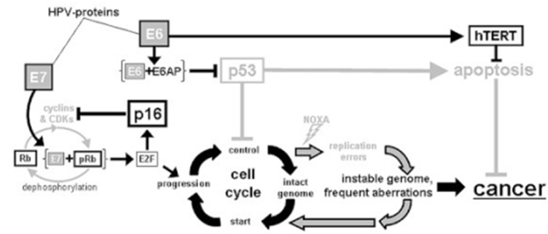
Background
HPV in cancer
HPV in cervical cancer
The oncogenic mechanisms used by HPV to induce CC
Alpha group
5, 6, 7, 9 and 11
Model for HPV in BC
30 HPV types
HR-HPV:
16, 18, 31, 33…
LR–HPV:
6, 11, 40, 42…

Slide 5
Objective
The study aimed to assess the presence of HPV DNA in breast cancer cases from Rwanda and to evaluate the association between HPV infection and clinico-pathological features.

Slide 6
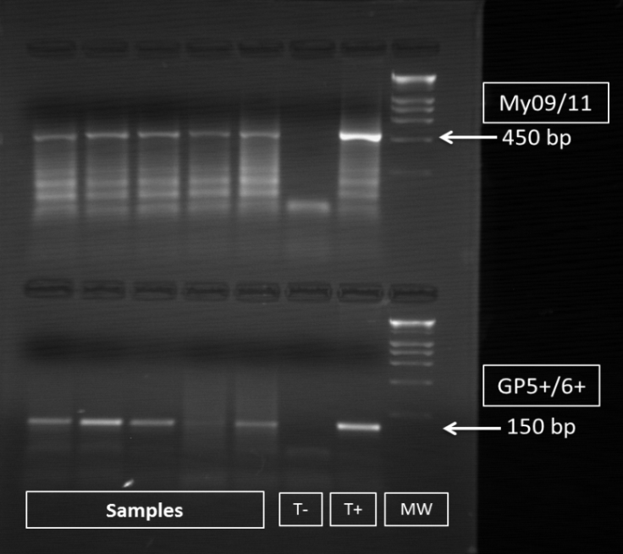
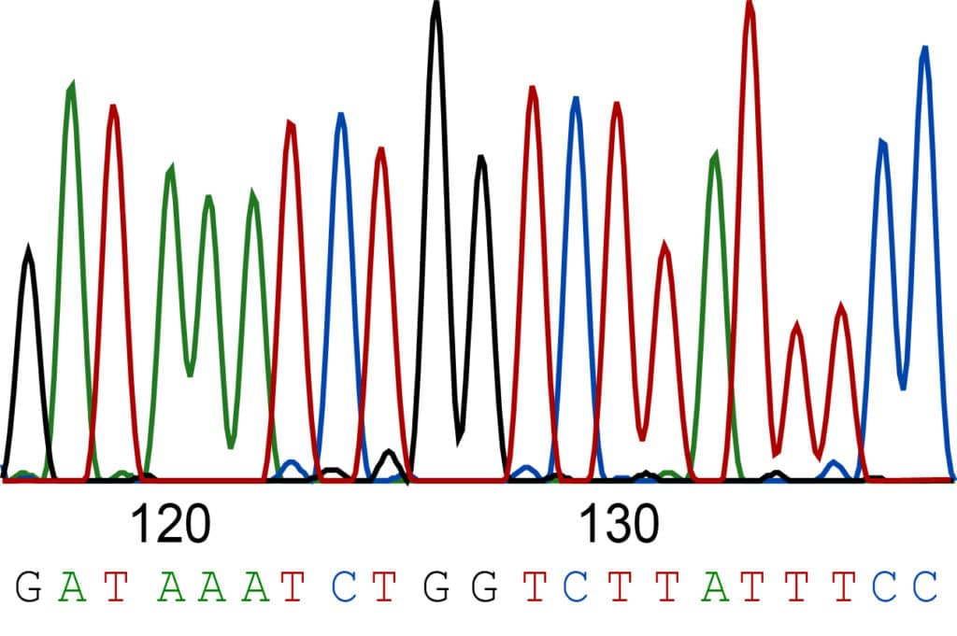
Materials & Methods
47 archived BC FFPE tissues (25-74 years old)
HPV detection
Gene | Primer | Sequence 5’→3’ | Size (Bp)
L1 | MY09 | CGTCCMARRGGAWACTGATC | 450
 | MY11 | GCMCAGGGWCATAAYAATGG
 | GP5⁺ | TTTGTTACTGTGGTAGATACTAC | 150
 | GP6⁺ | CTTATACTAAATGTCAAATAAAAA
Nested PCR
HPV Genotyping
by DNA sequencing

Slide 7
Results
Prevalence of HPV DNA
 | HPV – | HPV + | HPV types
 |  |  | HPV16 | HPV31 | HPV33
N=47 | 25 (53.19%) | 22 (46.81%) | 17 (77.27%) | 2 (9.09% ) | 3 (13.64% )
BLAST analysis
HPV Types | NCBI accession Number | Identity (%)
16 | DQ448212.1 | 98
 | JN617890.1 | 100
 | AF548831.1 | 99
 | KF921508.1 | 100
 | KU961844.1 | 100
 | LC155223.1 | 100
 | HM596509.1 | 100
31 | DQ448212.1 | 98
33 | DQ448213.1 | 99
In BC

Slide 8
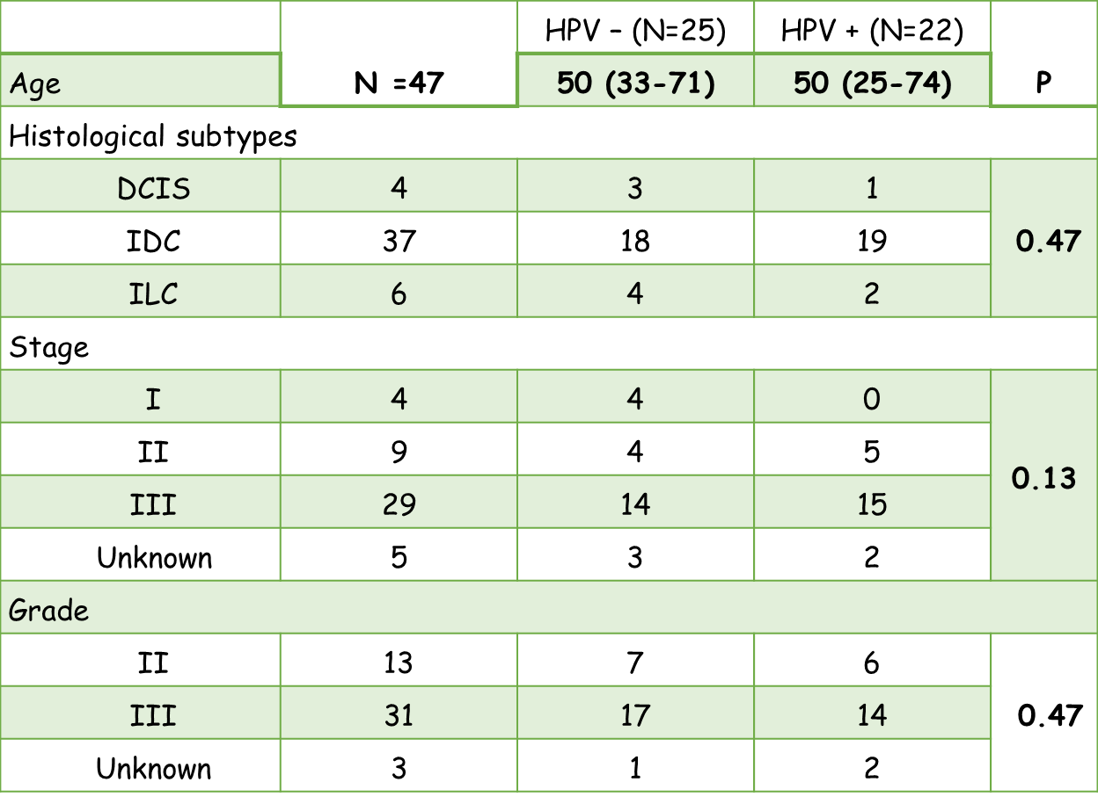
Results
Distribution of HPV status according to clinico-pathological features

Slide 9
Results
Distribution of HPV status according to intrinsic molecular subtypes
 | Total | HPV – (N=25) | HPV + (N=22) | P
Luminal A | 21 | 9 | 12 | 0.39
Luminal B | 10 | 7 | 3
TNBC | 9 | 5 | 4
Her 2 | 6 | 3 | 3
Unknown | 1 | 1 | 0

Slide 10
Conclusion and Future directions
46.81% of BC cases were HPV positive with HPV16 the most predominant (77.27%)
The prevalence reported in other studies, ranged from 12 to 23%
HR-HPV infections could be a risk factor associated with human BC development

Slide 11
Conclusion and Future directions
An improved understanding of potential biomarkers should provide promising BC biomarkers for better stratification Rwandese population and allow a better design and implementation of national BC program.
Effective biomarkers could enhance
Tertiary prevention through the reduction of morbidity
Secondary prevention through early detection of disease, and
Primary prevention as a risk marker to reduce overall BC incidence.
Further large-scale studies and multivariate are needed to provide more consistent conclusions and recommendations.

Slide 12
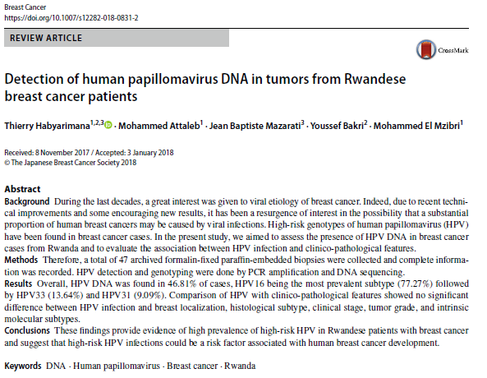
Conclusion and Future directions

Slide 13
Acknowledgements

