Slide 1
PharmLinks
e-Pharmacy Solutions Social media: @PharmLinksTz info@pharmlinks.com

Slide 2
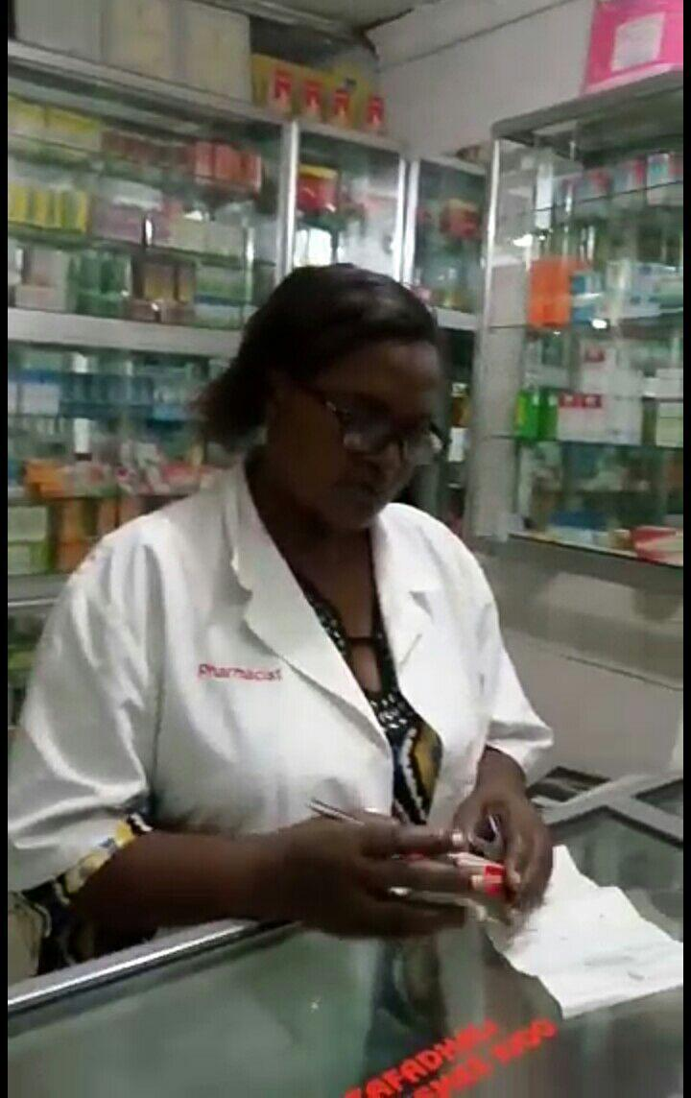
Notes:
This is my aunt, Hawa Dagaa. She owns a Retail pharmacy at Tandale area in Dar es salaam. She face challenges and wastes a lot of time in ordering drugs from wholesale pharmacies which almost all are located in kariakoo area, dar es salaam city center. Delivery of her packages is very unpredictable,with a lot of misplaced orders. The prices of similar drug are very fluctuating from one wholesale shop to another.
Considering those plus many other challenges faced by Pharmacy sector in Tanzania, PharmLinkers are working really hard to use innovation and technology in improving the sector.

Slide 3
Approximately 75% of Tanzanians live in rural and peri-urban communities (where ADDO are the main drug outlets in those areas)
There are more than 10,000 ADDOs in Tanzania
(Source: Management Sciences for Health Report,2014)
Full service pharmacies are located in major urban areas where 60-70% are in Dar es Salaam alone!!
Notes:
ADDO - Accredited Drug Dispensing Outlets.
These are drug stores, lower ranked compared to pharmacies. They are allowed to sell only certain types of medicines (mostly essential medicines)
90% of ADDO owners are WOMEN.

Slide 4
RESULTS OF MARKET SURVEY IN DAR ES SALAAM
73.3% Pharmacies reported to face challenges in the current method of procuring & delivery of Drugs
74.2% of pharmacies visited has Internet connection
54.8% of the respondents have a idea of online commerce (e-commerce)
90% of the respondents were ready to use PharmLink

Slide 5
Mission
To Provide Convenience and increase productivity in Buying and Selling of DRUGS, Medical & other Pharmaceutical Products in Africa using Our Digital platform.
VISION
A healthy community in which people get Drugs, medical and Pharmaceutical products of good quality according to their needs at the right time and place

Slide 6
PROBLEM
Procuring Medicines From Wholesalers Can Be Costly, Time Consuming and Unpredictable

Slide 7
SOLUTION
“We are bringing PharmLink, a centralized system to link Wholesale Pharmacies to Retail Pharmacies and ADDO Shops. Providing Convenience in Ordering Medical Products, Inventory Management, Tracking of Medicine Outflow Data, tracking authenticity of medicines and Managing Transactions through Digital Payment”

Slide 8
FEATURES OF PharmLink
Android Application Used By Retailers and ADDO
For Ordering and Notifications.
Inventory Management
Web Application Used By Wholesalers
To Receive and Process Orders.
To Manage Inventory.
To Track Drug Usage.

Slide 9
TARGETED CUSTOMERS AND REVENUE STREAMS
Main Suppliers and Wholesalers.
We will be using a subscription model
Business intelligence
Retailers and ADDO Shops.
We will charge based on the total purchases
The model is not yet public -> Still undergoing perfection.

Slide 10
PharmLink UNIQUE VALUE PROPOSITION
Saving Time and Resources | No needs to make phone calls or travel long distance to place your orders.
Timely Delivery | The ordered package will be delivered in time to the intended shop.
Managing of Inventory and Keep Records | Managing of data, e.g consumer consumption of drugs will be made easier.
Improving The Client Base of The Wholesalers | Ensuring clients to the wholesalers.
Reducing Costs of Operations | Cutting down the resource needed by the business
Tracking authenticity of medicines trafficked | this will greatly reduce the supply and consumption of expired medicines.
Drug abuse prevention | technology enabled tracking system assist in back tracing the channel of counterfeit medicines

Slide 11
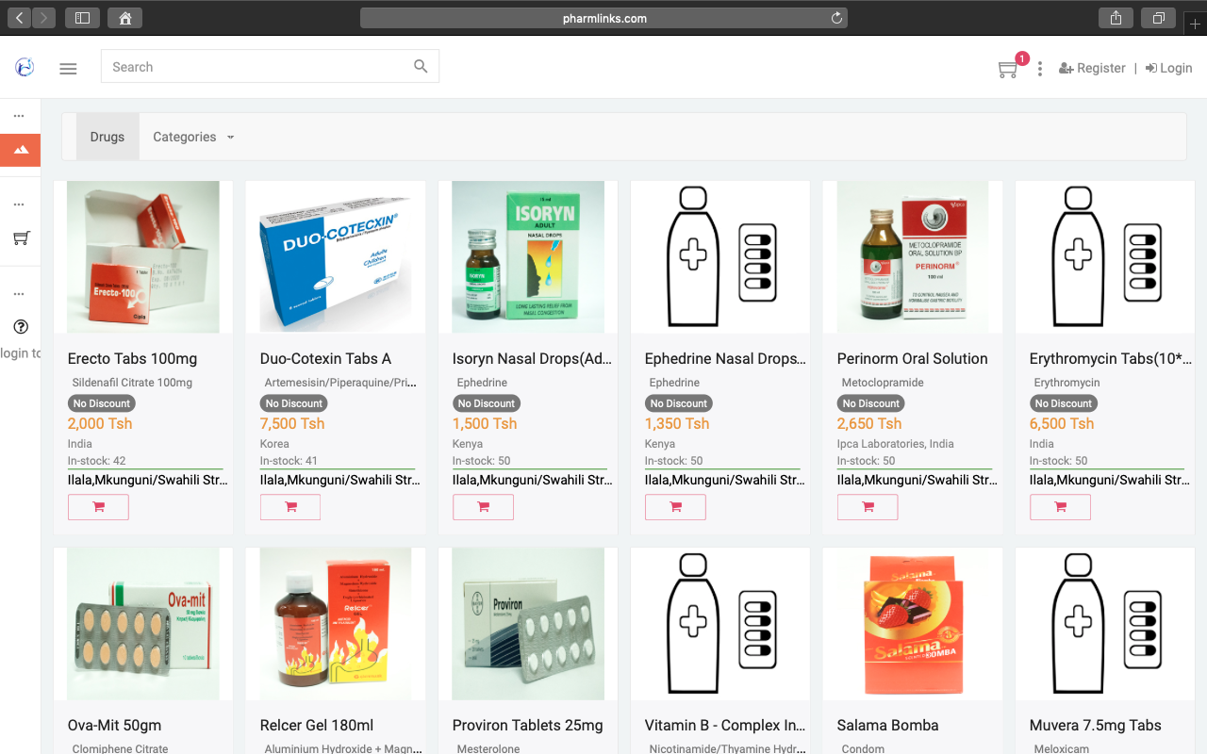
ANDROID PROJECT
PharmLink Prototype Android Version.
Place your screenshot here

Slide 12
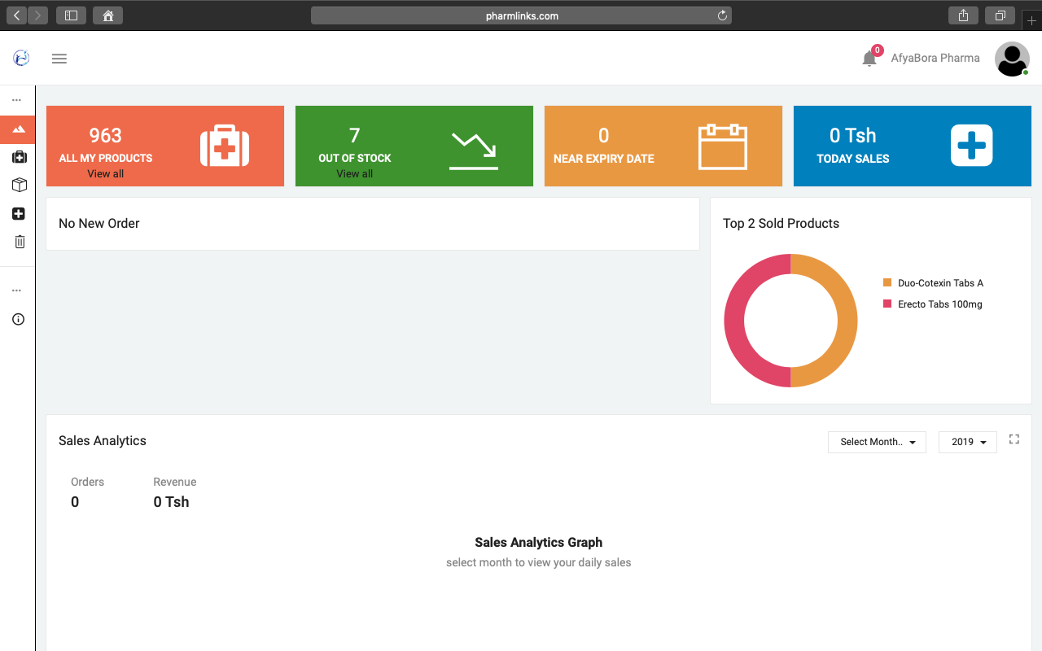
DESKTOP PROJECT
PharmLink Application Web Version.

Slide 13
MARKET ENTRANCE STRATEGY
First | Targeting Dar es Salaam Market (with 120 Wholesale Pharmacies, 624 retail pharmacies and some peri urban ADDO shops)
Second | Urban,Peri Urban and Rural Markets From Across The Country (Where 75% of people lives and Use ADDO)
Third | Targeting East African Regional Market.

Slide 14
THE FUTURE
AREAS TO DIVERSIFY!!
Our e-Pharmacy model will diversify into providing service to:
Anyone in need of Drugs to reach a pharmacy via our platform (e-pharmacy for everyone)
Drug dictionary
e- Prescription
e- Dispensing
Drug monitoring and Drug reminders
ONLINE CONSULTATION

Slide 15
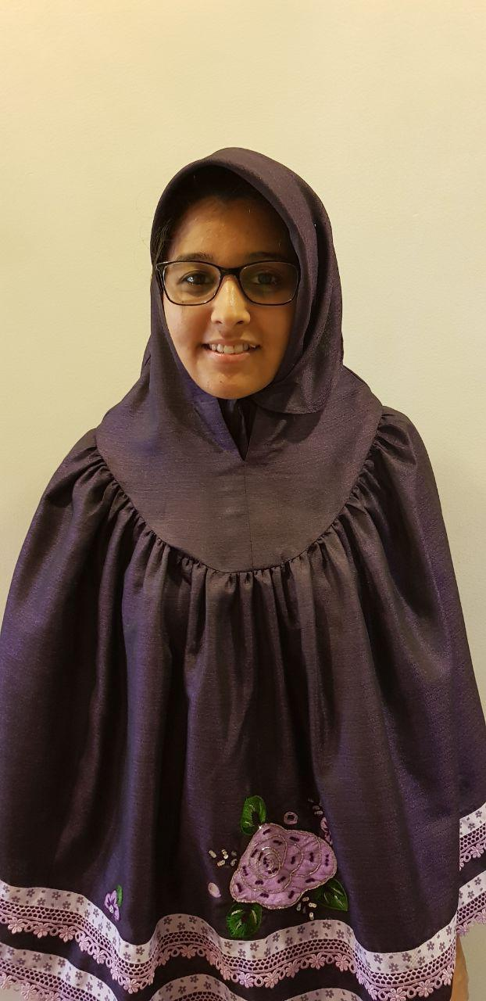
TEAM
Frank Arabi
Daniel Lyatuu
Castory Munishi
Zainab Patel
Team Lead, CEO
Software Developer, CTO
COO
CFO

