Slide 1
Pharmacy refill counts and self-reported adherence overestimate adherence to antiretroviral treatment among people living with HIV in Kilimanjaro, Tanzania
The 7th EAHSC
Marion Sumari-de Boer, Kennedy Ngowi, Elizabeth Moirana, Pythia Nieuwkerk, Francis Pima, Benson Mtesha, Blandina T. Mmbaga, Eva Muro, Rob Aarnoutse
Kilimanjaro Clinical Research Institute, Moshi, Tanzania
Kilimanjaro Christian Medical Centre, Moshi, Tanzania
UMC Amsterdam – Location AMC, the Netherlands
Radboud University Nijmegen, the Netherlands

Slide 2
Background (1)
Adherence to ARV is challenging
  >95% of doses is needed
  Prevent drug resistance and treatment failure
Early detection of limited adherence is needed
Health care staff needs to have good insight in adherence to ARV treatment

Slide 3
Background (2)
Adherence measurement challenging
  Direct: drug levels in blood
  Indirect
    Self-report
    Pharmacy refill counts
    Visual analogue scales
    Real Time Medication Monitoring
No Golden standard

Slide 4
Objectives
To what extent do pharmacy refill counts represent true levels of medication intake?
1. What is the relationship between pharmacy refill counts adherence and self- reported adherence?
2. What is the relationship between pharmacy refill counts adherence and adherence measured with real time medication monitors?

Slide 5
Methodology (1)
Data from randomized Clinical Trial: REMIND
To investigate improvement of adherence and treatment outcome
3 arms
  RTMM
  SMS
  Control
Outcomes: adherence and viral load

Slide 6
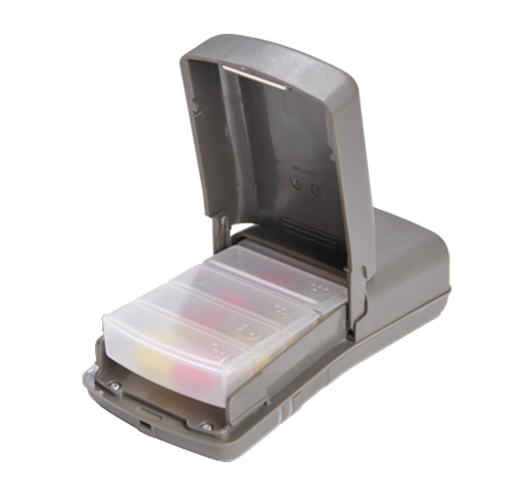
RTMM: Wisepill

Slide 7
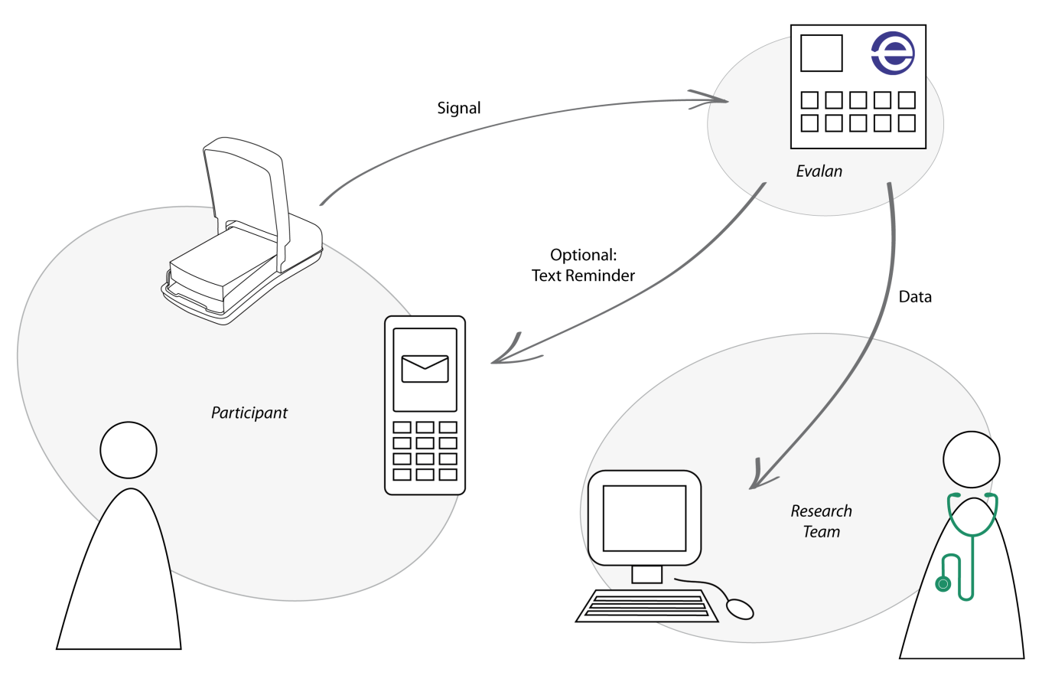
Processes in RTMM

Slide 8
Methodology (2)
Data from screening, enrolment and first follow-up visit
Adherence measurements
  Self-report: Reported missed pills in the past month
  Pharmacy refills: number of days with pills taken divided by the number of days between visits
  RTMM: number of days with pills taken divided by the number of days between visits
Missing pharmacy refill counts: assumption is 100%
Spearman correlation coefficients

Slide 9
Results (1)
42 PLHIV
Mean adherence
  Pharmacy refill: 91% (SD 20.4)
  Self-report: 97% (SD 31.2)
  RTMM: 84% (SD 28.2)
Adherence less than 95%
  Pharmacy refill: 19%
  Self-report: 17%
  RTMM: 48%
67% had less than 95% adherence in any of the methods

Slide 10
Results (2)
 | Pharmacy refill | Self-report | RTMM
Pharmacy refill | - | 0.14 (0.15) | 0.08 (0.62)
Self-report | 0.14 (0.15) | - | 0.22 (0.14)
RTMM | 0.08 (0.62) | 0.22 (0.14) | -

Slide 11
Discussion
Each measures different aspects of adherence
Self-report: overestimation
Pharmacy refill counts: overestimation
  Sharing of pills
  Pills getting lost
  Forgetting to take pills for refill count
  Others
RTMM adherence could be underestimation
  Bulk of pills taken out of the box

Slide 12
Recommendation
Assessment of adherence needs combined methods
Improved instructions on pharmacy refill counts are needed
RTMM is a promising way of getting more comprehensive determination

Slide 13


Acknowledgements
Study coordinator: Kennedy Ngowi
Study team, specifically study nurses
Participants
KCMC & KCRI administration
EDCTP
The EDCTP2 programme is supported under Horizon 2020, the European
Union’s Framework Programme for Research and Innovation.

