Slide 1
THE 7TH EAHSC
Site personnel survey on practical and training aspect related to the implementation of Point of Care test for HIV Early Infant Diagnosis
Hellen Mahiga, Study Clinician

Slide 2
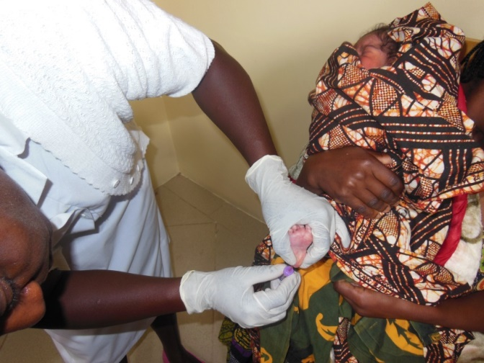
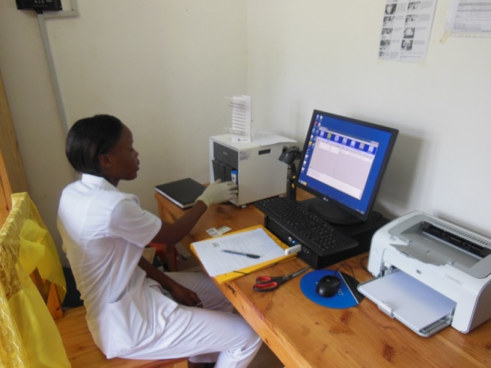
Outline
Introduction
Objective
Method
Results
Conclusion

Slide 3
Introduction
Point-of-Care (PoC) HIV testing for early infant diagnosis (EID) enables nurse-based, decentralized testing with the potential to replace centralized laboratory EID.
Xpert HIV-1 (Cepheid) is one of the recommended tests for EID in the latest 2016 WHO guidelines.
Xpert® HIV-1 Qual assays is simple to use test suitable for operators with limited experience and training.
Self-contained tests
  RT-PCR and PCR reagents and processes are hosted in single use, self-contained GeneXpert cartridges.
  Operator intervention is not required during analysis steps.
Specialized training is not required for troubleshooting or error code interpretation and results are easy to interpret.
The BABY Study was a prospective diagnostic cohort study in infants born from HIV infected mothers evaluating the accuracy and operational feasibility of the Xpert® HIV-1 Qual PoC test at different time-points performed by nurses or midwives at five primary obstetric heath facilities in Mbeya.
Recruitment period: June 2015 to Sep 2016.
We observed a 100% sensitivity and specificity of Xpert HIV-1 Qual PoC from whole blood for the detection of neonatal HIV from birth until week 6.

Slide 4
Objective
To undertake a field based performance study to demonstrate that the results obtained by the intended user, nurses and lab technicians, are comparable with results obtained by a professional user (laboratory technologist) in a central testing facility and that % error/invalid results remains below 5%.
To assess training requirements to ensure competency at different end users skill levels in Mbeya, Tanzania

Slide 5
Methods
HIV-infected pregnant mothers, were enrolled at the time of delivery.
Nurses/midwives performed EID procedures using the Xpert HIV-1 Qual PoC at these clinics.
Infant HIV testing was retrospectively performed from stored infant DBS at the NIMR-MMRC lab by lab technicians using the Xpert HIV-1 Qual plus from collected maternal plasma samples using the Xpert HIV-1 VL for viral load measurements.
Xpert analyser training was performed prior to study procedures for involved clinic and laboratory personnel.
The training was conducted by Cepheid and included a three days centralized workshop including practical training, and in addition a training session performed at each site.
The Cepheid Xpert user manual was provided to each site and the laboratory.
Addition we created an adopted simplified user manual as a SOP.
Overall, 25 clinical and 4 laboratory staffs were involved in the Xpert HIV-1 qual infants diagnostics.
The structured questionnaire was provided to all staff members involved in the Xpert HIV-1 Qual testing, and all except one clinical officer (not available) provided responses.

Slide 6
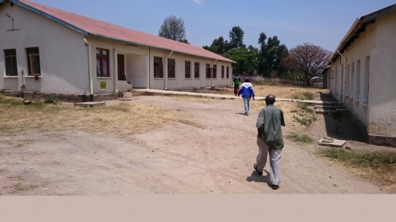

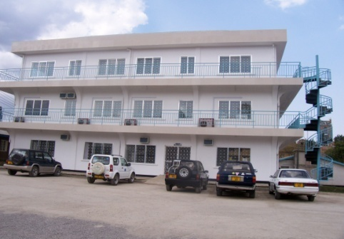

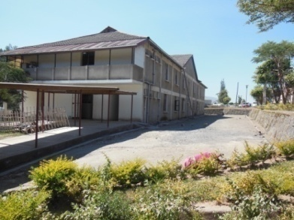
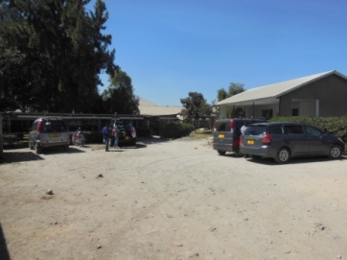
Study location 5 Reproductive and Child Health (RCH) clinics in Mbeya,Tanzania
Igawilo Hospital
META Hospital
NIMR-MMRC
Mbeya Regional Hospital
Kiwanjampaka Health Centre
Ruanda Health Centre

Slide 7
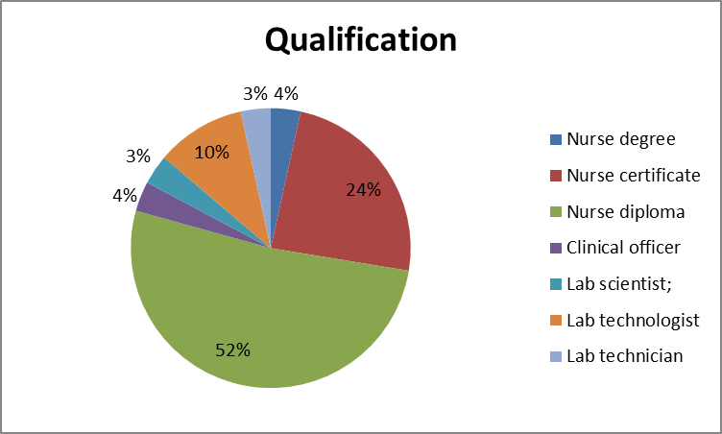
Overview results
TRAINING | Strongly Agree | Agree | Disagree | Strongly disagree | Average Score
Training Adequacy | 14 | 14 |  |  | 1.5
Time | 7 | 15 | 6 |  | 1.96
Hands On Time | 10 | 15 | 3 |  | 1.75
User Confidence | 9 | 17 | 2 |  | 1.75

Slide 8
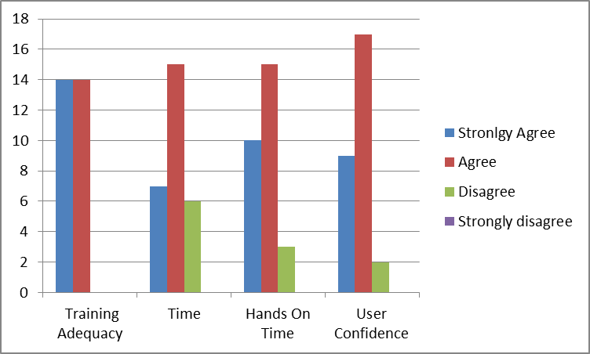
Overview results cont

Slide 9
Overview results cont

Slide 10
Overview results cont

Slide 11
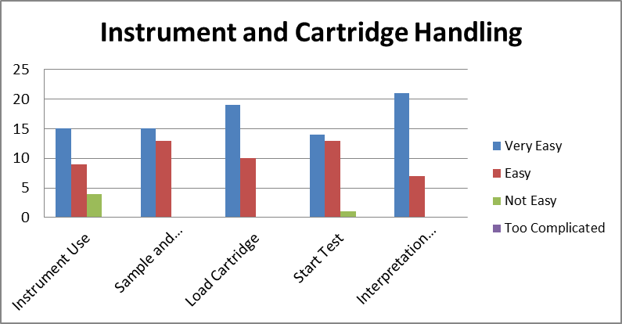
Overview results cont……

Slide 12
Overview results cont…
Xpert PoC test performance at the health facilities (data extracted from the study database)
PoC test performed | N=2736
Valid test result obtained | 2673 (97.7%)
No valid test result obtained | 63 (2.3%)
PoC test problem reported by nurses | 183 (6.7%)
Early terminated analysis because of power cut | 106 (57.9%)
Error/invalid result message | 61 (33.3%)
Problem with computer or analyser handling | 4 (2.2%)
Clotted blood | 2 (1.1%)
No reason indicated | 10 (5.5%)
PoC testing had to be repeated | 132 (4.8%)
PoC testing performed at other site (sample transferred) | 210 (7.7%)

Slide 13
Overall impression on the use of the HIV-1 Qual PoC system in the public setting by N=24 nurses

Slide 14
Conclusion
Overall, we observed a very good operational feasibility of the HIV-1 Xpert PoC system for the use of early HIV infant diagnosis at obstetric health facilities and at the laboratory. At the clinics, the system was perceived as easy to handle and provided valid test results in over 97% of tests.
In this respect we also received responses indicating that Xpert system training might need to be improved, and they were especially related to nurses affiliated to primary health care facilities. These could be attributed to:
Decreased number of tests run on the instrument and user less accustomed to new diagnostic procedures/technologies.
User attendance -all training could not be attended due to workloads and previous work conflicts
Challenges raised above indicate that training sessions for primary health care facilities needs to be customized with increased hands on time ensuring user confidence in use of the technology/platform. Training tools can also include simplified workflows to simplify and streamline work in these facilities.
Overall, the results of this study demonstrated an excellent performance and operational feasibility of the Xpert HIV-1 PoC system. Deficiencies and their affiliated impact – especially related to sustained power supplies and trainings - could be identified and can be subject to improvements.

Slide 15






Acknowledgment
Mbeya Medical Research Center
& Mbeya Zonal Referral Hospital
Clinic
Issa Sabi (PI)
Hellen Mahiga (cordinator)
Debora Kikaro (nurse)
Sarah Mlelwa (nurse)
John France (HoD Obs & Gyn MZRH)
Data Management
Peter Agrea
Willyhelmina Olomi
Lab
Lilian Njovu
Last Mwaipopo
Lucy Mesayi
Epifania Ndunguru
LMU Munich
Arne Kroidl
Otto Geisenberger (monitoring)
Sabine Kastner (monitoring)
Fidelina Zekoll (data managment)
Conny Luer (local lab management)
Michael Hoelscher
Cepheid South Africa
Dipti Lallubhai
Gwynn Stevens
Supported by:
All nurses and midwives at the Mbeya study sites !

