Slide 1
7th EAST AFRICA HEALTH AND SCIENTIFIC (EAHS) CONFERENCE
Nyerere International Conventional Centre, Dar es Salaam, Tanzania.
27TH – 29TH MARCH, 2019

Slide 2
CONFERENCE THEME
“Technology for Health Systems Transformation
and
Attainment of the UN-Sustainable Development Goals”

Slide 3
Role of Academia in Advancing Research in Public Private Partnership for Healthcare related Technologies Dr. Kennedy Ogollah School of Business, University of Nairobi

Slide 4
Unveiling Public-Private-Partnership (PPP)

Slide 5
Defining the PPP Concept
PPP means an arrangement between government (or statutory entity or government owned entity) on one side and a private sector entity/non profit partner on the other, for the provision of
- public assets and/or
- related services for public benefit
(Federal Highway Administration, 2015)
the resources of each sector (public and private) are shared.
In addition each party shares the potential risks and rewards in the delivery of the service and/or facility.
the private sector receives performance linked payments that conform (or are benchmarked) to specified, pre-determined and measurable performance standards.
* NPM theorist argue that PPP is privatization in disguise for Public sector failure (Wellenhall, 2005)

Slide 6
Goal is to create financially sustainable system
PUBLIC
SECTOR
PRIVATE
SECTOR

Break Even


Free Provision of Products
and Services

Profit Maximization
Unsustainable for Consumers
Unsustainable for Government &
Donors



Slide 7
PPP definition continued…
Four basic features of a typical PPP model
Collaboration (2) Cooperation (3) Communicative Management (4) Co-Management
(Kooiman, in Wellenhall, 2005)
It is aimed to:
Promote behaviours reducing incidences of diseases
Facilitate equitable access to vaccines and treatment
Improve healthcare delivery (Thomas & Curtis, 2003)
* PPP have not always been successful !!!!

Slide 8
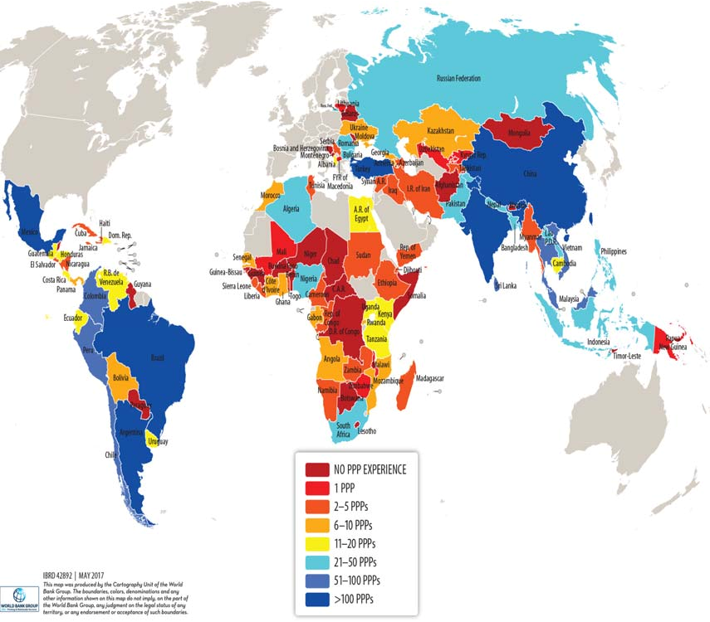

Slide 9
Classifying PPP in Healthcare.
One time/short partnership
Donation of land, money, equipment
Participation in campaigns
Continuous long term partnership
Social franchising of service
Contracting in and out
Social marketing
Capacity building
Service oriented
- Social marketing
- Social franchising
- Contracting health care providers
- Mobile vans
Infrastructure oriented
Construction/Repair of buildings
Donation of equipment/vehicles etc
Capacity Building
Training for skill enhancement and counseling
Sponsoring conferences for management capacity
Information/advocacy oriented
Contracting out IEC activities to NGO’s
Category campaign with private partners
Outsourcing non-clinical support services
Outsourcing clinical support services
Outsourcing clinical services
Private management of a public hospital

Slide 10
Concepts – Making them simple!
Health is not merely the absence of disease or infirmity. It is a state of complete physical, mental and social well-being.
Technology is the branch of knowledge that deals with the creation and use of technical means and their interrelation with life, society, and the environment, drawing upon such subjects as industrial arts, engineering, applied science, and pure science.
Health Technology is the prevention and rehabilitation, vaccines,pharmaceuticals and devices, medical and surgical procedures, and the systems within which health is protected and maintained.
They form the backbone of the services medicine can offer in the prevention, diagnosis and treatment of illness and disease.

Slide 11
What is Healthcare Related Technologies
This term is typically used to encompass all technologies that are used in the healthcare field inclusive of both medical personnel and patients.
The information technologies (IT) developed with the purpose to improve productivity of hospitals, clinics, and health administration services and enhance access to and quality of healthcare.
Examples:
healthcare information management systems, healthcare document management, healthcare business intelligence software, electronic medical records, mobile health services, and patient monitoring systems etc.

Slide 12
HEALTH TECHNOLOGIES AND DECISION MAKING
Health technology has the tremendous potential to change our understanding of disease, transform the delivery of healthcare services, and improve health outcomes. But using such technology comes at a price
Decisions about whether to purchase and use new technology should be based on high-quality evidence on its impact on health care and health outcomes.
Health Technologies and Decision Making analyses the barriers to, and facilitators of, evidence-based decision making in health-care systems

Slide 13
Emerging Technologies in Healthcare – The Journey!
Small form factor devices (SMARTPHONES) have become so widely accepted in clinical care
Leverage is on: Accelerometers, Camera and Bluetooth
Enterprise Environment (Wi-fi) has moved into the Mobile Platform
WLAN has created more connected hospitals than wired LAN
BYOD Policy = Mobile Devices Management Solutions (Disruptive Technology)
Focus = Customer Service Delivery vs Technology Control
Cloud Infrastructure dictated by consumer

Slide 14
The journey Continued …..
HITECH (Health Information Technology for Economic and Clinical Health) Act of 2009
HIPAA (Health Insurance Portability and Accountability Act of 1996)
Meaningful use
ICD10 (International Statistical Classification of Diseases)
Big Data catalyst (VOIP=Creating Traffic Communication Flexibility)
- Mobile to Applications (20,000+) and Social Media Platforms
- Search and Mobile search
Virtualization = IP based Medical Devices (M2M) minimizing human errors
Mobile Diagnostics (mHealth) = Video remote interpretations
Wearable Technology (Including 3D Prints and Bio Printing)
PRIVACY?????

Slide 15
Major Changes in Healthcare Technologies
Data Analytics
Artificial Intelligence (AI)
Blockchains in Healthcare = Bitcoin and Mutual Distributed Ledger
Internet of Medical Things (IoMT) Technology = Medical Devices Connectedness - (Regulatory Hurdles & High Cost of Entry Barriers)
Non-Invasive treatments
Gene treatments
5G enhanced Mobile Broadband (eMBB)

Slide 16
The PPP can provide a sustainable business model in:
Healthcare
Health education
Health research

Slide 17
Where Does Academia Fit in?
Research Activities
Academia has to delve into research that does not end up in the library shelves without much impact on societal concerns.
Scholars and academic institutions have a huge opportunity of providing non-biased research support.
Due to divergent interest on public and private parties, academia to bridge the gap by providing neutral research support services that can be harnessed for the greater impact in society.
Act like a convergence point for experts and other stakeholders due to scenario based challenges

Slide 18
Universities through the entrepreneurial university trend have shifted to consider technology transfer and commercialization as a vital part of their mission and spur collaborative researches initiatives:
Product development to develop solutions e.g. drugs, vaccines and diagnostic solutions
Precompetitive PPPs to generate novel concepts and infrastructure to support the medical field
Access PPPs that improve accessibility of specific treatments to alleviate disease burden through mass drug administration programs
Academia and research are two sides of the same coin and scholars are increasingly being called upon to provide relevant solutions to society.

Slide 19
Scholars and academic institutions can also seek to provide decisive information with respect to commonly misunderstood diseases in society.
Academia through PPPs with private companies and nongovernmental organizations can delve into research relating to such diseases to provide informed prescriptions.
Drawing attention to scholars on emerging alternative medicines would provide research activities that would inform the general public on their efficacy and safety.

Slide 20
Healthcare Education
Academic institutions have a role to play in public education and awareness.
As part of their knowledge dissemination initiatives, academic institutions can engage in public education and development of technologies to promote health.
Universities can provide the manpower to boost public health specialists in educating communities.
PPPs can allow for collaboration between private companies and academic institutions to access information dissemination channels provided by private companies.

Slide 21
Monitoring and Evaluation
A key challenge in PPPs is monitoring and evaluation of the success of the initiative.
Academic institutions have a vital role to play in helping the partners to define key deliverables for the project.
More specifically, academicians may provide services such as data collection, data management, analysis, interpretation and dissemination.

Slide 22
Policy Development
Academic institutions are custodians of knowledge and information acquired overtime through books, journals and other reference materials.
These can be applied to isolate historical trends in healthcare management for the development of informed policies in the health sector.
Academicians through critical review of literature can drive policies and regulations that have more empirical backing.
These policies would provide a foundation and rules of engagement for the partners in PPP initiatives.

Slide 23
ROLE OF ACADEMIA ENHANCED
Thought Leadership
Access to Experts and Hot Shot Teams
Rapid prototyping and innovation platform
Open, unbiased, and transparent forum
Facilitation Function
Network Scalability
PPP project design and management experience
Legitimacy and Reputation
Long term engagement

Slide 24
Challenges for Academia
Closed Shop – Don’t want to collaborate
Overly protective of ideas and first idea bias
Not responsive or flexible
Business schools only have one business model!
–Students and Exec Ed
–Poor understanding of alternative business models
–Land Grant Universities key exception
Poor incentive structures
–What’s in it for me culture
Limited account management support
Limited to no PPP design and management experience

Slide 25
Take a Lean Startup Approach
Get the partners out of the office
Co-Identify and Co-Define
–the Customers and Users
–their Jobs to be Done
–their Pains and Gains
Co-Design the Value Proposition
Co-Design Multi-sided Business Model
–Customers/Users; Students; Industry; Government; Academics; Universities
Rapid Prototype, Test, and Pivot
Co-Participate and Communicate
Scale and Replicate

Slide 26
WAY FORWARD ACADEMICS AND PPP IN RESEARCH!!!!!
The point is not to predict the future but to prepare for it and to shape it
Professionals and patients will become much more equal partners
Health care systems will increasingly be concerned with chronic not acute disease
Health will increasingly be at the centre not the edge of politics
Some things - ethics, learning, leadership - will continue to be important whatever happens!!!!!!

Slide 27
THANK YOU!

