Slide 1
7th East African Health & Scientific Conference
« Smartphone use among trainees and consultant Surgeons within the Pan African Academy of Christians Surgeons »
Alliance Niyukuri¹, Andrew Strong, and J.O’Connor.
¹General Surgeon
Kibuye Hope Hospital
Hope Africa University
Burundi-EAC

Slide 2
Rural based surgical training program in African Christian hospitals.
Training sites:
Kenya, Tanzania, Ethiopia, Cameroon, Niger, Gabon, Malawi, Egypt.
Trainees: 79
Graduates: 73

Slide 3
Background
Information and communication technologies (ICTs) are the core tools through which information is captured, processed, stored, manipulated and exchanged in the information age.
Notes:
ICT competitvness

Slide 4
America and Europe invested in landlines first then mobile phones, sub Saharan Africa is doing just the opposite:
Mobile phone usage: 45%.
Mobile technology is the leading technology in education.
General surgery trainees have reported benefits of smartphones
Notes:
half of the subsaharan africa population will own a smartphone by 2020 (the mobile economy 2017)
multifunctional smartphones for the on-the-move decision making and communication with collegues

Slide 5
Purpose:
Assess the trends in smartphones usage among residents, fellows and attending surgeons (who work and train in Africa)
within PAACS

Slide 6
METHODOLOGY:
IRB approval
Duration: September 2,2017-February 2,2018
Total email invitations sent out (Survey Monkey®):120
Total number of responses: 80
Data analysis: JMP (v13.2.0, SAS Institute Inc. Cary, North Carolina).
Notes:
Survey Monkey®.
Inclusion criteria:
All PAACS residents and fellows
All long-term PAACS attending surgeons
Inclusion criteria:
All PAACS residents and fellows
All long-term PAACS attending surgeons

Slide 7
Most attending surgeons are 41 years of age and older, while most trainees are 41 year old and younger (p<0.01).

Slide 8
Attending surgeons and trainees are equally likely to own a smartphone (97% vs 100%, p=0.427).
They both use Wifi and GSM to connect to internet but they find GSM more reliable (66.6% vs 66.32%,p>0.99*)
Notes:
*

Slide 9
Both trainees and attending surgeons are not likely to pay for a medical application (18.75% vs 25.0%, p=0.5702).
Trainees are also more likely to install a:
clinical reference app (85.42%vs 62.5%, p=0.03),
MCQ (41.67% vs 12.50%, p=0.006) and
Tutorials (29.17% vs 6.25%, p=0.02)

Slide 10
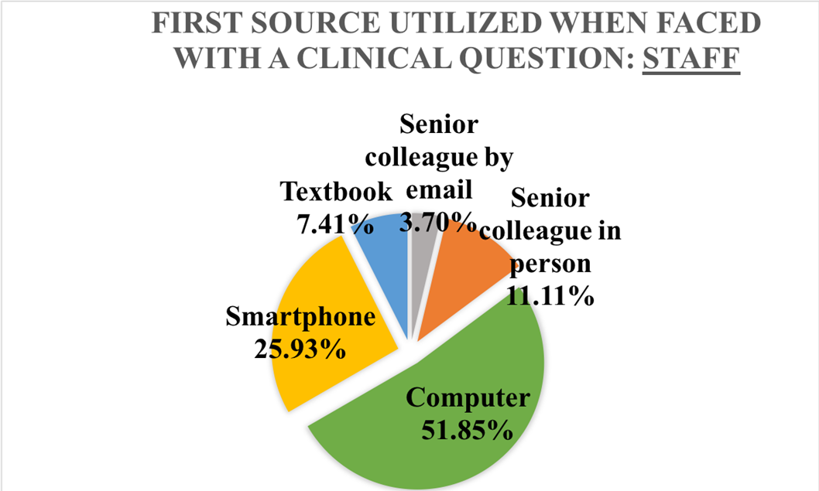
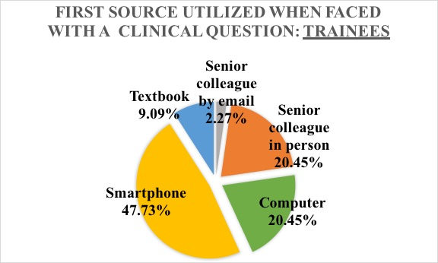
Most trainees will consult their smartphone first, when faced with a clinical question.

Slide 11
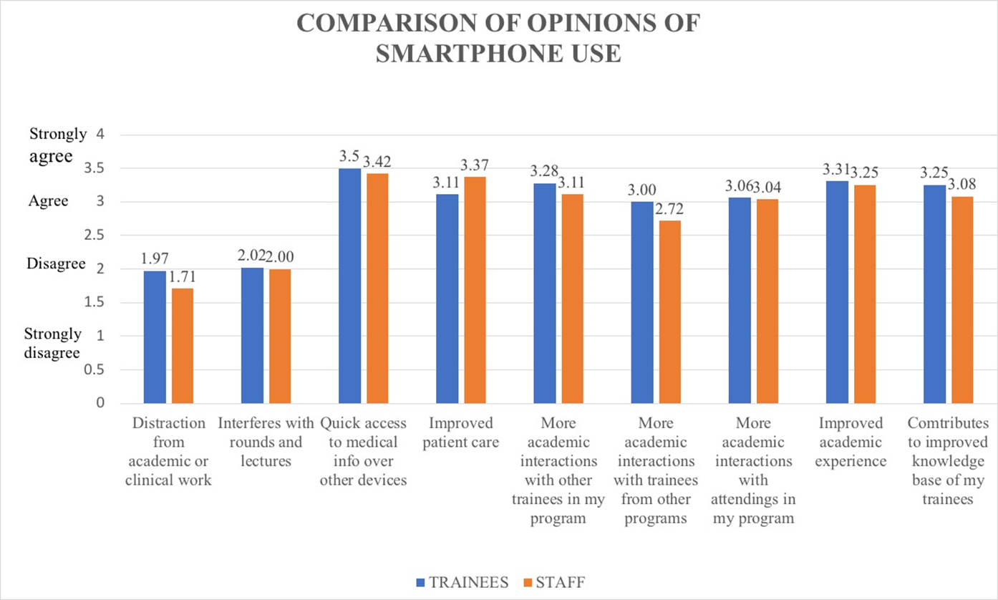
Generally trainees spend more time on their smartphone in search for medical information than attending surgeons.

Slide 12
Overall, “Whats-app” is the most used social media application mainly by trainees (83.33% vs 59.38%, p=0.021).
Both trainees and attending surgeons find that Wifi connection is the greatest challenge to smartphone use (56.25% vs 56.25%, p>0.99).

Slide 13
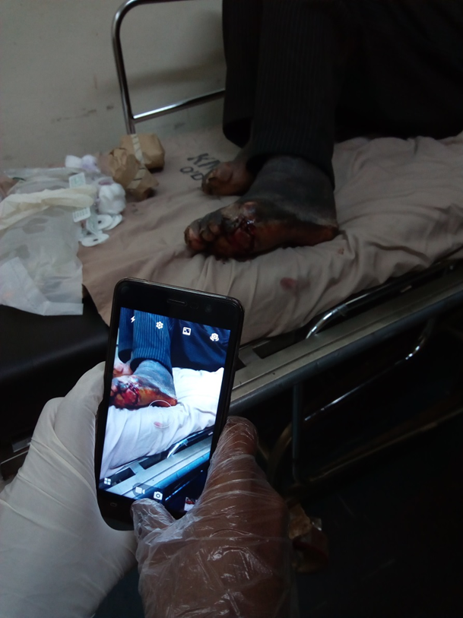
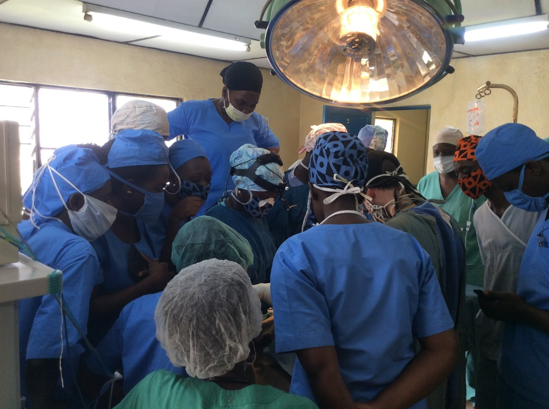
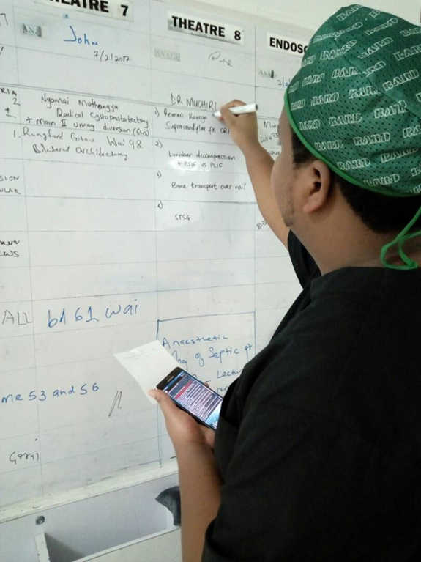
CONCLUSION

Slide 14
Trainees and attending surgeons use smartphones for varied educational and clinical purposes.
Positive impact on patient care, learning activities interactions amongst trainees and interactions.
Wifi connection is the greatest challenge.
Further study: Enlarge the study to look at use of smartphones within a larger African surgical training program, with emphasis on rural setting.

Slide 15
Acknowledgement

