Slide 1
USE OF MOBILE TECHNOLOGY IN DATA COLLECTION: A CASE STUDY OF THE KEMRI BOLD APP
7th EAHSC, Dar Es Salaam, United Republic of Tanzania from 27th to 29th March 2019.
Ndombi A¹, Wanjiku E¹, Matu S¹, Bwire K¹, Maina J¹, Mureithi M¹, Nyambura J¹, Makau B¹, Mwai M¹, Miheso B¹, Karugu M¹, Ng’ang’a J², Kathure I⁵, Kipruto H⁶,Gitonga S⁴, Tumwa D³, Amukoye E¹, Meme H¹.

Slide 2
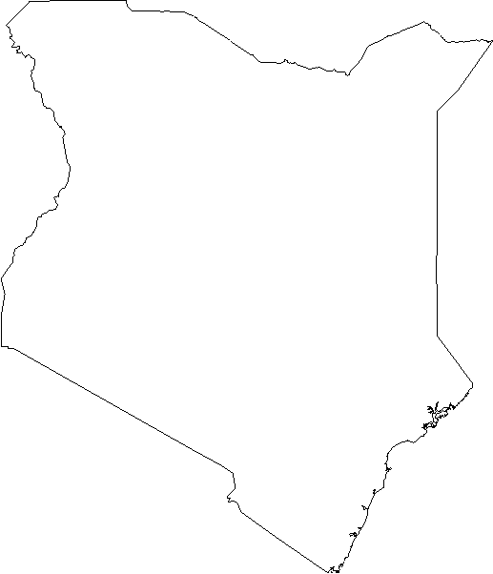
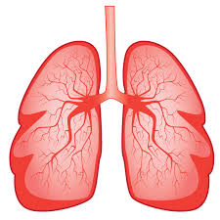
INTRODUCTION
KEMRI BOLD App is a generic version of the ODK based data collection app with slight improvements and modifications.
It applies form logic, entry constraints, and repeating sub-structures.
It supports geo locations which helps in identifying the clusters.
The App was developed for the BOLD study for easy of data collection, real time relay of results and timely quality control.

Slide 3
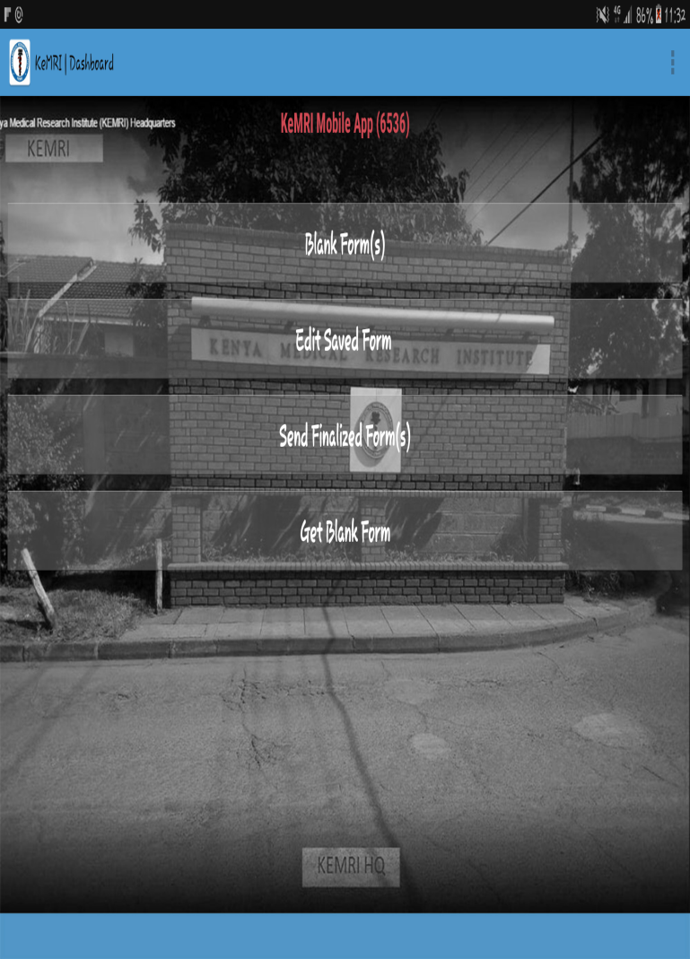
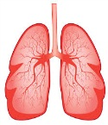
KEMRI BOLD App Homepage
Blank form
Edit saved form
Send finalized form
Get blank Form
Place your screenshot here

Slide 4
Benefits of mobile data collection
Mobile data collection.
One of the Clinicians using the App
Data quality
Risk mitigation and enumerator management
Easy to use solution, and user friendly

Slide 5
METHOD
It is a mobile App developed using Excel format for designing forms.(ODK XLS form design) where the skip logics and constricts were implemented., the form was converted from XLS format to Extensible Markup Language (XML )format so that it could be readable .
It runs on an android platform, that supports electronic questionnaires. The App was used by the clinicians to collect data from participants in the randomly selected households.
Filled in forms were submitted to the private cloud server and new forms downloaded from the server.

Slide 6
Method
Once questionnaire is downloaded on the phone;
Data can be collected offline and stored on the phone until when the mobile data is on.

Slide 7
Electronic Questionnaire
There are two major questionnaires;
Bold Main Questionnaire
Listing Questionnaire

Slide 8
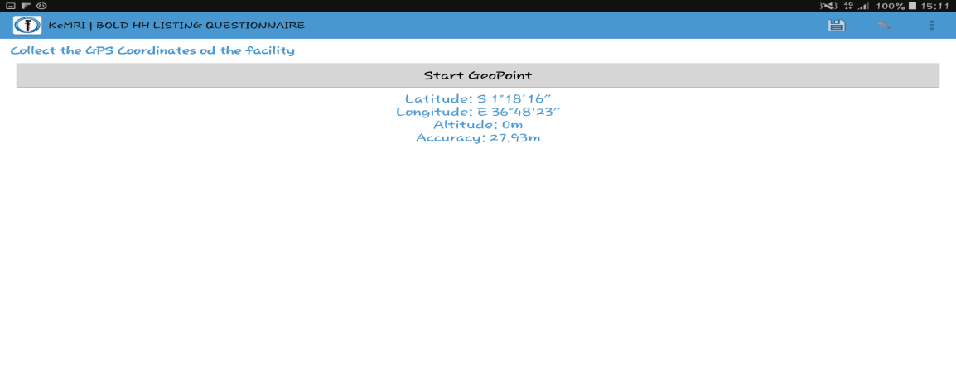
Capturing Geo points.

Slide 9
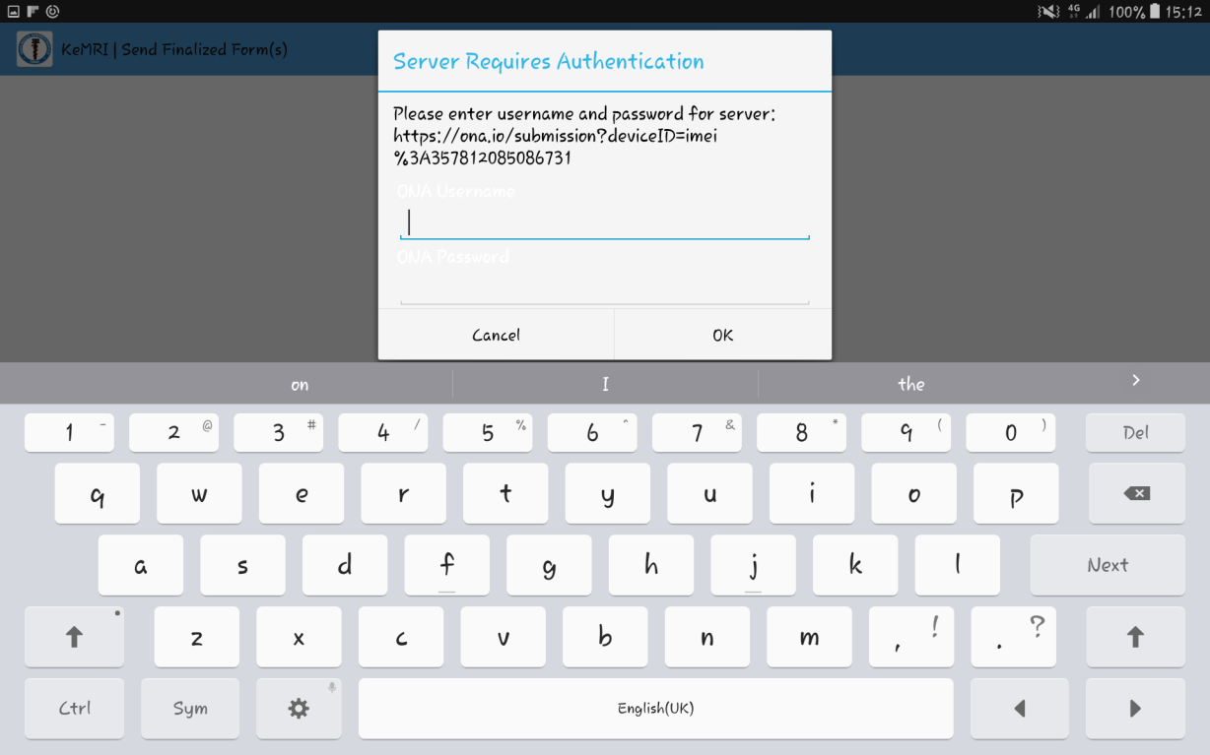
Data quality and safety
Data is encrypted and password protected
Built in quality checks ensuring no incomplete submissions

Slide 10
Cloud server
Data collected is submitted to a private cloud server.

Slide 11
What worked well?
Easy to set up the tablets with App
Data collection was consistent and logical for all clinicians.
Each group was assigned a tablet with the App downloaded onto it.
Easy to update the changes when they are done during the Pilot study.

Slide 12
RESULTS
The mobile App allowed inclusive daily real-time supervision of the data collected, with no data loss.
In addition it also allowed the identification of how many households were visited daily with real-time quality control .
The BOLD field staff have good uptake of the use of the App. However there where several challenge which include; missing skip patterns. These errors have been corrected.

Slide 13
CONCLUSION
During the BOLD pilot study, this App was found to be portable,
time saving and ensure that all variable were captured.
Timely relay of the data captured from the field was ensured which is important for real time quality control.

Slide 14
AKNOWLEDGEMENT
I wish to thank the KEMRI Management and the BOLD Team for the support .

