Slide 1
The 7th EAHSC
Web-based database is essential for HIV AND AIDS program management
HJF MEDICAL RESEARCH INTERNATIONAL
Katemana Victor, Mwakapinga G, Mapala Y, Khamadi S, Mkumbwa A, Makasi S, Chintowa J, Adetosoye A.

Slide 2
Presentation Outline
1. Introduction
2. Objectives
3. Methods
4. Results
5. Lessons learnt

Slide 3
1. Introduction
HJFMRI had faced many challenges with regards to data quality, data management and dissemination.
Strategic information staff spent most of the time on data collection and aggregation rather than focusing more on data demand and information use
Data access was very limited, only one personal was the custodian of the program data.

Slide 4
1. Cont..
All strategic information staff were gathered centrally for data entry in DATIM. This activity was very costly to the program given a number of resources consumed.
Routine Data visualizations showing data trends and progress towards target were very limited. Thus most of the program decisions delayed due to tardily access of routine data for decision making
Given the challenges, developing a real time web-based database was inevitable

Slide 5
1. Cont..
In 2016, HJFMRI – Tz developed a real time web-based database called IMPACT (Improving MHRP Performance, Analytics, Cohesion & Transparency) , which enables real time data collection, review, cleaning and visualization of multiple service points.
HJFMRI adapted DHIS2, a free and open source health management data platform, to develop IMPACT
IMPACT reports data for 5 regions, Mbeya, Rukwa, Ruvuma and Katavi covering 485 facilities in the southern highlands of Tanzania

Slide 6
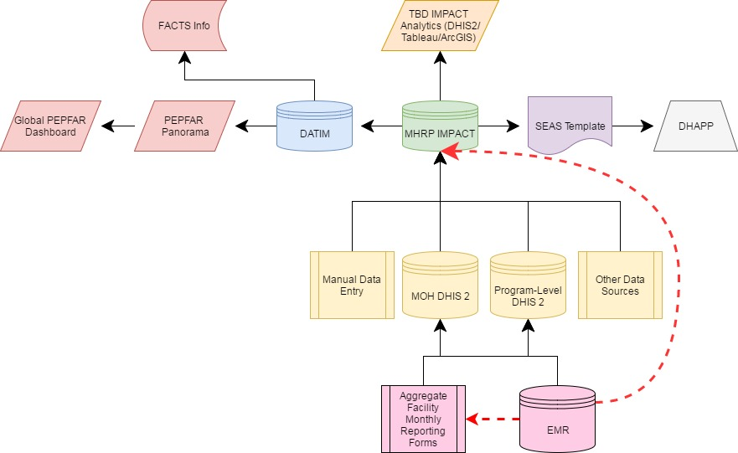

Slide 7
2. Objective
The main objective of this evaluation was to assess the impact of web based database for HIV/AIDS program in southern highlands of Tanzania.

Slide 8
3. Methods
Requirement gathering to determine the functionalities of the system was done through program staff
After developing and configuring the system, a test instance was Deployed
All program staff were trained using the deployed test instance
After incorporating all the user feedback, the production instance was Deployed
Strategic Information staff started reporting facility and community data in April 2016

Slide 9
3. Cont…
The IMPACT database collects quantitative data on a monthly basis at 485 PEPFAR supported HIV/AIDS care and treatment facilities.
This data is collected from facility registers and uploaded directly while at the facility by strategic information data assistants.
IMPACT collects data at the full spectrum of necessary levels of
granularity:
  from facility and community level reporting
  through program/mechanism and global (MHRP) roll up
However, patient-level data is not collected in IMPACT

Slide 10
4. Results
Since the introduction of the web-based system for data collection, review, cleaning and reporting there has been
1. Improved and sustainable reporting rates
2. Timely access to facility reports where this has improved by more than 95% across all 485 facilities in southern highlands of Tanzania. During manual aggregation, district and regional report aggregation would require more than 7 days while, with the real time web-based system, the reports are aggregated every hour.

Slide 11
4. cont…
3. Data accountability has improved through data accessibility to program staff who provide instant comments and feedback upon data visualization.
4. The database has reduced the workload for program staff by more than 96%, due to automation of most functionalities that were done manually. I.e. Data Quality, Aggregation.
5. The system facilitates informed decision making by providing access to real time and historical data.

Slide 12
5. Lessons Learnt
The IMPACT database has proven to be very useful and reliable.
Future plans are such as using slides generated by IMPACT for program review meetings which provide the program with critical performance insights apply corrections where needed. This is will to reduce workload of program staff who develop PowerPoint slides for feedback provision and ensure consistency in data presented.
There is however a need to cultivate the culture of system use among program staff for decision-making.
Furthermore in order to attain sustainability, Resources need to be invested in trainings and advocacy.

Slide 13


Acknowledgements

