Slide 1
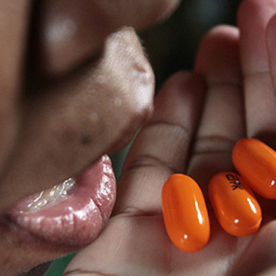
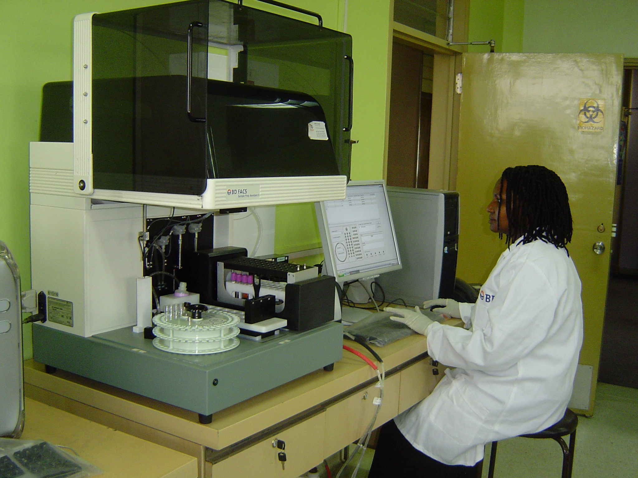
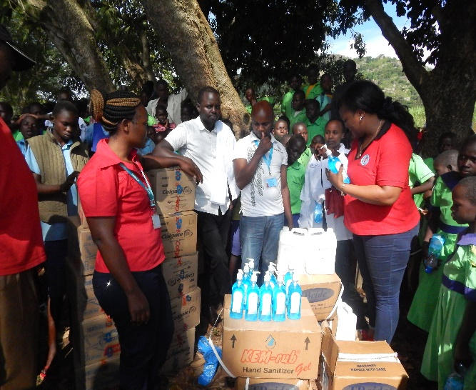


7th EAHSC
mHealth in Kenya: Why are we not feeling the impact as a country?!
Miheso B; Asiko O; Orina F; Were L

Slide 2




Outline
Background
Objective
Materials and methods
Results
Discussion
Conclusion
Recommendations
www.kemri.org
In Search of Better Health

Slide 3
Background
mHealth (mobile health)_use of mobile phones and other wireless technology in medicine and public health.
There has been proliferation of mobile health applications, unfortunately only few have had impact on public health outcomes.
This is despite growing evidence from various studies carried out in Kenya that have shown that various mobile approaches lead to improved health care and service delivery.
mHealth forms a good platform to improve primary health care because of its cost efficiencies and possibility to reach rural areas with various services across the patient healthcare pathway and health systems.
www.kemri.org
In Search of Better Health

Slide 4

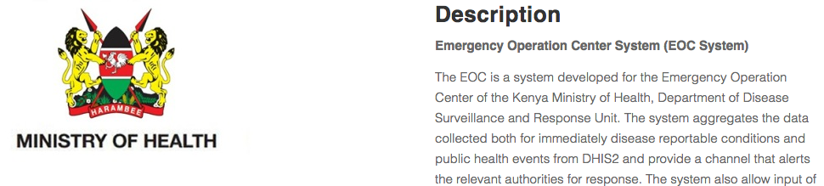

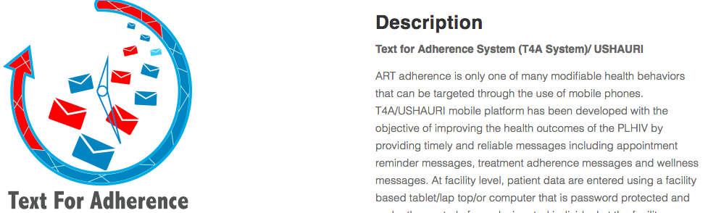

Examples of mhealth services in Kenya
www.kemri.org
In Search of Better Health

Slide 5
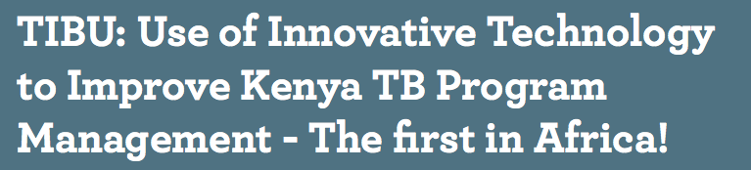
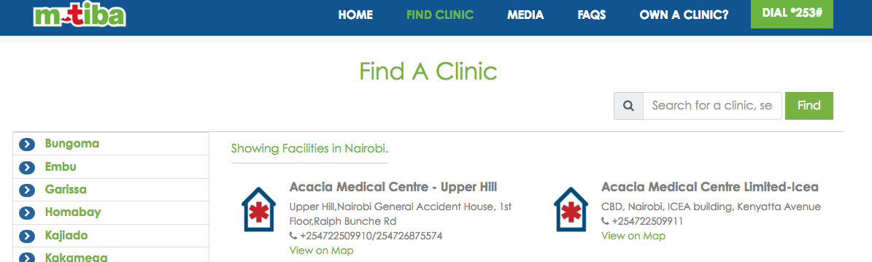
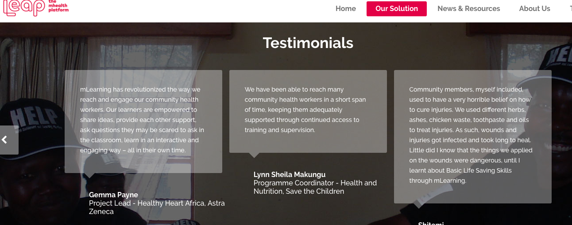
examples
www.kemri.org
In Search of Better Health

Slide 6
Objective
To present results of review of available literature on mHealth in Kenya
Materials & Methods
Literature reviews, grey literatures of high relevance evaluating, describing or discussing mHealth in Kenya were included for review.
www.kemri.org
In Search of Better Health

Slide 7
Results
29 peer-reviewed studies. 5 studies from white or grey literature were included.
All the studies were based in Kenya.
The studies showed different mobile health approaches which included
The studies showed different mobile health approaches which included:
appointment reminders or alerts that results are ready via sms to patients, prerecorded messages for adherence or support, mobile phone app used by community health workers to screen for different conditions.
www.kemri.org
In Search of Better Health

Slide 8
Discussion
Very good mHealth innovations_specific to certain groups
No scale up of mHealth innovations due to;
lack of collaboration between the various stack holders
duplication of the mHealth services and products
lack of understanding the market nor its needs
lack of awareness of the available mHealth services
no knowledge of what mHealth initiatives that are already happening within the country.
www.kemri.org
In Search of Better Health

Slide 9
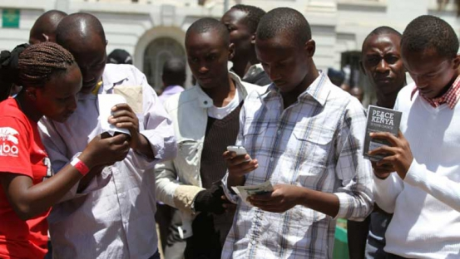
Conclusion
mHealth still remains an effective option of improving primary health care in Kenya
www.kemri.org
In Search of Better Health

Slide 10
Recommendations
Collaboration between stakeholders to avoid duplication
HMIS ( Strengthening)
Buy in by MOH on mHealth tools shown to be efficient
Create awareness
Goal_Primary Health Care
www.kemri.org
In Search of Better Health

Slide 11
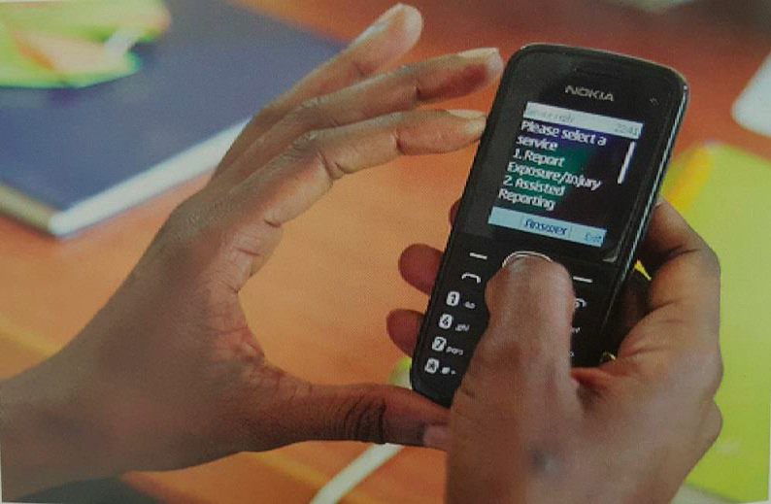
Thank you
www.kemri.org
In Search of Better Health

