Slide 1
ANTIMICROBIAL ACTIVITY OF MORINGA OLEIFERA, ALOE VERA AND WARBUGIA UGANDENSIS ON MULTIDRUG RESISTANT ESCHERICHIA COLI, PSEUDOMONAS AERUGINOSA AND STAPHYLOCOCCUS AUREUS
Peter G. Kirira*, Anne Muhuha, Stanley Kang’ethe
MOUNT KENYA UNIVERSITY
KENYA
Presentation at the 6th Health and Scientific Conference & International Health Exhibition and Trade Fair, 29th-31st March, 2017, Bujumbura, Burundi

Slide 2
INTRODUCTION
Antibiotic resistance is inability of drug(s) to kill a microbe that was previously used to treat the same microbe
New resistance mechanisms have developed and have spread widely (due to use and misuse of antibiotics) challenging our ability to manage common infectious diseases resulting to mortality and morbidity of individuals. (WHO, 2015)
Development of new antibiotics on a downward trajectory

Slide 3
MDR Microbes increasing

Slide 4
INTRODUCTION cont’
The rising prevalence of multi-drug resistant bacterial strains and recent emergence of strains with deprived sensitivity to antibiotics raises the scope of unmanageable microbes (Rojas et al., 2006).
Sub therapeutic use of antibiotics on domestic animals (Kivuvi et al, Kariuki et al; 2006).
The therapeutic properties of plants have been evaluated by many studies all over the world giving promising results (Adriana et al., 2007).

Slide 5
OBJECTIVES
Broad Objective
To determine the antimicrobial activity of W. ugandensis, M. oleifera, and A. vera on multi drug resistant S. aureus, P. aeruginosa and E. coli.
Specific objectives
To determine the zone of inhibition of W. ugandensis, M. oleifera, and A. vera on multidrug resistant S. aureus, P. aeruginosa and E. coli through agar diffusion assay.
To determine the Minimum Inhibitory Concentration (MIC) and Minimum Bactericidal Concentration (MBC) of W. ugandensis, M. oleifera, and A. vera on multidrug resistant S. aureus, P. aeruginosa and E. coli.

Slide 6
METHODOLOGY
Study Area
The multi-drug resistant micro-organisms were obtained from Microbiology National Public Health Reference Laboratory, Nairobi
All the experiments were carried out at Mount Kenya University research laboratories
Plant Materials
200 grams of Aloe vera leaves, Moringa oleifera leaves and Warbugia ugandensis were harvested from their natural habitat

Slide 7
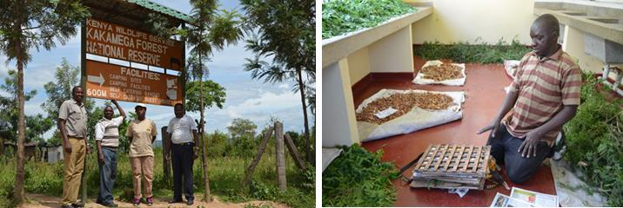
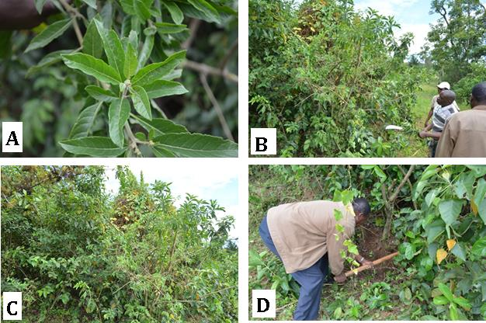

Slide 8
METHODS cont’
Anti-bacterial Assay
Disc diffusion method was used to determine anti-microbial activity by measuring zones of inhibition in millimeters.
Serial dilution of the extract was done to determine the Minimum inhibitory Concentration(MIC) (Rahman et al., 2009).

Slide 9
METHODS cont’
Minimum Bactericidal Concentration(MBC) was also determined.
Controls
Standard bacteria ;S. aureus (ATCC 26923), P. aeruginosa (ATCC 27853) and E. coli (ATCC 29218) were used and tetracycline(25 ug) was used as a conventional antimicrobial for both gram positive and gram negative bacteria

Slide 10
DATA ANALYSIS
Raw data was entered in Microsoft excel and later exported to Minitab version 17.0 for statistical analysis.
Data was subjected to descriptive statistic and expressed as mean± standard error of mean (SEM). p value less or equals to 0.05 was considered significant.
ANOVA was used to determine statistical difference among different treatment groups followed by Tukey’s post hoc test for pairwise comparison between different treatment groups.

Slide 11
RESULTS: METHANOLIC EXTRACTS
 |  | Zones of inhibition (mm)
Group | Treatment | Standard S. aureus | Test S. aureus | Standard P. aeruginosa | Test P. aeruginosa | Standard E. coli | Test E. coli
Negative control | 4% DMSO | 0.00±0.00^{g} | 0.00±0.00^{f} | 0.00±0.00^{f} | 0.00±0.00e | 0.00±0.00^{f} | 0.00±0.00e
Positive control | Tetracycline | 24.56±0.34ª | 19.00±1.04ª | 29.11±0.39ª | 25.33±0.17ª | 25.44±0.24ª | 21.00±1.04ª
Methanol Extract | W. ugandensis 400μg/ml | 11.00±0.00^{c} | 9.89±0.11^{b} | 9.17±0.17^{b} | 8.33±0.17^{b} | 10.00±0.00^{b} | 9.17±0.12^{bc}
 | M.oleifera 400μg/ml | 12.00±0.00^{b} | 8.50±0.24^{bcde} | 9.00±0.00^{bc} | 8.50±0.25^{b} | 9.33±0.33^{c} | 9.00±0.00^{bdc}
 | Aloe vera 400μg/ml | 10.67±0.33^{cd} | 8.89±0.26^{bcd} | 9.00±00^{bc} | 8.06±0.06^{b} | 10.00±0.00^{b} | 9.78±0.15^{b}

Slide 12
RESULTS FOR METHANOL EXTRACTS

Slide 13
RESULTS FOR AQUEOUS EXTRACTS
 |  | Zones of inhibition (mm)
Group | Treatment | Standard S. aureus | Test S. aureus | Standard P. aeruginosa | Test P. aeruginosa | Standard E. coli | Test E. coli
Negative control | Distilled water | 0.00±0.00^{d} | 0.00±0.00^{d} | 0.00±0.00^{g} | 0.00±0.00^{h} | 0.00±0.00^{f} | 0.00±0.00^{c}
Positive control | Tetracycline | 23.56±0.34ª | 18.00±1.04ª | 28.11±0.39ª | 24.33±0.17ª | 24.44±0.24ª | 20.00±1.04ª
Aqueous Extract | W. ugandensis 400μg/ml | 8.00±0.00^{b} | 7.56±0.06^{bc} | 7.67±0.17^{cd} | 7.50±0.00^{cde} | 8.00±0.00^{c} | 7.72±0.19^{b}
 | M. oleifera 400μg/ml | 8.00±0.00^{b} | 8.33±0.14^{b} | 8.50±0.29^{b} | 8.50±0.14^{b} | 8.50±0.00^{b} | 7.89±0.22^{b}
 | Aloe vera 400μg/ml | 8.00±0.00^{b} | 7.50±0.00^{bc} | 7.83±0.17^{c} | 7.83±0.19^{c} | 8.00±0.00^{c} | 7.50±0.00^{b}

Slide 14
RESULTS FOR AQUEOUOS EXTRACT

Slide 15
MIC AND MBC
 | Methanol extract (μg/ml) |  |  |  |  |  | Aqueous extract (μg/ml)
 | W. ugandensis |  | M. oleifera |  | A. vera |  | W.Ugandensis |  | M. oleifera |  | A. vera
Bacteria strain | MIC | MBC | MIC | MBC | MIC | MBC | MIC | MBC | MIC | MBC | MIC | MBC
Standard S. aureus | 180 | 360 | 180 | 360 | 180 | 360 | 180 | 380 | 180 | 360 | 180 | 360
Test S. aureus | 180 | 360 | 180 | 360 | 180 | 360 | 160 | 320 | 180 | 360 | 180 | 360
Standard P. aeruginosa | 180 | 360 | 180 | 360 | 180 | 360 | 180 | 380 | 180 | 360 | 180 | 360
Test P. aeruginosa | 180 | 360 | 160 | 320 | 180 | 360 | 380 | ≥400 | 180 | 360 | 180 | 360
Standard E. coli | 180 | 360 | 180 | 360 | 180 | 360 | 180 | 380 | 180 | 360 | 180 | 360
Test E. coli | 160 | 320 | 160 | 320 | 160 | 320 | 380 | ≥400 | 160 | 320 | 260 | ≥400

Slide 16
RECOMMENDATION
The extracts of W. ugandensis, M. oleifera and A. vera should be investigated further to determine synergistic effects.
Purification and isolation of the bioactive compounds .
Using different parts of the plants e.g bark, roots, seeds.

Slide 17
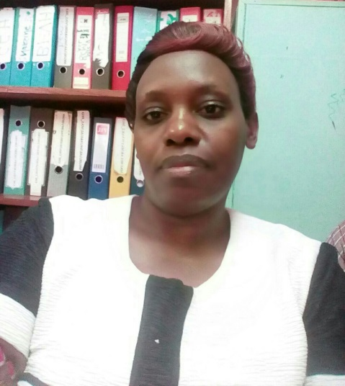
Acknowledgements
EAHRC / KEMRI for partial conference support
MKU for funding the project
Audience
Ms. Muhuha MSc. Candidate

