Slide 1
Cholera Outbreak Caused by Drinking Contaminated Lakeshore Water:
Kaiso Village, Uganda, Oct 2015
Oguttu D.W (BBLT, MZOO/Par, FET), Okullo A, Bwire G and Ario A.R.
The 6TH EAHSC

Slide 2
Events leading to investigation
2 suspected cholera deaths in Kaiso
Outbreak reported,
District response
Investigation
1 – 10 Oct | 12 Oct | 1 Nov

Slide 3
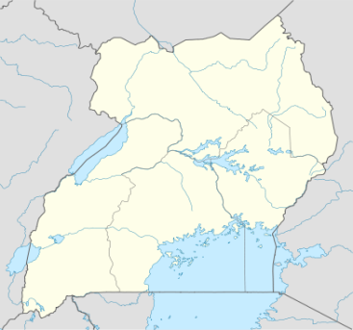
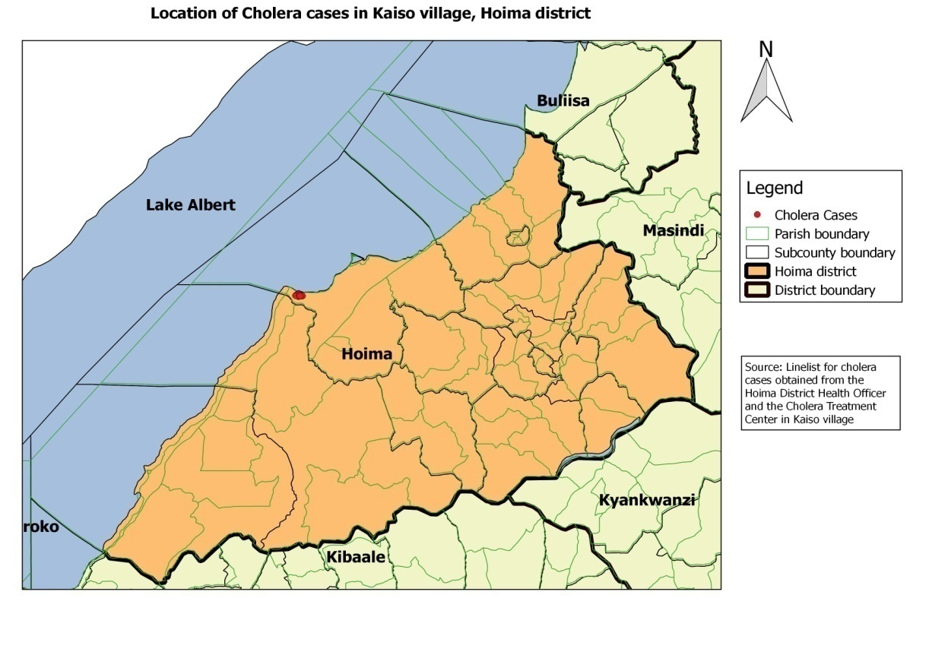
Located on shoreline of Lake Albert

Slide 4
Objectives
Identify source of infection
Identify mode of transmission
Recommend evidence-based public health actions to prevent future outbreaks

Slide 5
Case definition
Suspected case: Onset of watery diarrhoea in a resident of Kaiso village from 1st October onward
Confirmed case: A suspected case with vibrio cholerae identified in fecal sample by Lab culture

Slide 6
Systematic case finding and investigation
123 cases line listed from cholera treatment center and community
Rainfall data from Kabwoya Wildlife Reserve weather station

Slide 7
A point source outbreak after heavy rainfall
# cases
Tx ctr opened
Rainfall
(mm)
H2O chlorination
Investigation
Rainfall
Oct
Nov

Slide 8
Symptoms were consistent with Cholera

Slide 9
Cases by age and gender
Sex
Male | 70
Female | 53
Age
Range | 8mon – 65y
Median | 20y

Slide 10
Case distribution by settlement zone
SZ1
SZ2
SZ3

Slide 11
High Attack rates in SZ2 and SZ3
Zone | Cases | Popn (Estim.) | Attack rate (/1000)
Kaiso Village | 123 | 9000 | 14
SZ2 | 35 | 2000 | 17
SZ3 | 83 | 6500 | 13
SZ 1 | 2 | 500 | 4

Slide 12
Water likely source of transmission
Lake primary source of water for all cases
100% cases no water treatment
Heavy rainfall prior to outbreak
No large community festival prior to outbreak
>90% cases ate hot food from their homes

Slide 13
Case - control study
61 cases
126 randomly selected village controls from village register
Obtained Info on sources of drinking water and boiling water

Slide 14
Water collection points associated with cholera
Exposure | % cases exposed (n=61) | % controls exposed (n=126) | OR_{M-H} (95% CI)
Site C water | 69 | 33 | 6.7 (2.5 – 17)
Site B water | 21 | 37 | 1.8 (0.64 – 5.3)
Site A water | 10 | 30 | ref

Slide 15
Drinking unboiled water associated with disease
Exposure | % cases exposed (n=61) | % controls exposed (n=126) | OR_{M-H} (95% CI)
Drinking Un-boiled water | 100 | 93 | ∞ (1.0-∞)*
Drinking boiled H2O | 0 | 7 | Ref.
*Fisher’s exact CI

Slide 16
Environmental investigation: 3 water collection sites: A, B & C
A
B
C
Lake Albert
SZ1
SZ2
SZ3

Slide 17
Site C was contaminated
Raw feces

Slide 18
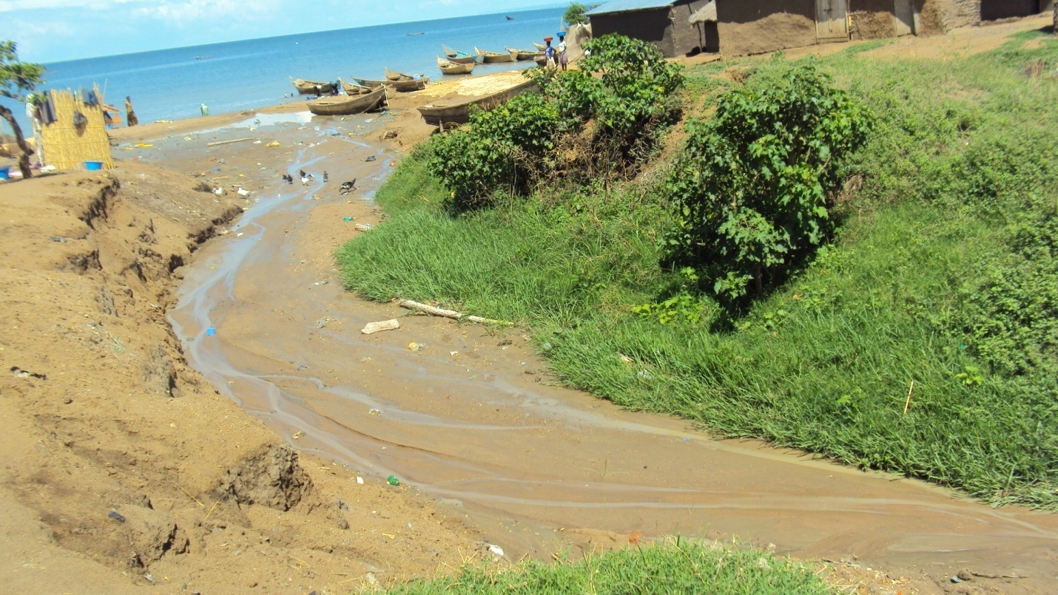
Gully channel washed sewage into lake shore at site C
C

Slide 19
Open defecation along the channel

Slide 20
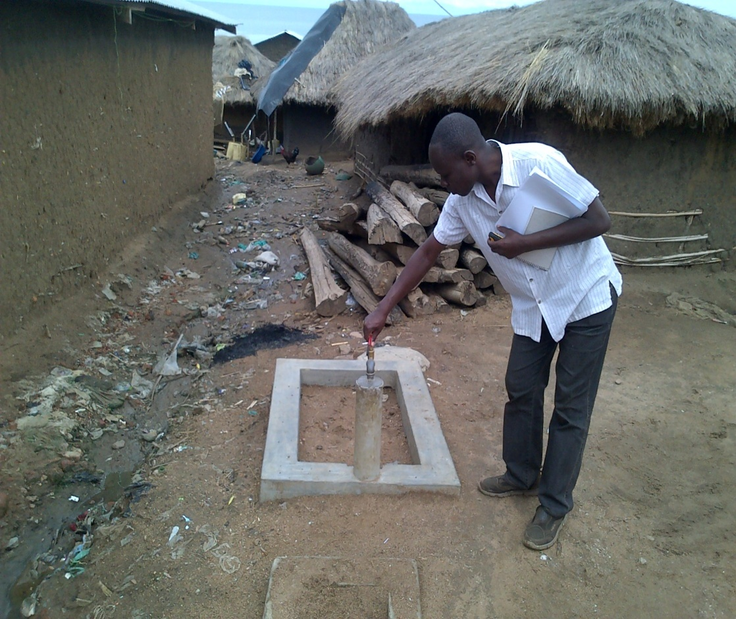
Piped water system vandalized

Slide 21
Conclusion
Drinking lakeshore water contaminated by feces washed down a gully channel from hillside open defecation area caused this outbreak

Slide 22
Recommendations
Immediate interventions:
Boiling & treatment of drinking water
Construction of public latrines
Ultimate solution: Fix the broken piped water system or provide alternative safe water to the community

Slide 23
Acknowledgements
Hoima DHO and DHT Members
MoH
WHO
PHFP fellow Allen Okullo
PHFP mentors Dr. Bao Ping Zhu and Dr. Ario Alex
Kabwoya Wild Life Reserve admin
Chairman LC1 Kaiso and VHTs

Slide 24
Kaiso village

Slide 25
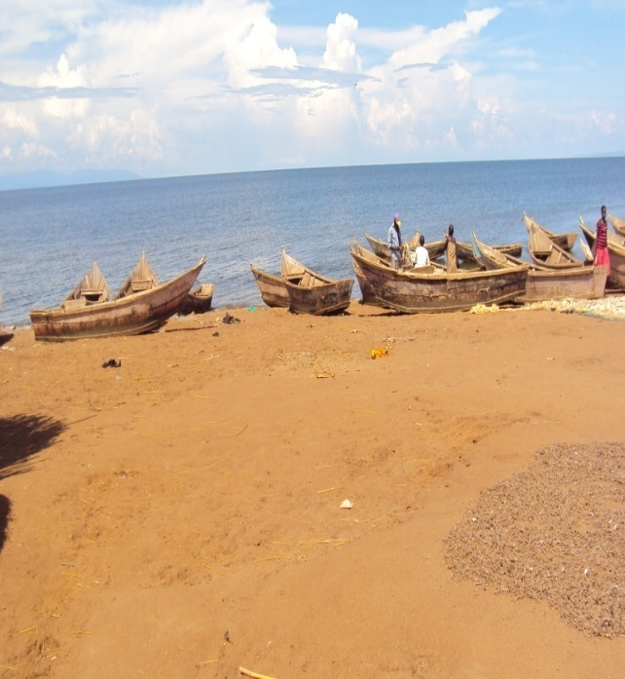
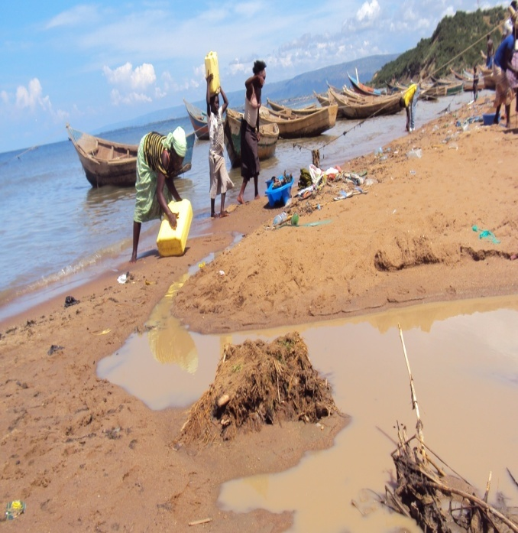
Site was contaminated
Site A: Rescue
Site B: Bakobya
Site C: Lendu
Raw feces

Slide 26
Kaiso on hill side

Slide 27
Distribution of cases in village zones

Slide 28
Environmental investigation: 3 water collection sites: A, B & C
Songa-Lendu
Songa-Bakobya
Ficama
ZS2
Attack rate 17/1000
SZ1
Attack rate 4/1000
SZ3
Attack rate 13/1000
B
A
C

