Slide 1
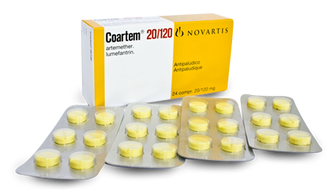
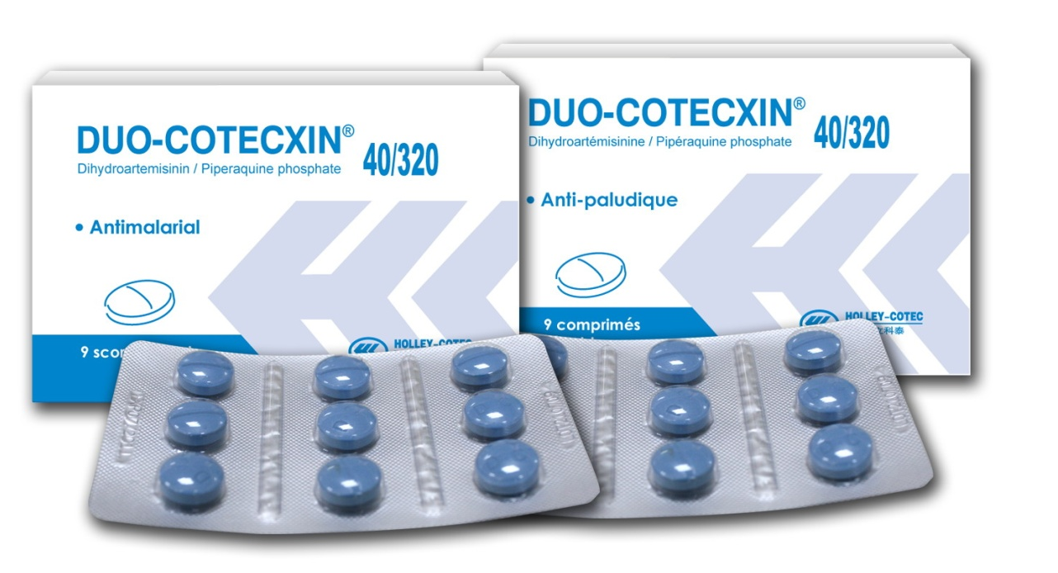
The 6th EAHSC & International Health Exhibition and Trade Fair
Bujumbura, Burundi.
Evaluation of the Efficacy of Artemisinin Combination Therapy in children aged between 6 Months and 12 years from EAPHLNP study sites in Kenya.
Kimani Francis.
PI-Malaria EAPHLNP
KEMRI Nairobi, Kenya
29th-31st March, 2017

Slide 2
The Journey WHO 2015
2000

Slide 3
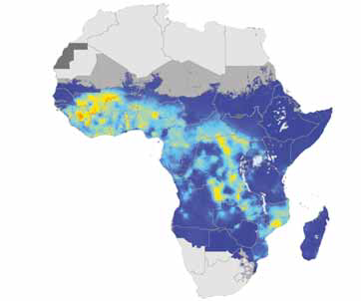
The Journey WHO 2015
2000
2015

Slide 4
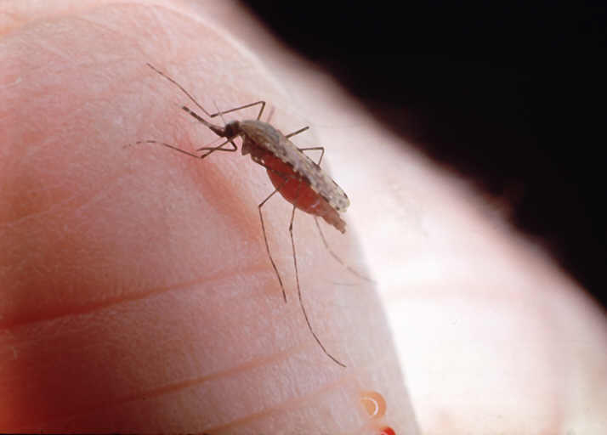
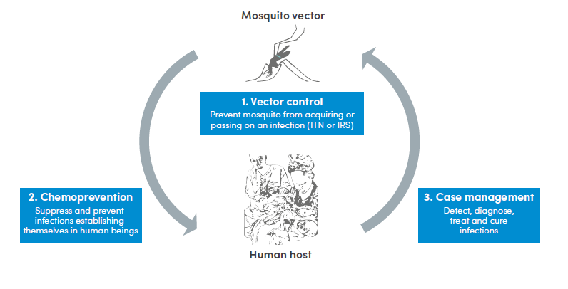
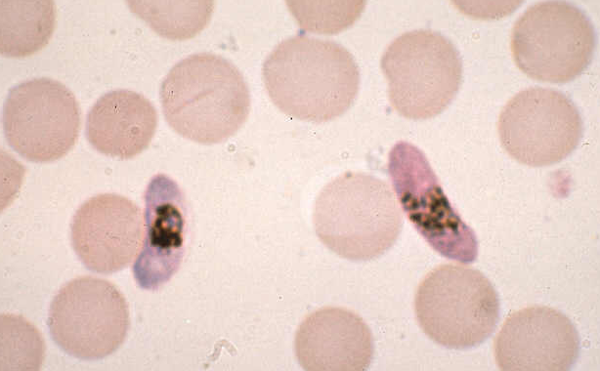
The Malaria control strategy (WHO 2015)
-

Slide 5
SP in 1998 Sabah 1998

Slide 6
SP in 1998 Sabah 1998

Slide 7
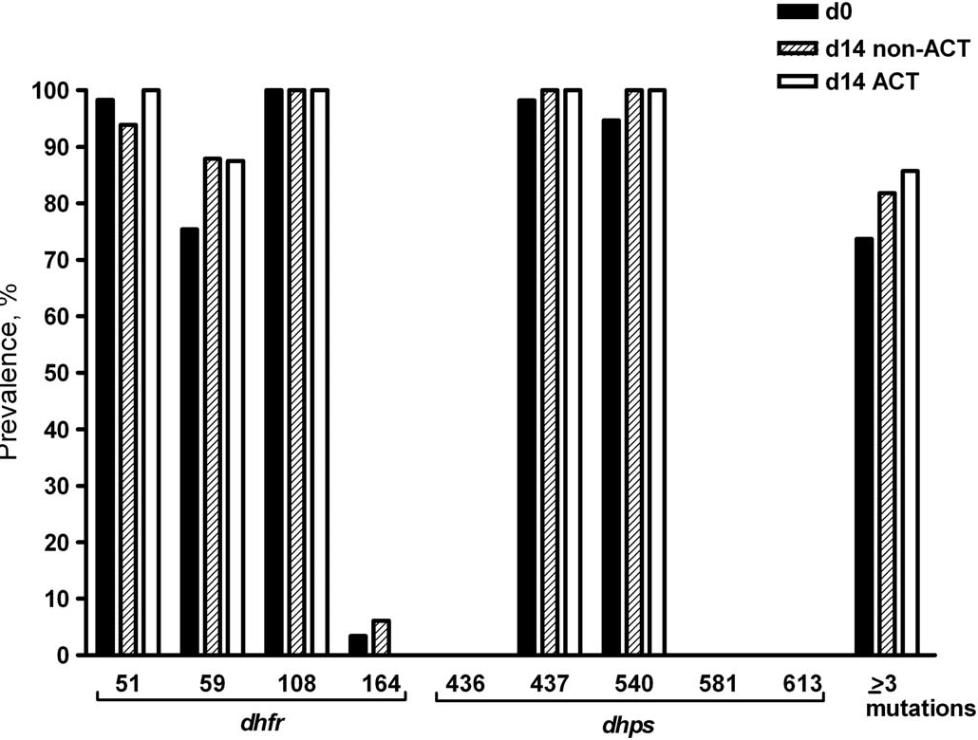
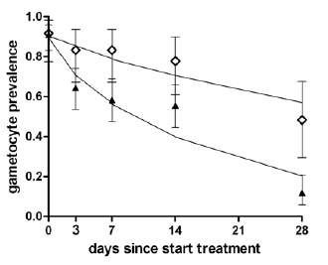
The trend in AMDR Sabah etal 2008, 2009, 2010

Slide 8
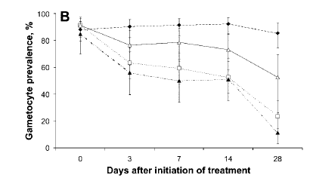
SP, AQ, AL in use Sabah et al 2004, 2006

Slide 9
The epicenter of drug resistant malaria.

Slide 10
Study Overview
Multi site randomised controlled clinical trial,
Clinical trial registered by WHO.- https://clinicaltrials.gov/ct2/show/NCT01899820
Two arm study
Artemether –lumefantrine - 1st line treatment
Dihyroartemisin- piperaquine – 2nd line treatment
External Clinical study monitoring in place

Slide 11
Study Objectives
Overall:
To evaluate the efficacy of fixed combinations, Artemether-lumefantrine and dihydroartemisinin-piperaquine in uncomplicated malaria patients in Kenya.
Specific:
To determine efficacy to AL and DP in uncomplicated malaria patients
To determine molecular markers related to reduced susceptibility to DP and AL
To compare level of adverse events in patients treated with either AL and DP.
To compare post-treatment gametocytaemia following treatment with AL and DP.

Slide 12
The study
Study design: Single-blinded randomized; two arm Non-inferiority clinical trial to assess the efficacy of dihydroartemisinin-piperaquine (DP) with artemether-lumefantrine (AL) as the comparative drug
Database developed in Open Clinica
Primary Outcome: adequate clinical and parasitological response (ACPR) at day 28 and 42
Secondary Outcomes:
Fever Clearance Time (FCT),
Asexual parasite clearance time (PCT),
Gametocyte carrier rates and
Adverse events

Slide 13
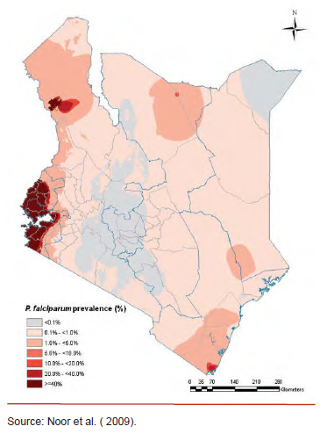
Study sites
Multi site,
Msambweni

Slide 14
Study sites
Multi site,
Msambweni
Nyando

Slide 15
Study sites
Multi site,
Msambweni
Nyando
Busia

Slide 16
Study sites
Multi site,
Msambweni
Nyando
Busia
Kisii

Slide 17
The populations
Parameters | Msambweni - Coastal Endemic |  |  | Ahero– lake Endemic |  |  | Busia – Matayos - Endemic |  |  | Kisii Epindemic
 | Act. | Tar. | Perf. (%) | Act. | Tar. | Perf. (%) | Act. | Tar. | Perf. (%) | Act
No. of potential subjects | 1,616 | - | - | 1,755 | - | - | 1,636 | - | - | WIP
testing positive | 476 |  | 29.5 | 705 |  | 40.2 | 868 |  | 53.1
patients consented | 427 | 300 | 142.3 | 347 | 300 | 115.7 | 341 | 300 | 113.6
patients enrolled | 352 | 300 | 117.3 | 315 | 300 | 105.0 | 334 | 300 | 111.3 | 160

Slide 18
Study participant flowchart – 2 sites

Slide 19
Study participant flowchart

Slide 20
Study participant flowchart

Slide 21
Baseline characteristics
Characteristic | Ahero N=315 | Msambweni N=352 | P-value
Age in months, median (IQR) | 44 (24-68) | 56 (32-86.5) | 0.0001
Gender (female) – N (%) | 147 (47) | 166 (53) | 0.93
Weight in Kgs, median (IQR) | 15.3 (11.5-19.5) | 15 (11-19.5) | 0.42
Height in Cms, median (IQR) | 103 (83-116) | 102 (85-118) | 0.63
Admission Temp ±SD | 37.6 ±1.2 | 38.0 ±1.1 | <0.0001
Screening Heart rate, median (IQR) | 103 (100-115) | 129 (115-138) | <0.0001
Parasite counts, median (IQR) | 38080 (18000-56080) | 20760 (8320-46000) | <0.0001
Gametocyte carrier rate, median (IQR)* |  | 120 (80-200)
Haemoglobin g/dl | 10.7 ±2.1 | 10.0 ±1.9 | <0.0001
Duration of illness, median (IQR) | 2 (1-3) | 2 (1-2) | 0.125
Table 1a. Baseline characteristics of the intention-to-treat population by sites.

Slide 22
Baseline characteristics
Characteristic | Arm A N=348 | Arm B N=319
Age in months, median (IQR) | 48 (29-73.5) | 51.5 (28-82)
Gender (female) – N (%) | 174 (56) | 139 (44)
Weight in Kgs, median (IQR) | 15 (11.2-19.5) | 15.1 (11.5-19.6)
Height in Cms, median (IQR) | 100.8 (84-116) | 103 (84-118)
Admission Temp± SD | 37.8 ± 1.2 | 37.7 ± 1.2
Screening Heart rate, median (IQR) | 115 (102-134) | 113 (100-130)
Parasite counts, median (IQR) | 26840 (9600-50400) | 34000 (13840-53000)
Gametocyte carrier rate, median (IQR)* | 120 (80-200) | 80 (40-240)
Haemoglobin g/dl | 10.2 ± 2.0 | 10.4 ± 2.0
Duration of illness, median (IQR) | 2 (1-2) | 2 (1-3)
Sites
Msambweni – N (%) | 196 (56) | 156 (44)
Ahero – N (%) | 152 (48) | 163 (52)
Table 1. Baseline characteristics of the intention-to-treat population

Slide 23
Primary outcome
 | Intention to Treat Analysis (N=667) |  |  |  | Per Protocol analysis (N=593)
 | Arm A N=348 |  | Arm B N=319 | Difference, % (95% CI) | Arm A N=313 | Arm B N=280 | Difference, % (95% CI)
Day 42
Non-corrected ACPR | 268 (77) |  | 215 (68) | 0.09 (0.02 to 0.16) | 264 (84) | 210 (75) | 0.09 (0.01 to 0.16)
corrected ACPR
Day 28
Non-corrected ACPR |  | 293 (84) | 249 (78) | 0.06 (-0.01 to 0.12) | 289 (92) | 243 (87) | 0.05 (-0.01 to 0.10)
PCR-corrected ACPR
Table 2. Parasitological response (primary outcome)

Slide 24
Primary outcome
 | Intention to Treat Analysis (N=667) |  |  |  | Per Protocol analysis (N=593)
 | Arm A N=348 |  | Arm B N=319 | Difference, % (95% CI) | Arm A N=313 | Arm B N=280 | Difference, % (95% CI)
Day 42
Non-corrected ACPR | 268 (77) |  | 215 (68) | 0.09 (0.02 to 0.16) | 264 (84) | 210 (75) | 0.09 (0.01 to 0.16)
corrected ACPR
Day 28
Non-corrected ACPR |  | 293 (84) | 249 (78) | 0.06 (-0.01 to 0.12) | 289 (92) | 243 (87) | 0.05 (-0.01 to 0.10)
PCR-corrected ACPR
Table 2. Parasitological response (primary outcome)

Slide 25
Cont..
 | ITT analysis |  |  |  | Per Protocol analysis
Treatment Outcome | Arm A N=348 | Arm B N=319 | P-value | Total N=667 | Arm A N=313 | Arm B N=280 | P-value | Total N=593
Early treatment failure | 0 | 1 (0.3) | 0.48 | 1 (0.15) | 0 | 1 (0.36) | 0.47 | 1 (0.17)
Late treatment failure | 26 (7.5) | 50 (16) | 0.001 | 76 (11) | 26 (8.3) | 49 (18) | 0.001 | 75 (13)

Slide 26
Cont..
 | ITT analysis |  |  |  | Per Protocol analysis
Treatment Outcome | Arm A N=348 | Arm B N=319 | P-value | Total N=667 | Arm A N=313 | Arm B N=280 | P-value | Total N=593
Early treatment failure | 0 | 1 (0.3) | 0.48 | 1 (0.15) | 0 | 1 (0.36) | 0.47 | 1 (0.17)
Late treatment failure | 26 (7.5) | 50 (16) | 0.001 | 76 (11) | 26 (8.3) | 49 (18) | 0.001 | 75 (13)

Slide 27
Secondary outcomes
 | Intention to treat analysis (N=664) |  |  | Per protocol analysis (n=593)
 | Arm A N=348 | Arm B N=319 | P-Value | Arm A N=313 | Arm B N=280 | P-Value
Fever clearance, median time in | hrs (IQR)
All participants in the study | 22 (21-29) | 23 (21-30) | 0.11 | 22 (21-28) | 23 (21-30) | 0.12
who cleared day 2 and beyond | 49 (48-50) | 48 (48-50) | 0.87 | 49 (48-50) | 48 (48-50) | 0.74
Asexual PCT in hrs, median (IQR)
All participants in the study | 46 (23-48) | 47 (24-48) | 0.29 | 46 (23-48) | 47 (24-48) | 0.20
who cleared day 2 and beyond | 48 (47-49) | 48 (47-49) | 0.79 | 48 (47-49) | 48 (47-49) | 0.64
Recurrent parasitaemia – N (%) | 29 (8.4) | 56 (18) | 0.0002 | 29 (9.3) | 55 (20) | 0.0003
Adverse events – N (%) | 15 (4.3) | 20 (6.3) | 0.26 | 14 (4.6) | 18 (6.5) | 0.30
Day 28 Haemoglobin g/dl ± SD | 11.1 ± 1.1 | 11.3 ± 1.3 | 0.55 | 11.1± 1.5 | 11.3 ± 1.5 | 0.50
Day 42 Haemoglobin g/dl ± SD | 11.3 ± 1.3 | 11.3 ± 1.8 | 0.79 | 11.3± 1.3 | 11.4 ± 1.8 | 0.35
Gametocyte carrier rates on day 7, median (IQR)# | 1340 (120-2560) | 140 (40-240) | 0.44 | 1340 (120-2560) | 140 (40-240) | 0.44
Table 3. (Secondary outcome)

Slide 28
Secondary outcomes
 | Intention to treat analysis (N=664) |  |  | Per protocol analysis (n=593)
 | Arm A N=348 | Arm B N=319 | P-Value | Arm A N=313 | Arm B N=280 | P-Value
Fever clearance, median time in | hrs (IQR)
All participants in the study | 22 (21-29) | 23 (21-30) | 0.11 | 22 (21-28) | 23 (21-30) | 0.12
who cleared day 2 and beyond | 49 (48-50) | 48 (48-50) | 0.87 | 49 (48-50) | 48 (48-50) | 0.74
Asexual PCT in hrs, median (IQR)
All participants in the study | 46 (23-48) | 47 (24-48) | 0.29 | 46 (23-48) | 47 (24-48) | 0.20
who cleared day 2 and beyond | 48 (47-49) | 48 (47-49) | 0.79 | 48 (47-49) | 48 (47-49) | 0.64
Recurrent parasitaemia – N (%) | 29 (8.4) | 56 (18) | 0.0002 | 29 (9.3) | 55 (20) | 0.0003
Adverse events – N (%) | 15 (4.3) | 20 (6.3) | 0.26 | 14 (4.6) | 18 (6.5) | 0.30
Day 28 Haemoglobin g/dl ± SD | 11.1 ± 1.1 | 11.3 ± 1.3 | 0.55 | 11.1± 1.5 | 11.3 ± 1.5 | 0.50
Day 42 Haemoglobin g/dl ± SD | 11.3 ± 1.3 | 11.3 ± 1.8 | 0.79 | 11.3± 1.3 | 11.4 ± 1.8 | 0.35
Gametocyte carrier rates on day 7, median (IQR)# | 1340 (120-2560) | 140 (40-240) | 0.44 | 1340 (120-2560) | 140 (40-240) | 0.44
Table 3. (Secondary outcome)

Slide 29
Changes in axillary temperature
P=0.41

Slide 30
Changes of haemoglobin
P=0.79

Slide 31
Changes of Asexual parasite
P=0.72

Slide 32
Cumulative hazard of recurrent parasitaemia – KM analysis
Age, sex, site adjusted HR 2.21 (95% CI 1.42-3.46); P<0.0001

Slide 33
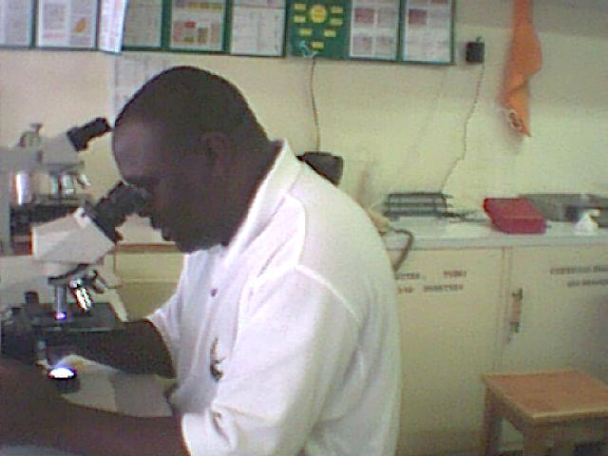
Way forward
Completion of the trials in all the study sites
initially planned to enhance the external validity of the results.
Profiling for the mutations driving the ACT resistance in Kenya.
Investigate the possible Impact on transmission (Gametocemia) with reduced efficacy.
Further efficacy studies in more endemic, epidemic and low endemic sites .
Continuous monitoring of ACTs in Kenya strongly recommended
Explore whether Tri ACTs have the solution, get prepared

Slide 34
Acknowledgements
The children and their families
DHMT
Hospital staff
MOH-MCU, Country Project Coordination Unit
Monitors KWT-CTF
EAPHLNP – World Bank
KEMRI team and Director KEMRI
EAC/EAHRC

