Slide 1
Fitness cost of resistance for lumefantrine and piperaquine-resistant Plasmodium berghei in a mouse model
The 6th East African Health and Scientific Conference and International Health Exhibition and Trade Fair
Francis W. Muregi¹ and Winnie R. Gimode²
¹Mount Kenya University, P.O. Box 342-01000, Thika, Kenya
²Kenyatta University, P.O. Box 43844 Nairobi, Kenya
Notes:
Efforts to develop an effective malaria vaccine are yet to be successful and thus chemotherapy may remain the mainstay of malaria control strategy for a long time. .
P. falciparum, the parasite that causes about 90% of all global malaria cases is increasingly becoming resistant to most antimalarial drugs in clinical use.
reports from Southeast Asia, of the parasite becoming resistant to the “magic bullet” artemisinins, the last line of defense in malaria chemotherapy

Slide 2
Background
Definition and key facts
Resistance cost of fitness refer to loss of fitness imposed on the pathogen by resistance
Chemotherapy is the mainstay of malaria control strategy
Global malaria situation exacerbated by emergence of drug resistance
Recent reports of resistance to artemisinin combination therapy (ACT) from SE Asia and our region increasing

Slide 3
Rationale
LM and PQ are both long-acting drugs, with mismatched pharmaco- kinetics with artemisinins, which may promote development of resistance
The greatest impediment to effective malaria control is drug resistance in Plasmodium falciparum, and thus understanding how resistance-conferred traits may influence parasite fitness and pathogenicity/virulence may aid in malaria control strategy

Slide 4
Objective
To find out how resistance against two quinoline-based antimalarial drugs, Lumefantrine (LM) and Piperaquine (PQ), two partner drugs in ACT impacts on parasite fitness

Slide 5
Clinical significance
Behaviour of drug-resistant mutants in the absence of drug is of clinical relevance since the drug that induced resistance can be reintroduced
That is the rationale behind WHO recommendation that at 10% level of resistance, withdraw the drug: Reports on CQ-resistance phenotypes shrinking in Malawi where withdrawal was done in1993

Slide 6
Experimental design and methods
Generation of resistance: P. berghei ANKA subjected to LM and PQ pressure using 2% relapses technique (Peters & Robinson, 1999) in mice over several generations; kindly donated by Dr Daniel Kiboi of KEMRI
Resistance cost of fitness; Considering the isogenicity of the parasites, their growth rate (serial passaging in Swiss albino mice) was used as a measure of fitness
Percentage % Loss of fitness = 100 – {(mean parasitaemia mutant/mean parasitaemia wildtype) × 100} ; (Muregi et al. 2011)

Slide 7
Results and Discussion:1
ED₅₀ and corresponding I₅₀ values of respective parasite lines were obtained to determine the level of resistance

Slide 8
Results and Discussion:2
LM- resistance is unstable LM-exposed parasites persisted only up to the 16th passage, after which no parasites could be microscopically observed after treatment with 30mg/kg cumulative dose of LM

Slide 9
Results and Discussion:3
There was no significant difference in %P for the respective parasite lines at D7pi: No fitness cost on the LM-exposed line
Transience: Is it epigenetic modification? Is it compensatory mutations? What is clinical significance?

Slide 10
Results and Discussion:4
PQ-resistance is stable and imposes a fitness cost on the resistant line

Slide 11
Results and Discussion:5
PQR showed significantly low (P<0.05) growth rates (mean parasitemia=5.6) relative to the wild-type parasite (28.4) at D₇ pi
This translates into a five-fold faster growth rate for the wild-type parasite by D₇ pi
An overall resistance cost of fitness of 80.3% for the PQ-resistant line was realized.

Slide 12
Results and Discussion:6
Previously, we had shown that parasite resistance to 5-fluoroorate (TS inhibitor) imposes a fitness cost of resistance of 66.0%, relative to the wild-type (Muregi et al., 2011)
There are similar reports from studies of other pathogens including different species of bacteria, Toxoplasma gondii, and viruses, indicating concomitant fitness cost in the absence of selection (Schrag & Perrot, 1996; Levin et al., 2000; Bjorkman et al., 1998; Bjorkman & Andersson, 2000; Mariam et al., 2004; Borman et al., 1996; Leigh et al., 2003; Lu et al., 2004; Fohl & Roos, 2003; Nagaev et al., 2001)

Slide 13
Conclusion and recommendation
In malaria-endemic countries, even partial resumption of drug sensitivity may positively impact public health
Monitoring development of resistance and prompt withdrawal of drugs from clinical use is necessary to allow for possible re-introduction of these drugs
_________________________________________
1.Gimode et al. (2015). Malaria Journal14:38
2. Muregi et al. (2011). Plos 6(6):e21251

Slide 14
ACKNOWLEDGEMENTS
TTWA

Slide 15
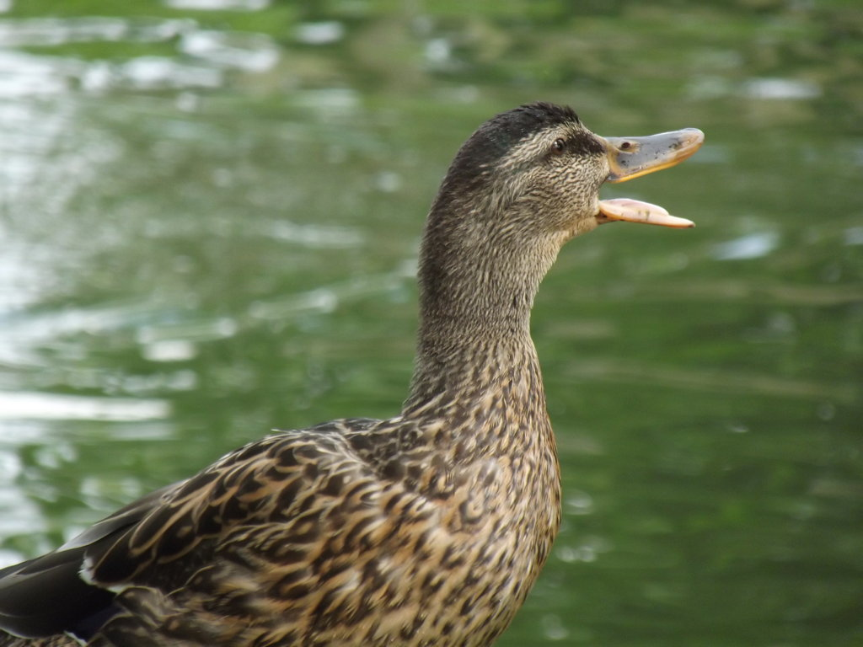
Thank you

