Slide 1
From Antiretroviral Therapy Access to provision of Third Line regimens: evidence of HIV Drug Resistance Mutations to first and second line regimens among Ugandan adults Dr.Ivan Namakoola on behalf of the CoLTART study team MRC/UVRI, Entebbe

Slide 2
Background
Antiretroviral therapy (ART) improves survival of HIV-infected individuals, reduces risk of AIDS and non-AIDS diseases and reduces HIV transmission
Globally, numbers of new HIV infections and mortality due to AIDS are declining
Acquired HIV drug resistance (HIVDR) limits sustained benefits of lifelong ART
Revised ART guidelines in resource limited settings urge
Routine viral load monitoring
Drug resistance testing at treatment failure
HIV Drug Resistance Surveillance in national programs
HIV drug resistance profiling prior to initiating ART is not yet standard HIV care in resource limited settings
Notes:
In 2014, globally 14.9 million (40%) people living with HIV were receiving ART, of which 13.5 million were in low- and middle-income countries [2]. In Uganda, 750,896 (50%) HIV infected people were receiving ART by December 2014 [3].

Slide 3
Background
ART roll out in Africa began as an emergency response with no access to wide spread Viral Load monitoring to guide early ART switches
In these conditions prolonged viral replication results in acquired HIVDR potentially compromising future treatment options
We report on a cross-sectional cohort study to determine patterns of acquired HIVDR among 953 HIV infected adults who had been on ART for 6 or more months with a median of 9 years
Notes:
In 2014, globally 14.9 million (40%) people living with HIV were receiving ART, of which 13.5 million were in low- and middle-income countries [2]. In Uganda, 750,896 (50%) HIV infected people were receiving ART by December 2014 .
The emergence of HIV drug resistance may limit the sustained benefits of antiretroviral therapy (ART) in settings with limited laboratory monitoring and drug options.

Slide 4
Methods
A cross-sectional study of HIV-Positive adults at enrolment into a prospective clinical cohort established to study the complications of long-term ART (CoLTART).
We recruited individuals from two ART cohorts;
The former Development of Antiretroviral Therapy in Africa (DART) Trial cohort established in 2003, and
The former Rural Clinical Cohort in south western Uganda where ART was introduced in 2004.
For each subject we obtained: ART history, CD4 count and Viral Load at cohort entry
Genotyping was performed on every sample with HIV RNA viral load of ≥ 1000 copies/mL
HIV drug resistance mutations (DRMs) were interpreted using the Stanford HIVdb Program, the 2009 WHO list for epidemiological surveillance of TDR alongside the IAS 2014 Update of DRMs of HIV-1.

Slide 5
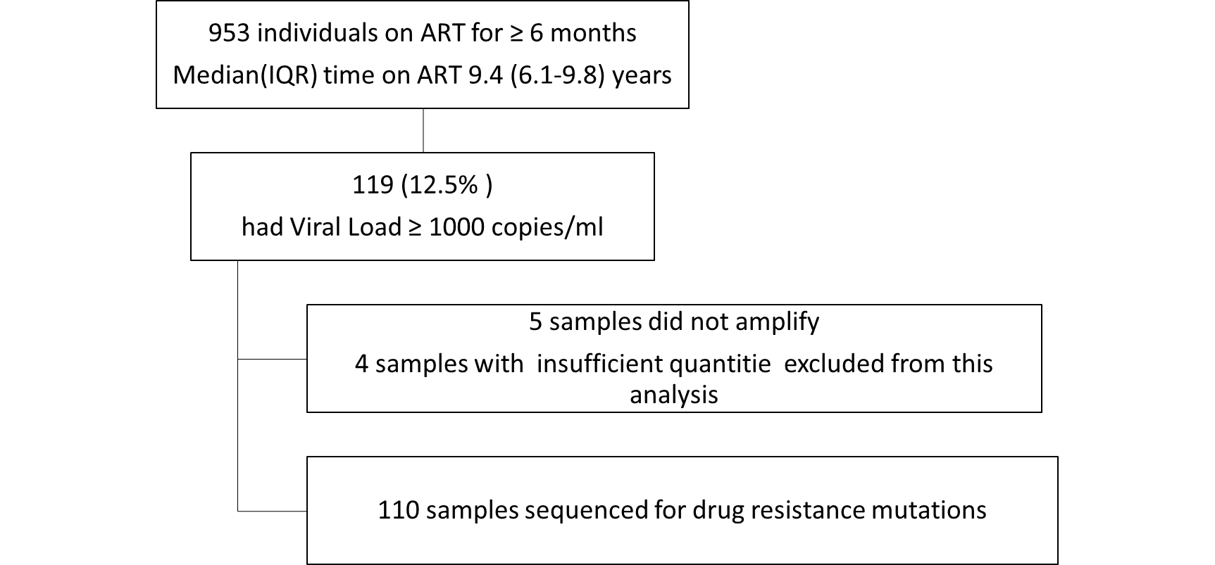
Findings
,

Slide 6
Characteristics of subjects with viral loads ≥1000 copies/ml at cohort entry
Characteristic | All participants | ART regimen
 |  | First line ART | Second line ART
 | n (%) | n (%) | n (%)
All | 110 | 74 | 36
Sex
Females | 73 (66.4) | 53 (71.6) | 20 (55.6)
Males | 37 (33.6) | 21 (28.4) | 16 (44.4)
Age, years
18-34 | 15 (13.6) | 6 (8.1) | 9 (25.0)
35-49 | 72 (65.5) | 50 (67.6) | 22 (61.1)
50+ | 23 (20.9) | 18 (24.3) | 5 (13.9)
HIV subtype
A | 37 (33.6) | 25 (33.8) | 12 (33.3)
B | 5 (4.5) | 3 (4.1) | 2 (5.6)
C | 6 (5.5) | 5 (6.8) | 1 (2.8)
D | 38 (34.5) | 22 (29.7) | 16 (44.4)
CRF01_AE | 24 (21.8) | 19 (25.7) | 5 (13.9)
CD4 cell counts at cohort entry Cells/ml
<=350 | 65 (63.7) | 41 (60.3) | 24 (70.6)
351–500 | 26 (25.5) | 22 (32.4) | 4 (11.8)
501+ | 11 (10.8) | 5 (7.4) | 6 (17.6)
Total duration on ART, years
0-<5 | 15 (13.6) | 9 (12.2) | 6 (16.7)
5-<9 | 6 (5.5) | 2 (2.7) | 4 (11.1)
9+ | 89 (80.9) | 63 (85.1) | 26 (72.2)
Duration on current ART regimen, years
<5 | 17 (17.5) | 9 (12.2) | 8 (34.8)
5-<9 | 17 (17.5) | 2 (2.7) | 15 (65.2)
9+ | 63 (64.9) | 63 (85.1) | 0 (0.0)

Slide 7
Commonest Clinically Significant Mutations
 | DRM detected % of samples | DRM detected % of samples | DRM detected % of samples | DRM detected % of samples
Non Thymidine Analogue Mutations | M184V 20.7% | K65R 8.0%
Thymidine Analogue Mutations | M41L 8.0% | K70R 8.0%
NNRTI Mutations | K103N 19.0% | G190A 7.0% | Y181C 6.0%
Major PI Mutations | V82A 7.0% | I54V 5.0% | M461I 5.0% | L33I 5.0%
Accessory PI resistance mutations | L10I 27.0% | L10V 12.0% | L10F 5.0%

Slide 8
What this means for 2nd line treatment options
Of the 7 patients with major PI DRMs
5 had high level resistance to Indinavir, Fosamprenavir, Atazanavir, Lopinavir and Nelfinavir
6 of the 7 retained susceptibility to Darunavir and 1 subject expressed low level resistance to Darunavir
2 subjects expressed susceptibility to Tipranavir
Lopinavir and Atazanavir are the main PIs available for 2nd line treatment in Uganda and in other resource limited settings
Darunavir is only available in limited centers in Uganda
Tipranavir is not listed

Slide 9
Uganda’s Revised ART Policy (2016)
Routine VL monitoring to guide early ART switches is now recommended in Uganda, though not yet widely available
In addition, we now recommend HIV phenotyping at 2nd line regimen failure to permit selection of effective ART for continued treatment
Increased advocacy for access to 3rd line regimens is ongoing
Revised Policy now includes introduction of Dolutegravir, a new class of ARV into national program

Slide 10
Acknowledgements
This research was jointly funded by the UK Medical Research Council (MRC) and the UK Department for International Development (DFID) under the MRC/DFID Concordant agreement
CoLTART study participants
MRC/UVRI Research Unit
CoLTART study team
CDLS Laboratory
Basic Sciences Laboratory
Statistics Section

Slide 11
Thank you.

