Slide 1
THE 6TH HEALTH AND SCIENTIFIC CONFERENCE & INTERNATIONAL HEALTH EXHIBITION AND TRADE FAIR 29th – 31st MARCH 2017, BUJUMBURA BURUNDI
Hospital Epidemiology Of Methicillin –Resistant Staphylococcus aureus (MRSA) In A Tertiary Care Hospital In Moshi Tanzania As Determined By Whole Genome Sequencing
Happiness Houka Kumburu, Tolbert Sonda, Marco Zwetselaar, Oksana Lukjancenko, Pimlapas Leetcharoenphon, Michael Alifrangis, Ole Lund, Blandina Theophil Mmbaga Gibson Kibiki, Frank M. Aarestrup
Kilimanjaro Clinical Research Institute, Moshi, Tanzania
Kilimanjaro Christian Medical Centre, Moshi, Tanzania
Kilimanjaro Christian Medical University College, Moshi, Tanzania
Centre for Medical Parasitology, Department of Immunology and Microbiology, University of Copenhagen, Denmark
Centre for Biological Sequence Analysis, Department of Bioinformatics, Technical University of Denmark
DTU-Food, Technical University of Denmark

Slide 2
Epidemiology of MRSA
1st Va resistant MRSA in Japan 1996, Both CA-MRSA &HA-MRSA
Himaratsu K et al, 1997, Hallin M et al,2008 ,Harbath S et al, 2005
Increase infection rates in hospitals
(1975-1991)
Panillio AL et al ,1992
Effective control measures(“Search & destroy” )
Holzknecht BJ et al ,2010
Serious hospital infections worldwide
Himaratsu K et al, 1997
1st MRSA isolate in 1961in USA
Barret McGebee et al, 1968
1960s
1970s
1980s
1990s
2000s
2010s

Slide 3
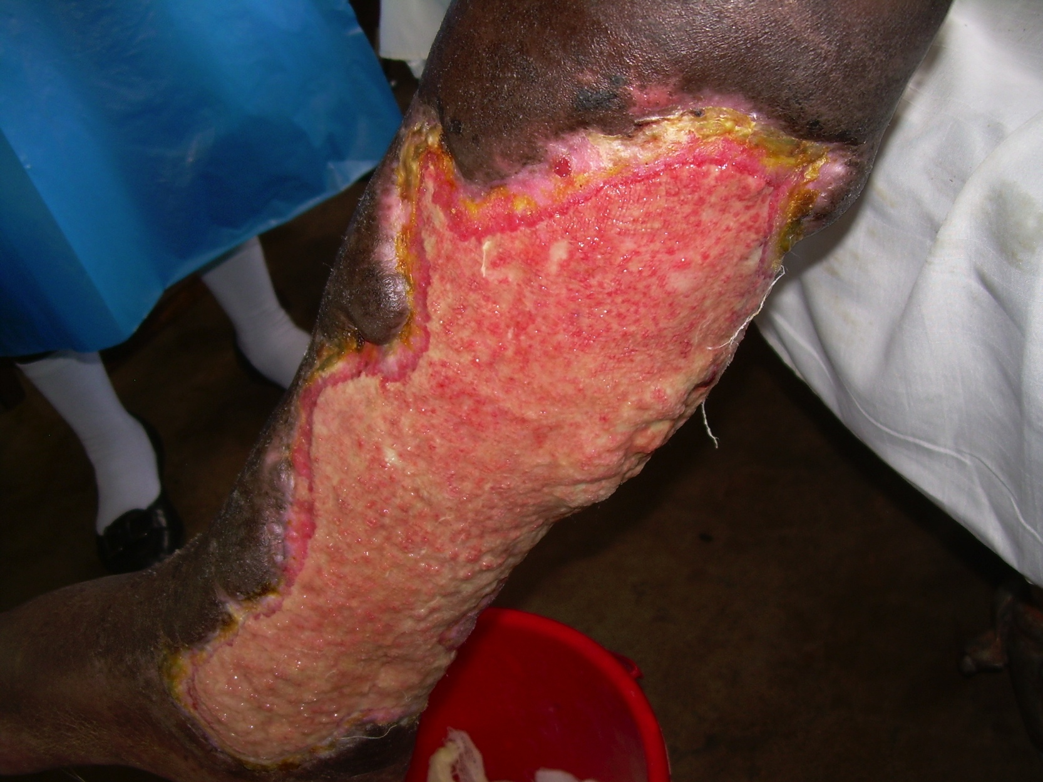
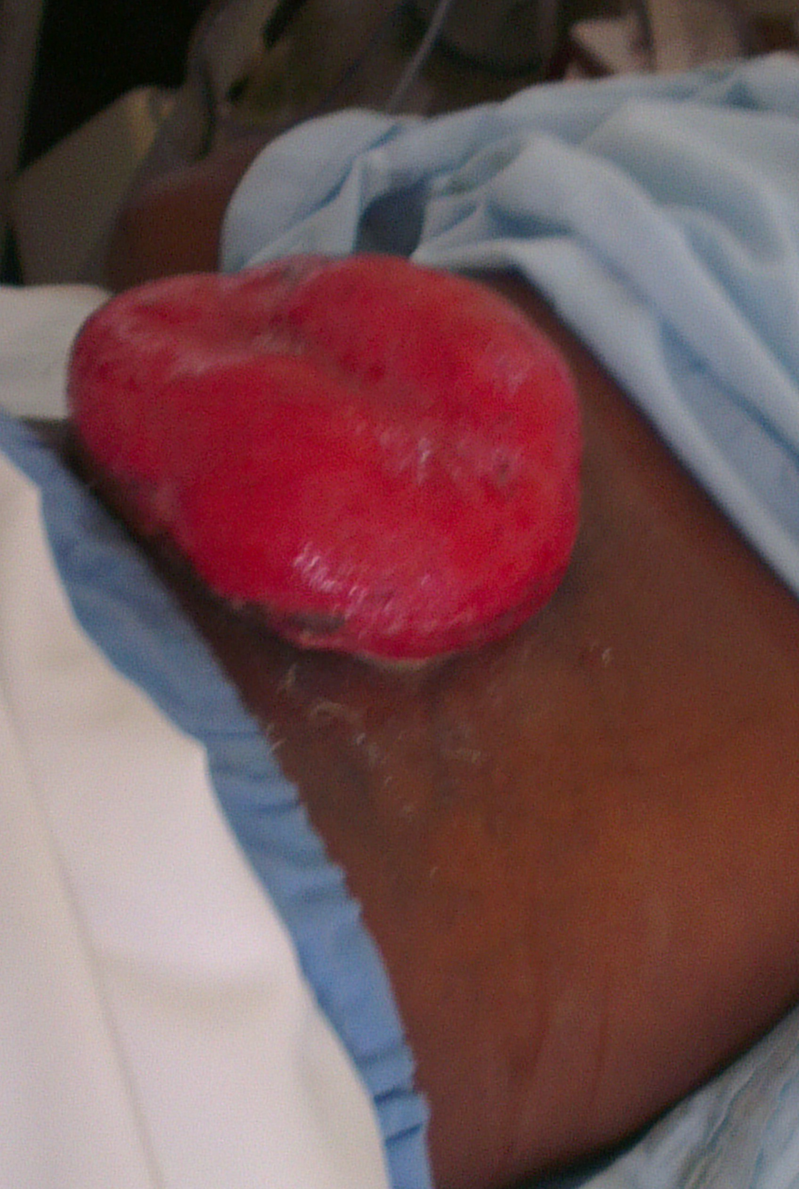
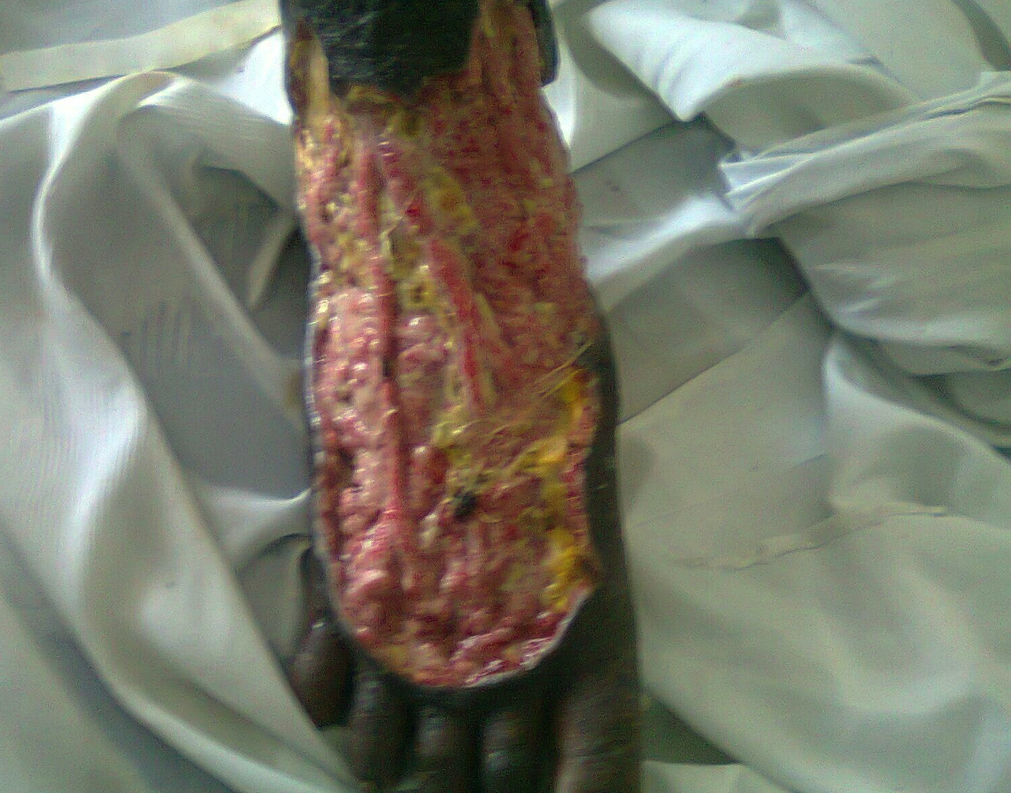
Wound/pus swabs from infected wounds
Blood samples
sputum
Stool samples

Slide 4
Bacterial isolates and source of specimen
Notes:
Enrolled 575 patients, total Samples-590
Wound/pus swabs_286
Blood samples_126
Sputum_122
Stool_56
Culture positive 249 (42.2%) –total isolates 377

Slide 5
Characteristics 33 Staphylococcus spp sequenced

Slide 6
Raw sequence data – Spp confirmation KmerFinder , MLST (version 1.7), ResFinder (version 2.1) and VirulenceFinder (version 1.0² available from CGE (http://cge.cbs.dtu.dk/services/all.php).
ANALYSIS OF SEQUENCE DATA

Slide 7
Antimicrobial Resistance Genes detected
Of the 30 S. aureus isolates 10 (33.3%) were MRSA-mecA
mecA-like
Notes:
Conclusion

Slide 8
RESISTANCE AND VIRULENCE GENES
Of the 30 S. aureus isolates 10 (33.3%) were MRSA-mecA
Six of mecA belonged to ST-8.All 3 CoNS-mecA+
S.aureus possessing PVL genes-5(16.7%) . All were MSSA

Slide 9
Phylogenetic analysis
A phylogenetic analysis were performed on the six ST-8 MRSA isolates to better understand the transmission epidemiology.
For global comparison 24 ST-8 MRSA –from ENA.
The mapping of the raw reads of these 30 genomes to the reference genome, S.aureus USA300_FPR3757, detected qualified 1,663 SNPs.
36-significant recombination SNPs eliminated -RecHMM
1,627 SNPs – for temporal phylogenetic tree using Bayesian Evolutionary Analysis Sampling Tree (BEAST) which involves the time component

Slide 10
For the most common MLST (sequence type-8), additional 24-genome from ENA (http://www.ebi.ac.uk/ena) and the isolates were compared using single nucleotide polymorphisms (SNPs).

Slide 11
SNP sequences were used for reconstructing temporal phylogenetic tree, using Bayesian Evolutionary Analysis Sampling Trees version 1.8.3 (BEAST) to estimate mutation rate and divergence time.

Slide 12
Acknowledgements
Study Participants
Prof Ole Lund
Prof Frank Moller
Johanne Ahrenfeldt
Christina Aaby
Marco van Zwetselaar
Tolbert Sonda
Michael Alifrangis

