Slide 1
Impact of kdr gene frequencies on major malaria vectors’ host blood meal preferences in Teso sub counties, western Kenya.
6th East African Health and Scientific Conference & International Health Exhibition and Trade Fair
29th to 31st March 2017
Bujumbura, Burundi

Slide 2
Authors & their institutional affiliation
Githinji Edward *^{1&2}, Irungu Lucy², Ndegwa Paul², Atieli Francis³, Kemei Brigid³, Machani Maxwell³, Amito Richard³, Murima Paul⁴, Ombok Maurice³, Wanjoya Antony⁵, Mbogo Charles⁶ & Mathenge Evan¹
Eastern & Southern Africa Centre for International Parasite Control (ESACIPAC), KEMRI Nairobi University of Nairobi Centre for Global Health Research (CGHR), KEMRI Kisumu Vector-borne Disease Control Unit Ministry of Health, Nairobi Jomo Kenyatta University of Agriculture & Training JKUAT Juja, Nairobi KEMRI-Wellcome Trust Research Programme, Nairobi

Slide 3
Back ground information
Malaria is a leading cause of morbidity & mortality
Malaria vector control relies heavily on insecticide-based interventions (IRS & LLINs)
The efficacy of these tools depends on the feeding behaviour of mosquitoes.
Insecticide resistance among major vectors is emerging as a major threat
Insecticide resistance management programmes to be optimized
(Kenya National Malaria Strategy 2009 -2017)
4 major types of IR: Target-site , Metabolic, Behavioural & Cuticular
Current understanding of the evolution of IR results from mutation of the target sites (kdr or super-kdr) or from overexpression of GSTs, esterases & cytochrome P450s
An. gambiae s.s & An. funestus are highly endophagic & anthropophagic while An. arabiensis is zoophilic but endophagic (Githeko et al., 1994).

Slide 4
Problem statement
Malaria remains a major public health problem in Kenya, accounts for an 18% of outpatient consultations & 10% of hospital admissions
Many insecticides extensively used to control domestic & agricultural pests, exerting more insecticide resistance selection pressure.
Cross resistance cause vector populations to develop resistance very rapidly to newly introduced insecticides
Malaria vector control rely heavily on a single safe insecticide class: pyrethroids
Despite the huge investments in LLINs and IRS roll out
Need for surveillance, monitoring & evaluation while operational research is vital for tracking the progress of malaria prevention & control activities

Slide 5
General Objective:
Insecticide resistance & it’s impact on malaria transmission potential among the major vectors in Teso sub – counties, western Kenya
Specific Objective
The crossectional study aimed at determining blood meal preferences in Anopheles gambiae sensu lato in areas with & areas without insecticide resistance in Teso sub-counties, western Kenya.

Slide 6
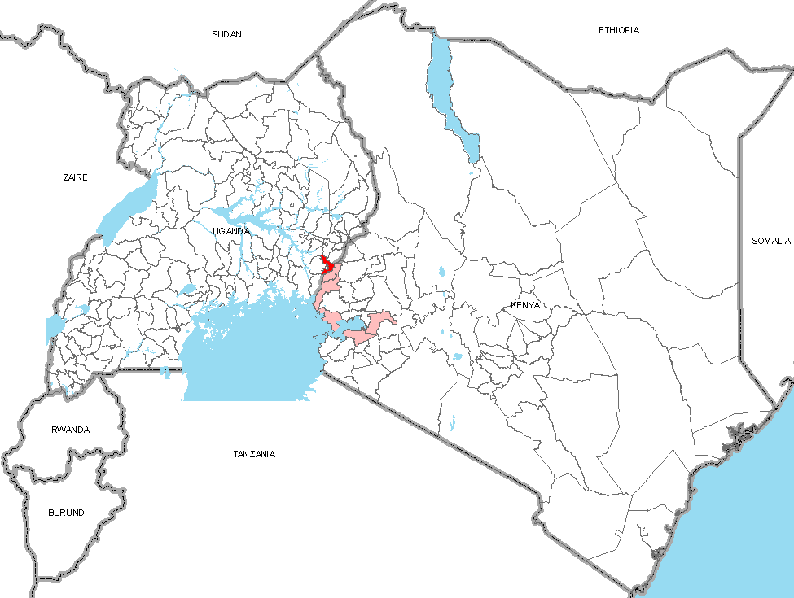
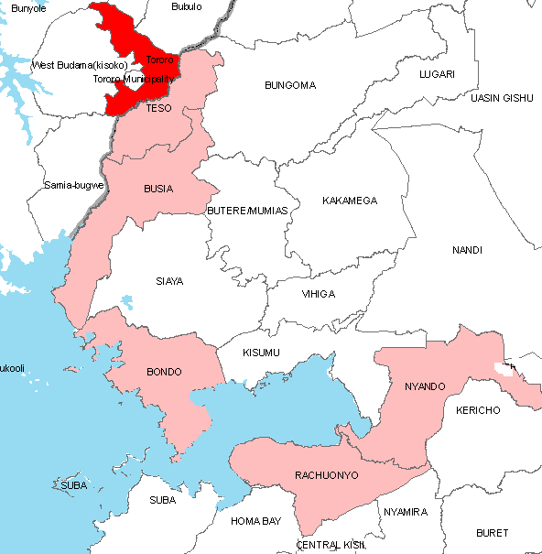
Study site:
Teso North & Teso South
sub-counties
Lake Victoria
Indian Ocean
Four divisions ; Amagoro, Amukura, Angurai & Chakol
Population at risk in Teso is 252, 884 people among whom 51,424 are aged between 0&4 years
Lake Victoria

Slide 7
Methods & materials
Mosquito larvae sampled & reared to adults.
3-5 days-old female mosquitoes were exposed to insecticides (permethrin, deltamethrin & bendiocarb)
Adult mosquitoes also sampled (indoor & outdoor) by human landing catch method, indoor aspiration, pyrethrum spray catch, window exit trap & outdoor pot collection methods
Blood meal ELISA, Species ID PCR, Blood meal & kdr East gene PCR performed
Kdr East TaqMan assay where FAM & HEX reporting dyes detected mutant allele & wild type respectively

Slide 8
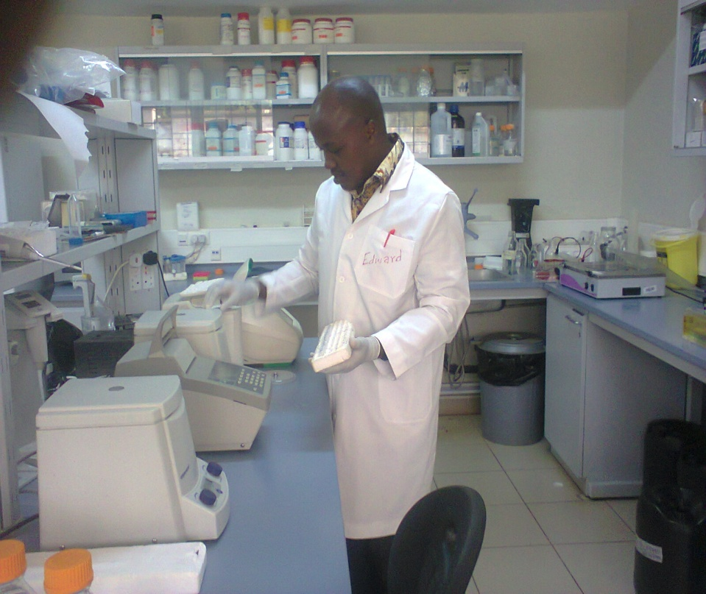
Larval sampling
DNA extraction, sometimes blood meal ELISA,
species , blood meal & Kdr PCR;
Field mosquito larvae collections and Laboratory work

Slide 9
Percentages of homozygous & heterozygous resistance alleles in Teso sub-county western Kenya
n = 560; 112 samples@cluster done kdr assay

Slide 10
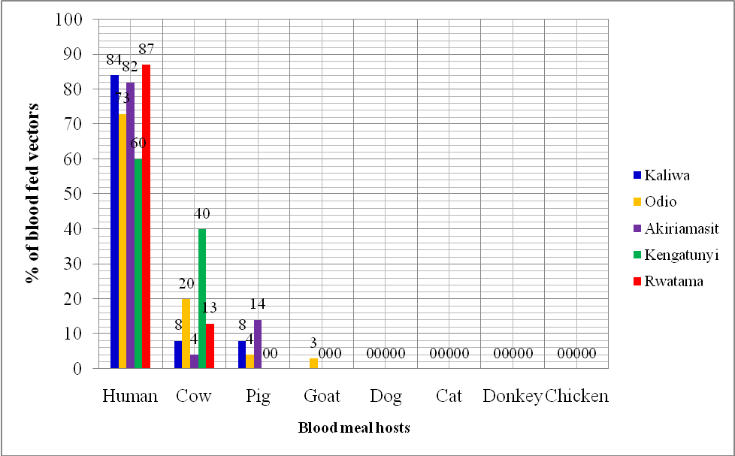
Host blood preferences in different clusters

Slide 11
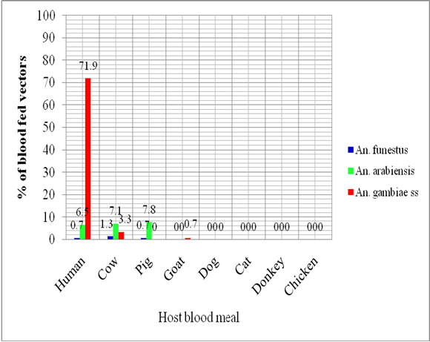
Species preference for different blood meal sources

Slide 12
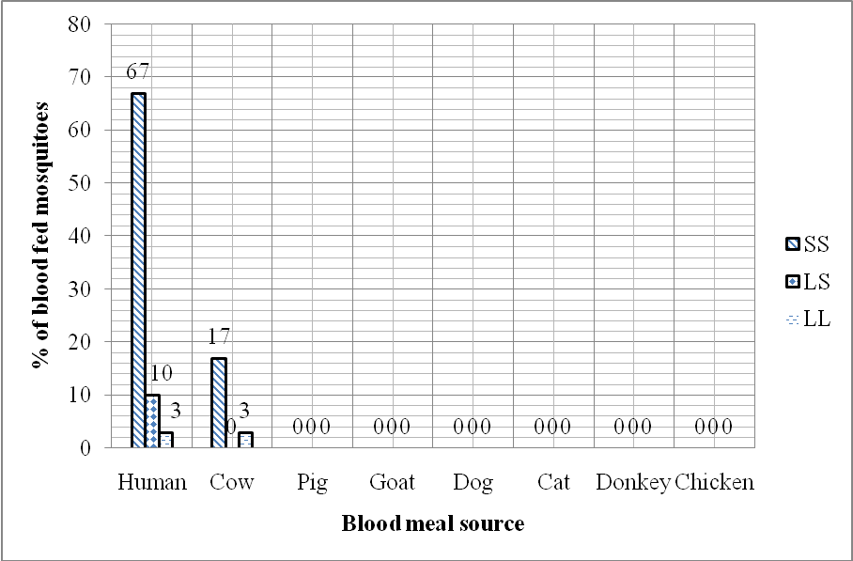
Allele frequencies compared to host preference

Slide 13
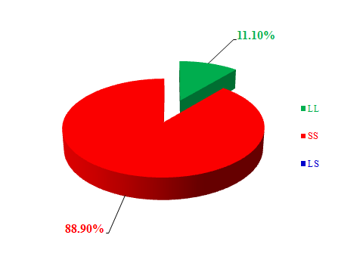
Impact of insecticide resistance on endophagic & endophilic behavior in female Anopheles mosquitoes; Pyrethrum Spray Catch (n = 338)

Slide 14
Discussion
Homozygous LL & heterozygous LS allelic vectors had significantly higher affinity for bovine blood while SS allelic vectors had significantly higher affinity for human rather than bovine blood (p<0.05) Resistant malaria vectors were more anthropophagic than zoophagic Susceptible mosquitoes preferred bovine blood meal the most An. funestus had a higher affinity for bovine blood meal than human’s and pig’s Blood meal preference was dependent on resistance status, species & location Host preference is normally affected by a myriad of extrinsic & intrinsic factors. Inherent factors are determined by genetic selection even due to insecticidal selection pressure

Slide 15
Conclusion
Resistance genes may be enhancing or depressing anthropozoophagic behavior in malaria vectors hence influencing transmission levels
Recommendation
Zoo-prophylaxis may reduce plasmodium transmission rates by anthropozoophagic vectors Continued monitoring of impact of insecticide resistance genes in vectors, on their malaria transmission potential to inform Insecticide Resistance Management Programmes

Slide 16
Acknowledgments
UoN
NACOSTI
KEMRI / WHO-BILL & Melinda Gates IR PROJECT
Supervisors
Family
Friends
Colleagues
God Almighty

Slide 17
Thank you for listening

