Slide 1
Isolation of Medically Important Fungi and Fluconazole resistant of Candida From hospital cockroaches. 6th East African Health and Scientific Conference Bujumbura, Burundi 28-30th March 2017
Erasto Baraka and Doreen Mloka
Muhimbili of University of Health and Allied Sciences (MUHAS), Tanzania

Slide 2
Introduction
The incidence rate for invasive fungal infections has increased globally over the past 2 to 3 decades particularly in healthcare settings( patients suffering from immunosuppressive conditions such as Cancer , HIV and Diabetes ) ( Yang et al; 2013)
More use of immunosuppressive drugs ( organ transplant patients)
More elderly patients
TREND CHANGE IN FUNGAL HAIs

Slide 3
New Trends of fungal HAI’s
Fungi originally not considered a traditional causes of HAI’s, now represents 10% to 15% of all HAI’s.
Change in spectrum of invasive fungal agents from mainly being Candida albicans to infections caused by Non albicans Candida sps and infections caused by molds such as Aspergillus, Fusarium and Mucor
Antifungal resistance rapidly developing to few available antifungal agents.

Slide 4
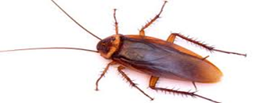
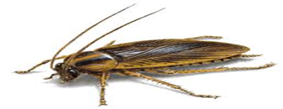
Question
Could there be new possible sources and vectors of these novel fungal pathogens affecting immunosuppressed patients in hospitals ?
Blattella germanica
Periplaneta americana

Slide 5
Cockroaches are common pests of homes, schools, restaurants, hospitals, warehouses, virtually in any structure that has food preparation or storage areas.
They feed on garbage and sewage and defecate indiscriminately and so have abundant opportunity to disseminate microbes.
Hospital cockroaches have been shown to harbour and transmit pathogenic bacteria associated with food borne diseases such Salmonella spp., Shigella spp., and Staphylococcus spp.,
Develop resistance to insecticides including organophosphates, carbamates and pyrethroids (Pai et al; 2005)

Slide 6
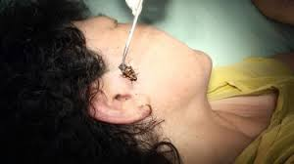
What is their role ???
There are limited number of studies that have looked at role of cockroaches as reservoirs and vectors of fungal pathogens in hospital settings especially when one considers that cockroaches are frequent if not permanent hospital residents!!!

Slide 7
What was Done
Trapped Cockroaches using sticky paper placed overnight in cupboards and floors of wards of a national Referral Teaching Hospital with 1,500 bed facility, attending 1,000 to 1,200 outpatients per day in Dar es Salaam Tanzania between Feb – march 2015
Cultured External cockroach washings on Sabouraud's dextrose agar containing 0.5% chloramphenicol and gentamicin 0.05% for 3 weeks at 30°C and examined daily for growth.
Macroscopic, Microscopic and other specific mycological tests to identify isolates.
Used CCLSI M27-A3 microdilution method for Antifungal susceptibility testing of Candida isolates.

Slide 8
What was Found
72 cockroaches were trapped - 58 Periplaneta americana and 14 Blattella germanica .

Slide 9
Isolates
956 medically important fungi isolated

Slide 10
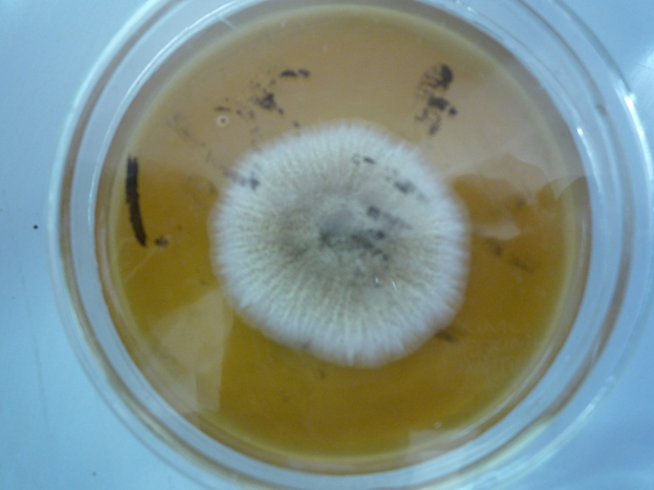
Aspergillus fumigatus
Coccidioides immits

Slide 13
Candida Fluconazole Resistance
Species | Number of Isolates | Susceptible (S) | Susceptible dose dependent (SDD) | R-Resistant | Percentage Resistant isolates (%)
C.pseudotropicalis | 42 | 18 | 14 | 10 | 23.8
C. albicans | 32 | 22 | 8 | 2 | 6.3
C.rugosa | 8 | 6 | 1 | 1 | 12.5
C.parapsilosis | 16 | 5 | 2 | 3 | 18.8
C. glabarata | 10 | 8 | 1 | 2 | 20.0
Mean |  |  |  |  | 16.3

Slide 14
Conclusion and recommendation
Hospital cockroaches can carry on their external surfaces fungal pathogens associated hospital acquired infections exhibiting drug resistance.
Hospitals implement an effective pest-control policies to ensure that buildings are kept clean and safe for patients.

Slide 15
Acknowledgments
Global Antibiotic Resistance Partnership (GARP) - Tanzania

