Slide 1
The 6th East African Health Research Commission
Leveraging Horizontal Models to Develop Healthcare Capacity: LifeNet International’s Conversion Franchise Innovation
Gloria Havyarimana, MBA
Burundi Country Director
LifeNet International

Slide 2
WEAK HEALTH SYSTEMS AND MANAGEMENT OF EPIDEMICS, PANDEMICS, AND OUTBREAKS: LESSONS FROM THE EBOLA OUTBREAK
“…the largest, longest, most severe and most complex in nearly 4-decade history of the disease…”-Margaret Chan, WHO
"Riots are breaking out. Isolation centers are overwhelmed. Health workers on the frontline are becoming infected and are dying in shocking numbers.”-Dr. Joanne Liu, International President of Doctors Without Borders
"It is the world’s first Ebola epidemic, and it’s spiraling out of control.”-Dr. Tom Frieden, Director, Centers for Disease Control and Prevention
Notes:
On 26th of December 2013, an 18 month old boy in the village of Meliandou, Guinea developed a disease that caused him to have fever, vomit, and have black stools. 2 days later, the child died. About 2 weeks later, several members of his family had developed the same symptoms and had died. The staff that had treated them at a hospital in nearby Guackedou also died in the same mysterious way. A week later, members of the family who’d attended the funeral of those who’d passed on or helped care for them, suffered the same fate. In three short weeks, several deaths were registered and the disease spread to 4 districts near the village.
It was not until two months later, on the 21st of March that the disease was recognized as Ebola. By then, it had spread to two other countries: Liberia and Sierra Leone.
Speaking at the London School of Hygiene and Tropical Diseases, Dr. Margaret Chan, Director General of the World Health Organization described the 2014 Ebola outbreak as the “largest, longest, most severe and most complex in nearly 4 decade-history of this disease”
By the time she was speaking, 24,000 cases and 10,000 deaths in Guinea, Liberia, and Sierra Leone compared to 2,400 cases in all 24 previous Ebola outbreaks combined.

Slide 3
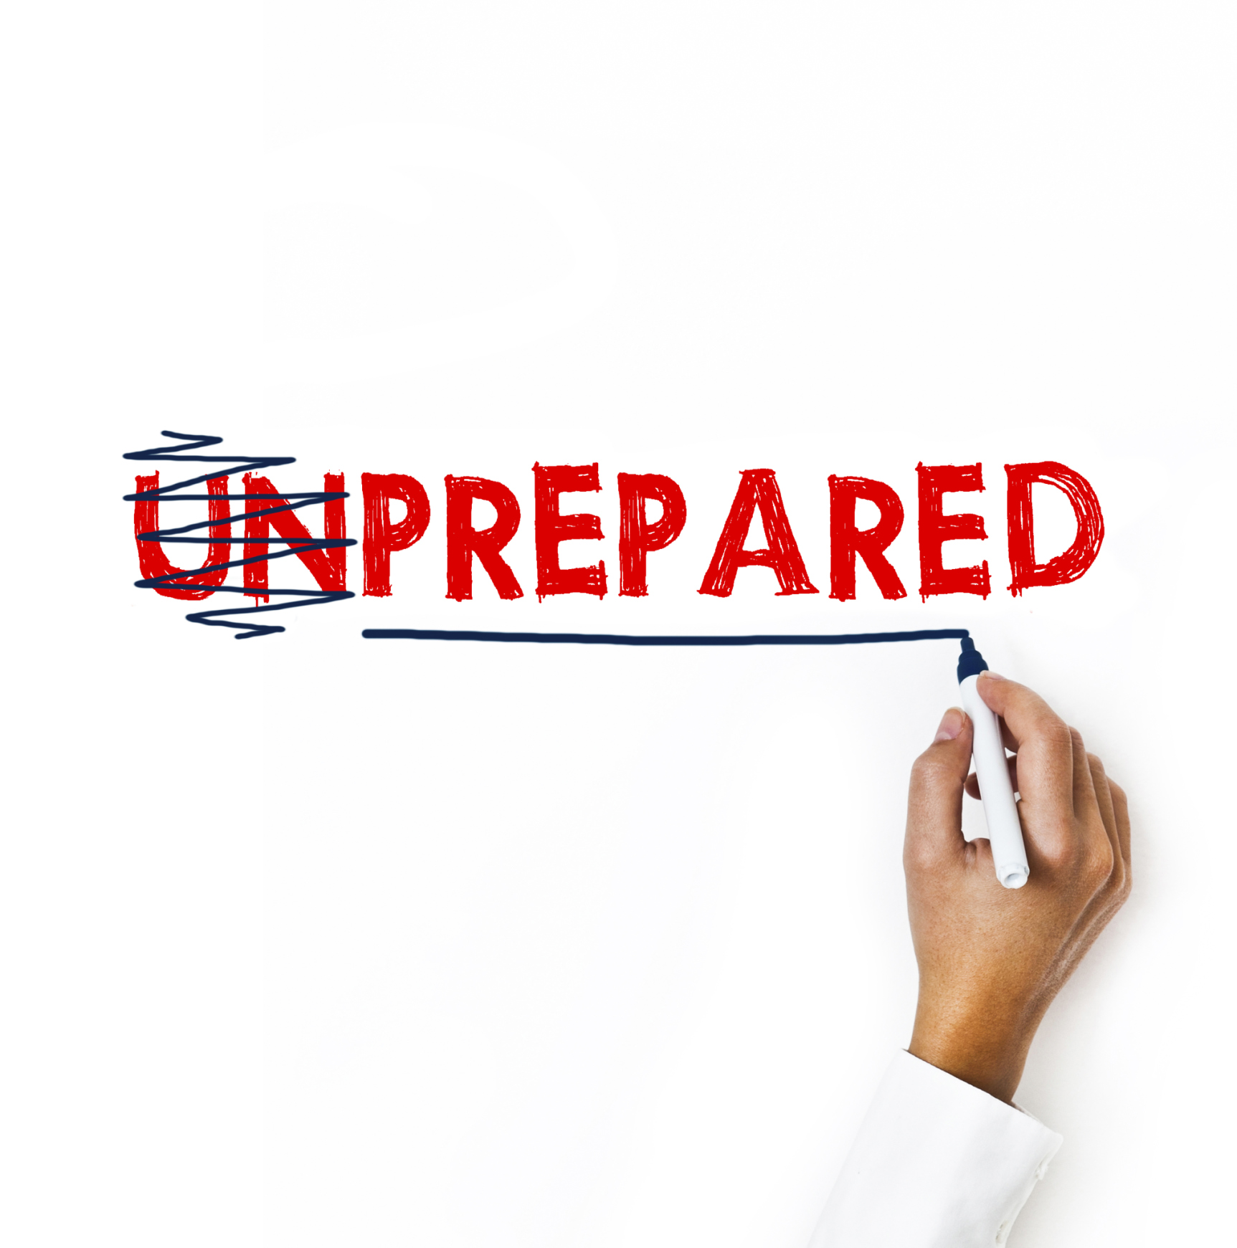
Why was the Ebola outbreak so devastating?
Unpredictable
Weak health systems
“The Ebola epidemic is a battle of basic medical care, and future epidemics in these and other countries with poorly developed health care systems are likely to require similar services”
Notes:
Source: The Ebola Outbreak, Fragile Health Systems, and Quality as a cure
The outbreak was difficult to manage for several reasons and the first was its unpredictability. West Africa had no prior experience with the disease. This was the first time it had hit a region outside of Equatorial Africa since 1976, when the first cases emerged. The pattern was usually the same-it surfaced at irregular intervals, in rural areas, and then retract in remote forests. This time, however, it spread through cities and mutated, exploiting new geographic reasons and developing in a manner that was difficult to contain. There was nothing in the past that could have prepared this West African region for what it was about to endure.
The outbreak was also difficult to handle because of an even deeper problem: weak health systems. In the Article, “The Ebola Outbreak, Fragile Health Systems, and Quality as a cure” Authors Dr. Farmer and colleagues state that “if the Ebola virus surfaced in Boston or Toronto, there is little doubt that their health systems, despite shortcomings, could effectively contain and then eliminate the disease with far lower case-fatality rates than those reported now in West Africa. Why the disparity when there is no proven drug or vaccine available? The answer lies not with the virus, but in the collective failure to ensure the availability of adequate health care staff, resources, and systems required for the delivery of high-quality health care services”.
All three West African countries that were affected were poor. They had come out of years of civil wars. There was an insufficient number of qualified healthcare workers, with 1 to 2 doctors to 100.000 patients. Compare this to 1 to 2 per each 245 patients in the US.
Secondly, even Nurses and Doctors who were there were not adequately prepared to diagnose the disease. From December 26th 2013 until 21st of March 2014, the disease was diagnosed as cholera and then Lassa Fever and continued to spread unknown before it was recognized as Ebola.
Due to insufficient numbers of qualified healthcare staff and poor diagnosis, there was weak surveillance. Due to weak infrastructures, there were no laboratories to confirm that cases that were being reported were Ebola. This contributed to further spread of the disease.

Slide 4
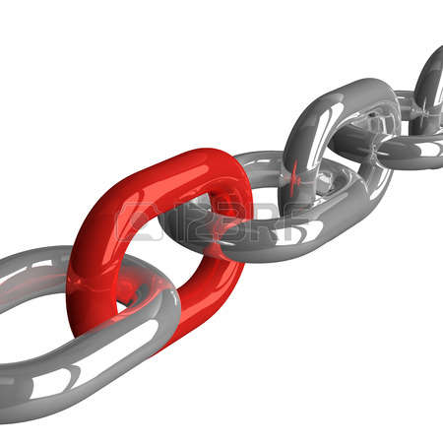
The major lesson about health systems strengthening from Ebola Outbreak
Strong Health Systems are indispensable to effectively combating epidemics, pandemics, and outbreaks.
Notes:
What does this have to teach us?
From Dr. Margaret Chan, WHO:
“This is the first big lesson. Well-functioning health systems need to be in place before a health crisis strikes….”
Prevention of an outbreak, epidemics, and pandemics begins here, with a robust health system, with qualified teams of health care workers, a well functioning M&E and information management system, as well as infrastructure in place.
If this is the case, Is the East African, and particularly, Burundian health system adequately equipped to handle an epidemic, pandemic, or outbreak?

Slide 5
THE SITUATION IN EAST AFRICA
Extreme poverty
High child and maternal mortality rates Low human development index
Vertical medical approaches are the most popular but are LIMITED
PEOPLE ARE DYING UNNECESSARILY.
WE HAVE TO DO SOMETHING DIFFERENTLY.
Notes:
Let’s look at the context.
According to the 2016 State of East Africa report by the Social Think Tank Society for International Development (SID), 41.08% of the population in East Africa lives at the poverty line. In Burundi, these numbers are as high as 66.9% or 2/3rds of the population and affects the rural population the most with close to 70% of people at national poverty line. (2012 data). It is reported that East Africa employs millions of rural poor who work but do not earn enough to live above the poverty line. Just as in West Africa, we see a prevalence of poverty rates.
Add to this high child and maternal mortality rates: In Kenya, 510 women for every 100.000 births die to child-bearing complications. In Tanzania, the rate is at 398 and Burundi has the 5th highest mortality rate in the world with 712 women for every 100.000 births die due to the same reason. This seems like a small number until you consider that The Millennium Development Goals fix this rate at 330 and that in the Untied States this number is at 14.
On the HDI, developed to assess the human capacities of a country as an indicator of development such as educational capacities, gross national income per capita, and health and length of life, East African Countries score poorly with Kenya at 146 (2015 report) and the rest of East African Countries at the lowest rank. Burundi is lowest at 184 over 188. This means that the length of schooling for adults and children of entering school age is short, gross national income per capita is low, and people’s life expectancies and health are at low levels.

Slide 6
THE HEALTH CHALLENGE
115 million+ people live in Uganda, Burundi and the DRC For every 1 million people = 125 doctors
Nurses at community health centers are at the heart of
East Africa’s healthcare solution
BUT...
Notes:
Against this backdrop, just as in West Africa, health systems in East Africa are weakened by a lack of a sufficient number of qualified healthcare providers. There are 125 doctors for each 1 million people or 1 doctor per 100.000 in Burundi, DRC, and Uganda combined, exactly the same ratio as in West Africa at the time of the Ebola outbreak.
In Burundi, the 2016-2025 National Strategic Plan of the Ministry of Health reports that there are just above 500 doctors for a population of close to 10 million or approximately 1 doctor for every 16,000 people. For this reason, 80% of healthcare is provided by nurses.
Of the total number of Nurses, 61%, according to the Ministry of Health 2016-2025 strategic plan, are not adequately qualified. If an outbreak was to occur, the country isn’t well positioned, staff-wise, to respond quickly diagnose and treat it.

Slide 7
Nurses are limited by
pharmaceutical shortages
insufficient medical training
lack of management training
inability to provide necessary healthcare
Notes:
In addition to inadequate qualification levels, pharmaceutical shortages are a big problem. In Burundi, the MOH strategic plan for 2016-2025 reports that for each 100 medicine needed at public and private health centers, roughly 42 were available. In the past year where malaria cases rose due to El Nino, there were widespread stock-outs at various private and public health facilities. The supply chain struggled to meet the demand.
In the event of an outbreak, you need a reliable and strong supply chain management.
Pharmaceutical shortages, insufficient medical and management training lend to inability to provide necessary healthcare.

Slide 8
THE SOLUTION
LifeNet transforms African health centers from the ground up, through its horizontal conversion franchise model by:
strengthening health systems
partnering with health centers
to provide quality, sustainable healthcare.
Notes:
In light of these challenges, LfieNet’s works within national health priorities and within the health system, in partnership with health centers, to equip them to provide quality, sustainable health care.

Slide 9
OUR APPROACH
CONVERSION FRANCHISE PLATFORM | STRENGTHENS IN-COUNTRY CAPACITY
NURSES RECEIVE COMPREHENSIVEONGOING TRAINING & QA | PARTNER HEALTH CENTERS FINANCE OPERATIONS, MEDICINES AND EQUIPMENT
Notes:
How do we do it? LN uses a conversion franchise model to improve quality of care. LN’s franchise model was developed after 3 years of research on the Burundian healthcare delivery. The research identified major issues at all levels of healthcare system, and especially at consultation, diagnosis, and treatment levels. In light of the inadequate qualification levels, access to medicine, and to proper infrastructure (water, electricity, equipment), the research team recommended a conversion franchise model as the best approach to addressing weaknesses in the system.
Conversion franchises are typical in the for-profit world, where a large organization partners with existing businesses for them to jointly improve performance. The existing businesses benefit from branding and centralized resources and the large organization benefits from ease of scale.
LN applies the same principles. We partner with existing health centers, providing them with a bundle package consisting of ongoing medical and management training, access to quality medicine, and medical equipment for growth financing.
With LN’s medical training, LN intervenes at the frontline of healthcare delivery by providing monthly medical training to primary care nurses. The curriculum is based on the Ministry of Health’s priorities as well as the Millennium Development Goals and teaches best practices in maternal, neonatal, and infant care, HIV/AIDS, malaria, reproductive health and more. Specialized trainings are incorporated into the program depending on need. During the Ebola outbreak, nurses received specialized training on detection and management of Ebola.
With LN’s management training, health facilities managers learn how to avoid medicine stock-outs, analyze their finances, design and monitor budgets, manage debts, and invest towards the sustainability of their health centers.
With LN’s medicine supply program, LN connects health facilities with local and regional wholesalers and delivers medicine on site. Prior to starting this program, LN discovered that nurses were purchasing medicine themselves, taking time away from receiving patients, and spending limited resources on transportation which was not adequate to preserve medicine quality. Moreover, because of insufficient time, nurses would purchase medicine indiscriminately when cheaper options were available for the same quality. LN takes care of the price shopping, and is able to negotiate competitive prices with pharmacies and then ensures delivery on site so nurses can focus on receiving patients.
With LN’s growth financing program, LN equips eligible health centers with medical equipment so they can diversify their services and generate more revenues. In 2015, LN sold 53 pieces of equipment to partner health centers in Burundi, generating over $16,000 in new revenue for these facilities over the course of the year.
LN’s model has been recognized as innovative by the World Health Organization’s Special Programme for Research and Training in Tropical Diseases.
By addressing each area of a health center’s operations, LN works to strengthen the whole system.

Slide 10
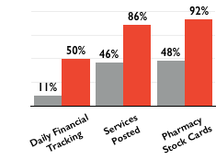
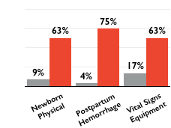
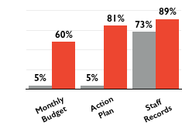
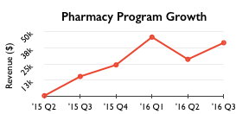
SUCCESS TO DATE
Medical
Management
Equipment
40 | Dental kits
8 | Delivery beds
6 | Microscopes
3 | Hospital beds
12 | Computers
Pharmacy
Notes:
What’s been the impact?
LN uses its quality score card to measure improvement across a set of quality indicators and staff adherence to LN-taught best practices. The tool is based on local Ministry of Health standards, the USAID/Smiling Sun Health Services “Quality and Monitoring Supervision Clinic Preparedness Guide,” the IFC Self-Assessment Guide for Health Care Organizations from the Joint Commission International, the Management Sciences for Health Financial Management Assessment Tool, the Columbia University Access Project Health Center Assessment Tool, and other similar sources
At the beginning of a partnership with LifeNet, each health facility receives a baseline quality evaluation. This helps LN focus its training and also measure impact. Each health center then receives monthly training and mentorship. At the end of a module, each health facility receives another quality evaluation to assess quality gains.
The graphs show quality improvements achieved across LN’s partner health facilities in Burundi, Uganda, and DRC on selected indicators. As can be seen, quality gains are usually double the initial level. To avoid biases, LN conducts a comparative analysis of quality gains from LN’s QSC and the Burundi Ministry of Health’s own scores. In the most recent comparative analysis done, scores were extremely close with a divergence of only 1.60% pre- intervention and 0.63% post-intervention.
In 2016, LN also delivered medicine of a total value of $25,000 each quarter.

Slide 11
IMPROVEMENT IN INFECTION PREVENTION
27%
75%
Nurses regularly wash their hands
56%
95%
Isolation precaution due to infectious disease
31%
88%
Exposure testing protocol in place
40%
80%
Proper waste disposal system in place
Notes:
Before you are quality gains by select indicators. These may seem basic, but as pre-intervention scores show, what we assume as most basic is typically not practiced by healthcare staff, hence the need for continued quality monitoring and training and infrastructure capacity building.

Slide 12
GROWTH
2012
1 country
2016
3 countries
11 health centers
90 health centers
127,088 patient visits
1,045,893 patient visits
5 team members
48 team members
Since inception, LN has doubled the quality of care delivered at these partner health centers.
Notes:
LN’s horizontal approach to health systems’ strengthening has proven successful.
Through its 4 programs, LN is able to strengthen every aspect of a health center’s operations.
Through its conversion franchise model, LN is scalable without compromising quality and impact.
Through a set curriculum, LN is able to adapt to countries with similar health systems challenges.
Today, LN works with 90 health centers, across 3 countries, and has doubled the quality of care delivered there.

Slide 13
OUR VISION FOR 2025
AFRICAN COUNTRIES
10
1,000
HEALTH CENTERS
PATIENT VISITS
20,000,000
Notes:
What's our vision for 2025? We want to see strong health systems across Africa. LN’s vision for 2025 is to strengthen capacities of 1,000 health centers in 10 countries for better quality of care for 20,000,000 patients.

Slide 14
CONCLUDING REMARKS:
"Strengthening health care systems not only improves our ability to deal with epidemics, but it also promotes health more broadly. Without a functioning health system, it is very hard for a country to end the cycle of disease and poverty. Health is so fundamental to development that even if there were no chance of another epidemic, building and improving health systems would be a worthwhile — and lifesaving — investment. The fact that they also bolster our ability to confront epidemics is all the more reason to invest in them.”
-Bill Gates, “The Next Epidemic”
Notes:
( The New England Journal of Medicine)

Slide 15
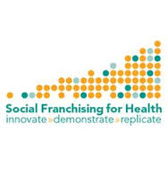
Thank You!

