Slide 1


JUMUIYA YA AFRIKA MASHARIKI
The 6th EAHSC
Modeling the Disease Burden of Hepatitis C Virus Infection in Burundi
Ntagirabiri R¹, Nde Helen², Robbins S²
¹Centre hospitalo-universitaire de Kamenge,
²Center for Disease Analysis

Slide 2
Global Burden of Hepatitis C
Hepatitis C virus (HCV) is leading cause of liver related morbidity, such as cirrhosis and hepatocellular carcinoma (HCC), as well as liver transplantation and liver-related death worldwide
The HCV disease burden continues to increase as the infected population advances to late stage liver disease¹
The global prevalence of viremic HCV is estimated to be 1.0% (95% CI 0.8–1.1) in 2015, corresponding to 71.1 million (62.5–79.4) viremic infections¹
The Polaris Observatory HCV Collaborators. Global prevalence and genotype distribution of hepatitis C virus infection in 2015: a modelling study. Lancet Gastroenterology and Hepatology 2016; 2(3): 161-176.

Slide 3
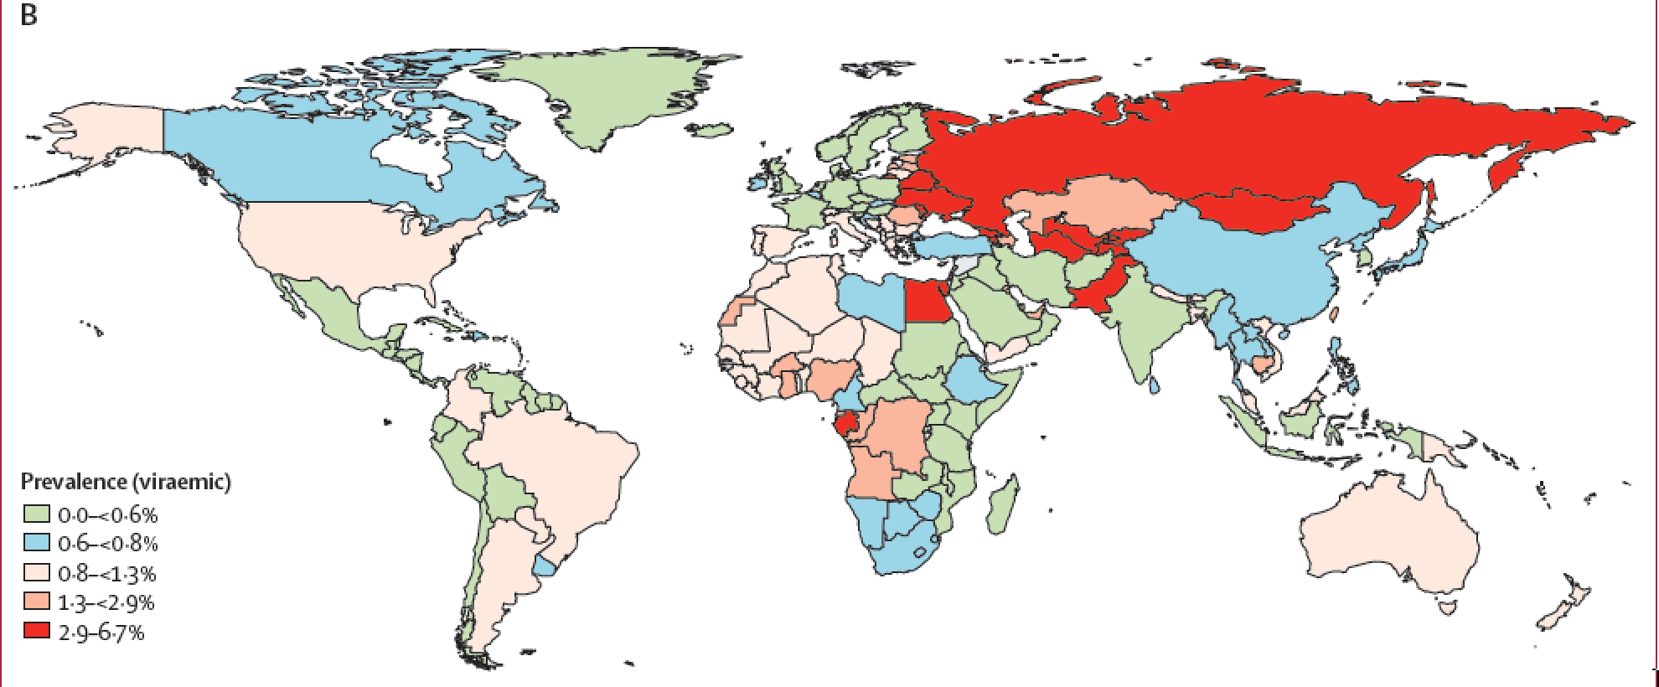
Global Prevalence of HCV
The Lancet. Global prevalence and genotype distribution of hepatitis C virus infection in 2015: a modelling study. Lancet Gastroenterology and Hepatology 2016; 2(3): 161-176.

Slide 4
Hepatitis C Disease Burden in Africa
There were an estimated 10 million viremic infections in Africa in 2015¹
  In Sub-Saharan Africa, East, there is an estimated viremic prevalence of 0.5% (95% CI 0.4-0.7) or 2.1 (1.6 – 2.9) million infections¹
In Burundi, anti-HCV prevalence has been estimated to be around 8% in adults²
Currently, there is little data to quantify the HCV disease burden in the country and its impact on late stage liver disease
  We aimed to quantify the HCV disease burden in Burundi from 2015-2030
-1The Polaris Observatory HCV Collaborators. Global prevalence and genotype distribution of hepatitis C virus infection in 2015: a modelling study. Lancet Gastroenterology and Hepatology 2016; 2(3): 161-176.
-2Ntagirabiri, R., Baransaka, E., Ndayiragije, A., et al. Prevalence of hepatitis C virus in Burundi: a nationwide survey. J Afr Hepatol. Gastroenterol. 2014; 8:25-28

Slide 5
METHODS
An Excel-based disease progression model was developed to estimate HCV prevalence, incidence, and liver related morbidity and mortality in Burundi
  Assumptions and transition probabilities of the model are based upon published literature and have been validated
  The outcomes of the analysis are from a “base case” scenario, in which the current treatment paradigm was extrapolated through year 2030.

Slide 6
Methodology Continued
Model Characteristics:
  Excel-based model
  Transparent – All formulas are unprotected and visible
  Ties to historical data – Published data is used to calibrate the model up to 2015
  Measures the impact of future decisions – Interface to input potential strategies
  Dynamic – Accounts for multiple interconnected disease stages
Model Inputs:
  Annual population (1950 – 2050)
  Mortality rates (1950 – 2050)
  Anti-HCV prevalence
  Viremic rate
  Genotype distribution
  Age and gender distribution
  Annual and newly diagnosed
  Annual number treated
  Liver transplants attributable to HCV
  Risk factors (blood transfusion and injection drug use)
  SVR rates

Slide 7
RESULTS
There were an estimated 407,000 total viremic infections in 2015
Approximately 40% of the total infected population was aged 20 to 39

Slide 8
Viremic Infections
Due to continued treatment of patients, HCV infections are assumed to decrease slightly
  The number of total infections is expected to decline by 10% by 2030

Slide 9
Liver Related Morbidity
Liver related morbidity is expected to increase as the infected population progresses to late stage liver disease
The number of HCC and Decompensated Cirrhosis cases are estimated to increase by 65% by 2030.

Slide 10
Liver Related Mortality
Similarly, the number of liver-related deaths is expected to increase by 60% from 1,400 deaths to 2,300 deaths by 2030

Slide 11
CONCLUSION
HCV-related disease burden is forecasted to increase significantly by 2030
Disease control strategies are needed in order to reduce the health and economic impact caused by HCV in Burundi

Slide 12
Appendix
Methodology
Literature search and data quality scoring
Develop disease progression model
Review inputs with country experts
Analyze additional data provided by experts
Validate model against empirical data, when available
Review inputs/ model outputs with country experts
Jointly analyze the impact of interventions– Tx, screening, prevention
Finalize country forecast
An Excel-based disease progression model was developed to estimate HCV prevalence, incidence, and liver related morbidity and mortality in Burundi
Notes:
Overall methodology of how the disease burden model is built and validated

