Slide 1
Needlestick and Sharps Injuries (NSIs) among final year Bachelor of Veterinary Medicine Students at The University of Nairobi
6th East African Health and Scientific Conference
Kimeli P. (BVM, MSc), Kirui G., Mwangi W.E., Mogoa E.M., Kipyegon A.N. and Thaiyah A.
Department of Clinical Studies,
Faculty of Veterinary Medicine, University of Nairobi
Email: kimeli08@yahoo.com

Slide 2
Introduction
Needle-stick and Sharps Injuries (NSIs) are accidental skin penetrating wounds caused by sharp instruments in a medical setting (Hashmi et al., 2012).
Include, but not limited to, hypodermic needles, blood-collection needles, Intra-venous catheter stylets, suture needles, scalpel blade and broken glass (Siddique et al., 2008).
In human medicine, considerable time and resources have been expended to reduce the incidences of NSIs >> this lacks in veterinary medicine (Weese and Faires, 2009).

Slide 3
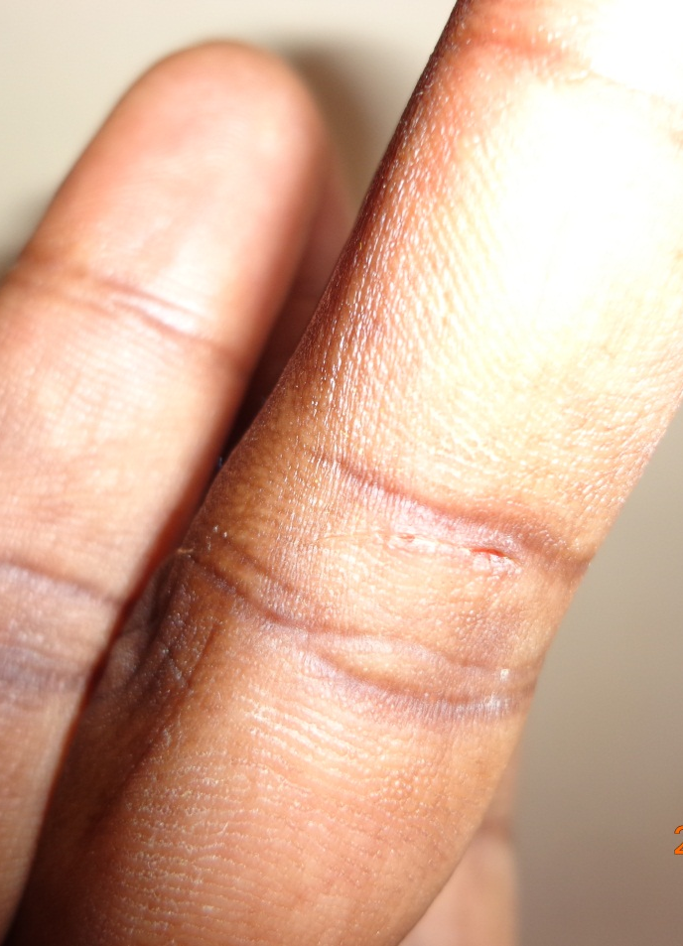
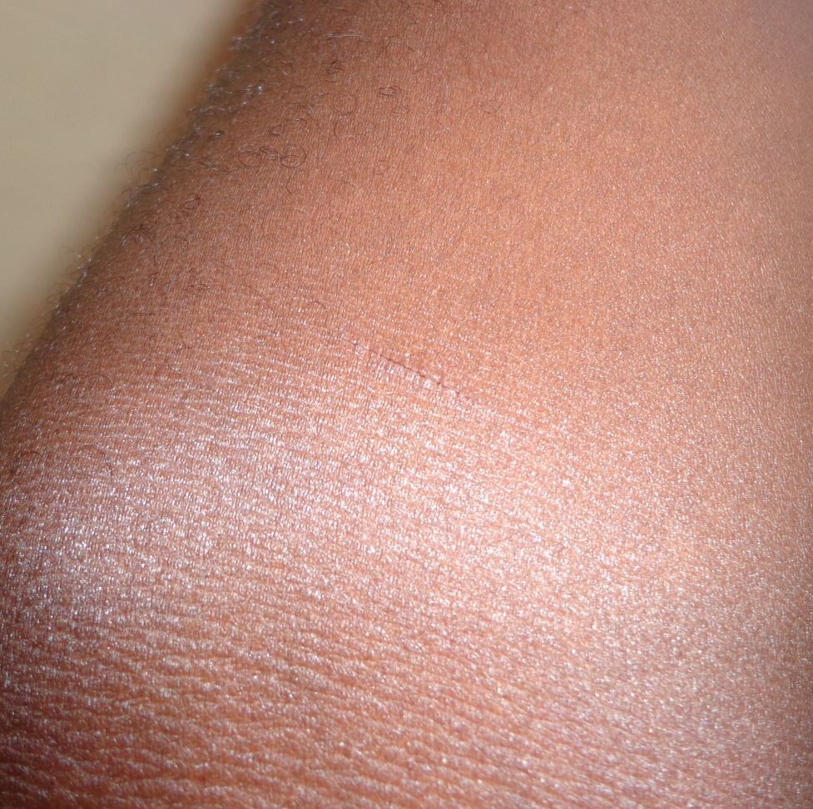
Examples of NS injuries

Slide 4
It is postulated that veterinarians are at higher risk of NSIs than other health care workers >>they treat patients that are often uncooperative and difficult to communicate with (Wllkins et al., 1997).
Students are at an increased risk for NSIs and its consequence because of their relative inexperience and lack of knowledge regarding instruments handling and disposal (Shahzad et al., 2013).
The current study is designed to estimate the rates of NSIs occurence, perception and associated risk factors among the final year Bachelor of Veterinary Medicine students, University of Nairobi.

Slide 5
Methodology
This survey was performed among 70 final year undergraduate vet students at the University of Nairobi through anonymous self-administered questionnaire
The questionnaire asked about the demographic characteristics, roles played during clinics, handling of needlestick and sharps, perception, causes, frequency and management of NS injuries during the last 6 months (min recall bias, duration of clinics).
The data collected from this study were entered and stored in Microsoft Office Excel 2007 then imported into imported into Statistical analysis system (SAS)

Slide 6
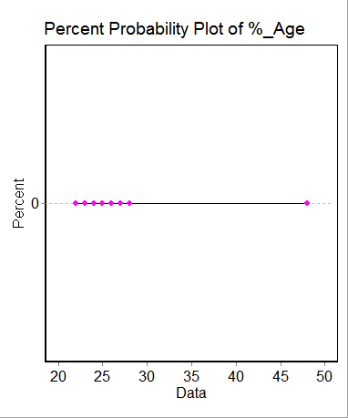
Results and Discussion
Demographics
No. of female | 28.57% (20)
No. of male | 71.43% (50)
Mean age (years) | 25.36± 3.06
Frequency of roles
Role | Mean Frequency
Assistant surgeon | 2.5±1.73
Surgeon | 2.59±2.41
Anaesthetist | 1.87±1.99
Restrainer | 17±33.47

Slide 7
Incidence rate
Type of injury | Incidence
NSIs injury (n=70) | 72.86% (51)
Causes of injury | Percentage
Hypodermic needle (n=51) | 76.47% (39)
Suture needle (n=51) | 56.86% (29)
Scalpel blade (n=51) | 39.22% (20)
Shaving Razor blade(n=51) | 19.61% (10)
Glass slides (n=51) | 13.73% (7)
Broken drug bottles (n=51) | 9.80% (5)
Wire saw(n=51) | 5.88% (3)
NB: Total> 100% as a person may have had >1 injury

Slide 8
Hypodermic needle injury
Mean Frequency | 2.5±1.74
Needle contents (n=39) | Antibiotic (58.97%); Blood (12.82%); Vaccine (10.26%); Anesthetic (10.26%); Ivermectin (5.13%); Hormone (2.56%)
Procedure at time of injury (n=39) | Drug injection (64.10%); Recapping (28.21%); Blood sampling (5.13%); Syringe loading (2.56%)
Immediate side effects (n=39) | Pain (74.36%); Bleeding (61.54%); Swelling (15.38%); Anaphylaxis (2.56%)
Animal spp at time of injury (n=39) | Bovine (64.10%); Feline (25.64%); Canine (5.13%); Porcine (5.13%)

Slide 9
Suture needle injury
Mean Frequency | 1.59±0.95
Tissue sutured (n=29) | Skin (86.21%); Muscles (13.79%)
Suture needle type (n=29) | Cutting (55.17%); Round bodied (44.83%)
Animal spp sutured (n=29) | Canine (68.97%); Bovine (27.59%); Feline (3.45%)
Scalpel blade injury
Mean frequency | 1.35±0.88
Blade Handle (n=20) | Present (55%); Absent (45%)
Tissues incised (n=20) | Skin (65%); Muscle (25%); Skin shaving (10%)
Animal spp incised (n=20) | Bovine (50%); Canine (50%)

Slide 10
Perception of risks

Slide 11
Conclusion
The incidence of NSIs in the current study was high {72.86% (51)} with a lower mean frequency (Mean 2.5±1.74)
NSIs were most often caused by hypodermic needle contaminated with antibiotic
Surgical blade injury was perceived to be highest during usage (56.7%) and due to improper disposal (56.7%) while suture needle and hypodermic needle injuries were perceived to occur highly after improper disposal (64%) and after use but before disposal (66.2%) respectively.

Slide 12
Recommendations
Proper guidelines and strategies to reduce NS injuries in veterinary practice should be promoted.
A similar study to investigate occurrence of NS injuries among practicing veterinarians needs to be undertaken.

Slide 13
Acknowledgement I wish to acknowledge the faculty of veterinary, University of Nairobi, medicine who gave us the permission to interview the final year vet students

