Slide 1
THE 6TH EAST AFRICA HEALTH RESEARCH COMMISSION
Prevalence and Intensity of Urinary Schistosomiasis in Pre-school age children pre-post treatment with Praziquantel of Kwale County, Kenya
Bridget W. Kimani
Co-Investigators: Paul M. Ng’ang’a³, Amos Mbugua⁴, Jimmy H. Kihara, ², ³ Doris W. Njomo²
Centre for Microbiology Research (CMR), Kenya Medical Research Institute (KEMRI
Eastern and Southern Africa Centre of International Parasite Control (ESACIPAC), Kenya Medical Research Institute (KEMRI)
Division of Vector Borne Diseases & Neglected Tropical Diseases (DVBD-NTD), Ministry of Health,
Jomo Kenyatta University of Agriculture and Technology (JKUAT)

Slide 2
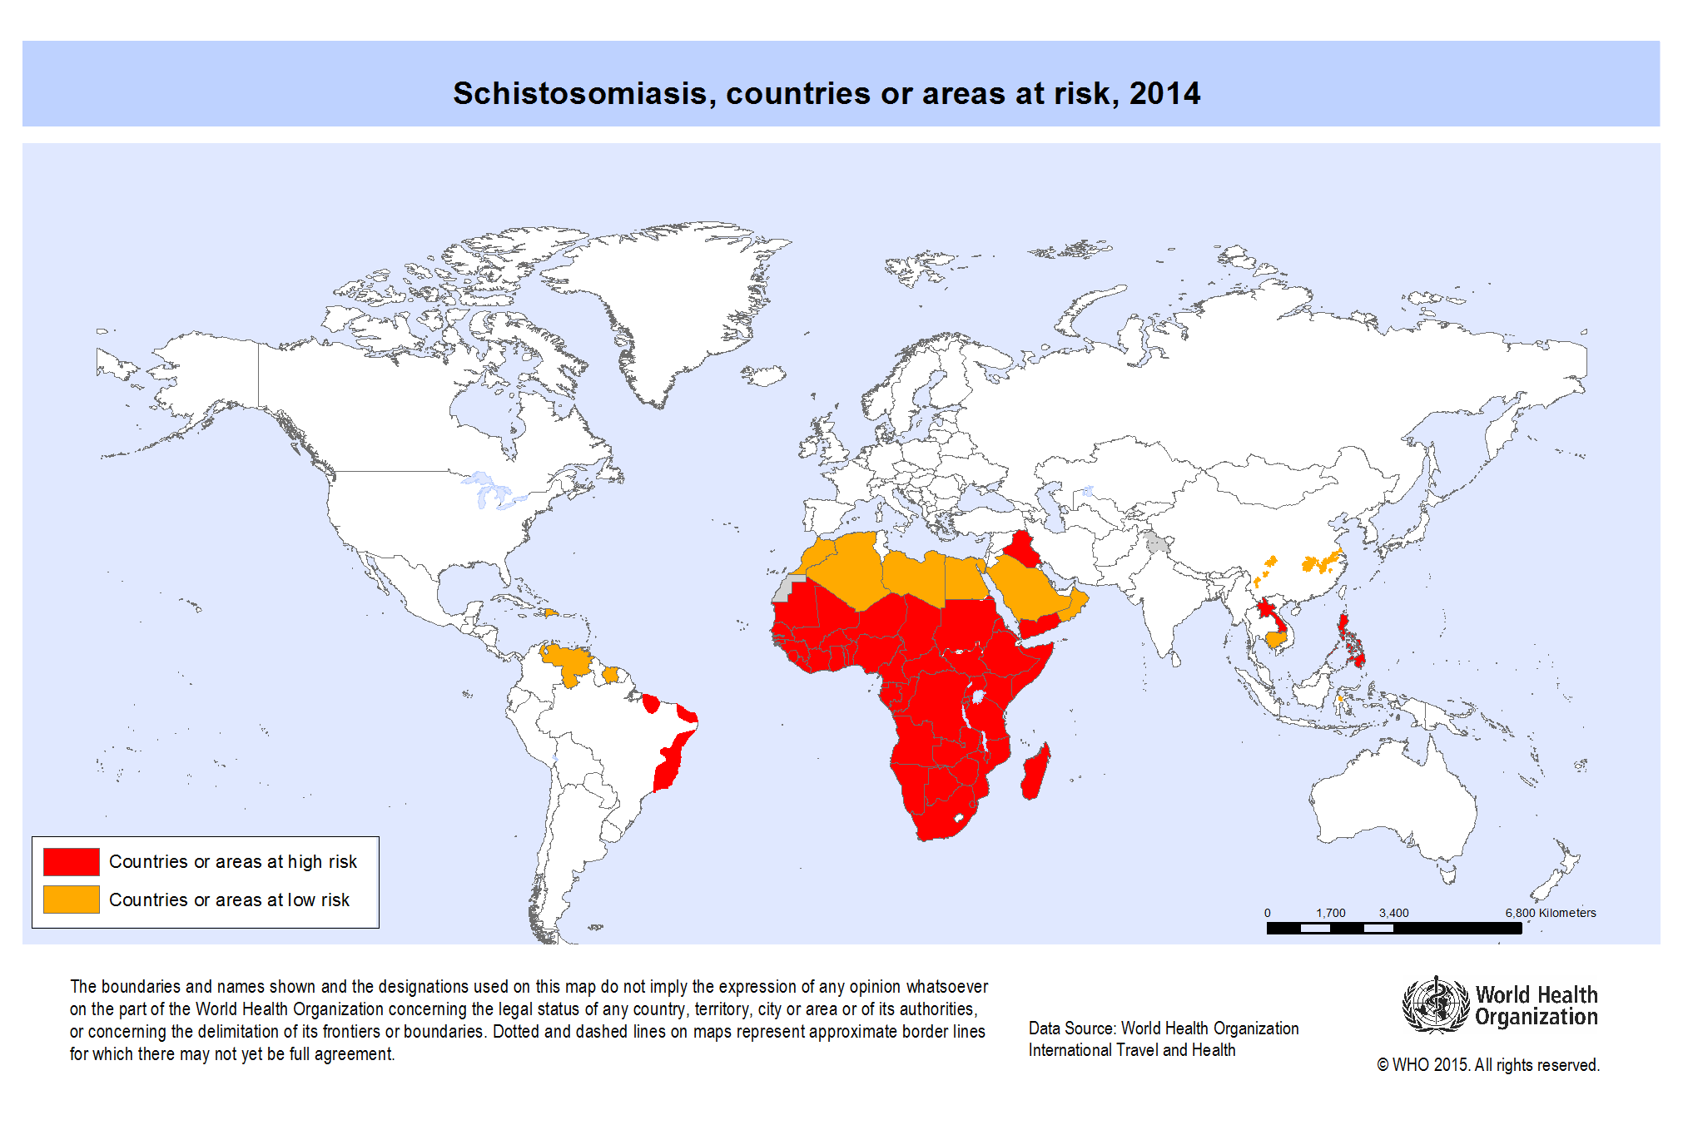
INTRODUCTION
Epidemiology
Human Schistosomiasis is a major yet neglected public health problem caused by trematodes of the genus Schistosoma.
An estimated 243 million people are affected globally, with 85% of these cases living in Sub-Saharan Africa, including Kenya, where nearly 6 million people are infected and an additional 15 million are at high risk of infection particularly in endemic areas.

Slide 3
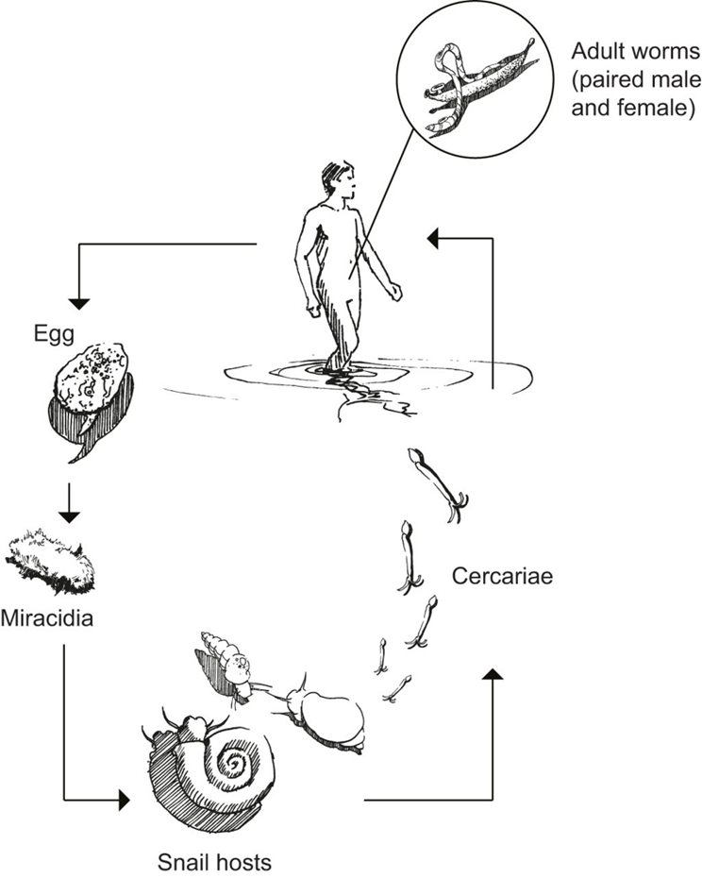
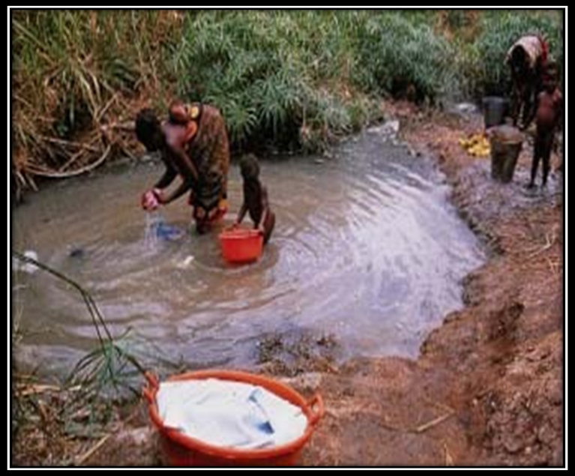
Introduction Cont’d
Transmission

Slide 4
Introduction Cont’d
Clinical presentation
Incubation period is typically 14–84 days for acute schistosomiasis (Katayama syndrome).
Chronic infection can remain asymptomatic for years.
Penetration of cercariae can be associated with a rash that develops within hours or up to a week after contaminated water exposures.
Acute schistosomiasis is characterized by fever, headache, myalgia, diarrhea, and respiratory symptoms. Eosinophilia is present, as well as often painful hepatomegaly or splenomegaly.
Diagnosis
Microscopic identification of parasite eggs in stool (S. mansoni or S. japonicum) or urine (S. haematobium).
Serologic tests are useful to diagnose light infections where egg shedding may not be consistent in travelers and in others who have not had schistosomiasis previously.

Slide 5
Introduction Cont’d
Treatment
Praziquantel is used to treat schistosomiasis
It is most effective against adult forms of the parasite and requires an immune response to the adult worm to be fully effective.
Prevention
No vaccines for preventing infection are available.
Preventive measures are primarily avoiding wading, swimming, or other contact with freshwater in disease-endemic countries.
Recommended strategy to control schistosomiasis is preventive chemotherapy.
Emphasis is placed on school-aged children but pre-school children are excluded from population treatment programs.

Slide 6
HYPOTHESIS
In high endemic areas, preschool-aged children are also at risk, and hence require treatment with praziquantel (PZQ).

Slide 7
METHODS
This study adopted a mixed methods study design combining descriptive explanatory research strategies. It was conducted in Kwale County, which is an administrative county in the Coast Region of Kenya.
A total of 400 pre-school aged children (≤ 72 months) were enrolled after consent by parents/guardians.
Urine samples were obtained from all assenting selected children between 10 a.m. and 2 p.m.
This was carried out before treatment and 5 weeks after treatment with praziquantel crushed and mixed with fruit juice, administered at a dose of 40mg/kg by the community health extension worker (CHEW)

Slide 8
Methods Cont’d
Urine was mixed and a duplicate 10 ml aliquot of urine was filtered through 15-mm polycarbonate filters, placed on a labeled slide and a drop of Lugol’s solution added.
They were then examined under a microscope within 6 hours and the mean counts of the two filters recorded and expressed as eggs per 10ml urine.
Three intensity categories were assigned as follows: negative for no detectable eggs; light for 1–49 eggs/10 ml urine; or heavy for ≥ 50 eggs/10 ml urine.

Slide 9
RESULTS
The overall pre-treatment prevalence of S. haematobium infections was 20.0% (95% confidence interval (CI) 16.4% - 24.2%).
The overall post-treatment prevalence of S. haematobium infections was 2.8% (95% confidence interval (CI) 1.5% - 4.9%).
Prevalence was higher in boys 22.9% (95% (CI) 17.7%-29.2%) when compared to girls 16.9 %( 95% (CI) 12.3%-22.8%).
Pre-treatment intensity with S. haematobium was 51.3%; heavy intensity of infection (≥50 eggs/10 ml urine), whereas 48.8% had light intensity of infection (1–49 eggs/10 ml urine).
After treatment with praziquantel, ten children were found to have an infection of low intensity. The reductions in the intensities of the infection was significant even when the analysis was stratified by sex and age.

Slide 10
Characteristics of enrolled children

Slide 11
Prevelance of S. haemotobium post-treatment
Gender
Age (years)

Slide 12
Prevalence of S. haematobium infection after treatment
Gender
Age group (years)

Slide 13
CONCLUSION & RECOMMENDATION
Pre-school children represent a high risk group for schistosomiasis and should be included in population treatment programs.

Slide 14
Acknowledgements

