Slide 1
Prevalence, Aetiology, and Antimicrobial Susceptibility Patterns of Urinary Tract Infection Amongst Children Admitted at Kilimanjaro Christian Medical Centre, Moshi
The 6th EAHSC
Joshua G Gidabayda, Rune Philemon,Mohammed S Abdallah, Aliasgher, M Saajan,Theresia Temu, Ipyana Kunjumu, Blandina T Mmbaga, Levina J Msuya
Kilimanjaro Clinical Research Institute, Moshi, Tanzania
Kilimanjaro Christian Medical Center, Moshi, Tanzania
Kilimanjaro Christian Medical University College, Moshi, Tanzania

Slide 2
Introduction
UTIs occur in
10% of all febrile children,
13.6% of febrile infants, and 7% of febrile newborns
In Tanzania; prevalence range from 16.7% to 39.7%
A variety of bacteria causes UTIs, in particular E. coli, K. pneumoniae
UTIs respond well to antimicrobial treatment,
Increasing resistance amongst organisms

Slide 3
Objective
To identify prevalence of UTI, etiology and antimicrobial susceptibility patterns of UTI amongst children admitted at pediatric ward at Kilimanjaro Christian Medical Centre (KCMC) in Moshi Tanzania

Slide 4
Methodology
Hospital based cross sectional study at KCMC
Children aged 2 months to 14 years
Demographic and clinical characteristics
Two urine specimens for spot testing and culture
SPSS version 20 (SPSS Inc., Chicago, IL, USA)

Slide 5
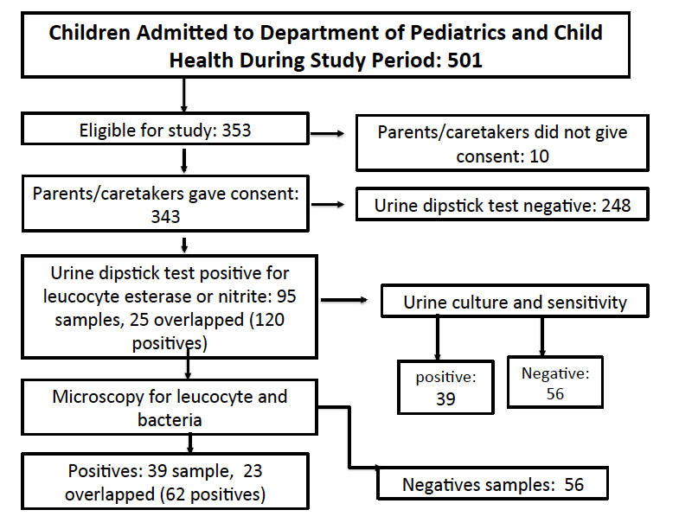
Results Figure. 1 number of participants and test results

Slide 6
Prevalence and risk factors
UTI confirmed by culture in 11.4% (39/343)
Higher prevalence
Female children 17% vs 7.7%
children less than 24 months old 14.5 vs 9.2%
Female sex: OR 2.46, 95% CI, 1.25-4.86
Leucocytes esterase: OR 32.0, 95% CI, 12.03-86.18 )
Nitrate in urine dipstick, OR 5.87, 95% CI, 3.44-3.65)

Slide 7
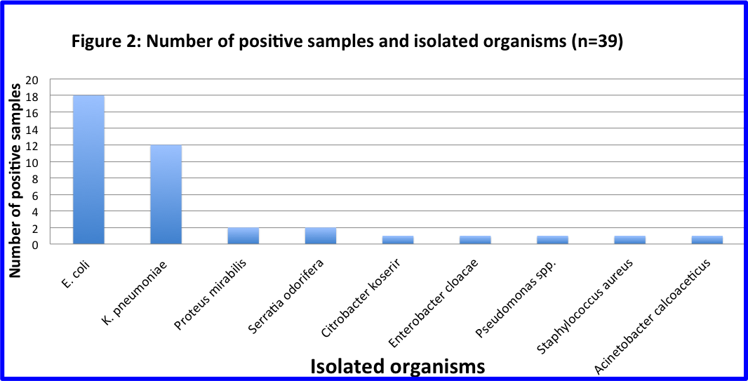

Slide 8
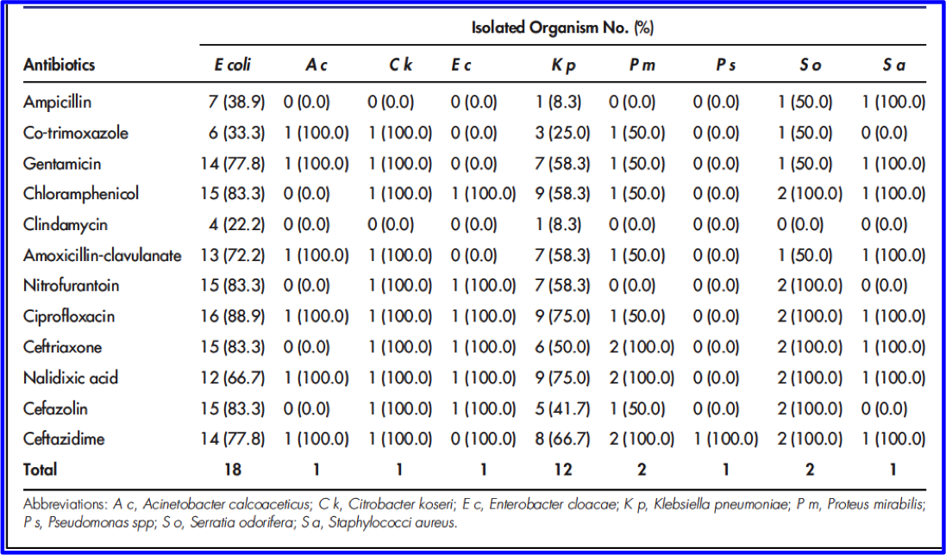
Table 1: Antimicrobial Susceptibility Pattern of the isolated organisms (N39)

Slide 9
Conclusion
UTIs common conditions affecting children
Children younger than 24 months and females
Commonest aetiological bacterial pathogens E coli (46.2%) and K pneumoniae (30.8%)
Low susceptibility: ampicillin, cotrimoxazole, clindamycin
Moderate to ciprofloxacin, ceftriaxone, and gentamicin and nalidixic acid, and ceftazidime.
A need for monitoring of antibiotics use for UTIs
Urine culture and antimicrobial sensitivity

Slide 10
Acknowledgement

